Slide 1
WEEK 1
What AI actually is,
and where it sits in sport
Four words you will meet for the rest of your career — and the three questions
you will ask of every technology anyone tries to sell you.
PES 3850 · Artificial Intelligence Applications in Sport · METU
Notes:
Do not start with definitions. Start with the demo (slide 3). Get the skeleton on the screen within the first eight minutes, before anyone has had time to decide they are in the wrong room.

Slide 2
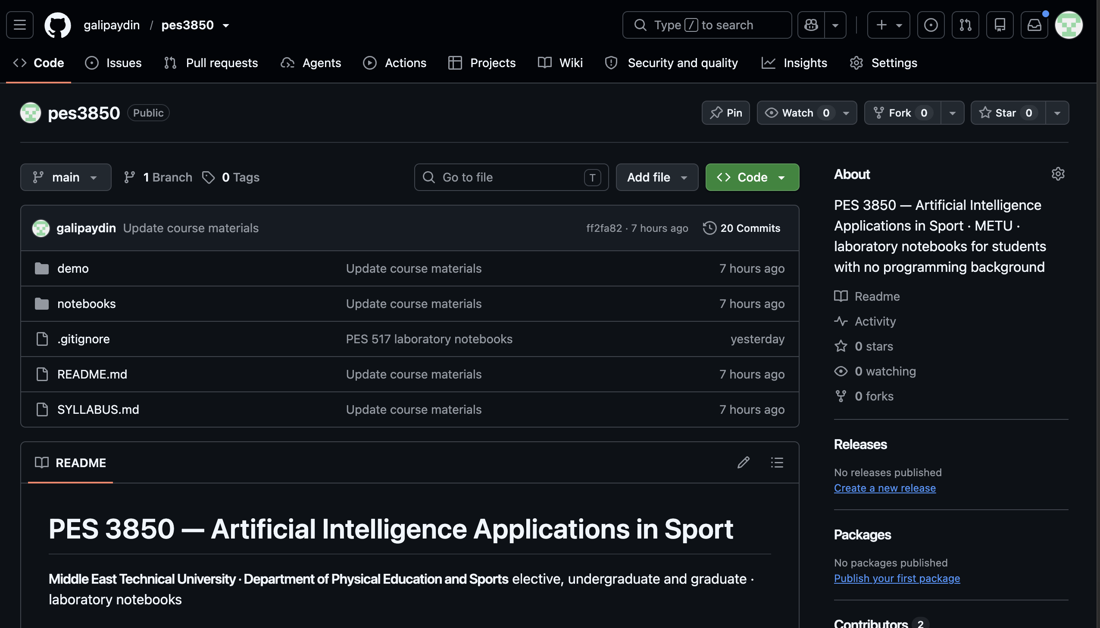
https://github.com/galipaydin/pes3850

Slide 3
1
Before anything else
Who is here, and what this course is not
Notes:
Week 01. Full teaching plan — timing, board work, what students ask, what to cut if you are short of time — is in lectures/week01/lecture-notes.md

Slide 4
WEEK 1 · WELCOME
Who is in this room
From the intake survey you filled in last week:
• You come from sport sciences, coaching, sport management, physiotherapy, and a few other departments.
• Most of you have never written a line of code. A few of you have copied something from the internet and run it.
• Some of you have used SPSS, Jamovi or Excel. Several of you have run a regression.
• Nobody here has a computer science degree. That is deliberate, and it is not a problem.
This course was built for exactly this room.
Notes:
Read the actual survey numbers out loud. It matters that they hear the room described accurately — the anxious ones need to know they are not the only one.

Slide 5
You will never be asked to write code from a blank page in this course.
Every notebook is written for you. You change values, swap data, and explain what came out.
The part that is graded is the explanation.
Notes:
Say this sentence, then pause. Then say it again. A third of the room is deciding this hour whether to drop, and this is the sentence that decides it.

Slide 6
WEEK 1 · WELCOME
What this course is, and is not
This course IS
This course is NOT
• Learning to judge an AI system the way you judge a fitness test: what was it validated on, and on whom?
• Running working tools on real sport data.
• Learning enough to ask a vendor a question they cannot dodge.
• Learning what these systems get wrong, and who pays for it.
• A programming course. There is no exam on Python syntax.
• A mathematics course. You will see no equations you have not already met in statistics.
• Training to become a data scientist. You will be able to work with one.
• A sales pitch for AI. Several weeks are about where it fails.
Notes:
Students from sport management often assume this is 'not for them'. Point at the right-hand column and say explicitly: if your thesis is about sponsorship or participation, project type F in Week 8 is built for you.

Slide 7
2
The demo
A phone clip of a squat, and a computer finding the knee. No explanation — just watch.
Notes:
WHAT TO PLAY, in this order:
1. squat_frontal_raise_side_by_side.png — one frame, raw on the left, skeleton on the right. Say nothing for five seconds.
2. squat_frontal_raise_overlay_web.mp4 — the clip with the skeleton moving. Play it twice.
3. squat_frontal_raise_knee_angle.png — the curve. Point at the three peaks and say 'those are the three squats'.
All three are ALREADY BUILT in lectures/week01/demo/out/. Copy them to the machine you teach from.
Rebuild from your own clip: python3 run_demo.py my_clip.mov --crop
Outputs are named after the clip, so a second run never overwrites the first.
Never install software in front of twenty students. See week01/demo/README.md and FILMING.md.

Slide 8
WEEK 1 · DEMO
What you just watched
A clip of somebody squatting, and a computer drawing a skeleton on them.
• Nobody attached a marker, a sensor or a strap to that person.
• The computer found the hip, the knee and the ankle in every single frame.
• From three points it computed a knee angle, and drew how it changed through the movement.
• That whole process took less time than it takes to set up a goniometer.
Notes:
Keep the clip short and the person recognisable — a student, a METU team, anything local. The point of the demo is emotional, not technical: 'this is reachable' beats any slide you could show.
Someone will ask HOW it works. Answer: 'deep learning, which is slide 13, and Week 10 in detail — hold the question for twenty minutes.' Write their name down and come back to them.
Optional 3-minute addition if the room is warm: Teachable Machine, trained live from the webcam on three squat positions. It dramatises 'we supply examples instead of writing rules', which is slide 11.

Slide 9
3
Four words
AI · machine learning · deep learning · generative AI
Notes:
Week 01. Full teaching plan — timing, board work, what students ask, what to cut if you are short of time — is in lectures/week01/lecture-notes.md

Slide 10
WEEK 1 · THE WORDS
Artificial intelligence
The broadest word, and the least useful one.
• "Artificial intelligence" means: a computer doing something we normally think requires human judgement.
• Recognising a face. Understanding a sentence. Deciding whether a player looks tired.
• It is a goal, not a method. Saying a product 'uses AI' tells you roughly as much as saying an athlete 'does training'.
Whenever someone says AI, your next question is: which kind, and how was it built?
Notes:
Resist the urge to define AI precisely. There is no agreed definition and the argument wastes ten minutes. What matters is that they stop treating 'AI' as informative.

Slide 11
We stop writing the rules.
We start supplying examples.
That single change is what machine learning is. Everything else is detail.
Notes:
This is the conceptual centre of the whole first half of the course. Draw it on the board as two boxes. Come back to this sentence in Weeks 4, 5 and 6.

Slide 12
WEEK 1 · THE WORDS
Two ways to make a computer decide something
Writing the rules (the old way)
Supplying examples (machine learning)
• You tell the computer exactly what to do, step by step.
• Offside: 'if the attacker is closer to the goal line than the second-last defender at the moment of the pass, flag it.'
• Works beautifully when the rule can be written down.
• Hopeless for 'does this athlete look like they are about to get injured?' — because nobody can write that rule.
• You show the computer thousands of past cases where you already know the answer.
• Two hundred athletes, their training data, and whether each one got injured.
• The computer finds the pattern that connects them.
• You never wrote the rule. You never see the rule. That is both the power and the problem.
Notes:
Spend real time here. Ask the room to suggest a sport decision that CAN be written as a rule, and one that cannot. Their examples are better than yours.

Slide 13
WEEK 1 · THE WORDS
Deep learning
A particular way of learning from examples, and the reason the last ten years happened.
• Older machine learning needed you to tell it what to look at — 'measure the knee angle, the sprint time, the jump height’.
• Feature Extraction
• Deep learning works from the raw thing itself: the pixels of a video, the waveform from a sensor.
• It builds up its own description in layers — edges, then shapes, then limbs, then a body.
• That is why the demo you just saw is possible at all. Nobody told it what a knee looks like.
The cost: it needs a great deal of data, and it cannot tell you why.
Notes:
Analogy that works: a coach who has watched 50,000 hours of football and 'just sees' that a player is out of position. They cannot articulate the rule either. Students find that reassuring rather than alarming, which is the right starting attitude.

Slide 14
WEEK 1 · THE WORDS
Generative AI, and large language models
The part everybody has already used.
• Older systems classify or predict: injured / not injured, 4.2 seconds, high risk.
• Generative systems produce something new: a paragraph, an image, a training plan, a piece of code.
• A "large language model" is one kind: it was trained by reading an enormous amount of text and learning to continue it.
• ChatGPT, Claude and Gemini are large language models with a chat window on the front.
Notes:
Ask by show of hands who has used ChatGPT for university work. It will be most of the room. Then ask who has checked a reference it gave them. That contrast opens Week 2.

Slide 15
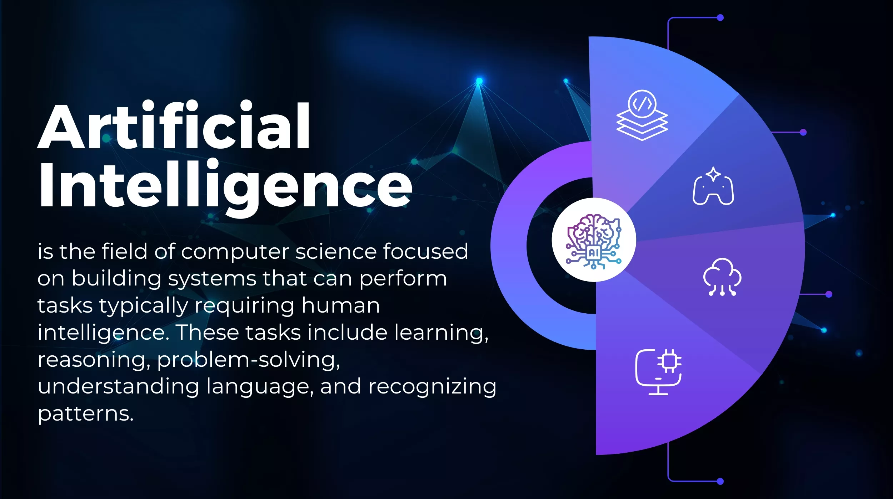

Slide 16
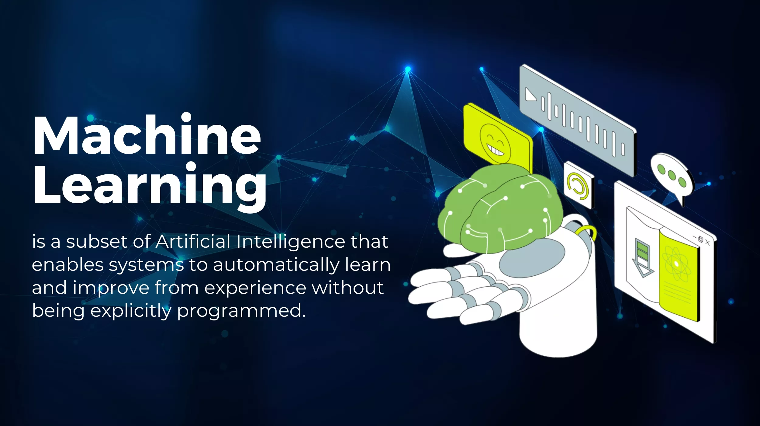

Slide 17
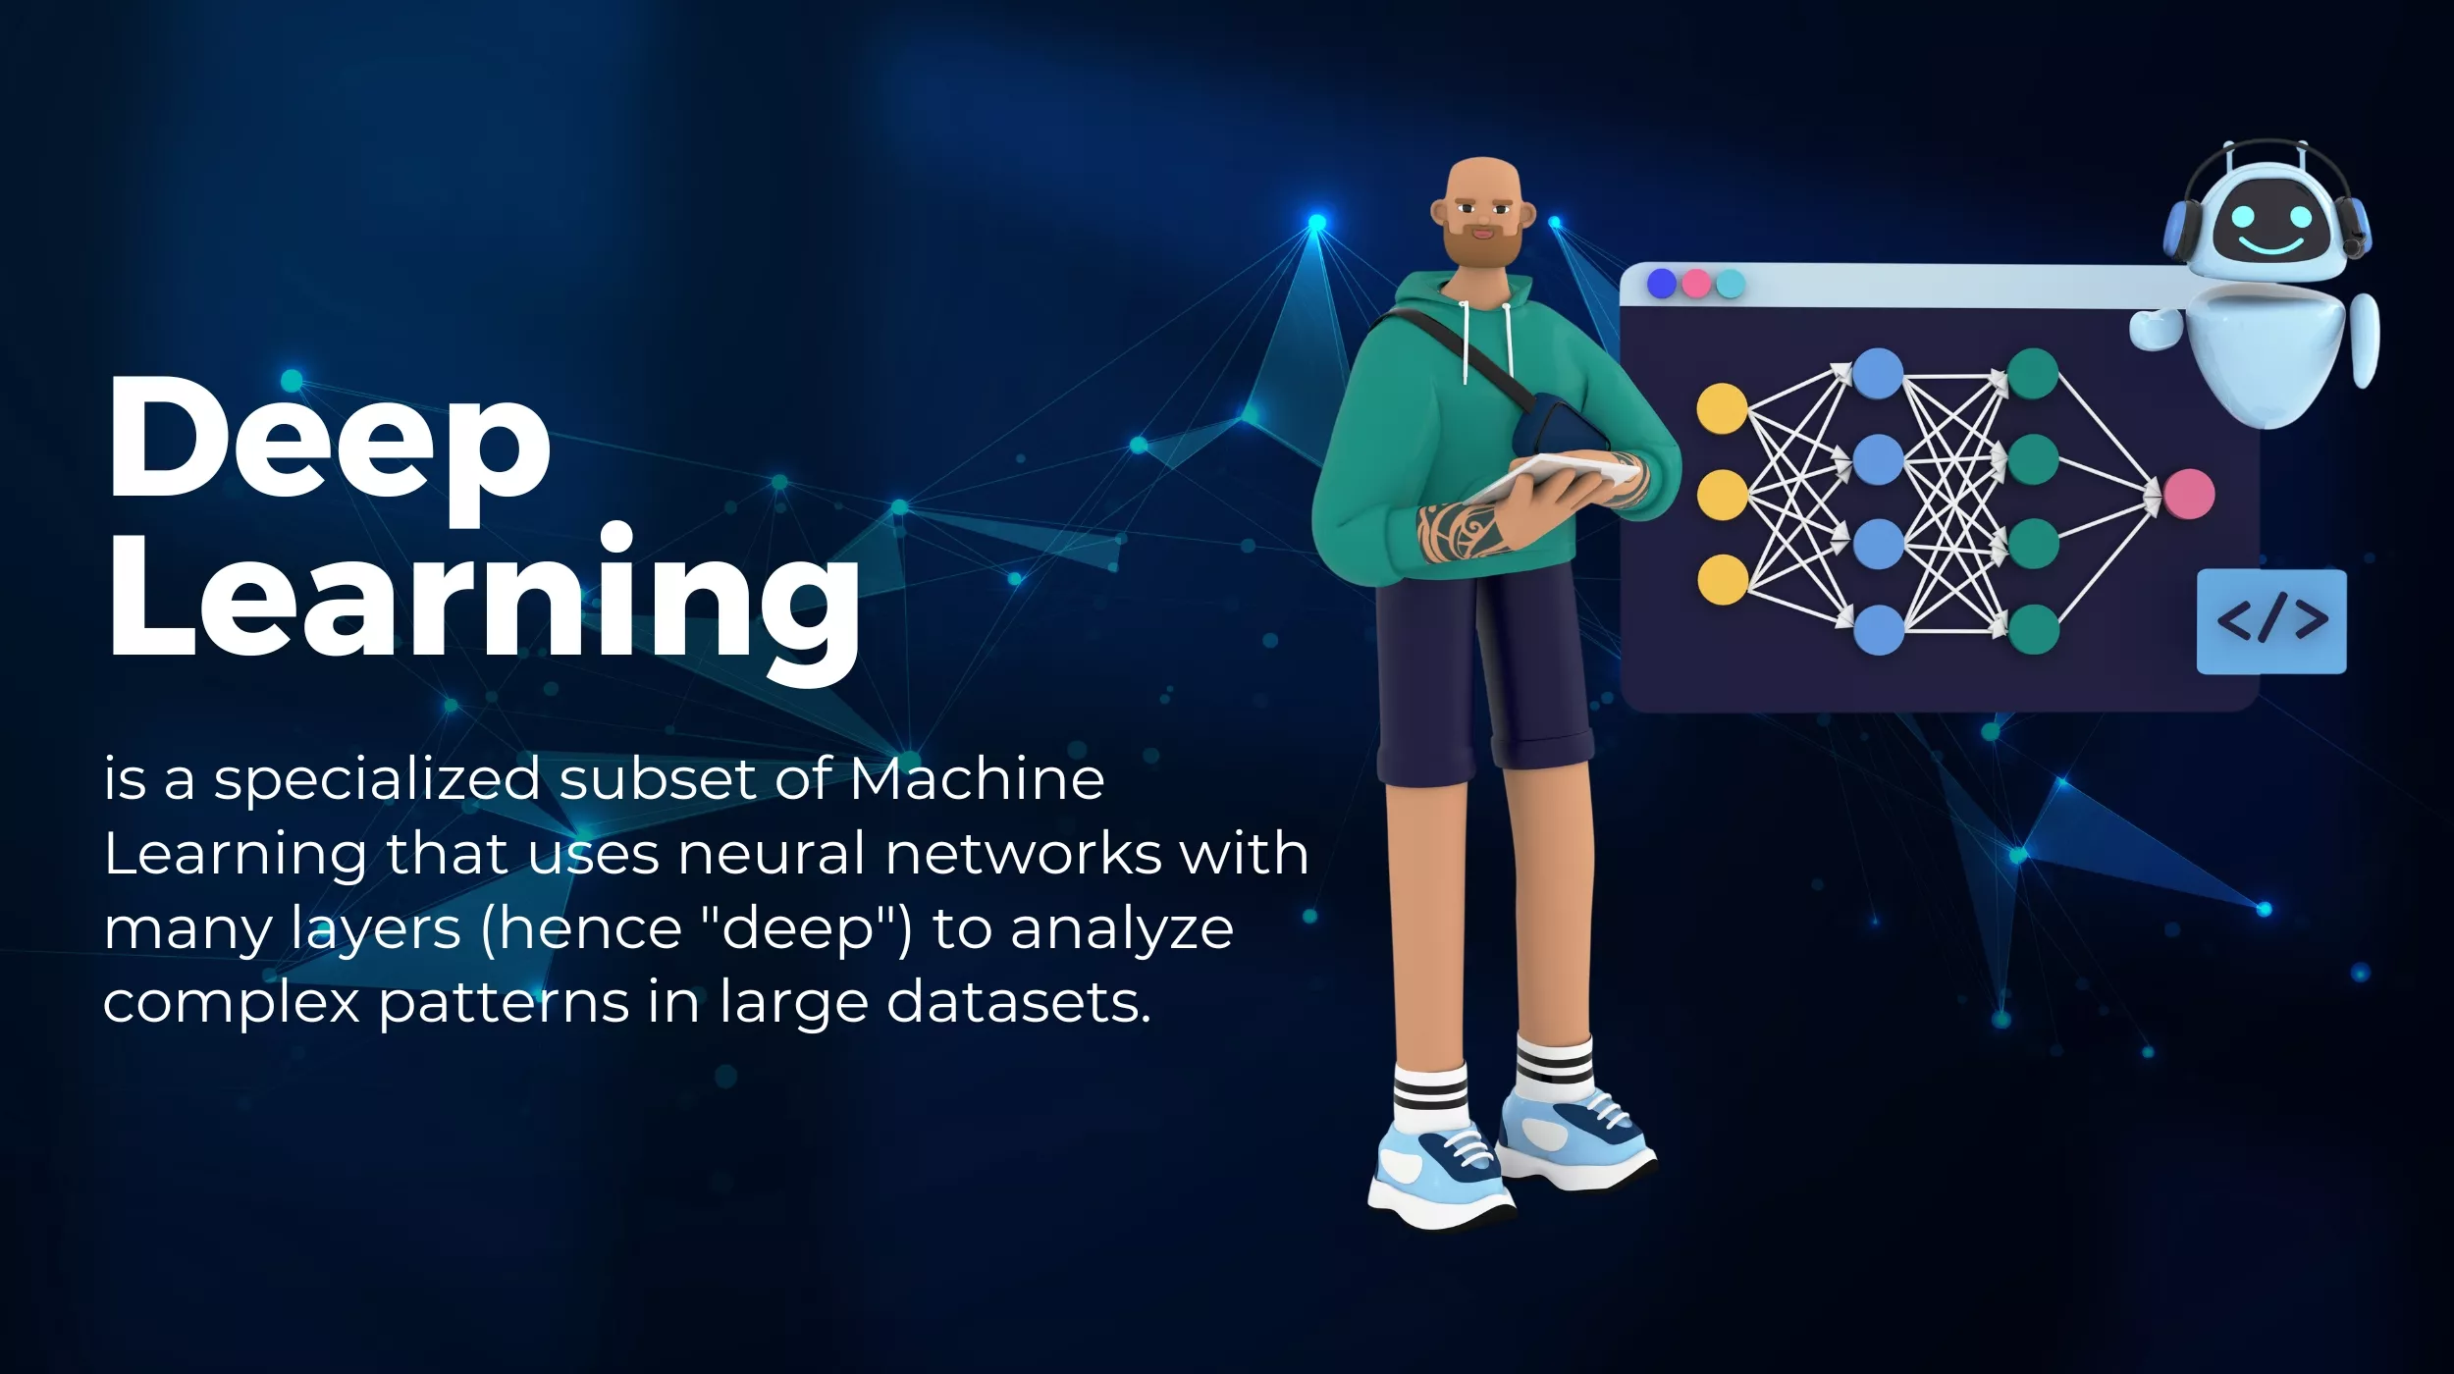

Slide 18
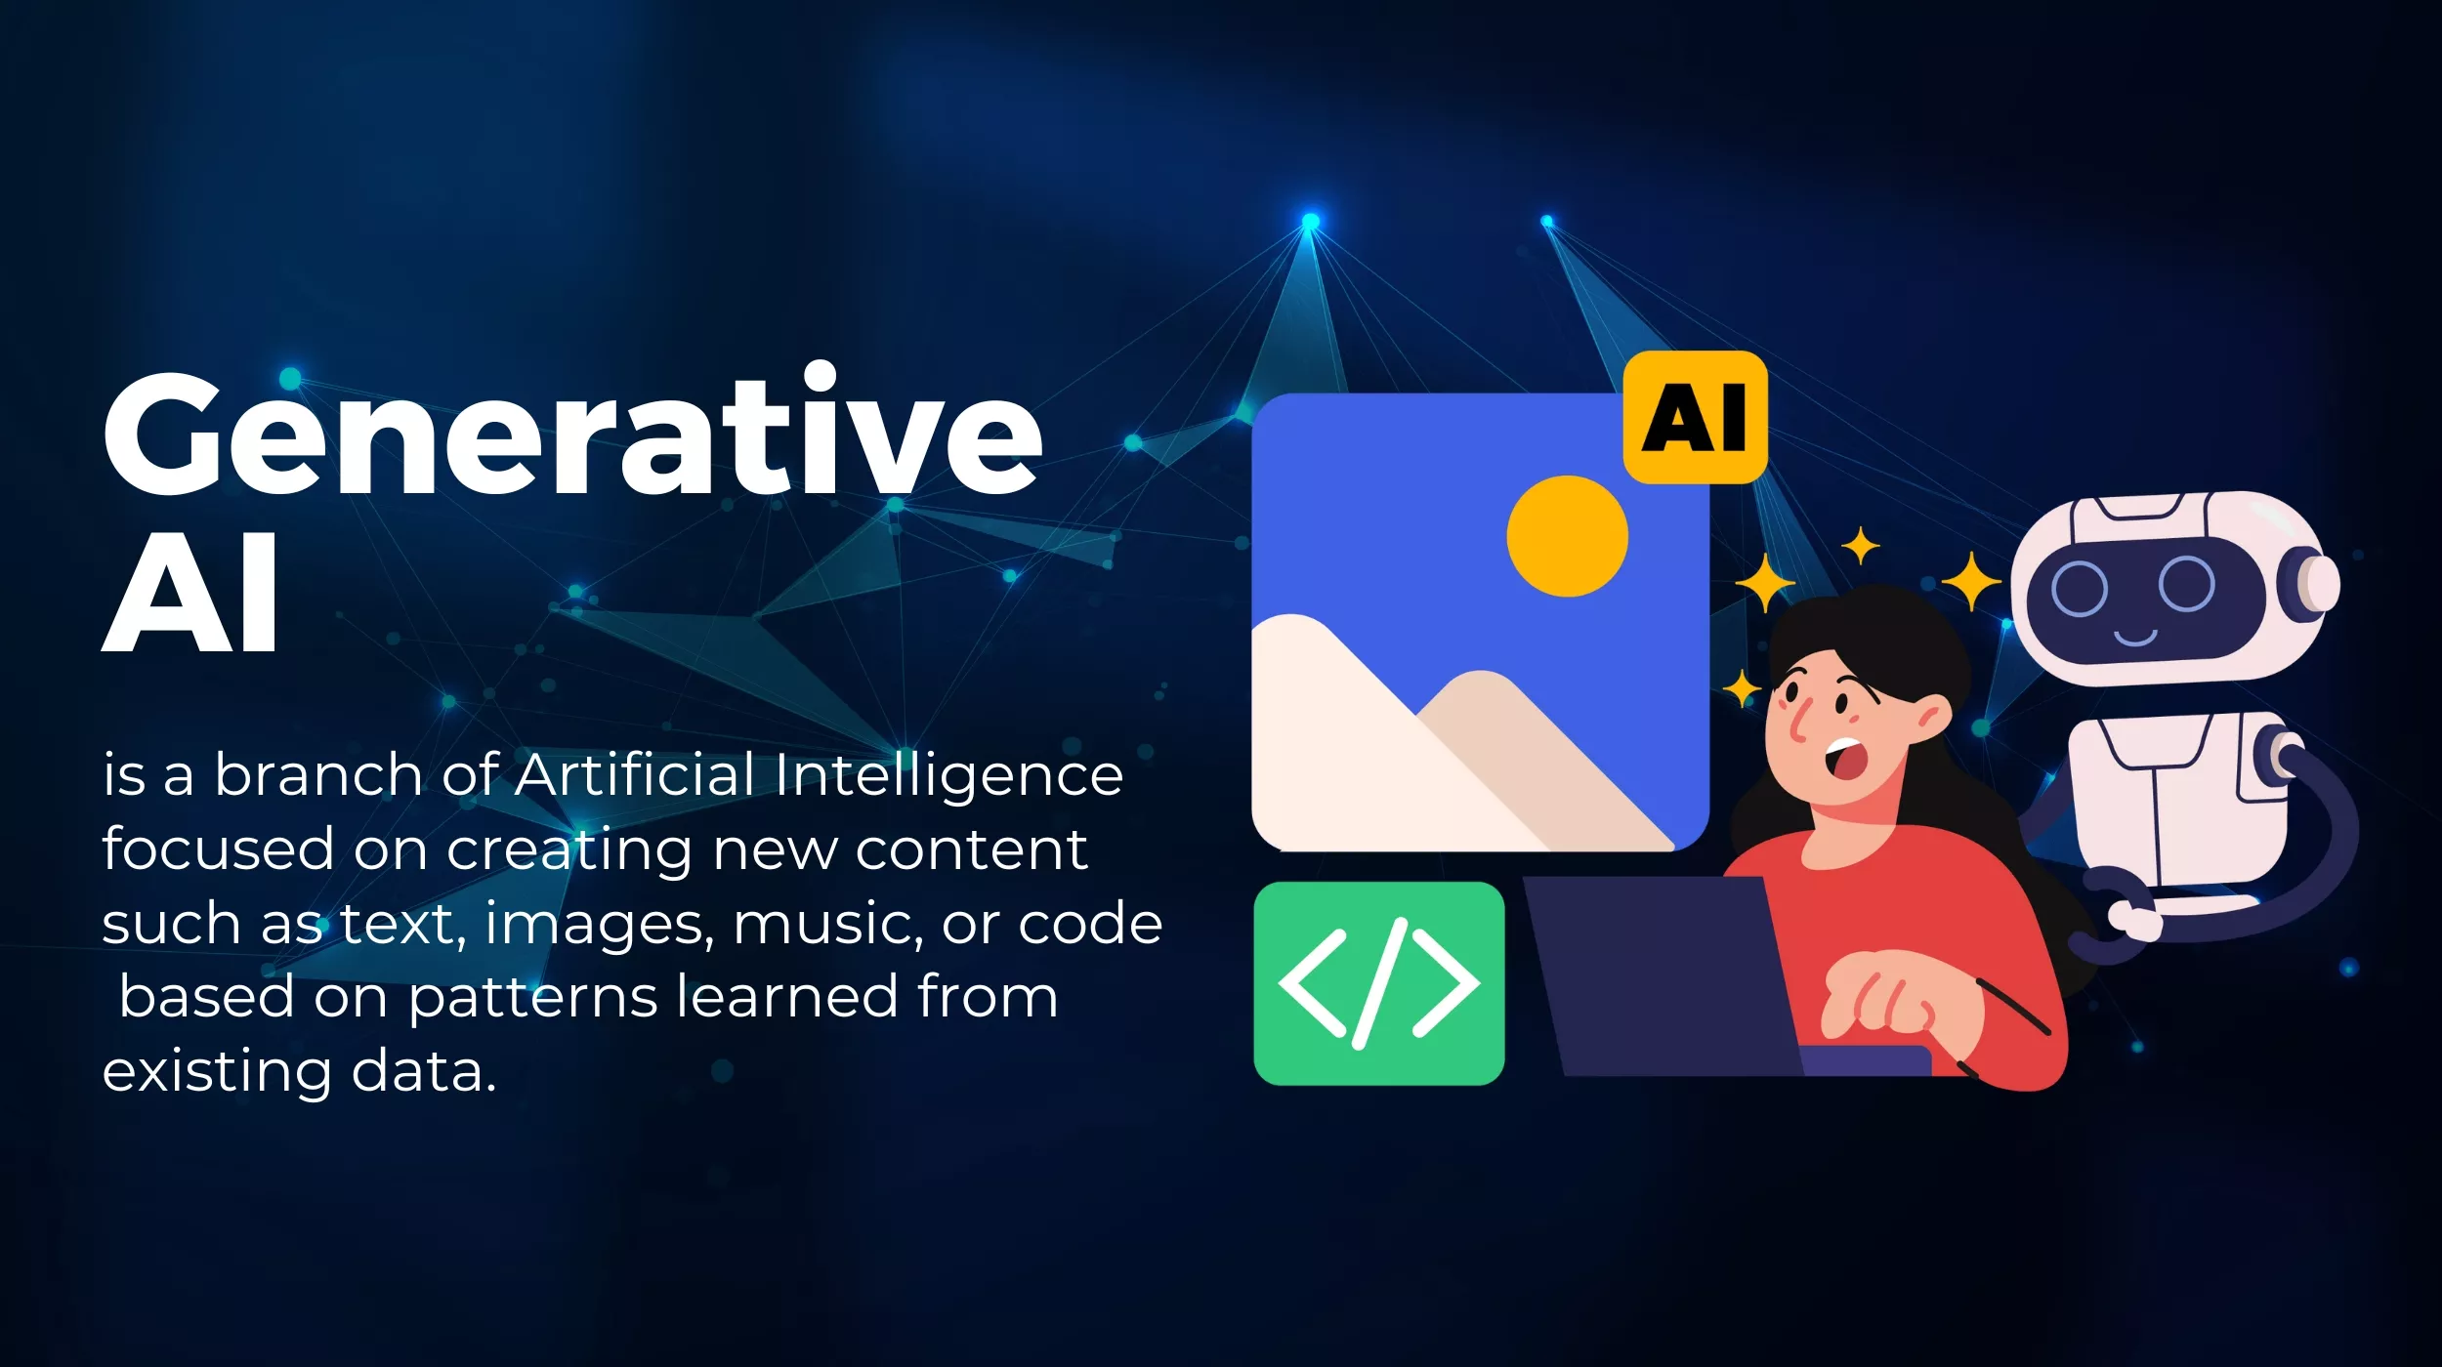

Slide 19
WEEK 1 · THE WORDS
The four words, on one slide
Word | In one sentence | A sport example
Artificial intelligence | A computer doing something that seems to need judgement. | Any of the four below.
Machine learning | Learning the pattern from examples instead of being given a rule. | Predicting match minutes from test scores.
Deep learning | Machine learning that works from raw video, sound or sensor signals. | Finding the knee in a video frame.
Generative AI / LLM | A model that produces new text, images or code. | Drafting an athlete education leaflet.
Each one sits inside the one above it. Every LLM is deep learning; all deep learning is machine learning; all of it counts as AI.
Notes:
Draw the four nested circles on the board while this slide is up. Students remember the drawing, not the table.

Slide 20
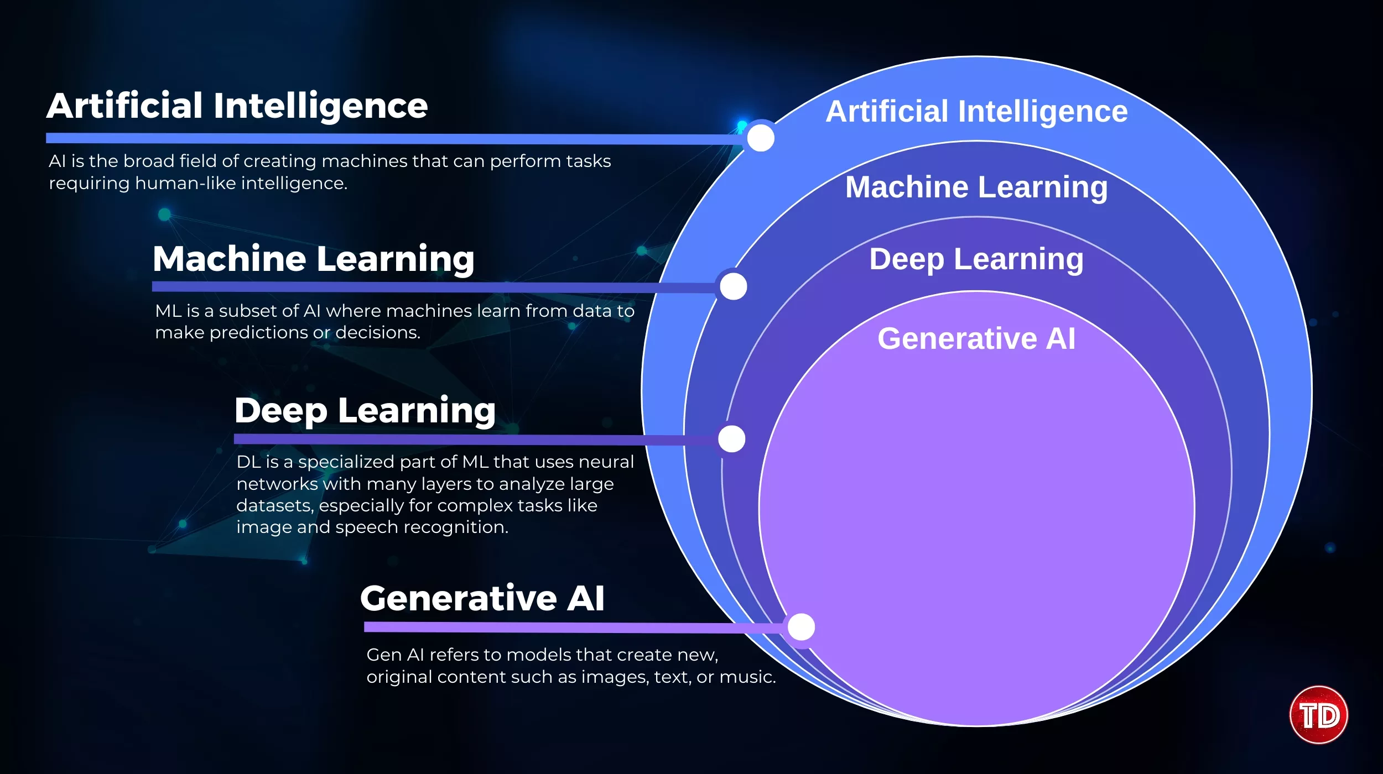

Slide 21
WEEK 1 · THE WORDS
What is NOT artificial intelligence
This matters, because departments buy things on the strength of the label.
• A threshold in a spreadsheet. 'Flag anyone whose acute:chronic ratio goes above 1.5' is a rule somebody typed.
• A formula. TRIMP, PlayerLoad, session RPE × duration — arithmetic, not learning.
• A regression fitted once, years ago, and never checked on anyone new.
• A dashboard. A dashboard displays numbers. What produced the numbers is the question.
Notes:
This is the slide practitioners quote back to you years later. If a product's description never says what it learned from, it probably did not learn.

Slide 22
DISCUSSION · IN PAIRS
Which is it?
1. A wearable that tells an athlete their 'recovery score' is 68 out of 100.
2. A system that watches a match and automatically labels every pass, shot and tackle.
3. A spreadsheet that turns red when weekly load rises more than 10%.
4. An app that writes a twelve-week marathon plan after three questions.
Notes:
The correct answer to at least two of these is 'unknowable from public information'. That frustration is the point, and it sets up Week 13's product audit.

Slide 23
4
Where AI shows up in sport
Six places, one honest limitation each
Notes:
Week 01. Full teaching plan — timing, board work, what students ask, what to cut if you are short of time — is in lectures/week01/lecture-notes.md

Slide 24
WEEK 1 · THE LANDSCAPE
Six domains you will meet
Domain | What it does | What it is honestly bad at
Performance analysis | Tags events in video; expected-goals models | Anything the training data never saw
Athlete health | Injury and illness risk flags | Being right often enough to act on alone
Biomechanics | Markerless motion capture from video | Absolute angles; anything out of the camera plane
Tactics | Player tracking, space and pressure models | Explaining why, in a coach's language
Officiating | Ball tracking, semi-automated offside | Judgement calls that were never geometric
Business and fans | Segmentation, pricing, content | Not being creepy about personal data
Notes:
Ask which column students expected to be longer. Most assume the middle one. By Week 13 they will assume the right one.

Slide 25
WEEK 1 · THE LANDSCAPE
Two things that are true at the same time
• "This technology is genuinely useful." Automated video tagging saves analysts entire days. Markerless capture puts movement screening in places that will never own a laboratory.
• A published injury-prediction model, evaluated honestly, reaches about 0.73–0.77 on a scale where 0.5 is a coin flip. Marketing materials routinely claim 0.95.
• Holding both of these at once is the professional skill. Enthusiasts miss the second. Cynics miss the first.
Your job is not to be for or against AI. It is to be able to tell which one you are looking at.
Notes:
If you only get one idea across in Week 1, make it this one. Everything in the syllabus is downstream of it.

Slide 26
5
The three questions
Notes:
Week 01. Full teaching plan — timing, board work, what students ask, what to cut if you are short of time — is in lectures/week01/lecture-notes.md

Slide 27
WEEK 1 · THE THREE QUESTIONS
Ask these of every system, forever
• "Q1 — What was the model trained on, and does my athlete look like that?"
– Built on senior male professionals? Then it has never met your U17 female squad.
• "Q2 — How was it evaluated, and would that number survive an honest test?"
• "Q3 — What happens when it is wrong, and who is accountable?"
– A missed injury and a needless rest day are not the same size of mistake.
Notes:
Hand out the printed card at this point. Physically. It sounds gimmicky and it works — students bring the card to the Week 8 exam.

Slide 28
DISCUSSION · WHOLE ROOM
Apply them to the demo
1. The pose system in the demo: what kind of people do you think it was built from?
2. How would you find out whether the knee angle it drew is correct?
3. If it is 8 degrees wrong and a physiotherapist believes it, what happens next?
Notes:
Write their answers on the board and photograph it. Show the same photograph in Week 10 after they have measured the error themselves. It lands hard.

Slide 29
LABORATORY · THIS SESSION
Lab 1 — Welcome to Google Colab
• Everything runs in a browser tab. Nothing is installed. It is free.
• You will open a notebook, run it, and see a table of twelve athletes.
• You will make one figure, then add a single typing error to the data and watch the correlation collapse from −0.99 to −0.45.
Notes:
Circulate constantly in the first lab. The failure here is never conceptual — it is 'my Google account is the wrong one' and 'I cannot find the share button'. Fix those and the term runs smoothly.

Slide 30
WEEK 1 · HOUSEKEEPING
Using AI tools in this course
You are expected to use ChatGPT, Claude or Gemini. That is part of the subject.
• Every submission carries an "AI Use Log": which tool, what you asked, what it produced, and what you changed or rejected.
• What you rejected tells me more about your judgement than what you kept.
• You own every claim in your work. 'The model said so' is not a defence for a wrong number.
• A fabricated citation is treated as a fabricated source: minus fifteen points and a conversation.
Notes:
Students expect a ban and are visibly relieved. Be clear that the log is graded, not decorative — the first lab that arrives without one sets the norm for the term.

Slide 31
What to take away from today
1. AI is a goal, not a method. 'Uses AI' tells you almost nothing — ask which kind, and how it was built.
2. Machine learning is one idea: stop writing the rules, start supplying examples. Everything else is detail.
3. The technology is genuinely useful AND most of what is sold is oversold. Both, at once.
4. Three questions, on the card, for the rest of your life: trained on what · evaluated how · wrong how badly, and who pays.
Notes:
Read the four aloud rather than leaving them on screen. Then the next-week slide.

Slide 32
WEEK 1 · NEXT
Before next week
• "Study Lab 1"
• "Read": 'AI and Machine Learning in Sport Research: An Introduction for Non-data Scientists', *Frontiers in Sports and Active Living* (2021). Open access, about fifteen pages. Read the three learning-type sections.
• "Set up": a free account on ChatGPT, Claude or Gemini. Bring your laptop with it logged in.
• "Next week": large language models — what they actually do, why they make things up, and how to get one to write your analysis code for you.
• https://universe.roboflow.com/browse/sports
• https://github.com/roboflow/sports
Notes:
Make the offer at the end of the first session, every year. The students who take it up are almost always the ones who go on to do the best projects.

