Slide 1
WEEK 3
Sport data literacy
Where the numbers come from, what they actually measure, and the quality problems
that quietly destroy an analysis before it starts.
PES 3850 · Artificial Intelligence Applications in Sport · METU

Slide 2
WEEK 3 · WHY THIS WEEK
Why a whole session on data
• Every hour you spend on a model is worth less than the first hour you spend on the data.
• In real projects, cleaning and understanding the data takes most of the time. Nobody advertises this.
• Almost every wrong answer in applied sport analytics is a data problem wearing a model's clothes.
You cannot judge whether a model is trustworthy if you cannot judge whether its data was.

Slide 3
1
Where sport data comes from
Eight sources, and what each one lies about

Slide 4
WEEK 3 · SOURCES
Eight sources you will meet
Source | How often it samples | What it measures | Its classic failure
Event data | per event | passes, shots, tackles | two providers define 'a tackle' differently
Optical tracking | 10–25 per second | x,y of every player | two players cross and swap identity
GPS / LPS | 10–18 per second | distance, speed, acceleration | each vendor sets its own 'high speed'
IMU / accelerometer | 100–1000 per second | acceleration, rotation | where it was worn; which way up
Heart rate, HRV | 1 per second | internal load | strap contact, movement artefact
Force plate | 1000 per second | force, power, asymmetry | filter choices change the answer
Video | 25–240 frames/s | everything and nothing | camera angle and perspective
Questionnaires | per session | wellness, RPE, soreness | people stop filling them in — and not at random

Slide 5
Sampling rate is a decision about what you are allowed to see.
A 10 Hz GPS unit cannot see a foot strike. A 30 fps phone cannot resolve take-off in a jump.
No amount of AI recovers something the sensor never recorded.

Slide 6
2
Getting it into a usable shape
One row, one observation

Slide 7
WEEK 3 · STRUCTURE
The shape that works, and the shape coaches send you
Tidy — one row is one observation
What actually arrives
• date | athlete | session | RPE | duration
• Every variable has its own column.
• Adding an athlete adds rows, not columns.
• Every tool in this course expects this shape.
• Boring to look at. Trivial to analyse.
• One sheet per athlete, twenty-two sheets.
• One column per week, so a new week means a new column.
• Merged cells, a photograph of a whiteboard, colour meaning something.
• Totals in the middle of the data.
• Beautiful to look at. Nearly impossible to analyse.

Slide 8
3
Quality problems that kill a model
Four, and they are all invisible in a summary table

Slide 9
WEEK 3 · QUALITY
1 — Missing values, and when they go missing
The count of missing values tells you almost nothing. The pattern tells you everything.
• In our monitoring dataset, wellness is missing on "5%" of ordinary days.
• On the day after a match it is missing on "23%" of days.
• Those are exactly the days when athletes are most fatigued and most at risk.
• Delete those rows and you delete the hardest days from the analysis.
• Fill them with the average and you have told the model post-match days were average.
Neither choice appears in the methods section of most papers. Both change the answer.

Slide 10
WEEK 3 · QUALITY
2 — Units, and 3 — outliers
• "Units." Metres and yards. Minutes and 'h:mm'. Kilograms and newtons. Two clubs, two conventions, one merged file, one silent disaster.
– Always print the minimum and maximum of every column. A 3.98 s twenty-metre sprint is a typing error; a 1.98 s one is a different unit.
• "Outliers." Some are errors. Some are the most interesting athlete in the squad.
– You cannot tell which from the number alone. You have to go back to the session, the video, or the person.
Deleting outliers because they are inconvenient is the most common form of quiet scientific misconduct in our field.

Slide 11
WEEK 3 · QUALITY
Four faults, one command
TYPE THIS
gps.describe().T
WHAT COMES BACK
mean min max
duration_min 66.92 15.00 120.40
distance 5123.13 200.00 14512.10
top_speed 9.42 1.56 35.23
sprint20m_s 3.01 1.98 3.98
WHAT IT JUST TOLD YOU
top speed 35.23 four athletes exported in km/h
distance 14512 three recorded in yards, not metres
1.98 s for 20 m a different timing gate entirely
3.98 s for 20 m somebody typed 3 where they meant 2
Four faults nobody mentioned, in one line, before you have modelled anything.

Slide 12
WEEK 3 · QUALITY
The column that was not in the summary
rpe is the rating of perceived exertion: how hard the athlete rated the session, from 0 to 10.
As it loads
One line to repair it
gps['rpe'].dtype
# dtype('O') <- text, not a number
gps['rpe'].astype(float)
# ValueError: could not convert
# string to float: '5,5'
gps['rpe'] = pd.to_numeric(
gps['rpe'].str.replace(',', '.'),
errors='coerce')
gps['rpe'].mean()
# 6.31 and nothing was lost
describe() never mentioned it
5,090 values, 0 nulls
A Turkish keyboard writes 6,5. One comma anywhere in a column and pandas reads the whole column as text.

Slide 13
WEEK 3 · QUALITY
What an automatic outlier rule actually removes
Drop anything beyond 3 SD
Look at the ten
m, sd = s.mean(), s.std()
s[(s - m).abs() > 3 * sd]
# 1.98 2.52 2.56 2.58 2.59
# 2.61 3.42 3.42 3.43 3.98
# 10 rows removed
1.98 a different timing gate
3.98 3 typed where 2 was meant
2.52 2.56 2.58 2.59 2.61
3.42 3.42 3.43
# the fastest and slowest athletes
# in the squad, measured correctly
8 of those 10 were real sessions
2 errors, and 8 athletes
A 3-SD rule removes about 0.3% of any normal column, whether or not anything is wrong with it.

Slide 14
WEEK 3 · QUALITY
4 — Your measurement is not exact
• Every test has a typical error — the wobble you get when nothing has changed.
• If your jump test has a typical error of 1.5 cm, no model built on it can reliably detect a 1 cm change.
• A model cannot be more precise than what went into it. It can, and will, look more precise.
Before you model anything, ask: is the effect I am hunting bigger than the noise in my measurement?

Slide 15
The n = 22 problem.
One squad, forty variables, twenty-two athletes. There are more ways to be wrong than there are athletes.
This is the permanent condition of sport science, and it shapes everything we do from Week 4 onwards.

Slide 16
WEEK 3 · ACCESS
Getting data you are allowed to have
• "Open datasets" — StatsBomb, public repositories, journal supplementary files. Fastest, and no ethics delay.
• "Your own organisation" — needs a written permission letter, and anonymisation before it reaches Colab.
• "Scraping websites" — usually against the terms of service. Do not build a project on it.
An athlete's GPS trace is personal data about a named individual. Treat it the way you would treat their medical file.

Slide 17


Slide 18
4
From a coach's file to a modelling table
Four operations. You will use all four in every project from here on.

Slide 19
WEEK 3 · PREPROCESSING
What preprocessing is
Everything you do to the data between receiving it and analysing it.
• Data is recorded for the system that produced it — a GPS unit, an app, a coach's spreadsheet — not for your question.
• Preprocessing turns it into one table that answers your question: one row per thing you study, every column a number you trust.
• It is not tidying up. Every step is a decision, and every decision can change the answer.
Every step you take here belongs in your methods section.

Slide 20
WEEK 3 · PREPROCESSING
Five sessions: as they arrive, and as they should be
Five real rows from gps_sessions.csv, 9 September. Four of the five are wrong, and nothing in the file says so.
As they arrive
Ready to analyse
athlete | top_speed | distance | rpe
a4 | 7.63 | 6822 | 4.9
A03 | 7.93 | 4435 | 4,0
A13 | 29.90 | 4151 | 7.2
A08 | 8.20 | 5564 | 5.9
A01 | 6.95 | 5904 | 4.1
athlete | top_speed | distance | rpe
A04 | 7.63 | 6822 | 4.9
A03 | 7.93 | 4435 | 4.0
A13 | 8.31 | 4151 | 7.2
A08 | 8.20 | 5087 | 5.9
A01 | 6.95 | 5904 | 4.1
→
An id typed in lower case, a comma for a decimal point, a speed in km/h, a distance in yards. That is preprocessing.

Slide 21
WEEK 3 · PREPROCESSING
Why it matters: what skipping a step does
Skipped | What it does to your answer | In today's files
Units | mixes two scales in one column | top speed 35.23, from km/h
Types | a variable silently disappears | rpe missing from describe()
Joins | rows are lost, or invented | 5,090 sessions became 5,126
Gaps | the hardest days look ordinary | soreness 4.29 fell to 3.96
The row | sessions counted as if they were athletes | 5,090 rows, but 30 athletes
Each one is silent. None of them raises an error.

Slide 22
WEEK 3 · PREPROCESSING
How: the steps, in order
Step | What you do | In pandas
1 · Look | shape, types, summary, what is missing | .shape .dtypes .describe() .isna()
2 · Fix | text into numbers, one unit for everything | pd.to_numeric() .str.replace()
3 · Check | impossible values and duplicates — by looking | .min() .max() .duplicated()
4 · Combine | one row per observation, files joined on a repaired key | .melt() .merge()
5 · Decide the row | aggregate to what you are studying | .groupby().agg()
6 · Prepare | gaps on purpose, categories encoded, features built | .fillna() pd.get_dummies()
Write down every decision. A reader should be able to rebuild your table from your methods section.

Slide 23
WEEK 3 · PREPARING
What is actually on the disk
Four files, synthetic, shaped exactly like the ones that arrive.
• gps_sessions.csv — 5,090 rows. One row per session.
• wellness_daily.csv — 4,588 rows. One row per athlete per morning.
• squad.csv — 30 rows. Position, date of birth, dominant limb.
• coach_training_load.xlsx — 30 rows, one column per week.
Not one of them joins to another without work.

Slide 24
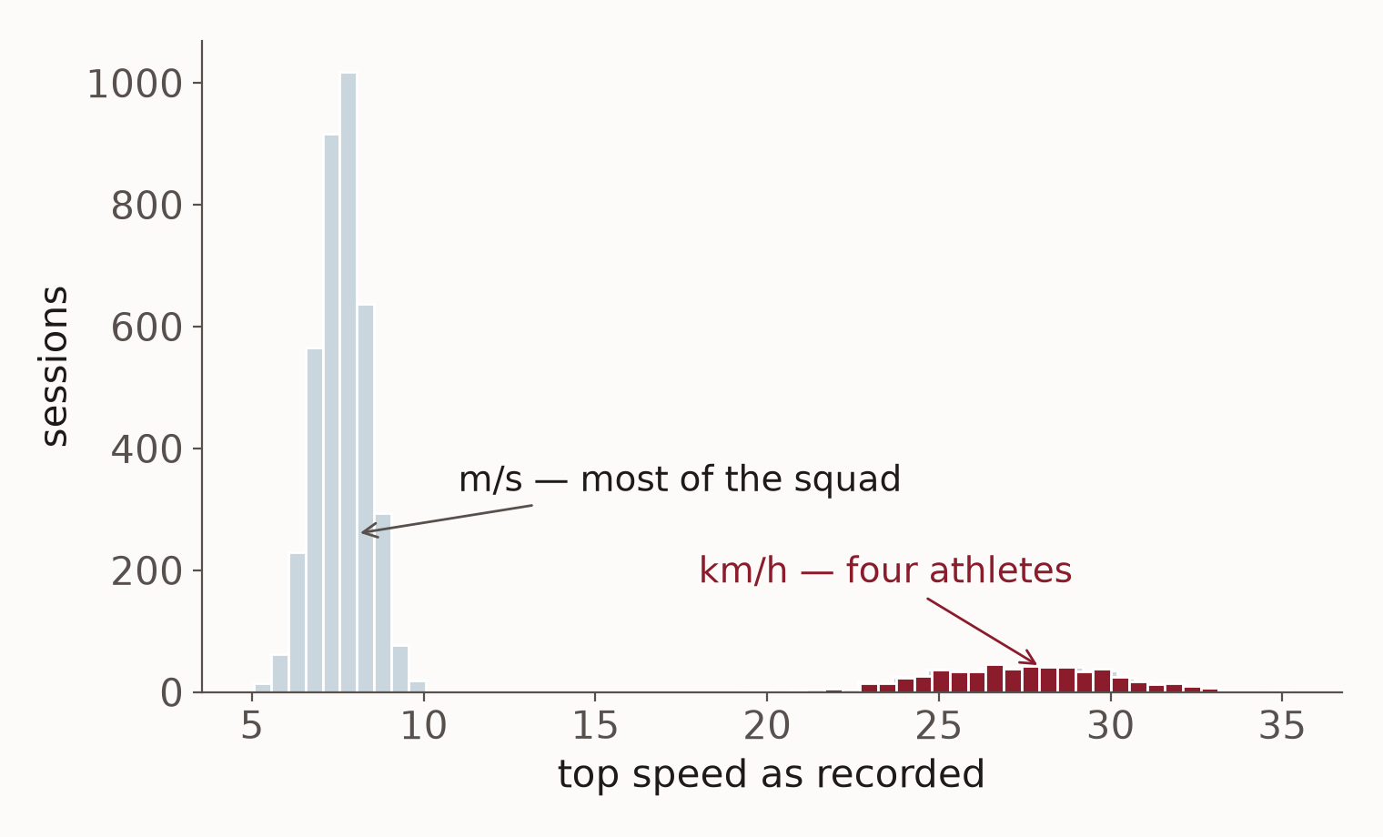
WEEK 3 · PREPROCESSING
Step 1 · Look: a plot finds what a summary hides
Every session's top speed, as recorded.
Most of the squad sits between 5 and 10. That is m/s, and it is human.
A second hump sits between 22 and 34: 581 sessions from four athletes whose GPS exported km/h.
An average of the two would describe nobody.
Before anything else: one plot per column.

Slide 25
WEEK 3 · PREPROCESSING
Step 2 · Fix: one kind of number, one unit
Four sessions of athlete A13. The speed is in the wrong unit and the RPE is stored as text.
As recorded
Fixed
athlete | date | top_speed | rpe
A13 | 2026-09-01 | 26.70 | 7,3
A13 | 2026-09-06 | 30.11 | 6,9
A13 | 2026-09-13 | 28.13 | 7,1
A13 | 2026-09-22 | 20.74 | 5,8
athlete | date | top_speed | rpe
A13 | 2026-09-01 | 7.42 | 7.3
A13 | 2026-09-06 | 8.36 | 6.9
A13 | 2026-09-13 | 7.81 | 7.1
A13 | 2026-09-22 | 5.76 | 5.8
→
km/h ÷ 3.6 = m/s. And '6,5' with a comma is text to the computer; 6.5 with a dot is a number.

Slide 26
WEEK 3 · PREPROCESSING
Step 2 · Fix: one athlete, one name
Whoever had the tablet typed the id. To a computer, 'A07' and 'a7' are two different athletes.
As typed
One spelling
athlete | date | session
A07 | 2026-09-01 | Recovery
a7 | 2026-09-02 | Training
a7 | 2026-09-03 | Training
A07 | 2026-09-05 | Training
athlete | date | session
A07 | 2026-09-01 | Recovery
A07 | 2026-09-02 | Training
A07 | 2026-09-03 | Training
A07 | 2026-09-05 | Training
→
Across the file: 60 different spellings for 30 athletes. Unrepaired, every count and every join is wrong.

Slide 27
WEEK 3 · PREPROCESSING
Step 3 · Check: the same morning, twice
Athlete A03 submitted the wellness form twice on 16 October. Both rows are real, and one of them is spurious.
As submitted
One row per morning
athlete | date | sleep_h | soreness
A03 | 2026-10-15 | 6.7 | 5
A03 | 2026-10-16 | 5.8 | 2
A03 | 2026-10-16 | 5.8 | 2
A03 | 2026-10-17 | 6.9 | 1
athlete | date | sleep_h | soreness
A03 | 2026-10-15 | 6.7 | 5
A03 | 2026-10-16 | 5.8 | 2
A03 | 2026-10-17 | 6.9 | 1
→
There are 41 of these in the wellness file. Kept, each one quietly doubles a session when the files are joined.

Slide 28
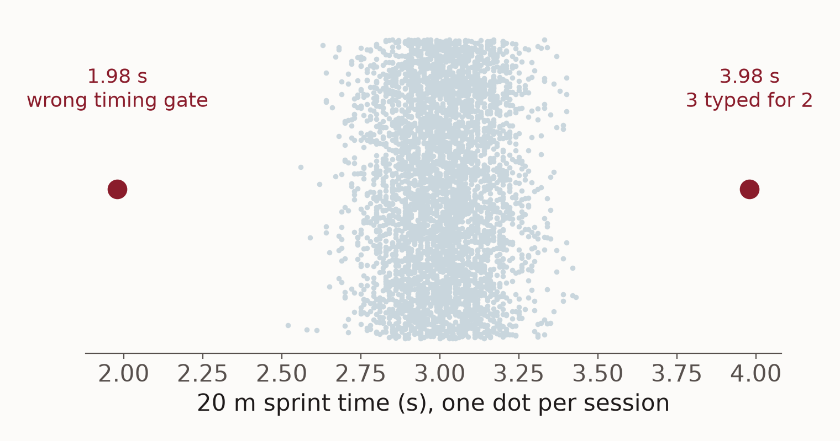
WEEK 3 · PREPROCESSING
Step 3 · Check: an error is not an extreme
4,415 sprint times, one dot each.
Two are impossible: 1.98 s is a different timing gate, 3.98 s is a 3 typed for a 2. Those are errors.
The dots at the edges of the crowd are not errors. They are the fastest and slowest athletes in the squad.
Fix errors. Keep extremes. You can only tell them apart by looking.

Slide 29
WEEK 3 · PREPROCESSING
Step 4 · Combine: wide to long
Three athletes and three weeks from the coach's spreadsheet. The numbers do not change; only the shape does.
Wide — as the coach keeps it
Long — one row, one observation
Athlete | W1 | W2 | W3
A01 | 331 | 487 | 400
A02 | 417 | 377 | 335
A03 | 458 | 476 | 446
Athlete | week | minutes
A01 | 1 | 331
A01 | 2 | 487
A01 | 3 | 400
A02 | 1 | 417
A02 | 2 | 377
A02 | 3 | 335
A03 | 1 | 458
A03 | 2 | 476
A03 | 3 | 446
→
Wide is easy to read. Long is what every analysis tool expects — adding a week adds rows, not columns.

Slide 30
WEEK 3 · PREPARING
One column per week, and what it has to become
As the spreadsheet opens
One row per athlete-week
wide = pd.read_excel(
'coach_training_load.xlsx',
sheet_name='Load', skiprows=2)
wide.shape
# (31, 27)
long = wide.melt(
id_vars='Athlete',
var_name='week',
value_name='minutes').dropna()
long.shape
# (780, 3) 30 athletes x 26 weeks
31 rows, and there are 30 athletes
Now every tool in the course can read it
The 31st row is TOTAL. It vanished only because those cells hold formulas.

Slide 31
WEEK 3 · PREPROCESSING
Step 4 · Combine: a join, on three athletes
Each session looks up that athlete's wellness for the same morning. A28 was never added to the wellness app.
Sessions (from the GPS file)
Sessions with wellness joined on
athlete | date | rpe
A05 | 2026-09-09 | 7.5
A06 | 2026-09-09 | 6.3
A28 | 2026-09-09 | 7.5
athlete | rpe | sleep_h | soreness
A05 | 7.5 | 7.8 | 2
A06 | 6.3 | 7.0 | 2
A28 | 7.5 | — | —
→
Matched on athlete and date. Where there is no match the gap stays visible — the row is kept, not thrown away.

Slide 32
WEEK 3 · PREPARING
The join, before and after
Keys as they were typed
Keys repaired, duplicates removed
df = gps.merge(well,
on=['athlete','date'], how='left')
len(df)
# 5112
df['sleep_h'].isna().mean()
# 0.385
# 'a3' and 'A03' are the same athlete
n = gps['athlete'].str.extract(r'(\d+)')[0]
gps['athlete'] = 'A' + n.str.zfill(2)
well = well.drop_duplicates(['athlete','date'])
df = gps.merge(well, on=['athlete','date'],
how='left')
# 5090 rows, 0.143 missing
38.5% of the wellness 'missing'
14.3% — the real figure
Same two files, same join. The first number was an artefact of how somebody typed an id.

Slide 33
WEEK 3 · PREPARING
Three ways a join goes wrong
What you see | What happened | What to do
Rows you expected are empty | the key is written differently in the two files | normalise the key before joining, every time
More rows than you started with | the key is not unique on one side | count duplicates on both sides first
Athletes have quietly disappeared | an inner join kept only the rows that matched | join with how='left', then count what is missing
In these files: 38.5% empty, 36 rows conjured out of nothing, and A28, A29, A30 gone without a word.

Slide 34
WEEK 3 · PREPROCESSING
Step 5 · Decide the row: from sessions to a week
Athlete A04, week 2 of the season. A coach plans in weeks, so the analysis usually does too.
One row per session
One row per athlete-week
date | session | min | rpe | load
08 Sep | Recovery | 46 | 7.1 | 329
09 Sep | Training | 63 | 4.9 | 307
10 Sep | Training | 63 | 4.4 | 278
11 Sep | Training | 72 | 5.5 | 396
12 Sep | Training | 79 | 7.7 | 611
13 Sep | Match | 94 | 4.1 | 384
athlete | week | sessions | min | load
A04 | 2 | 6 | 417 | 2305
→
Sum the load, count the sessions, average the soreness. One athlete-week, and 780 of them in the season.

Slide 35
WEEK 3 · PREPARING
What is one row?
Answer this before you aggregate anything.
• 675 athlete-days in this file carry two sessions — a gym session in the afternoon.
• Group by athlete and date and you have silently averaged them into one.
• 30 athletes measured 170 times each is still 30 athletes.
Decide the unit of analysis now. In Week 5 it decides how you are allowed to split the data.

Slide 36
WEEK 3 · PREPROCESSING
Step 6 · Prepare: one gap, four ways to fill it
Athlete A01, one week. The morning after the match was not filled in — the morning that matters most.
As recorded
Four choices for the gap
morning | soreness
Tue 15 Sep | 2
Wed 16 Sep | 1
Thu 17 Sep | 1
Fri 18 Sep | 4
Sat 19 Sep | 4
Sun 20 Sep | 4
Mon 21 Sep ← after match | —
drop it | column mean | carry forward | was missing?
2 | 2 | 2 | 0
1 | 1 | 1 | 0
1 | 1 | 1 | 0
4 | 4 | 4 | 0
4 | 4 | 4 | 0
4 | 4 | 4 | 0
— (dropped) | 3.0 | 4 | 1
→
Drop it, and the week loses its hardest day. The column mean says 3.0 — an ordinary day. Carrying forward says nothing changed overnight.

Slide 37
WEEK 3 · PREPARING
Four ways to handle a gap, four different claims
What you do | Mean post-match soreness | What you have claimed
Use only what was recorded | 4.29 | nothing — but a quarter of those days are gone
Fill with the column mean | 3.96 | that post-match days were ordinary days
Carry the last value forward | 3.92 | that nothing changed overnight after a match
Keep it, add a 'was missing' column | 4.29 | that the gap itself may carry information
Ordinary days average 2.80. The missing days are not noise — they are the hardest days in the season.

Slide 38
Every gap you fill is a sentence
you put in the model's mouth.
Filling is not the neutral choice. Neither is deleting. Both are claims, and both belong in your methods section.

Slide 39
WEEK 3 · PREPROCESSING
Step 6 · Prepare: turning a word into numbers
A model can only read numbers. 'GK' or 'MF' means nothing to it.
One text column
One 0/1 column per position
athlete | position
A04 | DF
A06 | FW
A01 | GK
A07 | MF
athlete | pos_FW | pos_GK | pos_MF
A04 | 0 | 0 | 0
A06 | 1 | 0 | 0
A01 | 0 | 1 | 0
A07 | 0 | 0 | 1
→
Four positions become three columns. DF is the row of zeros — if it is not FW, GK or MF, it is DF. This is called one-hot encoding.

Slide 40
WEEK 3 · PREPARING
Text columns, and what a model will take
Straight in
One column per category
X = squad[['position', 'dominant_limb']]
model.fit(X, y)
X = pd.get_dummies(
squad[['position','dominant_limb']],
drop_first=True)
X.shape # (30, 4)
# position_FW, position_GK, position_MF,
# dominant_limb_Right
ValueError: could not convert 'MF'
Four 0/1 columns it can use
drop_first keeps one category as the baseline, so the new columns are not redundant.

Slide 41
WEEK 3 · PREPROCESSING
Step 6 · Prepare: one scale for every column
Three athletes, week 5. Load is in thousands, sessions in single figures — so load would dominate any distance calculation.
Raw
Standardised (z-scores)
athlete | distance_km | load | sessions
A02 | 35.6 | 3312 | 7
A11 | 34.7 | 2543 | 6
A21 | 35.6 | 3067 | 8
athlete | distance_km | load | sessions
A02 | +0.58 | +1.18 | +0.45
A11 | +0.37 | -0.46 | -0.50
A21 | +0.59 | +0.66 | +1.39
→
z = (value − squad mean) ÷ squad standard deviation. 0 is an average week, +1 is one standard deviation above it.

Slide 42
WEEK 3 · PREPARING
When the size of a number matters
• Distance is in thousands of metres. RPE runs 1 to 10. Sleep is about 7.
• k-means, k-NN and anything regularised read that as 'distance is the important one'.
• Trees and forests do not care — they split on order, not on size.
Scale after you split the data, never before, and fit the scaler on the training part only.

Slide 43
WEEK 3 · PREPROCESSING
Step 6 · Prepare: building a new column
Athlete A10. Minutes say how long; RPE says how hard. Neither alone is training load.
What you were given
A new column: session load
date | session | min | rpe
09-01 | Recovery | 45 | 3.5
09-02 | Training | 67 | 7.9
09-03 | Training | 87 | 5.5
09-04 | Training | 69 | 8.1
date | session | min | rpe | load
09-01 | Recovery | 45 | 3.5 | 158
09-02 | Training | 67 | 7.9 | 529
09-03 | Training | 87 | 5.5 | 478
09-04 | Training | 69 | 8.1 | 559
→
load = minutes × RPE. A new number built from two old ones is called a feature, and choosing them is where sport knowledge enters the analysis.

Slide 44
WEEK 3 · PREPARING
A column worth more than the two it came from
What you were handed
Session load, built from both
duration_min rpe
95 7,0
72 6,0
38 3,0
# minutes, and a number out of ten
gps['load'] = gps['rpe'] * gps['duration_min']
gps.groupby('session_type')['load'].mean()
# Match 601
# Training 456
# Gym 280
# Recovery 240
Neither one is training load
The number coaches plan in
And it exists only because you repaired the comma first. Features are built, not found.

Slide 45
WEEK 3 · PREPARING
What Week 4 needs from you
This is the table you hand to a model next week.
• One row per athlete-week. 780 rows, not 5,090.
• Keys repaired, duplicates counted, every unit in one system.
• Categories encoded. Gaps handled on purpose, and written down.
• One column that is the thing you are trying to predict.
Everything from Week 4 onwards assumes this table already exists.

Slide 46
5
What you do with the table
Look first. Reach for a model only when you need to predict.

Slide 47
WEEK 3 · ANALYSIS
What data analysis is
Turning the table into an answer to a question somebody actually asked.
• It starts with the question, not the data: 'did the squad train harder in October?'
• Then the smallest piece of the table that answers it: one column, a few rows, sometimes one number.
• Then a summary or a picture that a coach can read in ten seconds.
• Then the honest part: could this have happened by chance, and is it big enough to matter?
The tools are simple. The skill is choosing which question you are asking.

Slide 48
WEEK 3 · ANALYSIS
Four kinds of question you can ask of data
Kind | The question | A sport example | How
Descriptive | What happened? | What was the squad's average weekly load? | averages, spread, a plot
Exploratory | Is there a pattern? | Are heavier weeks sorer weeks? | groups, plots, correlation
Inferential | Is it real, or chance? | Do midfielders really carry more load? | a test, a confidence interval
Predictive | What will happen? | Who is likely to be sore next week? | machine learning
The next two slides answer the first three, on today's table. From Week 4 onwards, the fourth.

Slide 49
WEEK 3 · ANALYSIS
Describing: the middle, and the spread
Athlete A04, seven weeks in a row. Week 13 came in at about half this athlete's usual load.
Seven weeks
Six numbers that describe them
week | load (AU)
week 8 | 3734
week 9 | 2412
week 10 | 3771
week 11 | 3967
week 12 | 2947
week 13 | 2033
week 14 | 3972
summary | value
mean | 3262
median | 3734
lowest | 2033
highest | 3972
range | 1939
standard deviation | 797
→
One odd week drags the mean (3262) below the median (3734). Without week 13 the mean would be 3467 and the median 3752: one week moved the mean 205 AU and the median 18.

Slide 50
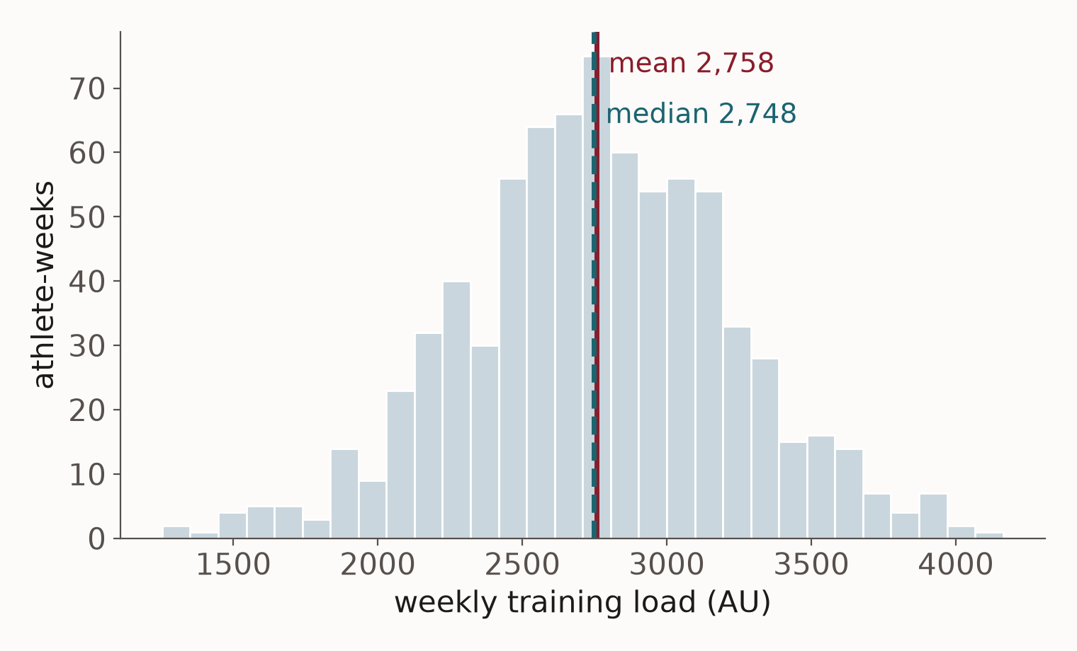
WEEK 3 · ANALYSIS
Describing a whole season: the distribution
Every athlete-week of the season: 780 of them.
A typical week is about 2,748 AU — mean 2,758, median 2,748. They agree, because nothing extreme pulls them apart.
Half of all weeks fall between 2,467 and 3,063.
About 70% sit within one standard deviation (470) of the mean.
A histogram answers 'what is normal here?' before you ask anything else.

Slide 51
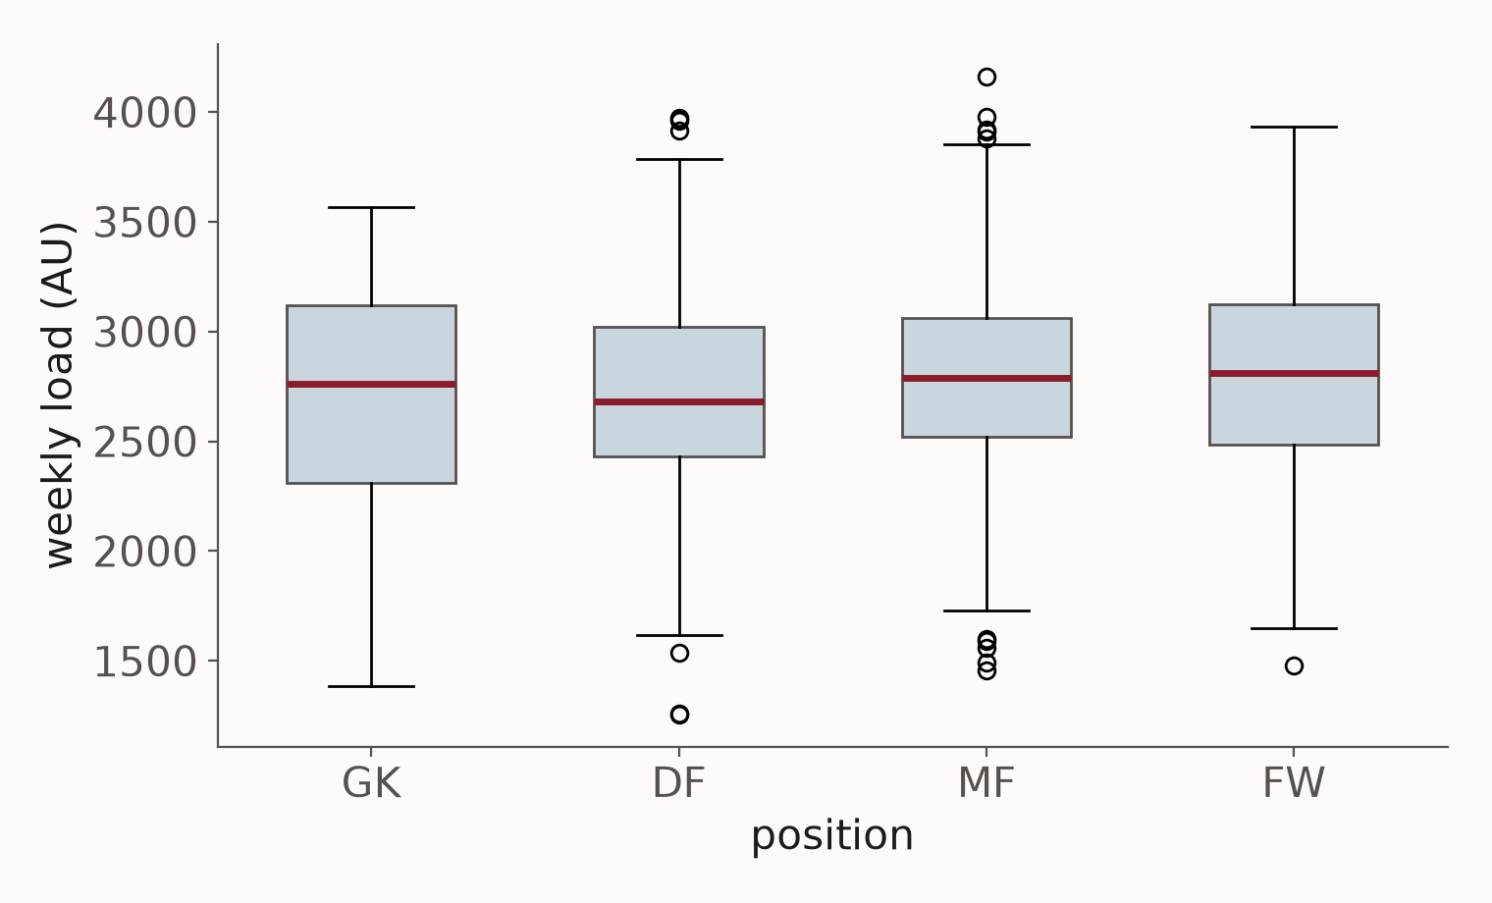
WEEK 3 · ANALYSIS
Comparing groups: reading a box plot
The line inside the box is the median.
The box holds the middle half of the weeks; the whiskers reach the rest, apart from the odd ones drawn as circles.
Medians: GK 2,761, DF 2,683, MF 2,787, FW 2,810.
The boxes overlap almost completely. Whatever separates positions, it is small next to how much weeks vary.
Look at the overlap before you look at the difference.

Slide 52
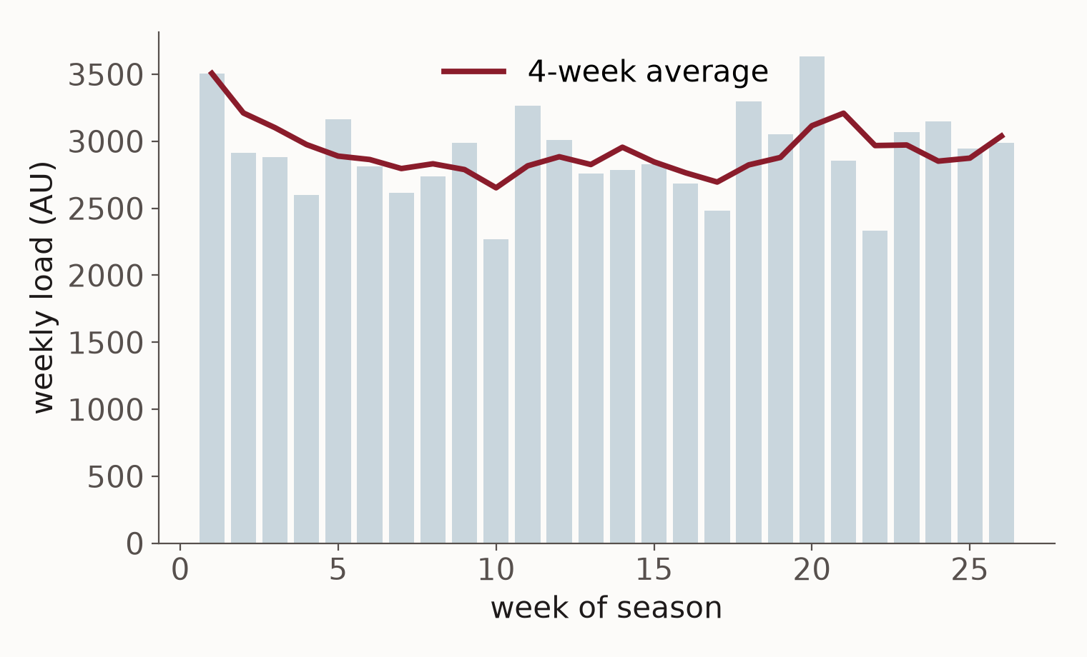
WEEK 3 · ANALYSIS
Over time: one athlete's season
Grey bars: athlete A07's load, week by week.
Red line: the average of the last four weeks, which smooths out one-off weeks.
The bars show what happened. The line shows the trend a coach plans around.
Change four to one and the line is as jumpy as the bars; change it to twelve and it barely moves.
The smoothing window is a choice that changes the story. Lab 3 lets you try it.

Slide 53
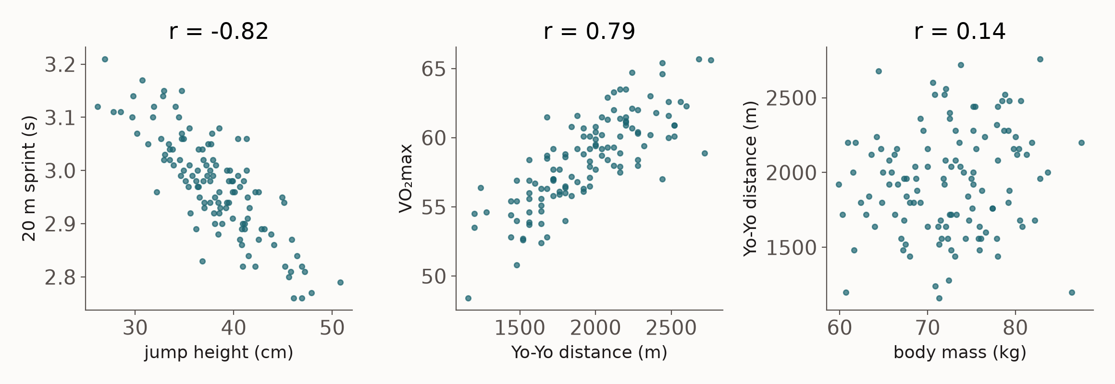
WEEK 3 · ANALYSIS
Two measures together: what r means
Correlation r runs from −1 to +1. Left, r = -0.82: higher jumpers sprint faster (lower times). Middle, r = 0.79: fitter on the Yo-Yo, higher VO₂max. Right, r = 0.14: body mass tells you almost nothing about Yo-Yo.

Slide 54
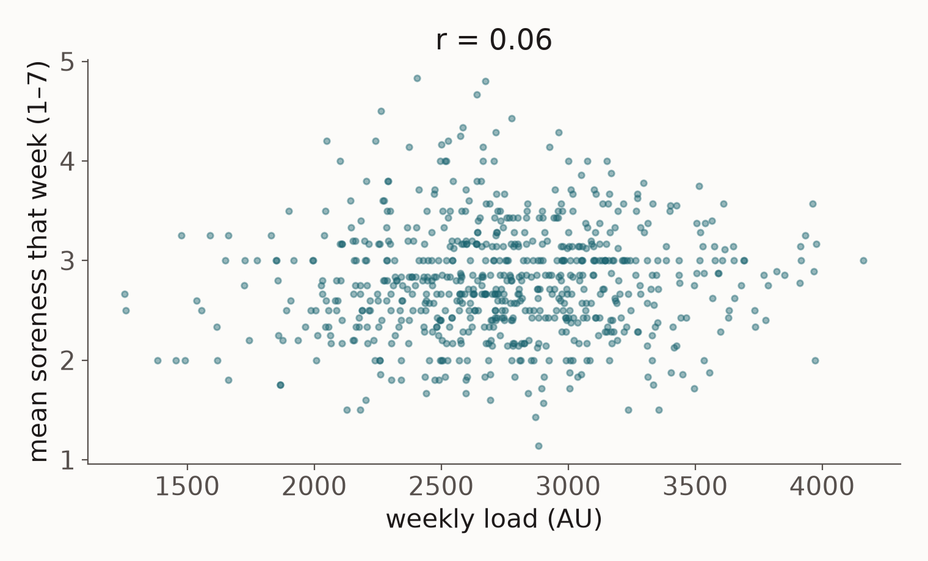
WEEK 3 · ANALYSIS
On our own table: are heavier weeks sorer weeks?
Each dot is one athlete-week: its load against its average soreness.
r = 0.06. A cloud with no direction — no relationship.
In this squad soreness follows matches, and everyone plays one a week, so weekly load hardly moves it.
'There is no relationship' is a finding. Report it.

Slide 55
WEEK 3 · ANALYSIS
Describe it, then look for a pattern
Descriptive: what happened?
Exploratory: is there a pattern?
weekly['load'].describe()
# mean 2758 AU sd 470
# min 1254 max 4163
weekly.groupby('position')['load'].mean()
# DF 2721 FW 2790 GK 2717 MF 2790
weekly[['load', 'soreness']].corr()
# r = 0.06 over 702 athlete-weeks
# heavier weeks are not sorer weeks
# in these files
A typical week, and how much weeks vary
No — and that is an answer too
Two lines each. Most questions a coach asks stop here.

Slide 56
WEEK 3 · ANALYSIS
A relationship is not a cause
Athletes who use the ice bath most get injured most. Does the ice bath cause injury?
• No. Sore and injured athletes are the ones sent to the ice bath. The injury came first.
• That is reverse causation: the arrow runs the other way.
• Or a third thing drives both: congested fixtures raise both training load and injuries, so load and injury rise together.
• Only an experiment — or a very careful design — can show a cause. A correlation never can.
Every r in this course is a pattern, not an explanation.

Slide 57
WEEK 3 · ANALYSIS
Is it real, or chance? What a p-value says
Midfielders carry 69 AU a week more than defenders. Real, or the luck of the squad?
• Imagine positions made no difference at all. How often would chance alone produce a gap this big?
• That 'how often' is the p-value. p = 0.05 means about one time in twenty.
• A small p says chance is an unlikely explanation. It does not say the difference is large or important.
• A large p says chance could easily explain it. It does not prove there is no difference.
And p depends on what you count as one observation — next slide.

Slide 58
WEEK 3 · ANALYSIS
Is the difference real? It depends on what you count
Every athlete-week as a row
Each athlete counted once
mids = weekly[weekly.position == 'MF']['load']
backs = weekly[weekly.position == 'DF']['load']
stats.ttest_ind(mids, backs)
# n = 312 against 286
# difference 69 AU, p = 0.07
per = (weekly.groupby(['athlete', 'position'])
['load'].mean().reset_index())
# n = 12 against 11
# difference 69 AU, p = 0.18
Looks close to 'significant'
The same 69 AU. Weak evidence of anything
Nothing changed but the counting. Thirty athletes are thirty pieces of evidence, not seven hundred.

Slide 59
WEEK 3 · ANALYSIS
Which picture for which question
Your question | The picture | On our table
What is a normal value? | histogram | weekly load across the season
Do groups differ? | box plot | load by position
How did it change? | line over time | one athlete's season
Do two measures go together? | scatter plot | load against soreness
How many in each category? | bar chart | sessions by type
Pick the question first. The picture follows from it.

Slide 60
Most questions a coach asks are answered
by a good table and a plot.
A model is for when you need to predict something that has not happened yet.

Slide 61
WEEK 3 · MACHINE LEARNING
What a machine learning model does
It learns a pattern from past examples, instead of being given a rule.
• You give it inputs — load, sleep, age — and, for past cases, the answer: injured or not, a sprint time.
• It finds the pattern that links them, then uses it on new cases where the answer is not known yet.
• Supervised: you have the answer for past cases. Unsupervised: you do not, and it looks for structure.
It finds patterns, not causes. 'Predicts injury' never means 'explains injury'.

Slide 62
WEEK 3 · MACHINE LEARNING
A rule you write, or a pattern it learns
A rule, written by a coach
A pattern, learned from examples
• 'Promote anyone who runs 20 m under 2.9 s.'
• Simple, and easy to explain.
• Uses one measure, chosen by one person.
• Never checked against who actually succeeded.
• Show it 120 past academy players: their tests, and who made the first team.
• It finds the combination of tests that best separated them.
• Then it applies that to a player it has never seen.
• That is all machine learning is. The rest of this part is examples.

Slide 63
WEEK 3 · MACHINE LEARNING
Two words: features, and the label
Five of the 120 academy players. Every machine learning problem has this shape.
Features — what you know about each player
Label — what you want to predict
player | jump cm | 20 m s | Yo-Yo m
P025 | 36.8 | 2.83 | 2000
P042 | 36.9 | 2.98 | 1720
P056 | 45.6 | 2.80 | 2000
P075 | 38.4 | 2.94 | 2440
P107 | 37.2 | 3.01 | 1880
made the first team?
yes
no
yes
yes
no
→
Learning from rows where the label is known, in order to predict it where it is not — that is supervised learning.

Slide 64
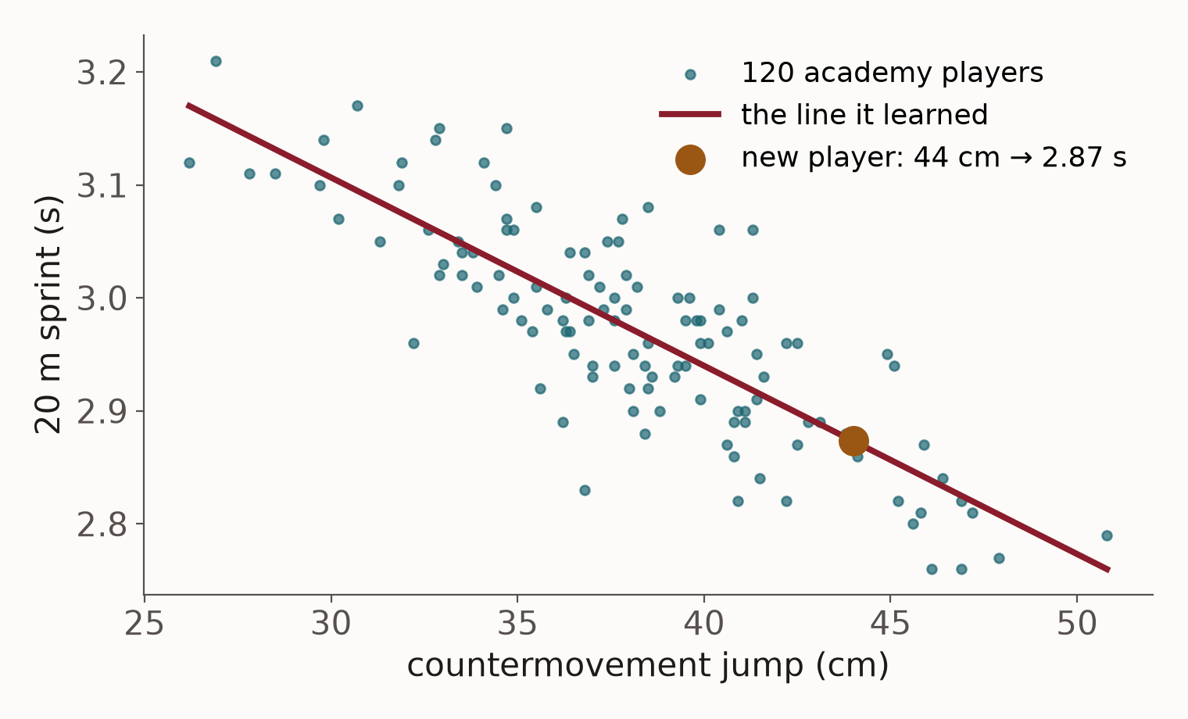
WEEK 3 · MACHINE LEARNING
Regression: predicting a number
Question: from a player's jump, how fast will they sprint 20 m?
The model draws the straight line closest to all 120 players. Its rule: sprint = 3.61 − 0.0167 × jump.
A new player jumps 44 cm. The line predicts 2.87 s.
On average it is 0.044 s out. That is linear regression — the same thing you met in statistics.
Predicting a number is called regression.

Slide 65
WEEK 3 · MACHINE LEARNING
Training and testing: keep some players back
A model always looks good on answers it has seen. The fair test is players it never saw.
• Split the 120 players: about 70% to learn from (the training set), 30% hidden away (the test set).
• Fit the model on the training set only.
• Then predict the test set and compare with what really happened. That error is the honest one.
• It is a memory test with the answers on the desk otherwise — and that is the next slide.
Never judge a model on the data it learned from.

Slide 66
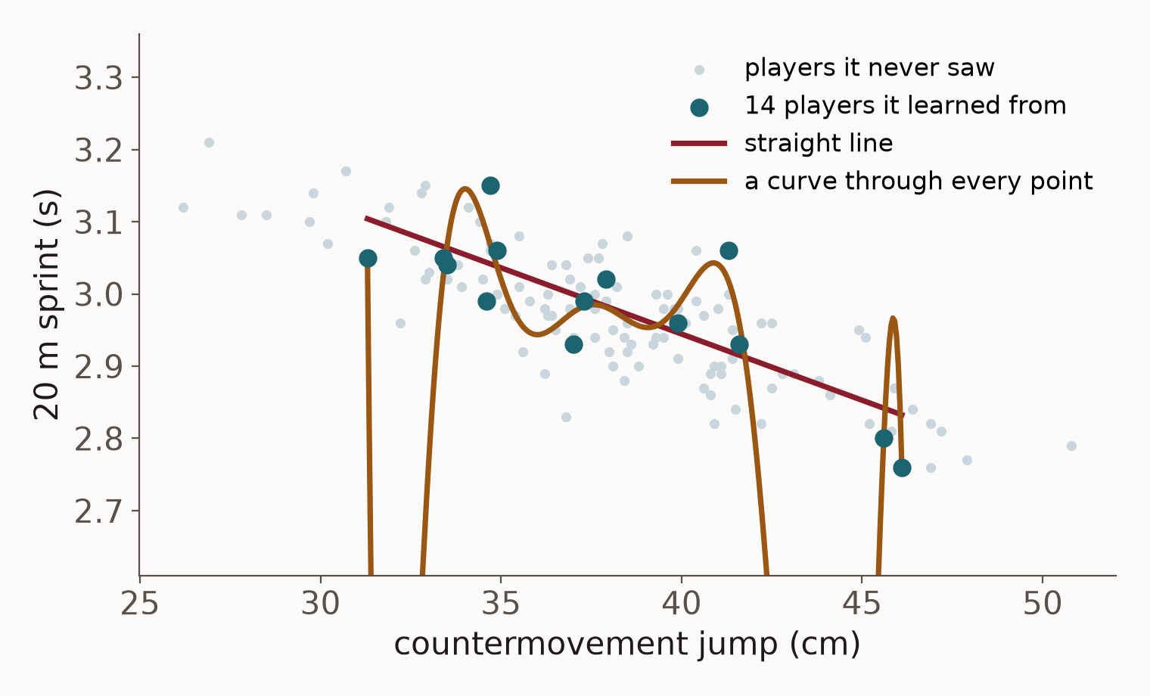
WEEK 3 · MACHINE LEARNING
Overfitting: learning players, not the pattern
Both models learned from the same 14 players, the large dots.
The straight line is 0.048 s out on them, and 0.047 s out on players it never saw.
The curve passes almost through every one: 0.031 s out on those 14 — better.
On new players it is 0.198 s out: four times worse than the line.
Fitting the training data perfectly is a warning, not a success.

Slide 67
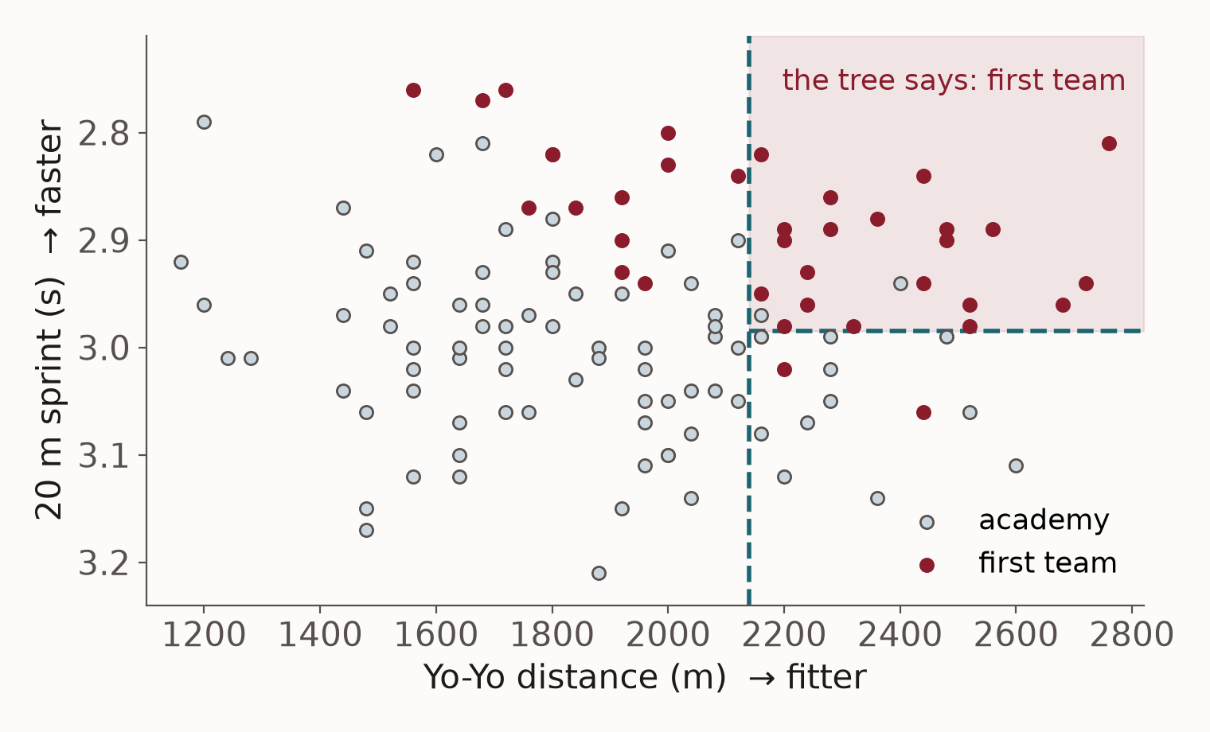
WEEK 3 · MACHINE LEARNING
Classification: predicting a category
Question: from Yo-Yo distance and 20 m sprint, who makes the first team? The answer is yes or no — a category.
Red dots made it; grey did not.
The model learned two cut-offs: Yo-Yo above 2,140 m, and sprint under 2.99 s.
Players in the shaded corner, it calls first team.
Predicting a category is called classification.

Slide 68
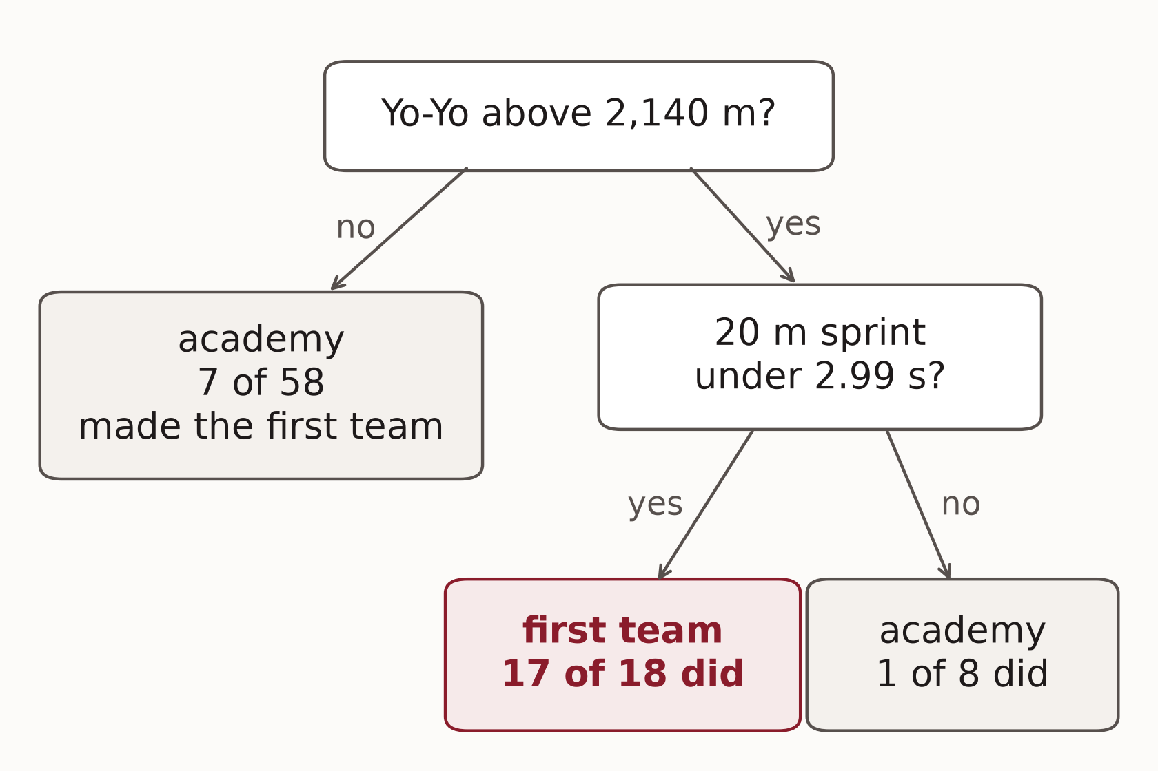
WEEK 3 · MACHINE LEARNING
A decision tree, read like a coach would read it
Learned from 84 players. Start at the top and answer each question.
Yo-Yo above 2,140 m and sprint under 2.99 s: 17 of 18 such players made it.
Yo-Yo below 2,140 m: only 7 of 58 did.
A tree is a flowchart the computer wrote. It is the one model you can draw on a whiteboard.
Every number in a box is a count of real players.

Slide 69
WEEK 3 · MACHINE LEARNING
A random forest: a hundred trees, voting
One tree is easy to read and easy to fool. So grow many, each from a different sample.
• Each tree sees a random selection of the training players, so each learns slightly different cut-offs.
• A new player: Yo-Yo 2,240 m, 20 m sprint 2.93 s.
• 88 of the 100 trees say first team; 12 say academy.
• So the forest says: first team, with 88% of the votes.
More stable than one tree, and much harder to explain. That trade appears all term.

Slide 70
WEEK 3 · MACHINE LEARNING
How good is it? Count the mistakes
 | really made the first team | really did not
the tree said: first team | 4 correct | 1 false alarm
the tree said: academy | 7 missed | 24 correct
36 players it never saw. It was right 28 times: 78%. But only 31% made it, so 'nobody makes the first team' would have scored 69% without learning anything — and it missed 7 of 11.

Slide 71
WEEK 3 · MACHINE LEARNING
Learning from answers: the supervised methods
Method | What it does | A sport question it answers | Week
Linear regression | fits a straight-line relationship | 20 m sprint time from jump height and body mass | 4
Ridge regression | the same, with no input dominating | the same, with many overlapping tests | 4
Decision tree | a flowchart of yes/no questions | is this athlete's week a risky one? | 4
Random forest | hundreds of trees, voting | injury risk; walking vs running from a phone | 4, 6, 9
Gradient boosting | trees in sequence, each fixing the last | the same questions, on larger data | 4
Week 4 runs the first five side by side on thirty athletes — and the straight line wins.

Slide 72
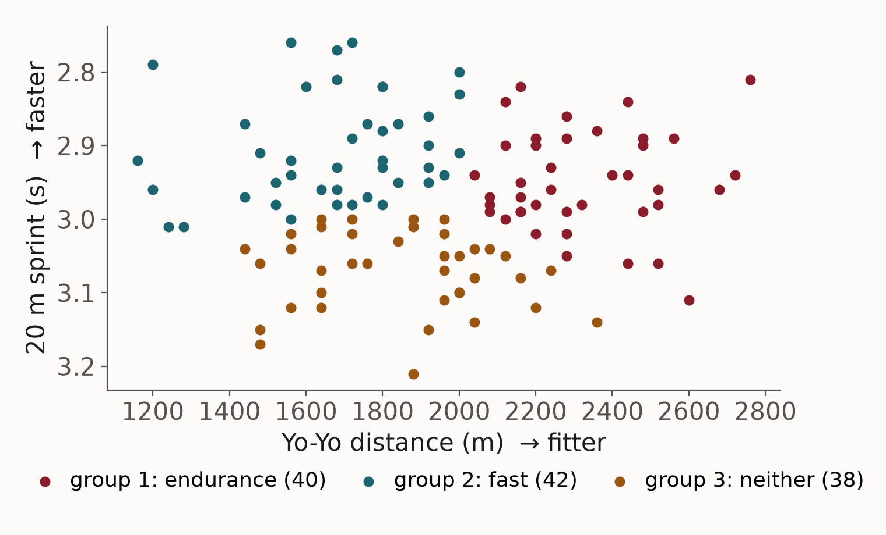
WEEK 3 · MACHINE LEARNING
Clustering: groups that nobody labelled
No label this time — nobody tells the model who belongs where.
k-means is asked for three groups and finds the three that sit closest together on sprint and Yo-Yo.
Fast group: 2.90 s sprint. Endurance group: 2,321 m Yo-Yo. The third stands out in neither.
It was never told positions, yet 28 of the endurance group are midfielders.
Finding structure without a label is unsupervised learning.

Slide 73
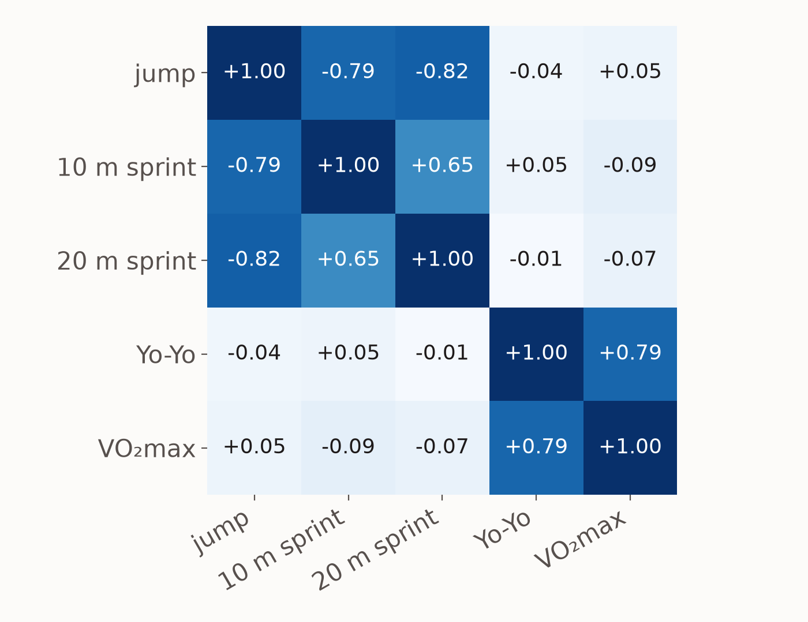
WEEK 3 · MACHINE LEARNING
PCA: five tests, measuring two things
Correlations between five tests on the same 120 players. Dark means the two tests move together.
Jump and the two sprints form one block. Yo-Yo and VO₂max form another. Between the blocks, almost nothing.
So five tests are really measuring two qualities: speed-power and endurance.
PCA finds those directions for you: here two of them carry 86% of everything the five tests say.
Fewer, truer measures — and a question about why you test five.

Slide 74
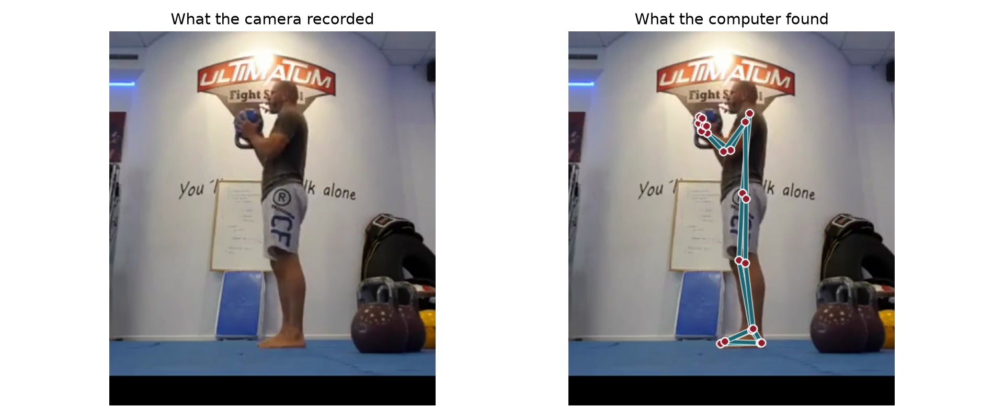
WEEK 3 · MACHINE LEARNING
Deep learning: learning straight from pixels
Week 1's demonstration. Nobody told the model what a knee looks like: it learned from millions of labelled images, and now finds 33 body points in every frame. From those points, the knee angle is simple geometry.
Video: Taco Fleur, Cavemantraining — CC BY-SA 4.0, Wikimedia Commons

Slide 75
WEEK 3 · MACHINE LEARNING
Finding structure, and learning from raw signals
Method | What it does | A sport question it answers | Week
k-means | groups athletes, no answer needed | which athletes have similar profiles? | 7
PCA | reduces many tests to a few qualities | 18 fitness tests: how many qualities? | 7
Deep learning | learns straight from images or signals | joint angles from ordinary video | 10
Week 1's pose demonstration was deep learning. You will not build one; you will learn to check one.

Slide 76
WEEK 3 · MACHINE LEARNING
Choosing a method: three questions
• Do you have the answer for past cases? Yes: supervised. No: unsupervised.
• Is the answer a number or a category? A number: regression. A category: classification.
• How many athletes? With thirty, the simplest model that could work usually does.
Start simple. Week 4 shows why, on real numbers.

Slide 77
LABORATORY · THIS SESSION
Lab 3 — From four files to one table
• The same four files you just watched on screen, downloaded into Colab.
• Four commands — then write down what looks wrong before you read the answer.
• Repair the comma, the km/h and the yards. A checkpoint says which fault is still there.
• Join the two files properly: 5,090 rows in, 5,090 rows out, nobody deleted.
• Build the calendar of mornings that should exist, and find the pattern in what is missing.
• Hand over the table Week 4 starts from: one row per athlete-week, every column a number.
Submit: Notebook with both checkpoints passing, plus which fault here would most distort an injury model, and why.

Slide 78
LABORATORY · BLOCK 3
Block 3 — the code to fill in
1 · RPE: REPLACE THE COMMA WITH A DOT, THEN MAKE IT A NUMBER
gps_clean = gps.copy()
gps_clean['rpe'] = pd.to_numeric(gps_clean['rpe'].str.replace(',', '.'))
2 · ONE CLEAN ID, HOWEVER IT WAS TYPED: A7 BECOMES A07
key = 'A' + gps_clean['athlete'].str.extract(r'(\d+)')[0].str.zfill(2)
3 · KM/H TO M/S, FOR THE FOUR ATHLETES WHOSE GPS EXPORTED KM/H
gps_clean.loc[key.isin(['A12','A13','A14','A15']), 'top_speed'] /= 3.6
4 · YARDS TO METRES, FOR THE THREE RECORDED IN YARDS
gps_clean.loc[key.isin(['A07','A08','A09']), 'distance'] /= 1.09361
In the notebook, only the highlighted parts of the code are blank. Everything else is already typed.

Slide 79
LABORATORY · BLOCK 4
Block 4 — the code to fill in
1 · REPAIR THE ID, EXACTLY AS IN BLOCK 3
n = gps_clean['athlete'].str.extract(r'(\d+)')[0]
g = gps_clean.assign(athlete='A' + n.str.zfill(2))
2 · ONE WELLNESS ROW PER ATHLETE PER MORNING
w = wellness.drop_duplicates(subset=['athlete','date'])
3 · KEEP EVERY SESSION, MATCHED OR NOT
joined = g.merge(w, on=['athlete','date'], how='left')
Two blanks: the columns that make a morning unique, and the how= that keeps every athlete.

Slide 80
OPEN CLINIC · LAST 20 MINUTES
Bring your own disaster
1. Open the data file you actually have. What shape is it in?
2. What is missing, and do you know why it is missing?
3. What units is everything in, and are you sure?
4. How many observations do you really have — rows, or people?
Twenty minutes. Bring the file; we will look at it together.

Slide 81
What to take away from today
1. Every source samples at a rate, and that rate decides what you are permitted to see.
2. One row, one observation. Restructure before you analyse, always.
3. Missingness is information. Ask when values go missing, not just how many.
4. Rows are not observations. Twenty-two athletes measured a hundred times is still twenty-two athletes.

