Slide 1
WEEK 4
Your first model
Features, labels, training and testing — and why the most complicated method
is so often not the best one.
PES 3850 · Artificial Intelligence Applications in Sport · METU

Slide 2
1
The setup
Four words, and then you know how all of it works

Slide 3
WEEK 4 · THE SETUP
Four words
• "Features" — what you put in. Age, jump height, sprint time, weekly load. Also called inputs or predictors.
• "Label" — what you want out. The answer you already know for past cases. Also called the target or outcome.
• "Training" — showing the model the features and the labels together, so it can find the connection.
• "Testing" — giving it features it has never seen, and comparing its answer with the truth you kept hidden.
That is the entire structure of supervised learning. Everything after this is variations on it.

Slide 4
WEEK 4 · THE SETUP
Two kinds of question
Regression — the answer is a number
Classification — the answer is a category
• How much will this athlete's sprint time improve?
• What is their expected match distance?
• How many days until return to play?
• Measured by: how far off, on average.
• Will this athlete be injured next week? Yes / no.
• Is this event a pass, a shot or a tackle?
• Is this athlete ready to return? Ready / not.
• Measured by: how often right — and Week 5 will complicate that.

Slide 5
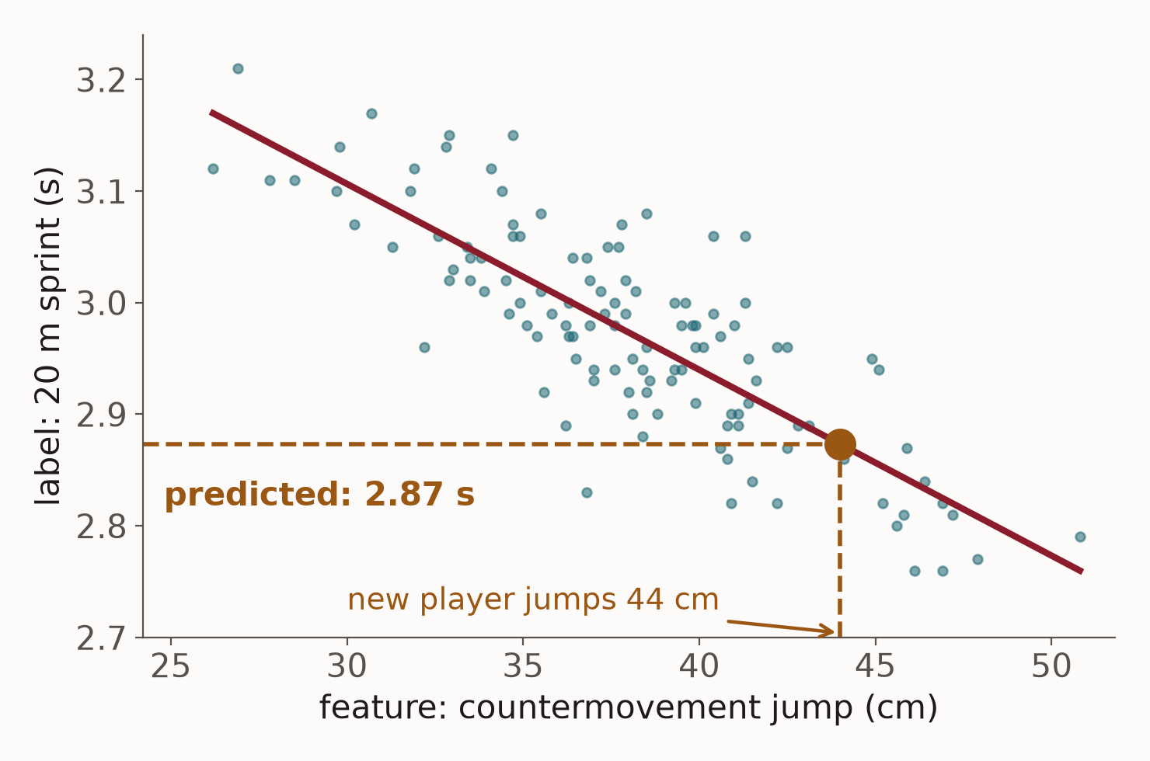
WEEK 4 · THE SETUP
Regression: the answer is a number
Regression predicts a number on a scale: a sprint time, a match distance, days until return to play.
It learns how the label changes as a feature changes. Here: the higher the jump, the faster the 20 m sprint.
Give it a new player's jump and it reads off a number: 44 cm → 2.87 s.
Judged by how far off it is: on these players, 0.044 s on average.
Features in, a number out.

Slide 6
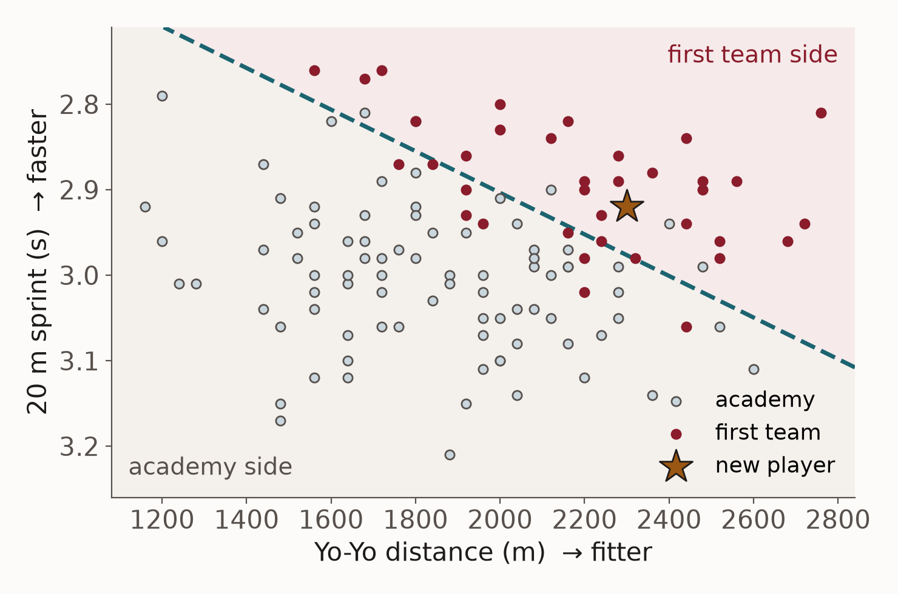
WEEK 4 · THE SETUP
Classification: the answer is a category
Classification predicts which of a fixed set of answers applies: first team or academy, injured or not.
It learns a boundary between the groups — the dashed line. Each side is one answer.
A new player, the star, falls on the first-team side: predicted first team, with 78% probability.
Judged by how often it is right — and Week 5 shows why that alone is not enough.
Features in, a category out.

Slide 7
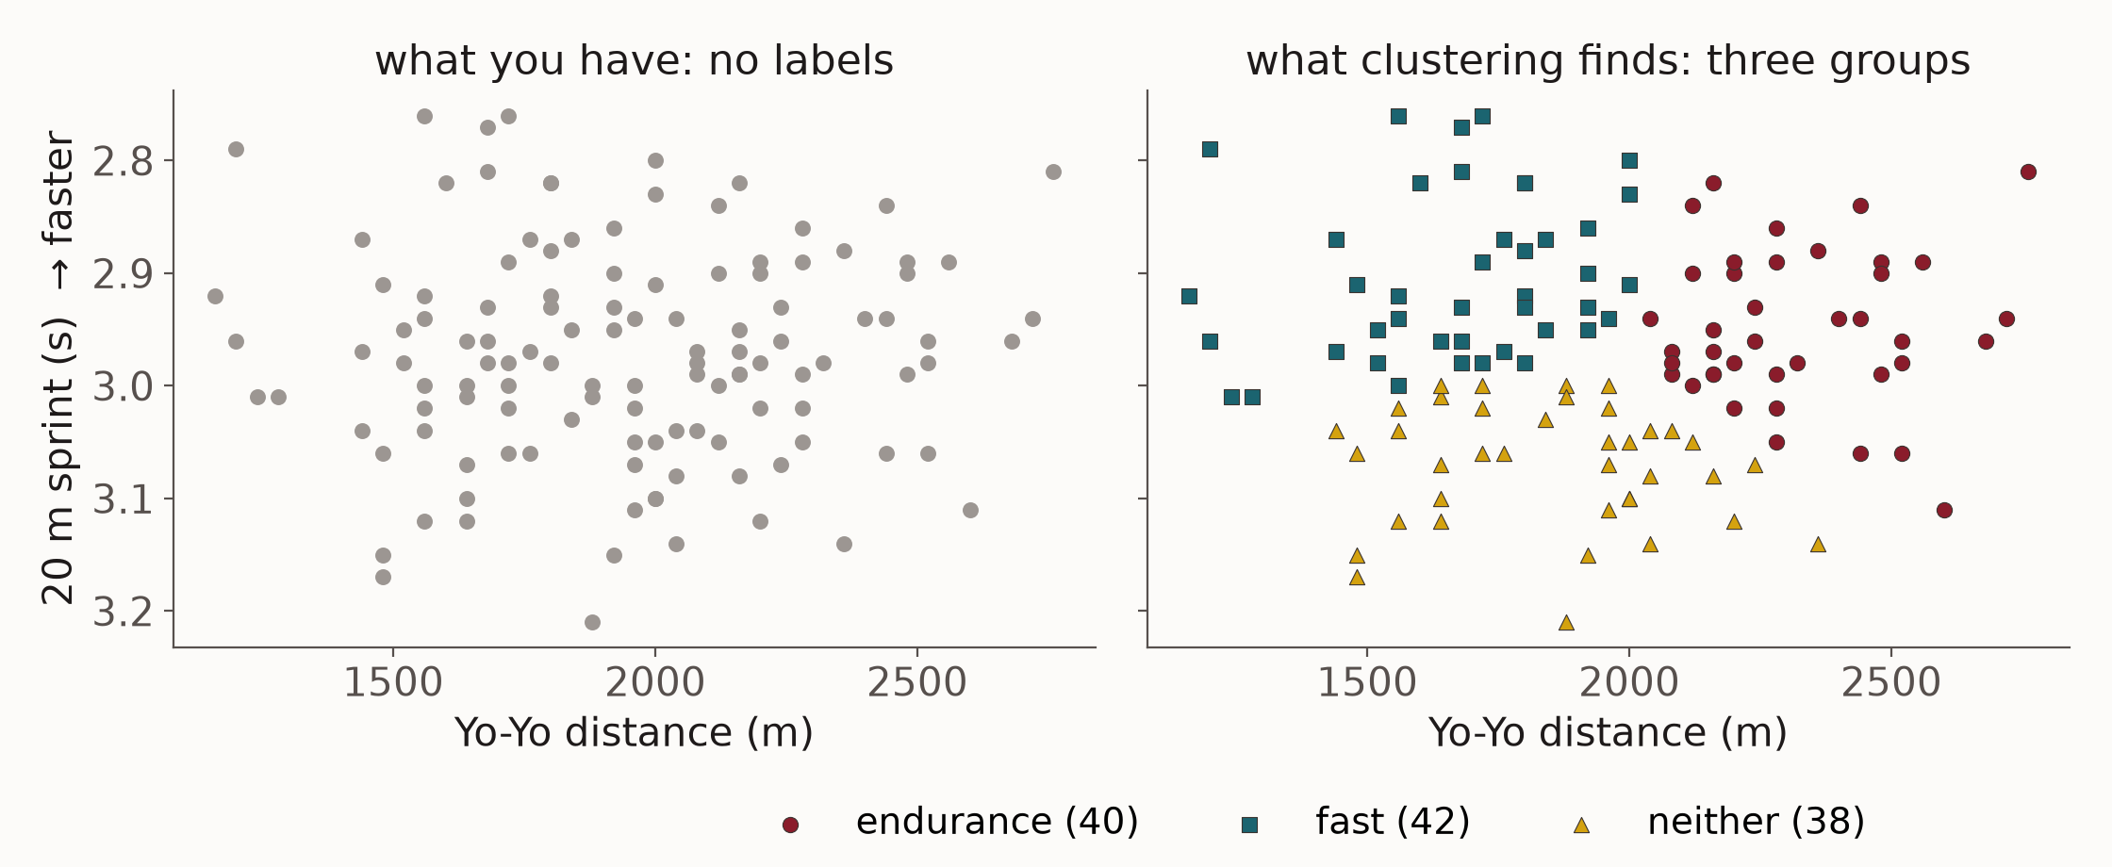
WEEK 4 · THE SETUP
Clustering: groups, with no answer given
Clustering finds groups in data that has no answer column. Nobody tells it who belongs where: it puts together players whose numbers are close, and you name the groups afterwards.

Slide 8
2
You already know a machine learning model
It is called linear regression

Slide 9
Linear regression is a machine learning model.
You have been doing this for years. What changes is not the mathematics — it is the question you are asking of it.

Slide 10
WEEK 4 · STATISTICS AND ML
Same machinery, different question
Statistics asks: is there an effect?
Machine learning asks: will it work next time?
• Does training age affect sprint performance?
• You care about the coefficient and its confidence interval.
• You want the simplest model you can defend.
• You check assumptions: normality, independence.
• You are explaining the athletes you measured.
• Can I predict the sprint time of an athlete I have not met?
• You care about the error on new people.
• You will accept complexity if it earns its place.
• You check it on data held back from training.
• You are generalising beyond the athletes you measured.

Slide 11
3
Why we hold data back
The most important habit in the course

Slide 12
WEEK 4 · TRAIN AND TEST
A memory test with the answers on the desk
A demonstration, not a metaphor.
• I give you a list of twenty athlete names and jump heights, and two minutes to memorise it.
• Then I test you — on the same twenty. You score 100%. Are you good at predicting jump height?
• Now I test you on twenty athletes you have never seen. That score is the real one.
Testing a model on the data it learned from is exactly this. It measures memory, not skill.

Slide 13
WEEK 4 · TRAIN AND TEST
How we do it
• Split the athletes: about three-quarters to learn from, one-quarter held back.
• Train on the first group. The model never sees the second.
• Test on the held-back group and report *that* number. Only that number.
• "Cross-validation" repeats this five times with different quarters held back, and averages — a steadier estimate from the same data.
Whenever anyone quotes you a model's performance, your first question is: on data it had never seen?

Slide 14
4
The model families
One sentence each. No mathematics.

Slide 15
WEEK 4 · MODELS
Five methods, in one sentence each
Method | What it does | Explain it to a coach?
Linear regression | Fits a straight-line relationship between inputs and output. | Yes — an equation
Ridge regression | The same, but reined in so no single input dominates. | Yes
Decision tree | A flowchart of yes/no questions, learned from the data. | Yes — draw it
Random forest | Hundreds of different trees, all voting. | Only roughly
Gradient boosting | Trees built in sequence, each fixing the last one's mistakes. | No
You will not implement any of these. You will run them, read the results, and choose between them — which is the actual professional task.

Slide 16
5
The result you will get today
And it is not the one you expect

Slide 17
On today’s data, plain linear regression beats
random forest and gradient boosting.
Average error 0.78 against 0.92. This is not a mistake in the lab. It is the lesson.

Slide 18
WEEK 4 · THE RESULT
Why the simple model won
• "The real relationship is close to a straight line." Aerobic capacity, recovery and speed each push the outcome one way, roughly proportionally.
• "Two hundred athletes." That is a large sport-science dataset and a small machine-learning one. Flexible methods need data to justify their flexibility.
• "Twelve clean, sensible predictors", with no hidden interactions to find. Boosting earns its keep on wide, messy data — GPS traces, video, event streams. Not on a test battery.
Complexity is a cost you pay in interpretability and in sample size. It has to be earned.

Slide 19
Run the simple model first. Always.
If the complicated one cannot beat it, you have learned something real about your problem —
and you get to keep the model you can explain to a coach.

Slide 20
WEEK 4 · READING RESULTS
Checking the model against what you already know
The model will tell you which inputs it relied on. Use that as a sanity check, not a discovery.
• In today's lab, the top four are 30 m sprint time, VO₂max, Yo-Yo distance and heart-rate recovery.
• Those are exactly the variables a sport scientist would have named without any model at all.
• "When the model agrees with physiology, that is evidence your pipeline is sound."
• When it disagrees, you have either found something interesting or broken something. It is almost always the second.
Important: 'the model weighted this heavily' is not the same as 'this causes it'. Week 6.

Slide 21
DISCUSSION · IN PAIRS
Which model would you deploy?
1. Your club's model is 0.4 units more accurate but you cannot show anyone how it works. Do you use it?
2. What would have to change about the accuracy gap for your answer to flip?
3. Your medical staff ask why an athlete was flagged. What can you say about each of the five methods?
4. Who in your organisation has to understand the model for it to actually get used?
Eight minutes, then we compare.

Slide 22
LABORATORY · THIS SESSION
Lab 4 — Predict a performance outcome
• Two hundred athletes, twelve test-battery measures, one outcome: repeated-sprint decrement.
• Five methods fitted in one readable loop, ranked in a table you can read.
• Permutation importance: shuffle one column, see how much worse the model gets. If nothing changes, it was not using it.
• Break it: train on 1% of the athletes. Watch the numbers become noise.
• Optional at the end: the two-line low-code version, for anyone with five minutes to spare.
Submit: Notebook + which model you would deploy in your club, and why it is not necessarily the top of the table.

Slide 23
What to take away from today
1. Features in, label out, train on some, test on the rest. That is supervised learning entire.
2. Linear regression is a machine learning model. The difference is the question, not the mathematics.
3. A score on data the model has already seen is not a score. It is a memory test.
4. Run the simple model first. Complexity is a cost that has to be earned.

