Slide 1


Lex-Based Word Chain

Slide 2

Project Overview
This project demonstrates the use of Lex, a compiler design tool, to build a Word Chain Game. Lex is used for efficient tokenization, input validation, and state management, showcasing its applications in parsing and pattern matching as part of a compiler design course project.
word chain
How We Achieve This:
Use Lex to tokenize inputs (words, commands) and manage game states efficiently.
Integrate C for game logic, such as turn handling and word validation.
Employ Lex's regular expressions to identify patterns like valid words and commands.
Combine state transitions in Lex with logic functions in C to implement multiple game modes.

Slide 3
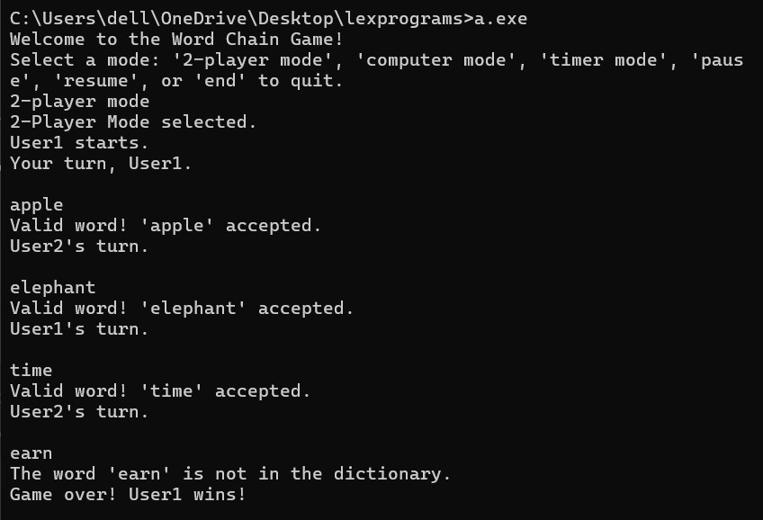
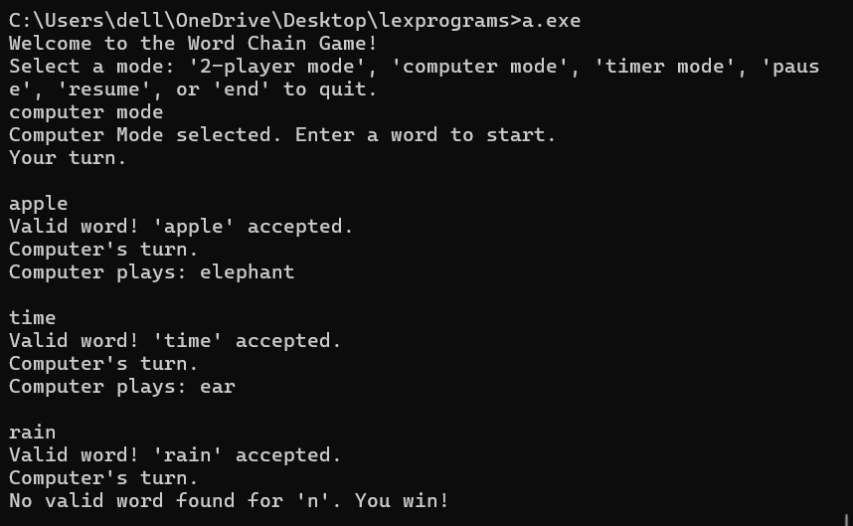
Code Snapshots Overview:
Lex File Structure:
Definitions Section: Regular expressions for tokens (words, commands).
Rules Section: Game modes and transitions (2-player mode, pause, resume).
State Handling: State-specific rules (<TWO_PLAYER>, <COMPUTER>).
C Integration:
Handles game logic: word validation, turn management, dictionary lookup.
Functions for specific modes and responses (e.g., computer-generated words).
Key Features:
Efficient input parsing and validation using Lex.
Seamless state transitions for managing game flow.
Modular design, combining Lex for parsing and C for logic
Codes :

Slide 4

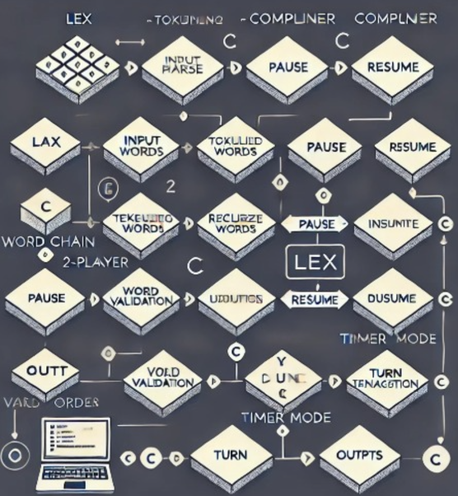
Vision
Code Flow Overview
How the Code Works:
Start: Game begins, waiting for user input (command or word).
Input Token: Lex identifies whether the input is a command (like switching mode, pause) or a word.
Command Handling:
If it's a command, it triggers actions like changing game modes or pausing/resuming the game.
Word Validation:
If it's a word, the game checks if it's valid (starting with the correct letter, not used before, exists in the dictionary).
Valid Word:
Adds the word to the used list and switches turns.
Invalid Word:
Declares the winner and ends the game.
End: Game ends either by winning/losing or via "end" command.
Lex handles token identification, allowing the game logic in C to focus on turn-taking, validation, and state management.

Slide 5
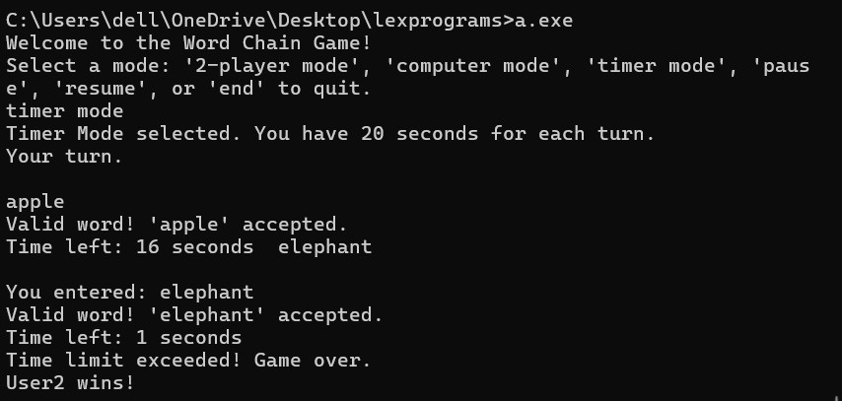
Home
Service
About Us
Contact
Code Breakdown
01
Check for Command or word:
The process_input function first checks if the input matches a predefined set of commands like "pause", "resume", or "end".
strcmp is used to compare the input string with the command string (e.g., "pause"). If they match, the appropriate action is taken.
Pause: Sets the paused flag to 1 and prints "Game paused".
Resume: Sets the paused flag to 0 and prints "Game resumed".
End: Prints "Game Over!" and exits the game.
Handling Word Input:
If the input is not a command, it's assumed to be a word, and the handle_word function is called.
02
Handling Word Input
The handle word function receives the expected starting letter and the input word.
to upper(word[0]) converts the first character of the word to uppercase, ensuring case-insensitive comparison.
The if statement checks if the expected letter (the last letter of the previous word) matches the first letter of the current word. If not, it prints an error message and exits the game.
Line of Code: if (expected_letter != '\0' && first_letter != toupper(expected_letter)) { ... }

Slide 6
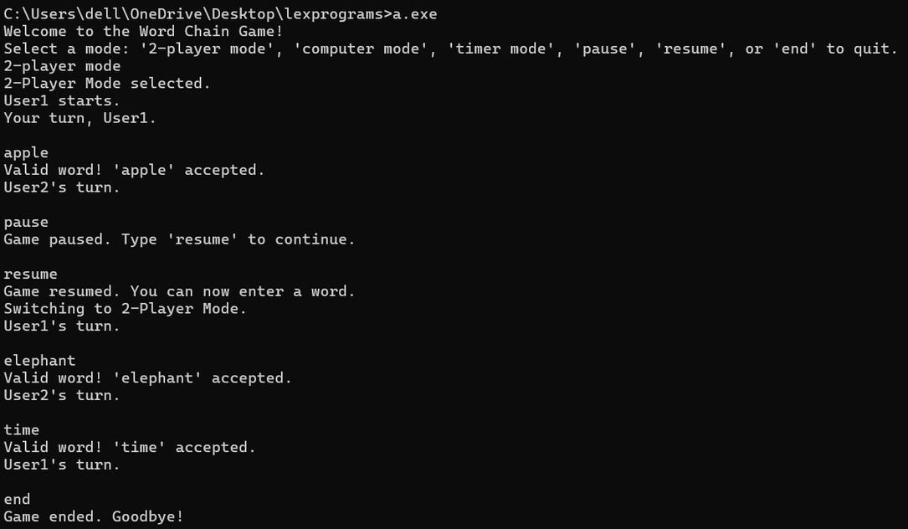
03
Handling Commands:
1. Pause Command
When the input matches "pause", the code checks if the game is already paused (paused flag).
If the game is already paused: It prints "Game is already paused." to notify the user.
If the game is not paused: It pauses the game by setting paused = 1 and prints "Game paused. Type 'resume' to continue.".
This ensures that the game state is paused correctly and gives the user feedback on whether the game is paused already.
2. Resume Command
When the input matches "resume", the code checks if the game is currently paused.
If the game is not paused: It prints "Game is already running.", indicating that the game is not in a paused state, so it can't be resumed.
If the game is paused: It resumes the game by setting paused = 0 and prints "Game resumed. Your turn, UserX.", where X is the current player (turn).
This ensures the game can only be resumed if it’s in a paused state and prevents errors like trying to resume a game that is already running.
3. End Command
When the input matches "end", the game is immediately terminated by printing "Game ended. Goodbye!" and using exit(0) to stop the program.
This is a way to quit the game cleanly and notify the player that the game has ended.

Slide 7
Word Validation and Adding to Used Words:
Word Validation and Adding to Used Words:
Expected Letter Check:
Handled by: handle_word()
Verifies if the entered word starts with the last letter of the previous word. If not, ends the game and declares the winner.
Check if Word Was Already Used:
Handled by: is_word_used()
Ensures no word is repeated in the game. If the word has been used, prompts the player to enter a new word.
Check if Word Exists in Dictionary:
Handled by: Dictionary lookup inside handle_word()
Validates the word against a predefined dictionary. If not found, the game ends and declares the current player as the loser.
Add Word to Used Words:
Handled by: add_used_word()
Adds the valid word to the list of used words to prevent future repetition.
Each function plays a specific role in ensuring valid gameplay, controlling word repetition, and confirming words from the dictionary.

Slide 8
Game Ending Logic :
End Game on Invalid Word:
Function: handle_word()
If the word does not start with the correct letter or is invalid, the game ends by calling exit(0) to stop the program and declare the winner.
End Game on Invalid Dictionary Word:
Function: handle_word()
If the word is not found in the dictionary, the game ends using exit(0).
End Game on Time Limit Exceeded (Timer Mode):
Function: handle_timer_mode()
If the time exceeds the TIME_LIMIT, the game ends with exit(0).
End Game on "end" Command:
Function: end
When the end command is typed, the game terminates using exit(0).
This handles the game termination in various situations by invoking the exit(0) function at the appropriate places.

Slide 9
Meet Our Team
CS22B1100 R.SHRINIDHI
CS22B1012 G.SATYA PRIYA
CS22B1017 K. SRI HARSHA PRIYA
CS22B1009 N.PRIYADARSHINI

Slide 10
Thank you!

