Slide 1
Automatic Evaluation of MathBERT Embeddings of Student’s Algebra Questions
.
CS22B1009 N.Priyadarshini
CS22B1012 G.Satya Priya

Slide 2
Agenda
Problem Statement
Data Description
Introduction
Objective
Literature survey
Methodology
Results and Analysis
Conclusion
References

Slide 3
Problem Statement:
Automate the process of evaluation of students’ open responses to high school level algebra problems.
Classification of answers to correct and incorrect using machine learning.
Data Description:
MathBERT embeddings of approximately 50 students’ response to 21 algebra questions.

Slide 4
Introduction
•Traditional hand-grading of written mathematical solutions can be time-consuming and laborious, especially for large classes.
• Immediate, detailed feedback on the answers which students have written will be given, so that teachers can evaluate the answer scripts in less time.
• There are many papers written on auto-Grading for MCQ questions but there are few papers published on evaluating descriptive answer scripts.
• Students' mathematical skills can't be improved by solving MCQ question whereas by conducting descriptive test skills of students get improved.

Slide 5
Objective:
Enhance Evaluation Efficiency : Reduce the manual effort and time required by educators for grading algebra responses.
Ensure Consistent Grading: Provide a standardized and unbiased approach to assessing student responses.
Promote Scalable Assessment: Enable evaluation of large volumes of student answers in a scalable manner.
Leverage Advanced NLP: Utilize MathBERT embeddings to understand mathematical language and concepts in student responses effectively.
Support Data-Driven Insights: Offer insights into common student mistakes and areas of difficulty to improve teaching strategies.

Slide 6
Literature Survey
S.No | Author(s) Name | Title | Inference | Research Gap
1. | Z. Wang, J. Liu and R. Dong | "Intelligent Auto-grading System," 2018 5th IEEE International Conference on Cloud Computing and Intelligence Systems (CCIS), Nanjing, China, 2018, pp. 430-435, doi: 10.1109/CCIS.2018.8691244 | The system could focus on automating and enhancing the grading process, potentially leveraging technologies like artificial intelligence, machine learning, or cloud computing to efficiently assess and grade assignments or assessments. This work might offer insights into the development and application of intelligent systems for automating educational assessment processes. | They only evaluate their model's effectiveness in a single convincing campaign. There models might not be as effective for other kinds of subjective questions. Therefore, in order to increase generalizability, our intelligent auto-grading systems should test and troubleshoot topics with unique formats.

Slide 7
S.No | Author(s) Name | Title | Inference | Research Gap
2 | R. V. Muddaluru, S. R. Thoguluva, S. Prabha, P. B. Pati and R. M. Balakrishnan | "Auto-grading C programming assignments with CodeBERT and Random Forest Regressor," 2023 14th International Conference on Computing Communication and Networking Technologies (ICCCNT), Delhi, India, 2023, pp. 1-6, doi: 10.1109/ICCCNT56998.2023.10308341. | The paper likely employs CodeBERT and Random Forest Regressor, leveraging machine learning for enhanced efficiency and accuracy in automating the grading of C programming assignments | They only worked on c programs, in future they can also work on other programming languages.

Slide 8
Methodolgy:
INPUT
MATHBERT
DATA PREPROCESSING
ML MODEL
RESULT ANALYSIS
FEATURE SELECTION

Slide 9
Data Set Description:
Dataset Consists of answers to 21 algebraic equation questions from approximately 50 students.
In our embeddings dataset we are having 1034 rows and 385 columns.

Slide 10
Preprocessing:
Duplicate Removal
Checked if there is any NULL values
Feature Extraction:
Using MathBERT we converted our dataset into embeddings.
Each instance is converted into a vector of size 385.

Slide 11
ML Models
Model Name | Hyper Parameters
K-NN Classifier | K=8 best
SVM Classsifier | 'C': 1, 'gamma': 0.1, 'kernel': 'rbf
Decision Tree | 'criterion': 'entropy', 'max_depth': 'max_features': 'sqrt', 'min_samples_leaf': 4, 'min_samples_split': 10
Random forest | 'bootstrap': False, 'max_depth': 30, 'min_samples_leaf': 2, 'min_samples_split': 10, 'n_estimators': 100

Slide 12
Feature Selection:
For feature selection, we used the Correlation Technique on the training set to identify relationships between features and the target variable.
Features with low correlation to the target or high correlation with each other were removed to eliminate redundancy and irrelevant data, helping to reduce the risk of overfitting(training set is greater than testing set).
After dropping unwanted features, all machine learning models were re-executed on both the training and testing sets.
This ensured improved efficiency, reduced complexity, and better generalization, leading to enhanced performance on unseen data.

Slide 13
Result and Analysis:
MODEL | TRAINING ACCURACY | TESTING ACCURACY | F1-SCORE | PRECISION | RECALL
KNN | 78.58% | 72.46% | 0.72 | 0.72 | 0.72
SVM | 76.54% | 78.26% | 0.74 | 0.77 | 0.78
DECISION TREE | 93.95% | 68.11% | 0.68 | 0.69 | 0.68
RF | 99.03% | 77.77% | 0.76 | 0.76 | 0.77

Slide 14
K – Fold Cross Validation:
Cross-validation is a technique used to evaluate the performance of a machine learning model and ensure it generalizes well to unseen data.
We performed 5-fold cross-validation to address overfitting and evaluate model performance.
Train the model on 5 folds and validate it on the remaining fold.
The dataset was split into 5 subsets, with each subset used once as the test set while the others formed the training set.
Mean accuracy and standard deviation across the folds were calculated to ensure reliable and generalized results.

Slide 15
Before Feature Selection:
Models | Accuracy |  | Precision |  | Recall |  | F1-Score
 | Mean | STD | Mean | STD | Mean | STD | Mean | STD
KNN | 0.73 | 0.02 | 0.71 | 0.02 | 0.73 | 0.02 | 0.71 | 0.02
SVM | 0.75 | 0.02 | 0.75 | 0.03 | 0.75 | 0.02 | 0.69 | 0.03
DECISION TREE | 0.66 | 0.04 | 0.66 | 0.05 | 0.66 | 0.04 | 0.66 | 0.01
RF | 0.73 | 0.02 | 0.72 | 0.01 | 0.74 | 0.01 | 0.71 | 0.01

Slide 16
From these metric values we can say that the SVM is the Good Model when compared to other models.​
Followed by RF, KNN, Decision Tree.​
We have also found feature selections by using correlation matrix.​
After that again we have found metric values for all the 4 models.​
And then we have written a complete metric table.

Slide 17
After Feature selection:
Models | Accuracy |  | Precision |  | Recall |  | F1-Score
 | Mean | STD | Mean | STD | Mean | STD | Mean | STD
KNN | 0.72 | 0.02 | 0.71 | 0.02 | 0.72 | 0.02 | 0.70 | 0.03
SVM | 0.74 | 0.02 | 0.73 | 0.03 | 0.74 | 0.02 | 0.71 | 0.02
DECISION TREE | 0.64 | 0.02 | 0.64 | 0.03 | 0.64 | 0.02 | 0.64 | 0.02
RF | 0.73 | 0.02 | 0.70 | 0.03 | 0.73 | 0.02 | 0.69 | 0.03

Slide 18
The comparison between metric values before feature selection and after feature selection, some of the metric values varied​
​
After the feature selection also SVM is the Good Model.​

Slide 19
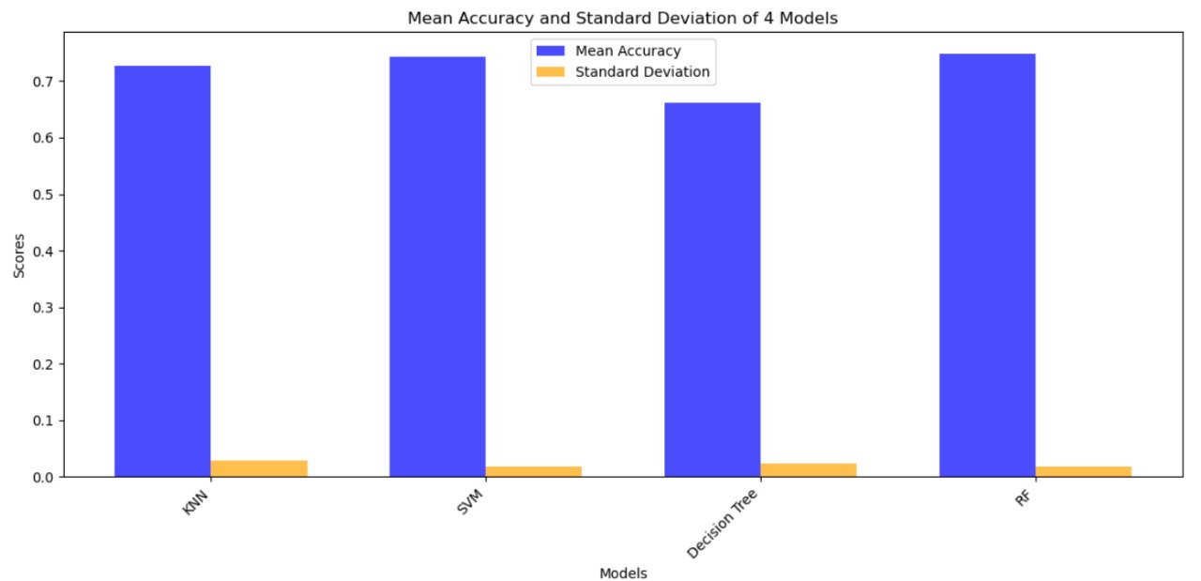
For the accuracy mean and standard Deviation We have done Bar plot:

Slide 20
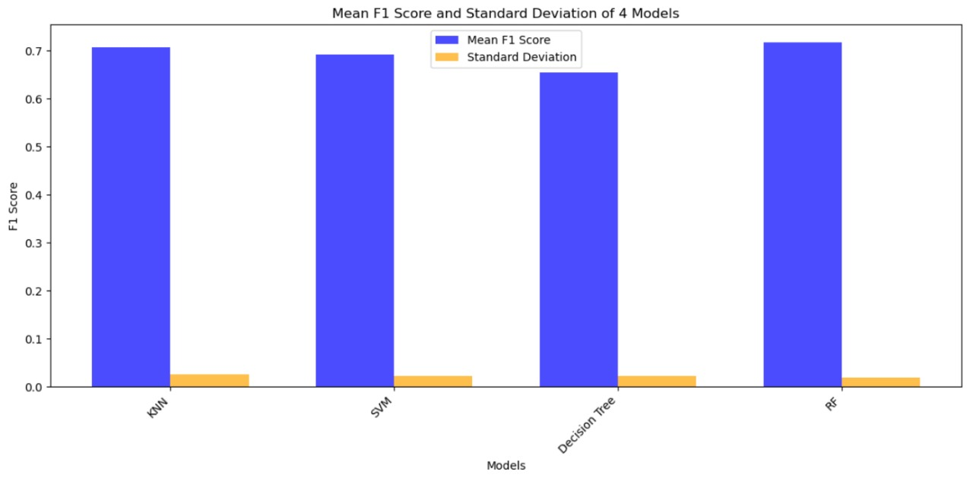
For the F1-score mean and standard Deviation We have done Bar plot:​​

Slide 21
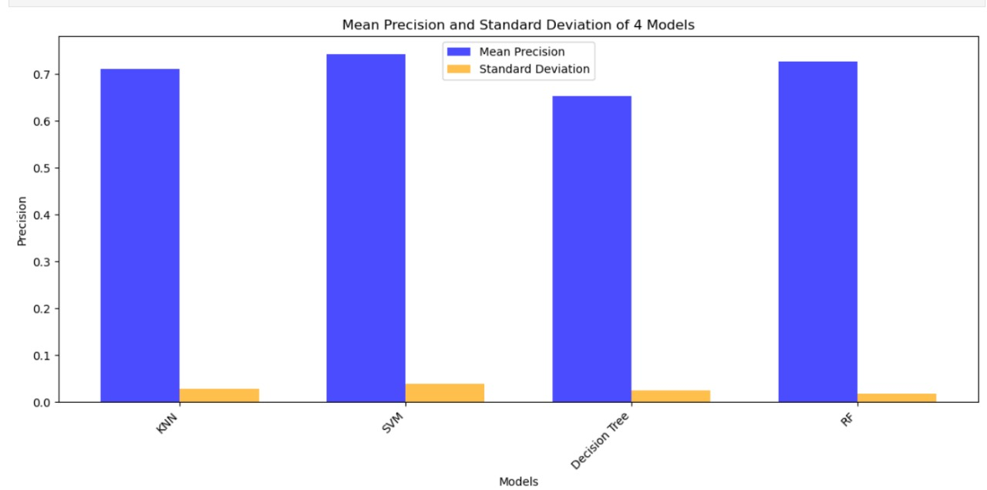
For the Precision mean and standard Deviation We have done Bar plot:​​

Slide 22
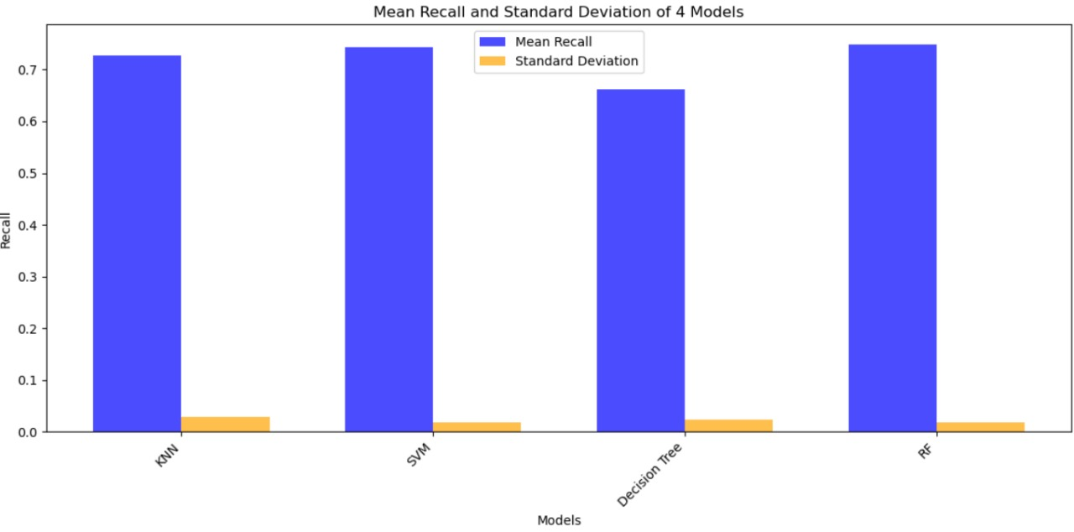
For the Recall mean and standard Deviation We have done Bar plot:​​

Slide 23
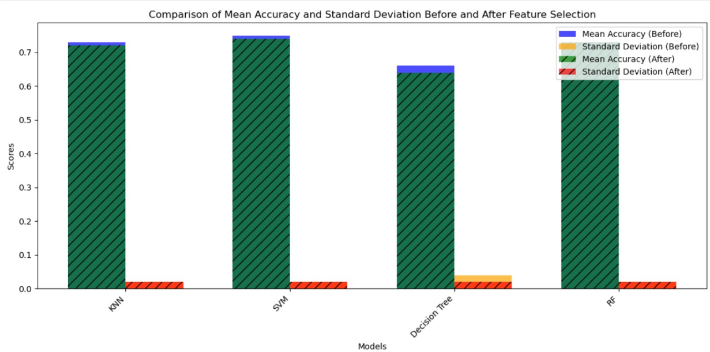
Analysis of the Results obtained before and after Feature Selection:
We found that the mean accuracy is slightly reduced after feature selection in almost all the ensemble models.
But the standard deviation is reduced which tells that the model behaves consistently after the highly correlated feature has been removed.

Slide 24
Conclusion:
In our project, we focused on classifying student’s responses to algebraic equations as correct or incorrect.
To improve the model's performance, we implemented advanced techniques such as hyperparameter tuning.
After performing feature selection to eliminate irrelevant and redundant data, the SVM model demonstrated the best accuracy, highlighting its effectiveness in this classification task.

Slide 25
Thank you !!!!!​

Slide 26
Appendix 1:
Explanation About MathBERT:
A language model specifically designed for natural language processing (NLP) in the context of teaching mathematics.
MathBERT is refined and improved to understand and produce mathematical language, equations, and expressions by utilizing BERT modifications.
MathBERT aims to improve natural language processing (NLP) particularly for mathematics education by concentrating on mathematical contexts.
This might lead to improvements in intelligent tutoring systems and educational technologies.

