Slide 1

Machine Learning
Zach Blanks
MIT 15.S64

Slide 3
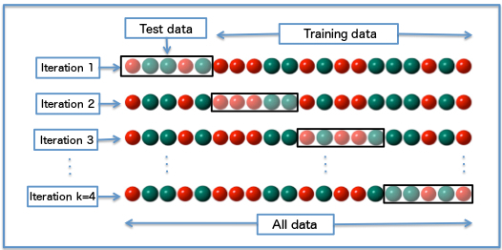
Cross-Validation

Slide 4
CART

Slide 5
CART

Slide 6
CART

Slide 7
CART

Slide 8
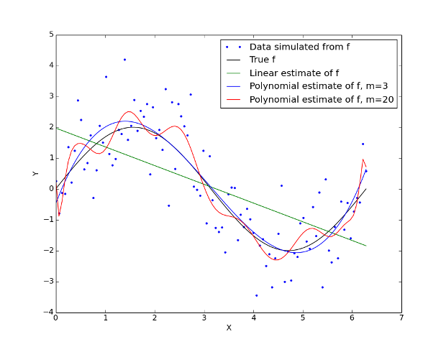
Bias-Variance Tradeoff

Slide 9
K-Means Clustering

