Slide 1

Exploring real estate prices in New York City
Wiktor Jakubowski
Mikołaj Gałkowski
Hubert Bujakowski
Łukasz Tomaszewski

Slide 2

Problem
Optimal marketplace prices in Technopolis cities
Trying to increase peoples awareness of possible exploits
2-sided approach – customer and real estate agent point of view

Slide 3

Concept
Train advanced machine learning model predicting real estate prices in New York City
Create Web Application for both buyers and sellers:
Customers – anti-exploit app providing comparative real state prices nearby
Real Estate Agents – database providing valueable insight into house market prices

Slide 4
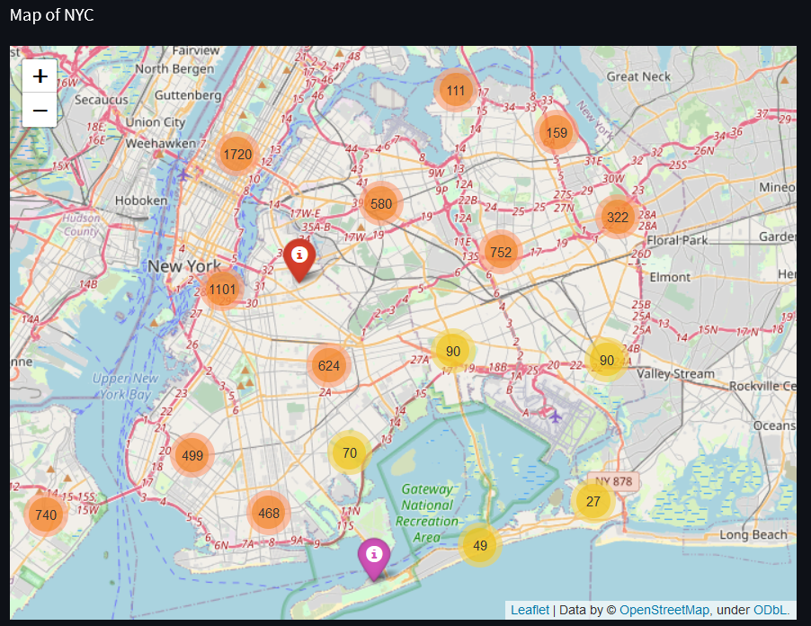
Solution
Visualizing the map of NYC
Show the possible real estates to buy
Compare the actual price scrapped from the Internet and the prices evaluated by our model

Slide 5
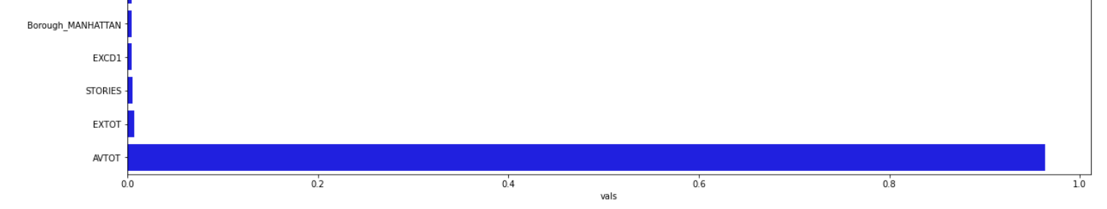
Conclusions
LEAST IMPORTANT | MOST IMPORTANT
Building class | Actual Total Value
Tax class | Number of storeys
Year of construction | Borough
Feature Importance Chart

Slide 6

Results
Used algorithm – Random Forest Regressor
Best model before HPO MAE was around 120k $
Final model MAE was 100k $ (8% of avg property price)
Model used in application in order to predict value of a customer's desired property

