Slide 1
Between the Lines
Majo Argote | Gal·la Gelpi | Cherryl Chico
Introduction to Text Mining & NLP | March 2026

Slide 2
RESEARCH QUESTION
How has the perception of men and women in the U.S. changed over
the past 25 years?
Notes:
Our question: how has perception changed? Two hypotheses with equations. Don't reveal results yet — the question comes first.

Slide 3
OUR CLAIM
The gap between how men's
and women's lives are narrated
is narrowing.
H1 Convergence
H2 Drivers
Descriptions of men and women in
obituaries are converging over time
Convergence driven especially by
career/profession and family/lifestyle
CosineSim(Mₜ, Fₜ) = α + β₁·Yearₜ + εₜ
Yᵢ = β₀ + β₁Fᵢ + Σγₜ·Dₜ + Σδₜ·(Fᵢ×Dₜ) + εᵢ

Slide 4
OUR CORPUS
Text data inventory.
obituaries
time span
coverage
~240K
2001–2025
US-wide
Raw Variables
Derived / Extracted
Full text, publication date, name, location
Gender (M/F) — first name + relational terms
Age at death — extracted from text
text_clean — lemmatized, names removed
4 thematic density scores per document
TF-IDF vectors per year × gender

Slide 5
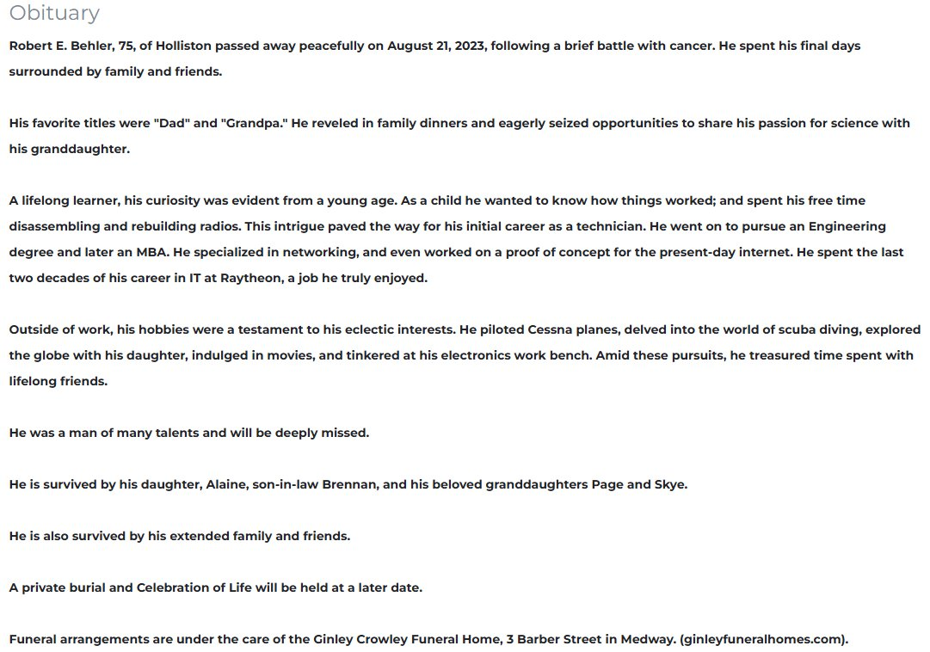
WHY OBITUARIES?
Obituaries are unguarded reflections of what
a life meant.
01
Unfiltered
Writer is not performing for a researcher — bypasses social desirability bias
02
Structured Genre
Consistent template: family, career, hobbies, faith — comparable across time
03
Dual Authorship
Captures what society, via the writer, thinks is important at the time of writing
Grimm 2010; Fowler 2007; Hume 2000
Notes:
VOICEOVER MOTIVATION: The world feels more divided than ever. But is it? Surveys tell us what people think they should say — social desirability bias obscures real values. Families and communities choose what to highlight in obituaries — these choices give us a trace of what society values. That's why obituaries are better than surveys: unfiltered, structured genre, dual authorship.

Slide 6
METHODOLOGY
A sequential analytical pipeline.
1
Scraping
2
Preprocessing
3
EDA
~240K obituaries
currentobituary.com
→
Clean, classify gender,
lemmatize, remove names
→
Distributions, genre
structure validation
Steps 1–3 form the foundation for both hypotheses
4a H1 — Overall Convergence
4b H2 — Domain Drivers
TF-IDF → centroids → cosine similarity → OLS
→
Dictionary density + Female × Year interactions
CosineSim = α + β₁·Year + ε
Y = β₀ + β₁F + Σγₜ·Dₜ + Σδₜ·(F×Dₜ) + ε

Slide 7
PREPROCESSING
How we turn raw text into structured data.
Sample Obituary
Pipeline Steps
Robert E. Behler, 75
of Holliston passed away peacefully on August 21, 2023.
His favorite titles were "Dad" and "Grandpa." He reveled in family dinners and seized opportunities to share his passion for science with his granddaughter.
A lifelong learner... He went on to pursue an Engineering degree and later an MBA. He spent the last two decades of his career in IT at Raytheon.
He piloted Cessna planes, delved into scuba diving, explored the globe with his daughter, and tinkered at his electronics work bench.
He is survived by his daughter, Alaine, son-in-law Brennan, and his beloved granddaughters Page and Skye.
✕
Remove names, dates, places
✕
Strip memorial/funeral details
◆
Classify gender (name + relational terms)
◆
Lemmatize text, remove stop words
●
Detect thematic terms via dictionaries
●
Compute TF-IDF vectors per year × gender
● Family ● Professional ● Lifestyle

Slide 8
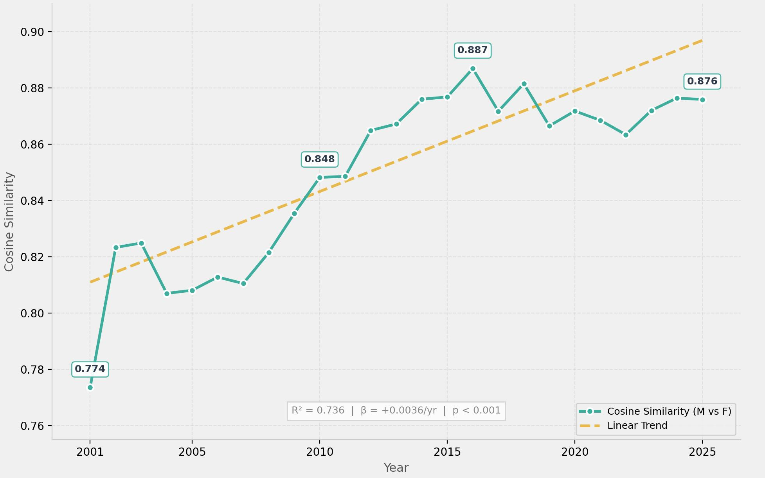
FINDING 1
The language gap is closing.
How we got here
After preprocessing, for each year:
Fit year-specific TF-IDF vectorizer
Create male and female centroid vectors (mean DTM)
Compute cosine similarity between centroids
Regress similarity scores on year (OLS)
R² = 0.736
p < 0.001
74% explained
Significant
25 years | F = 64.11 | β₁ = +0.0036/yr
Cosine similarity rose from 0.774 in 2001 to 0.876 in 2025 — a steady, significant convergence.
Notes:
After preprocessing: TF-IDF per year, male/female centroids, cosine similarity. Result: 0.77→0.88, R²=0.741, p<0.001. Year explains 74% of variance.

Slide 9
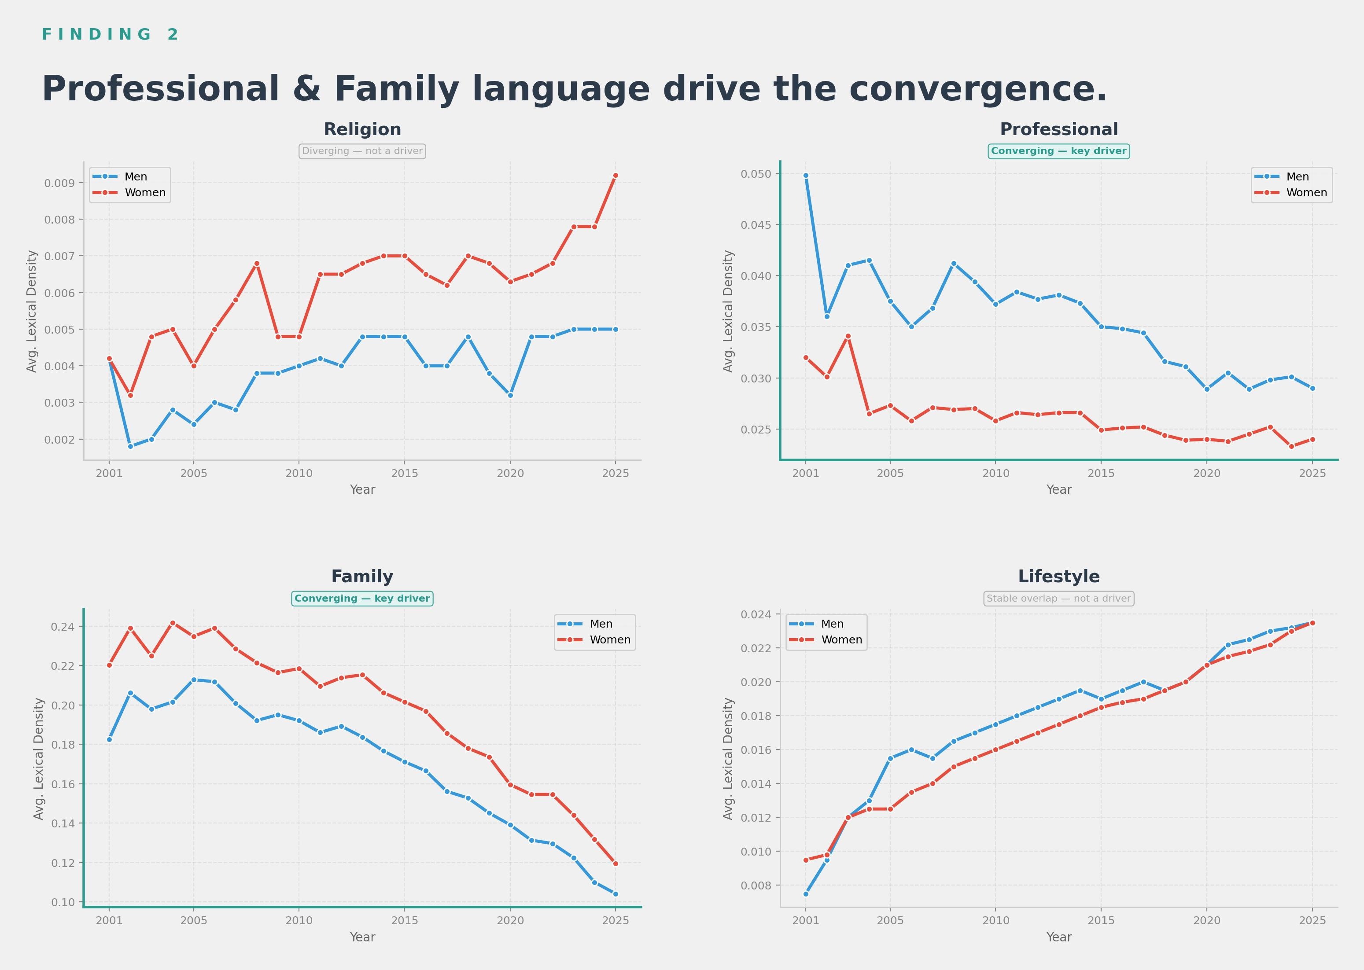
FINDING 2
Not all themes converge equally.
Dictionary-based lexical density, min age 70

Slide 10
NEXT STEPS
Where we go from here.
1
Refine Dictionary Lexicons
Validate theme-based word lists using LDA topic outputs from the full corpus to ensure comprehensive coverage.
2
Further Refine H2 Regression
Run regressions with obituary-year fixed effects.
3
Finalize Paper & Visualizations
Polish charts for the final report, strengthen integration between motivation, theory, and findings.
4

Slide 11
Between the Lines
Thank you. Questions?

Slide 12
APPENDIX A1
Data & Scraping Sources
SO WHAT: Corpus credibility: ~240K obituaries from a US-wide aggregator ensures geographic and temporal breadth.
Source: currentobituary.com (US-wide obituary aggregator) Web scraper — no API available. Each record contains: • Full obituary text • Publication date • Name of deceased • Location (city, state)
Sample raw record structure
{ "name": "Robert E. Behler", "date": "2023-08-21", "location": "Holliston, MA", "text": "Robert E. Behler, 75, of Holliston passed away peacefully on August 21..." }

Slide 13
APPENDIX A2
Preprocessing Technical Details
SO WHAT: Removing names, dates, and memorial details prevents genre noise from dominating the signal.
Pipeline steps: 1. HTML/special character cleaning 2. Name removal (prevents gender leakage) 3. Age extraction from text 4. Gender classification: name-based + relational term validation 5. Memorial detail removal: funeral logistics inflated religion scores 6. Lemmatization + stop word removal
Before → After example
BEFORE: "Robert E. Behler, 75, of Holliston passed away peacefully on Aug 21, 2023. Funeral services will be held at St. Mary's Church on Friday." AFTER: "pass away peacefully work engineer degree MBA career raytheon pilot cessna dive explore globe daughter survive"

Slide 14
APPENDIX A3
Assumptions + COVID Diagnostics
SO WHAT: Min-age-70 filter ensures comparable life arcs. COVID spike visible but does not break the trend.
Key assumption: Death is approximately random across gender within each year. COVID 2020–2021: • Male mortality disproportionately higher • Visible as dip in similarity scores • Does not break the overall 25-year trend Filter: min age 70 at death → ensures full life arcs are compared
COVID dip in convergence plot
Year Similarity 2018 0.882 2019 0.867 ← pre-COVID 2020 0.872 ← COVID 2021 0.869 ← COVID 2022 0.863 ← recovery 2023 0.872 ← bounce back Dip is small (~1.5%) and temporary. Trend resumes post-2022.

Slide 15
APPENDIX A4
Category Model & Dictionary Documentation
SO WHAT: Concrete, observable terms avoid subjectivity. Validated against Empath and expert review.
Religion (33 terms): church, faith, god, jesus, christ, lord, pastor, priest, bible, prayer... Professional (42 terms): career, retired, worked, professor, engineer, manager, business, degree... Family (31 terms): family, mother, father, daughter, husband, wife, survived, children... Lifestyle (40 terms): travel, hiking, golf, gardening, music, cooking, photography...
Validation approach
3-step validation: 1. Empath cross-check: Pre-trained ~200 categories mapped to our 4 pillars 2. Expert review: Manual scan of top TF-IDF terms per gender per decade 3. Concrete terms only: Observable words, not sentiment or inference

Slide 16
APPENDIX A5
"Why Not LDA?" Comparison
SO WHAT: Short documents + genre-dominated vocab make LDA unreliable. Dictionaries give interpretable, stable results.
LDA limitations for obituaries: 1. Short docs (150–300 words) → unreliable topic distributions 2. Incoherent topics: LDA mixed military, family, memorial into single topics 3. Genre vocabulary dominance: "brother", "sister", "wife" appeared in nearly every topic 4. Low coherence scores across k = 5, 10, 15, 20 topic models
Dictionary advantages
Why dictionaries work better: ✓ Interpretable by design (we know exactly what each category measures) ✓ Stable across years (same vocabulary, comparable density scores) ✓ Validated externally (Empath + expert review) ✓ Genre-aware (memorial terms excluded)

Slide 17
APPENDIX A6
Full Regression Specs & Coefficients
SO WHAT: H1 confirmed: year alone explains 74% of convergence. H2: Professional gap shrank from -0.018 to -0.005.
H1: CosineSim = α + β₁·Year + ε R² = 0.736 | Adj R² = 0.724 F = 64.11 | p < 0.001 const = -6.353 (se=0.900) β₁ = +0.0036 (se=0.000) H2 Professional: β₁(Female) = -0.0178 (p=0.001) δ₂₀₂₅(F×2025) = +0.0128 (p=0.025) Remaining gap: ~-0.005
H2 Family regression
H2 Family: β₁(Female) = +0.0378 (p=0.032) Interaction trend: δ₂₀₁₃ = -0.0062 δ₂₀₁₈ = -0.0157 δ₂₀₂₅ = -0.0225 Remaining gap in 2025: 0.0378 - 0.0225 = 0.0153 Family gap halved but persists (consistent with genre norms)

Slide 18
APPENDIX A7
Early EDA & Discarded Approaches
SO WHAT: Obituary length and age distributions are stable across gender, confirming comparability.
EDA confirmed: • Obituary length: comparable across genders (median ~200 words) • Age-at-death: similar distributions after min-70 filter • Gender ratio: roughly 50/50 across all years • Geographic spread: all 50 states represented
Discarded approaches
What we tried and dropped: ✕ N-gram analysis: Too noisy, no clear signal ✕ Sentiment analysis: Too coarse for this genre (obituaries are uniformly positive) ✕ Word embeddings (Word2Vec): Corpus too small per year for reliable year-specific models ✕ Raw word counts: Document length confounded results

Slide 19
APPENDIX A8
Stanford Empath Robustness Check
SO WHAT: Empath's pre-trained categories confirm our dictionary trends, ruling out coding-choice artifacts.
Empath: pre-trained lexicon model ~200 categories via word embeddings (Fast et al., 2016) Mapping to our 4 pillars: • Religion → "religion", "worship" • Professional → "work", "business" • Family → "family", "wedding" • Lifestyle → "leisure", "sports" Result: directional trends match our custom dictionaries
Empath vs Dictionary comparison
Theme Dict Empath ───────────────────────── Professional ✓ ↓gap ✓ ↓gap Lifestyle ✓ ↑both ✓ ↑both Family ✓ ↓slow ✓ ↓slow Religion ✓ flat ✓ flat All 4 directions confirmed. Magnitudes differ slightly (Empath categories are broader) but convergence pattern holds.

