Slide 1
Between the Lines
How gender perception has evolved
in US obituaries over 25 years
Majo Argote | Cherryl Chico | Gal.la Gelpi
Introduction to Text Mining & NLP | March 2026

Slide 2
RESEARCH QUESTION
How has the
perception gap
between men
and women
changed in the
past 25 years?
0.77 → 0.88
cosine similarity
2001 vs 2025
Preliminary evidence
of convergence

Slide 3
THE PROBLEM
Surveys tell us what people think they
should say.
This is the social desirability bias and it obscures how values actually evolve.
When surveys ask "What matters most to you?” people filter their answers through social expectations….
Source: Social desirability bias in survey research — Grimm (2010)

Slide 4
OUR DATA
Obituaries are unguarded
reflections of what
a life meant.
obituaries
~240K
time span
The writer is not performing for a researcher, they are memorializing a real human life.
Obituaries = less filtered window into actual cultural values.
2001–2025
geographic coverage
US-wide

Slide 5


ASSUMPTIONS
Obituaries capture two voices at once.
The Deceased's Life
The Writer's Values
The actual achievements, relationships, and milestones that defined someone's time on earth.
The cultural expectations of the present moment — what the writer thinks makes a life worth celebrating.
This dual authorship is not a limitation — it IS the phenomenon we study.

Slide 6
OUR CLAIM
The gap between how men's
and women's lives are narrated
is narrowing.

Slide 7
HYPOTHESES
Hypotheses.
H1
H2
Overall Convergence
Theme-Specific Patterns
The language used to describe men and women in obituaries is becoming more similar over time.
Convergence is not uniform — Professional and Lifestyle themes converge faster than Family and Religion.

Slide 8



METHODOLOGY
A three-step analytical pipeline.
01
02
03
Descriptive
Analysis
Dictionary
Analysis
Regression
Analysis
Corpus overview, summary statistics, obituary length & gender distribution across time.
Theme-based lexicons (Family, Professional, Religion, Lifestyle) measure lexical density by gender × year.
TF-IDF cosine similarity + OLS regression to measure and test convergence trend (year fixed effects).
Minimum age filter: 70 years | Lemmatized text

Slide 9
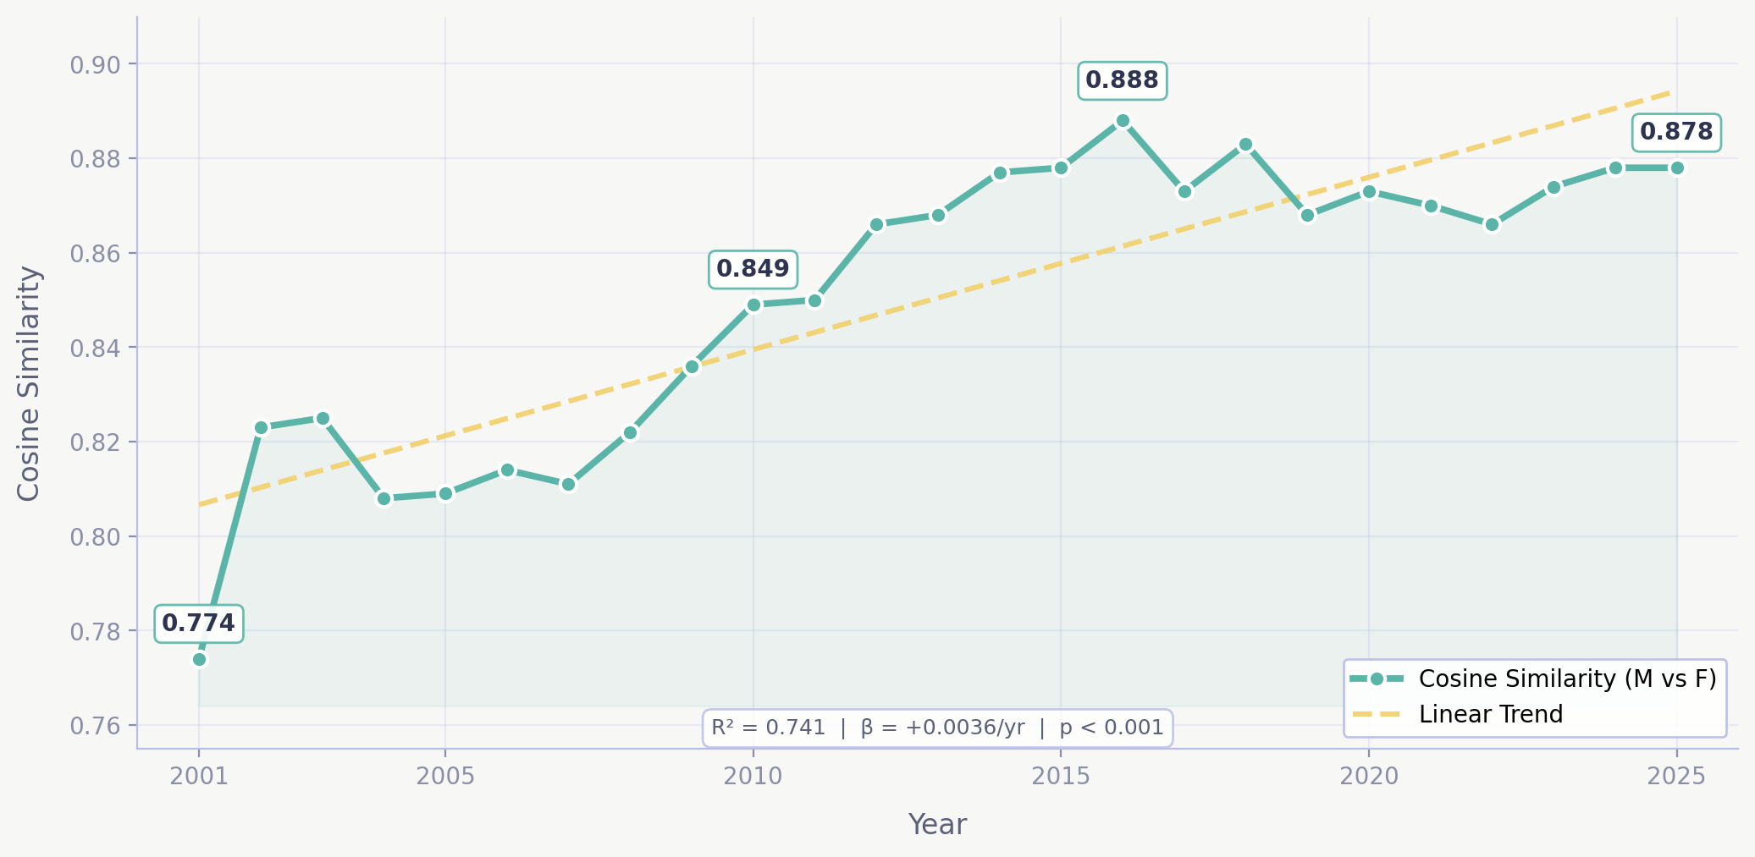
FINDING 1
The language gap is closing.
Cosine Similarity: Male vs Female Obituary Language
2001–2025 with regression trend line
R² = 0.741
Year alone explains 74% of
the variance in similarity
p < 0.001
Statistically significant
upward trend (coef = 0.0036)
Cosine similarity rose from 0.77 in 2001 to 0.88 in 2025 — a steady, significant convergence.

Slide 10
FINDING 1 | DEEP DIVE
Time explains the convergence.
OLS Regression Results: Cosine Similarity ~ Year
Variable
Coefficient
Std Error
t-stat
p-value
Intercept (const)
-6.4558
0.900
-7.170
< 0.001
Year (x₁)
+0.0036
0.000
8.114
< 0.001
Model: R² = 0.741 | Adj. R² = 0.730 | F-stat = 65.84 | N = 25 years
Each passing year increases the cosine similarity by 0.36 percentage points.

Slide 11
FINDING 2
Not all themes converge equally.
Professional
Lifestyle
Career, education, and military terms show convergence — women's professional lives are increasingly celebrated.
Hobbies, travel, and interests are described more similarly across genders over time.
Family
Religion
Family language remains gendered — motherhood and fatherhood are still narrated differently.
Religious language shows the least change — spiritual vocabulary remains relatively stable by gender.
Dictionary-based lexical density analysis by gender × year (min age: 70)

Slide 12
FINDING 2 | THEME TRENDS
Longitudinal thematic convergence.
[CHART: Professional]
Male vs Female lexical density (2001–2025)
[CHART: Lifestyle]
Male vs Female lexical density (2001–2025)
[CHART: Family]
Male vs Female lexical density (2001–2025)
[CHART: Religion]
Male vs Female lexical density (2001–2025)
Male (blue line) | Female (red line) | Converging = lines moving closer together

Slide 13
SO WHAT
The traditional linguistic
boundaries are eroding.
But some boundaries
persist.
This is not just a data pattern — it reflects a genuine societal shift toward a more unified view of what makes a life worth celebrating, regardless of gender.
Family and Religion remain gendered domains — motherhood and fatherhood are still narrated through different lenses. The convergence is real, but it's uneven.

Slide 14
NEXT STEPS
Where we go from here.
1
Refine Dictionary Lexicons
Validate theme-based word lists using LDA topic outputs from the full corpus to ensure comprehensive coverage.
2
Test Writer-Era Effect (H3)
Run regressions with obituary-year fixed effects to disentangle the writer's era from the deceased's generation.
3
Finalize Paper & Visualizations
Polish charts for the final report, strengthen integration between motivation, theory, and findings.
4

Slide 15
Between the Lines
The words we choose to remember the dead
reveal how the living see the world.
Thank you. Questions?

