Slide 1
Between the Lines
Majo Argote | Gal·la Gelpi | Cherryl Chico
Introduction to Text Mining & NLP | March 2026

Slide 2
RESEARCH QUESTION
How has the perception of men and women in the U.S. changed over
the past 25 years?
Notes:
Our question: how has perception changed? Two hypotheses with equations. Don't reveal results yet — the question comes first.

Slide 3
OUR CLAIM
The gap between how men's
and women's lives are narrated
is narrowing.
H1 Convergence
H2 Drivers
Descriptions of men and women in
obituaries are converging over time
Convergence driven especially by
career/profession and family/lifestyle
CosineSim(Mₜ, Fₜ) = α + β₁·Yearₜ + εₜ
Yᵢ = β₀ + β₁Fᵢ + Σγₜ·Dₜ + Σδₜ·(Fᵢ×Dₜ) + εᵢ

Slide 4
OUR CORPUS
Text data inventory.
obituaries
time span
coverage
~240K
2001–2025
US-wide
Raw Variables
Derived / Extracted
Full text, publication date, name, location
Gender (M/F) — first name + relational terms
Age at death — extracted from text
text_clean — lemmatized, names removed
4 thematic density scores per document
TF-IDF vectors per year × gender
Key filter: Minimum age 70 at death — ensures comparable life arcs

Slide 5
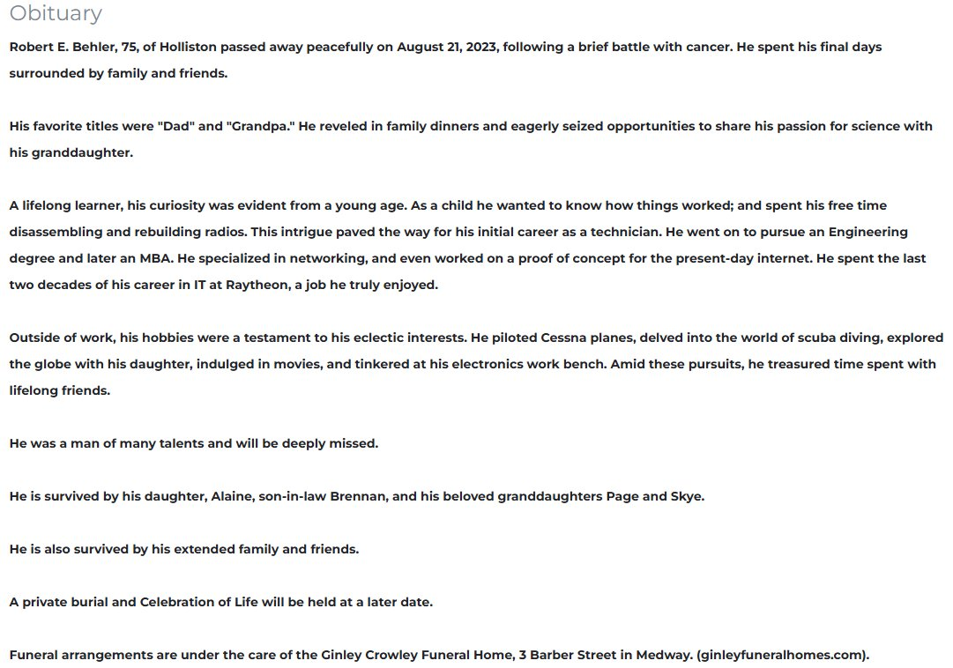
WHY OBITUARIES?
Obituaries are unguarded reflections of what
a life meant.
01
Unfiltered
Writer is not performing for a researcher — bypasses social desirability bias
02
Structured Genre
Consistent template: family, career, hobbies, faith — comparable across time
03
Dual Authorship
Captures what society, via the writer, thinks is important at the time of writing
Grimm 2010; Fowler 2007; Hume 2000
Notes:
VOICEOVER MOTIVATION: The world feels more divided than ever. But is it? Surveys tell us what people think they should say — social desirability bias obscures real values. Families and communities choose what to highlight in obituaries — these choices give us a trace of what society values. That's why obituaries are better than surveys: unfiltered, structured genre, dual authorship.

Slide 6
METHODOLOGY
A sequential analytical pipeline.
1
Scraping
2
Preprocessing
3
EDA
~240K obituaries
currentobituary.com
→
Clean, classify gender,
lemmatize, remove names
→
Distributions, genre
structure validation
Steps 1–3 form the foundation for both hypotheses
4a H1 — Overall Convergence
4b H2 — Domain Drivers
TF-IDF → centroids → cosine similarity → OLS
→
Dictionary density + Female × Year interactions
CosineSim = α + β₁·Year + ε
Y = β₀ + β₁F + Σγₜ·Dₜ + Σδₜ·(F×Dₜ) + ε

Slide 7
PREPROCESSING
How we turn raw text into structured data.
Sample Obituary
Pipeline Steps
Robert E. Behler, 75
of Holliston passed away peacefully on August 21, 2023.
His favorite titles were "Dad" and "Grandpa." He reveled in family dinners and seized opportunities to share his passion for science with his granddaughter.
A lifelong learner... He went on to pursue an Engineering degree and later an MBA. He spent the last two decades of his career in IT at Raytheon.
He piloted Cessna planes, delved into scuba diving, explored the globe with his daughter, and tinkered at his electronics work bench.
He is survived by his daughter, Alaine, son-in-law Brennan, and his beloved granddaughters Page and Skye.
✕
Remove names, dates, places
✕
Strip memorial/funeral details
◆
Classify gender (name + relational terms)
◆
Lemmatize text, remove stop words
●
Detect thematic terms via dictionaries
●
Compute TF-IDF vectors per year × gender
● Family ● Professional ● Lifestyle

Slide 8
FINDING 1
The language gap is closing.
How we got here
After preprocessing, for each year:
1. Fit year-specific TF-IDF vectorizer
2. Create male and female centroid vectors (mean DTM)
3. Compute cosine similarity between centroids
4. Regress similarity scores on year (OLS)
R² = 0.741
p < 0.001
74% explained
Significant
Cosine similarity rose from 0.77 in 2001 to 0.88 in 2025 — a steady, significant convergence.
Notes:
After preprocessing: TF-IDF per year, male/female centroids, cosine similarity. Result: 0.77→0.88, R²=0.741, p<0.001. Year explains 74% of variance.

Slide 9
FINDING 2
Not all themes converge equally.
How we got here
Built 4 thematic dictionaries:
Family, Professional, Religion, Lifestyle
1. Compute lexical density per document per theme
2. Pool both genders, add year dummies
3. Add Female × Year interaction terms
4. OLS regression per domain
Male = omitted category, 2001 = base year
Professional:
NARROWING
Lifestyle:
CONVERGING
Family:
PERSISTENT
Religion:
STICKY
● Male ● Female | Lexical density by gender × year

Slide 10
NEXT STEPS
Where we go from here.
1
Refine Dictionary Lexicons
Validate theme-based word lists using LDA topic outputs from the full corpus to ensure comprehensive coverage.
2
Further Refine H2 Regression
Run regressions with obituary-year fixed effects.
3
Finalize Paper & Visualizations
Polish charts for the final report, strengthen integration between motivation, theory, and findings.
4

Slide 11
Between the Lines
The words we choose to remember the dead
reveal how the living see the world.
Thank you. Questions?

Slide 12
APPENDIX A1
Data & Scraping Sources
Source: currentobituary.com (US-wide aggregator)
Web scraper — no API. Each record: full text, date, name, location
[PLACEHOLDER: Screenshot of source website]
[PLACEHOLDER: Sample raw record JSON/CSV]

Slide 13
APPENDIX A2
Preprocessing Technical Details
HTML/special character cleaning → name removal → age extraction
Gender classification: name-based + relational term validation
Memorial detail removal: funeral logistics inflated religion scores
[PLACEHOLDER: Before/after code snippet of raw vs. cleaned text]

Slide 14
APPENDIX A3
Assumptions + COVID Diagnostics
Assumption: death is random across gender within each year
COVID 2020–2021: male mortality disproportionately higher
[PLACEHOLDER: Age distribution plot by gender over time]
[PLACEHOLDER: Gender ratio per year chart]

Slide 15
APPENDIX A4
Category Model & Dictionary Documentation
Religion (33), Professional (31), Family (31), Lifestyle (40 terms)
[PLACEHOLDER: Full dictionary term lists as table]
Validation: (1) Empath check (2) expert review (3) concrete terms

Slide 16
APPENDIX A5
"Why Not LDA?" Comparison
Short docs (150–300 words) → unreliable topic distributions
Incoherent topics: LDA mixed military, family, memorial
Genre vocabulary dominance: brother, sister, wife in every topic
[PLACEHOLDER: LDA coherence scores comparison]

Slide 17
APPENDIX A6
Full Regression Specs & Coefficient Tables
H1: CosineSim = α + β₁·Year + ε
[PLACEHOLDER: Full OLS summary table for H1]
H2: Y = β₀ + β₁·Female + Σγₜ·D(Year=t) + Σδₜ·(F×D(Year=t)) + ε
[PLACEHOLDER: Coefficient tables for all 4 domains]

Slide 18
APPENDIX A7
Early EDA & Discarded Approaches
[PLACEHOLDER: Obituary length distribution by gender over time]
[PLACEHOLDER: Age-at-death distribution confirming min-70 filter]
Discarded: n-gram approaches, sentiment analysis (too coarse)

Slide 19
APPENDIX A8
Stanford Empath Robustness Check
Pre-trained model: ~200 categories via word embeddings
[PLACEHOLDER: Empath category mapping to our 4 pillars]
[PLACEHOLDER: Empath vs. dictionary trend comparison]

