Slide 2
Goal
Take Distil aggregate data from S3
For DDOS days (Dec. 20 – 22, 2013) take aggregate country and time violations.
Aggregate data via parallel algorithm.
Identify a cluster of correlated offenders.

Slide 3
Technology
IPython Notebooks for development, analysis and testing.
Boto for accessing S3 data.
Pandas for text file processing and aggregation.
Scipy for calculating correlation matrix of timeseries.
Sklearn for correlation clustering.

Slide 4
Architecture
List of Files
~270 log files for 3 days of attacks.
Each log file has subset of all countries and hours
…
Country/Hour Sums
Country/Hour Sums
Country/Hour Sums
Populate Country/Hour violations table
 | 0 | 1 | 2 | 3 | 4 |  | … |  | 24
DE | 12 | 2 | 4 | 6 | 0 |  |  |  | 2
FR | 100 | 234 | 45 | 14
TT

Slide 5

Correlate Timeseries Data
For each country pair, compute the Pearson correlation coefficient.
Combine into correlation matrix of size NxN where N is the total number of countries in the datatset. Matrix element i,j is the correlation between country i and country j’s traffic.

Slide 6
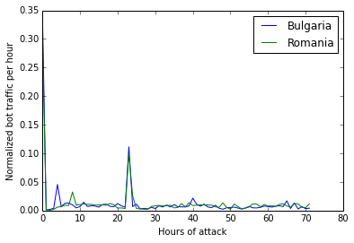
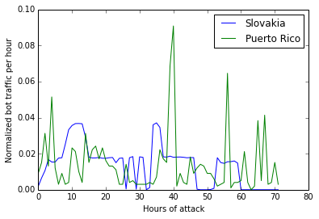
Example
Correlation between Bulgaria and Romania is 0.984246615926
Correlation between Slovakia and Puerto Rico is 0.08119
High correlation
No correlation

Slide 7
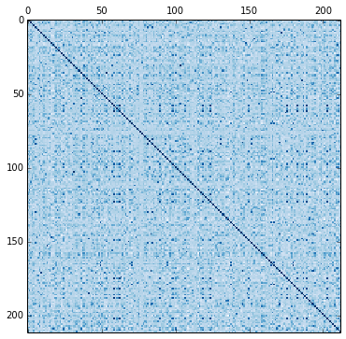
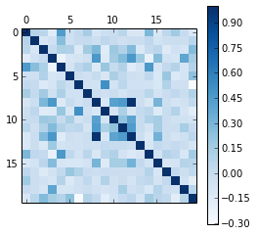
Correlation Matrix Example
Bulgaria’
Burkina Faso
Belgium
Bangladesh
Romania
'Belgium’
'Burkina Faso’
'Bulgaria’
Bulgaria is highly correlated with Romania, but not Bangladesh. It is also correlated with Belgium and Burkina Faso (?).

Slide 8
Cluster The Correlation Matrix
Tried various methods:
Biclustering
Ward heirarchical clustering
Ward produced most reasonable results.
Both are implemented in sklearn
Ultimately I’d like to try many options and use the union of the generated sets.
Notes:
http://en.wikipedia.org/wiki/Ward%27s_method

Slide 9
Top 25 Offending Countries
Philippines
Mexico
Hong Kong
Australia
Indonesia
Brazil
Japan
Korea, Republic of
India
Portugal
Spain
Ukraine
France
Canada
China
Singapore
Malaysia
Slovakia
Virgin Islands, British
Netherlands
Norway
Russian Federation
Germany
United Kingdom
United States
These countries generated the most violations during the 72 hour window in question. These aren’t necessarily the countries that move as a cohort, though.

Slide 10
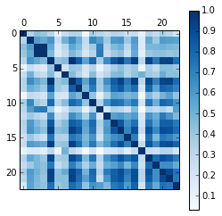
Correlated Countries
Trinidad and Tobago
Lithuania
Germany
Russian Federation
Romania
Belgium
Burkina Faso
Bulgaria
Switzerland
Czech Republic
Cyprus
Costa Rica
Latvia
Poland
Italy
Austria
Norway
Niger
France
Finland
Hungary
Slovenia
Sweden
Correlation Matrix for Offenders

Slide 11
Alternative Methods
Choose n highest traffic offenders.
Choose n highest traffic offenders and select highest correlated countries to these.
Cluster the correlation matrix a different way DBSCAN, modified k-means, spectral clustering
Graph methods
Window based correlation

Slide 12
Conclusion

