Slide 1
Django, part 1
Jean-Matthieu Gallard, 09/04/15, TUM

Slide 2
Overview
Python
Django
MVC
Overview & starting from scratch
Model
Fields & X-to-X relationships
Model API
Controller
In-depth example & ModelForm
Routing with urls.py
View
Template syntax
Templates settings & static files
Admin-site & User model

Slide 3
Python
Conceived in the late 80’s
8th most popular language on the TIOBE index
High-level multipurpose multiparadigm interpreted language
Use GC & Dynamic typing (duck typing)
Significant indentation instead of curly brace
No needs for semicolon
#Hello World
def hw():
s = 'Hello'+" World!"
x = 1 + 1.5 == 2.5
if(x):
print(s)
hw()

Slide 4
Python, class paradigm
No keywords (abstract, static, public, ….)
No interfaces
But multiple inheritance allowed
No parametric polymorphism
class MyInt:
myType = "integer"
def __init__(self, value):
self.value = value
def incr(self):
self.value += 1

Slide 5
Python, pros & cons
Pros
Easy to learn
Less code for the same result
Multiparadigm
Multiplatform

Slide 6
Python, pros & cons
Pros
Easy to learn
Less code for the same result
Multiparadigm
Multiplatform
Cons
Slow
Python2 legacy
Different paradigm from C/Java-like language
Not made for the web (fixed by frameworks like Django)

Slide 7
Python, pros & cons
Pros
Easy to learn
Less code for the same result
Multiparadigm
Multiplatform
Cons
Slow
Python2 legacy
Different paradigm from C/Java-like language
Not made for the web (fixed by frameworks like Django)
Matter of taste
Indentation based syntax
Dynamic typing
No keywords

Slide 8

Django, the D is silent

Slide 9

Django
Born in 2003, released in 2005 (BSD license)
MVC Framework (with its own nomenclature)
Template engine ported to other language (js: swig, php: twig, …)
Version 1.8 since April 1 2015
Can use Python2
Easy to install/use

Slide 10
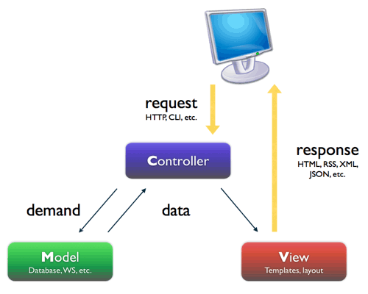
MVC
Introduced in the 70’s for GUI by Trygve Reenskaug
Architectural pattern for software interface
Used in many web framework
User requests are routed through the controller
The controller queries the model
The controller calls the view
The user see the view

Slide 11
MVC, why use it ?
Separation of concerns
Simplified development and maintenance
Heavy use of abstraction layer
No need to know python/php/ruby to make great templates

Slide 12
MVC, why use it ?
Separation of concerns
Simplified development and maintenance
Heavy use of abstraction layer
No need to know python/php/ruby to make great templates
Scalability
New functionality? => add an app, configure new routing => done
Can participate to dev without knowing all the project

Slide 13
MVC, why use it ?
Separation of concerns
Simplified development and maintenance
Heavy use of abstraction layer
No need to know python/php/ruby to make great templates
Scalability
New functionality? => add an app, configure new routing => done
Can participate to dev without knowing all the project
Readability
Routing, models, templates
Enforce good pratice

Slide 14
MVC, why use it ?
Separation of concerns
Simplified development and maintenance
Heavy use of abstraction layer
No need to know python/php/ruby to make great templates
Scalability
New functionality? => add an app, configure new routing => done
Can participate to dev without knowing all the project
Readability
Routing, models, templates
Enforce good pratice
Tests
Unit test
TDD

Slide 15
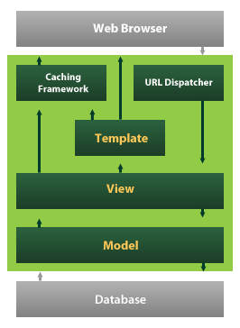
Django’s MVT
Model-View-Controller => Model-Template-View

Slide 16
Django, project & apps
An app is a Web application that does something – e.g., a Weblog system, a database of public records or a simple poll app.
A project is a collection of configuration and apps for a particular Web site.
A project can contain multiple apps. An app can be in multiple projects.

Slide 17
Django, project & apps
An app is a Web application that does something – e.g., a Weblog system, a database of public records or a simple poll app.
A project is a collection of configuration and apps for a particular Web site.
A project can contain multiple apps. An app can be in multiple projects.
A project layout:
mysite/
manage.py
mysite/
__init__.py
settings.py
urls.py
wsgi.py
someapp1/
migrations/ **
templates/ *
admin.py
models.py
tests.py
urls.py *
views.py

Slide 18
Django, starting a project
Assuming you have python and Django installed:
$ django-admin startproject mysite

Slide 19
Django, starting a project
Assuming you have python and Django installed:
$ django-admin startproject mysite
Configure the settings, especially the database ones.
Then migrate it:
$ python manage.py migrate

Slide 20
Django, starting a project
Assuming you have python and Django installed:
$ django-admin startproject mysite
Configure the settings, especially the database ones.
Then migrate it:
$ python manage.py migrate
Start the development server:
$ python manage.py runserver
Go to http://127.0.0.1:8000/

Slide 21
Django, adding an app
To create an app:
$ python manage.py startapp someapp1

Slide 22
Django, adding an app
To create an app:
$ python manage.py startapp someapp1
Add it to the installed app in settings.py:
INSTALLED_APPS = (
'django.contrib.admin',
#[…]
‘someapp1', )

Slide 23
Django, adding an app
To create an app:
$ python manage.py startapp someapp1
Add it to the installed app in settings.py:
INSTALLED_APPS = (
'django.contrib.admin',
#[…]
‘someapp1', )
If there is some models defined:
$ python manage.py makemigrations someapp1
$ python manage.py migrate

Slide 24
Django, settings.py
DEBUG: allows detailed error page. Always false in production
TEMPLATE_DEBUG: deprecated in 1.8

Slide 25
Django, settings.py
DEBUG: allows detailed error page. Always false in production
TEMPLATE_DEBUG: deprecated in 1.8
DATABASES: dictionary containing the DB settings
DATABASES = {
'default': {
'ENGINE': 'django.db.backends.postgresql_psycopg2',
'NAME': 'mydatabase',
'USER': 'mydatabaseuser',
'PASSWORD': 'mypassword',
'HOST': '127.0.0.1',
'PORT': '5432',
}
}

Slide 26
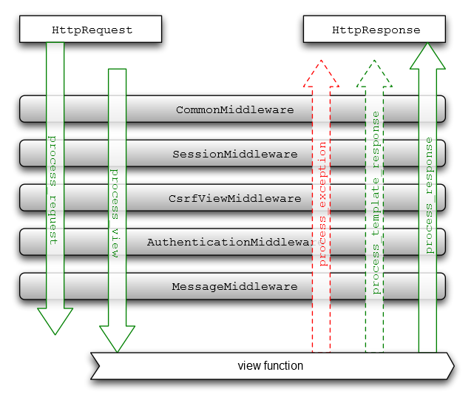
Django, settings.py
DEBUG: allows detailed error page. Always false in production
TEMPLATE_DEBUG: deprecated in 1.8
DATABASES: dictionary containing the DB settings
INSTALLED_APPS: all enabled apps
MIDDLEWARE_CLASSES: middleware to use
DATABASES = {
'default': {
'ENGINE': 'django.db.backends.postgresql_psycopg2',
'NAME': 'mydatabase',
'USER': 'mydatabaseuser',
'PASSWORD': 'mypassword',
'HOST': '127.0.0.1',
'PORT': '5432',
}
}

Slide 27
Django‘s MVC
Develop a basic application
Model
Controller
View
View
Template

Slide 28
Model, models.py overview
from django.db import models
class Person(models.Model):
first_name = models.CharField(max_length=50)
last_name = models.CharField(max_length=50)
birth_date = models.DateField()
def baby_boomer_status(self):
"Returns the person's baby-boomer status."
import datetime
if self.birth_date < datetime.date(1945, 8, 1):
return "Pre-boomer"
elif self.birth_date < datetime.date(1965, 1, 1):
return "Baby boomer"
else:
return "Post-boomer"
def _get_full_name(self):
"Returns the person's full name."
return '%s %s' % (self.first_name, self.last_name)
full_name = property(_get_full_name)

Slide 29
Model, models.py overview
from django.db import models
class Person(models.Model):
first_name = models.CharField(max_length=50)
last_name = models.CharField(max_length=50)
birth_date = models.DateField()
def baby_boomer_status(self):
"Returns the person's baby-boomer status."
import datetime
if self.birth_date < datetime.date(1945, 8, 1):
return "Pre-boomer"
elif self.birth_date < datetime.date(1965, 1, 1):
return "Baby boomer"
else:
return "Post-boomer"
def _get_full_name(self):
"Returns the person's full name."
return '%s %s' % (self.first_name, self.last_name)
full_name = property(_get_full_name)
Extends Model

Slide 30
Model, models.py overview
from django.db import models
class Person(models.Model):
first_name = models.CharField(max_length=50)
last_name = models.CharField(max_length=50)
birth_date = models.DateField()
def baby_boomer_status(self):
"Returns the person's baby-boomer status."
import datetime
if self.birth_date < datetime.date(1945, 8, 1):
return "Pre-boomer"
elif self.birth_date < datetime.date(1965, 1, 1):
return "Baby boomer"
else:
return "Post-boomer"
def _get_full_name(self):
"Returns the person's full name."
return '%s %s' % (self.first_name, self.last_name)
full_name = property(_get_full_name)
DB Fields

Slide 31
Model, models.py overview
from django.db import models
class Person(models.Model):
first_name = models.CharField(max_length=50)
last_name = models.CharField(max_length=50)
birth_date = models.DateField()
def baby_boomer_status(self):
"Returns the person's baby-boomer status."
import datetime
if self.birth_date < datetime.date(1945, 8, 1):
return "Pre-boomer"
elif self.birth_date < datetime.date(1965, 1, 1):
return "Baby boomer"
else:
return "Post-boomer"
def _get_full_name(self):
"Returns the person's full name."
return '%s %s' % (self.first_name, self.last_name)
full_name = property(_get_full_name)
Model methods
Contains business logic

Slide 32
Model, fields and X-to-X relationships
Data fields
BooleanField
CharField
DateField
DecimalField
IntegerField

Slide 33
Model, fields and X-to-X relationships
Data fields
BooleanField
CharField
DateField
DecimalField
IntegerField
Relationships
ForeignKey, many-to-one relationship
ManyToManyField, will create an intermediary join table if not defined
OneToOneField
from django.db import models
class Car(models.Model):
manufacturer = models.ForeignKey('Manufacturer')
# ...
class Manufacturer(models.Model):
# ...

Slide 34
Model, model API
save(), synchronized change (create/update) to the DB
delete()

Slide 35
Model, model API
save(), synchronized change (create/update) to the DB
delete()
Construct a QuerySet to fetch object using Manager: MyModel.objects
all() to get all
filter(cond1=val1), enforce specific condition
exclude(cond1=val1), reverse of filter
get() if there is only one (return an object)
QuerySet are lazy, evaluate them using iteration or list() for example
from blog.models import Blog
b = Blog.objects.get(id=2)
b.category = some_category
b.save()

Slide 36
Django‘s MVC
Develop a basic application
Model
Controller
View
View
Template

Slide 37
Controller, views.py overview
from django.http import HttpResponse
from box.models import Box
from django.shortcuts import get_object_or_404, render, redirect
from django.forms import ModelForm
from django.contrib.auth.decorators import login_required
class BoxCreateForm(ModelForm):
class Meta:
model = Box
fields = ['tag', 'storage']
def badCount(request):
nb_box = Box.objects.count()
return HttpResponse(nb_box + ' boxes')
def index(request):
box_list = Box.objects.all()
return render(request, 'index.html', {'box_list': box_list})
@login_required
def create(request):
form = BoxCreateForm(request.POST or None)
if form.is_valid():
form.save()
return redirect('box:index')
return render(request, 'create.html', {'form':form})

Slide 38
Controller, views.py overview
from django.http import HttpResponse
from box.models import Box
from django.shortcuts import get_object_or_404, render, redirect
from django.forms import ModelForm
from django.contrib.auth.decorators import login_required
class BoxCreateForm(ModelForm):
class Meta:
model = Box
fields = ['tag', 'storage']
def badCount(request):
nb_box = Box.objects.count()
return HttpResponse(nb_box + ' boxes')
def index(request):
box_list = Box.objects.all()
return render(request, 'index.html', {'box_list': box_list})
@login_required
def create(request):
form = BoxCreateForm(request.POST or None)
if form.is_valid():
form.save()
return redirect('box:index')
return render(request, 'create.html', {'form':form})
Imports

Slide 39
Controller, views.py overview
from django.http import HttpResponse
from box.models import Box
from django.shortcuts import get_object_or_404, render, redirect
from django.forms import ModelForm
from django.contrib.auth.decorators import login_required
class BoxCreateForm(ModelForm):
class Meta:
model = Box
fields = ['tag', 'storage']
def badCount(request):
nb_box = Box.objects.count()
return HttpResponse(nb_box + ' boxes')
def index(request):
box_list = Box.objects.all()
return render(request, 'index.html', {'box_list': box_list})
@login_required
def create(request):
form = BoxCreateForm(request.POST or None)
if form.is_valid():
form.save()
return redirect('box:index')
return render(request, 'create.html', {'form':form})
Basic HttpResponse

Slide 40
Controller, views.py overview
from django.http import HttpResponse
from box.models import Box
from django.shortcuts import get_object_or_404, render, redirect
from django.forms import ModelForm
from django.contrib.auth.decorators import login_required
class BoxCreateForm(ModelForm):
class Meta:
model = Box
fields = ['tag', 'storage']
def badCount(request):
nb_box = Box.objects.count()
return HttpResponse(nb_box + ' boxes')
def index(request):
box_list = Box.objects.all()
return render(request, 'index.html', {'box_list': box_list})
@login_required
def create(request):
form = BoxCreateForm(request.POST or None)
if form.is_valid():
form.save()
return redirect('box:index')
return render(request, 'create.html', {'form':form})
Template render

Slide 41
Controller, views.py overview
from django.http import HttpResponse
from box.models import Box
from django.shortcuts import get_object_or_404, render, redirect
from django.forms import ModelForm
from django.contrib.auth.decorators import login_required
class BoxCreateForm(ModelForm):
class Meta:
model = Box
fields = ['tag', 'storage']
def badCount(request):
nb_box = Box.objects.count()
return HttpResponse(nb_box + ' boxes')
def index(request):
box_list = Box.objects.all()
return render(request, 'index.html', {'box_list': box_list})
@login_required
def create(request):
form = BoxCreateForm(request.POST or None)
if form.is_valid():
form.save()
return redirect('box:index')
return render(request, 'create.html', {'form':form})
Authentication wall

Slide 42
Controller, views.py overview
from django.http import HttpResponse
from box.models import Box
from django.shortcuts import get_object_or_404, render, redirect
from django.forms import ModelForm
from django.contrib.auth.decorators import login_required
class BoxCreateForm(ModelForm):
class Meta:
model = Box
fields = ['tag', 'storage']
def badCount(request):
nb_box = Box.objects.count()
return HttpResponse(nb_box + ' boxes')
def index(request):
box_list = Box.objects.all()
return render(request, 'index.html', {'box_list': box_list})
@login_required
def create(request):
form = BoxCreateForm(request.POST or None)
if form.is_valid():
form.save()
return redirect('box:index')
return render(request, 'create.html', {'form':form})
ModelForm
Use ModelForm

Slide 43
Controller, routing with urls.py
urls.py
from django.conf.urls import patterns, include, url
from django.contrib import admin
urlpatterns = patterns('',
url(r'^admin/', include(admin.site.urls)), #Admin site
url(r'^box/', include('box.urls', namespace='box')), #Box app
)
box/urls.py
from django.conf.urls import patterns, url
from box import views
urlpatterns = patterns('',
url(r'^$', views.index, name='index'),
url(r'^create/$', views.create, name='create'),
url(r'^(?P<box_id>\d+)/$', views.read, name='read'),
)

Slide 44
Django‘s MVC
Develop a basic application
Model
Controller
View
View
Template

Slide 45
View, template
{{variable}} to print a variable
{% if bool %} … {% else %} … {% endif %} for branching
{% for a in a_set %} … {% endfor %} to iterate over a set
{% function %} to execute a function
{% block BlockName %} … {% endblock %} to define blocks
{% extends "base.html" %}
{% block content %}
{% if list %}
<ul>
{% for item in list %}
<li>{{item.tag}}</li>
{% endfor %}
</ul>
{% else %}
<p>No items are available.</p>
{% endif %}
<p><a href="{% url 'item:create' %}">Create an item</a></p>
{% endblock %}

Slide 46
View, template
{{variable}} to print a variable
{% if bool %} … {% else %} … {% endif %} for branching
{% for a in a_set %} … {% endfor %} to iterate over a set
{% function %} to execute a function
{% block BlockName %} … {% endblock %} to define blocks
Template inheritance
{% extends "base.html" %}
{% block content %}
{% if list %}
<ul>
{% for item in list %}
<li>{{item.tag}}</li>
{% endfor %}
</ul>
{% else %}
<p>No items are available.</p>
{% endif %}
<p><a href="{% url 'item:create' %}">Create an item</a></p>
{% endblock %}

Slide 47
View, template
{{variable}} to print a variable
{% if bool %} … {% else %} … {% endif %} for branching
{% for a in a_set %} … {% endfor %} to iterate over a set
{% function %} to execute a function
{% block BlockName %} … {% endblock %} to define blocks
{% extends "base.html" %}
{% block content %}
{% if list %}
<ul>
{% for item in list %}
<li>{{item.tag}}</li>
{% endfor %}
</ul>
{% else %}
<p>No items are available.</p>
{% endif %}
<p><a href="{% url 'item:create' %}">Create an item</a></p>
{% endblock %}
Block override

Slide 48
View, template
{{variable}} to print a variable
{% if bool %} … {% else %} … {% endif %} for branching
{% for a in a_set %} … {% endfor %} to iterate over a set
{% function %} to execute a function
{% block BlockName %} … {% endblock %} to define blocks
{% extends "base.html" %}
{% block content %}
{% if list %}
<ul>
{% for item in list %}
<li>{{item.tag}}</li>
{% endfor %}
</ul>
{% else %}
<p>No items are available.</p>
{% endif %}
<p><a href="{% url 'item:create' %}">Create an item</a></p>
{% endblock %}
Branching

Slide 49
View, template
{{variable}} to print a variable
{% if bool %} … {% else %} … {% endif %} for branching
{% for a in a_set %} … {% endfor %} to iterate over a set
{% function %} to execute a function
{% block BlockName %} … {% endblock %} to define blocks
{% extends "base.html" %}
{% block content %}
{% if list %}
<ul>
{% for item in list %}
<li>{{item.tag}}</li>
{% endfor %}
</ul>
{% else %}
<p>No items are available.</p>
{% endif %}
<p><a href="{% url 'item:create' %}">Create an item</a></p>
{% endblock %}
For loop

Slide 50
View, template
{{variable}} to print a variable
{% if bool %} … {% else %} … {% endif %} for branching
{% for a in a_set %} … {% endfor %} to iterate over a set
{% function %} to execute a function
{% block BlockName %} … {% endblock %} to define blocks
{% extends "base.html" %}
{% block content %}
{% if list %}
<ul>
{% for item in list %}
<li>{{item.tag}}</li>
{% endfor %}
</ul>
{% else %}
<p>No items are available.</p>
{% endif %}
<p><a href="{% url 'item:create' %}">Create an item</a></p>
{% endblock %}
URL generation

Slide 51
View, templates loader
Django 1.7
App directories loader, look inside somapp1/templates
Filesystem loader, use TEMPLATE_DIR
TEMPLATE_DIRS = (
os.path.join(BASE_DIR, 'templates'),
)

Slide 52
View, templates loader
Django 1.7
App directories loader, look inside somapp1/templates
Filesystem loader, use TEMPLATE_DIR
Django 1.8
TEMPLATE setting
TEMPLATE_DIRS = (
os.path.join(BASE_DIR, 'templates'),
)
TEMPLATES = [
{
'BACKEND': 'django.template.backends.django.DjangoTemplates',
'APP_DIRS': True,
'DIRS': [
os.path.join(BASE_DIR, 'templates'),
],
},
]

Slide 53
View, static files
Relative paths won’t work with templates inheritance
Use static file for CSS/js and images
In settings.py:
STATIC_URL = '/static/'
STATICFILES_DIRS = (
os.path.join(BASE_DIR, "static"),
)
In the templates:
{% load staticfiles %}
<link href="{% static 'bootstrap.min.css' %}" rel="stylesheet">

Slide 54
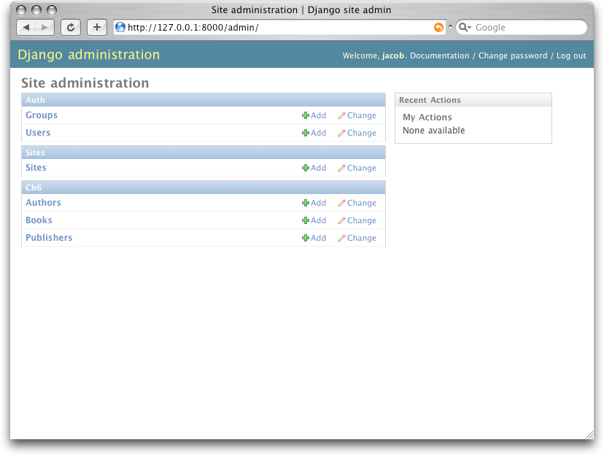
Admin site
Django provides a fully-fledged admin site with the django.contrib.admin app
Create an admin superuser
Set up settings.py (set up by default)
Set up the route (set up by default)
Hook models to the admin site
Customize the admin site (optional)
In someapp1/admin.py:
from django.contrib import admin
from item.models import Item
admin.site.register(Item)

Slide 55
User model
Django provide an authentication model with the django.contrib.auth
Use the provided model to create views for login, registration, ect…

Slide 56
User model
Django provide an authentication model with the django.contrib.auth
Use the provided model to create views for login, registration, ect…
OR use the default views adding the required routes and templates
Login template:
{% extends "base.html" %}
{% block content %}
<form method="post">
{% csrf_token %}
{{ form.as_p }}
<input type="submit" value="Login" />
<input type="hidden" name="next" value="{% url 'index' %}" />
</form>
{% endblock %}
urls.py:
url('^login/','django.contrib.auth.views.login', {'template_name': 'login.html'}, name='login'),

Slide 57
User model, extending it
Provided user model is basic, to extend it:
Override the default user model with AUTH_USER_MODEL in settings.py
Not supported by migrations, do it before setting up the DB
Not recommended for reusable apps

Slide 58
User model, extending it
Provided user model is basic, to extend it:
Override the default user model with AUTH_USER_MODEL in settings.py
Not supported by migrations, do it before setting up the DB
Not recommended for reusable apps
OR Add a one-to-one model linked to the user (proxy-model)
Called a profile model
very useful if you don’t want to change the auth
Use signals to link there creation/modification to user creation/modification
from django.contrib.auth.models import User
class Employee(models.Model):
user = models.OneToOneField(User)
department = models.CharField(max_length=100)

Slide 59
Django, pros & cons
Pros
Easy to learn
Easy to setup / deploy in dev
Build in admin & authentication

Slide 60
Django, pros & cons
Pros
Easy to learn
Easy to setup / deploy in dev
Build in admin & authentication
Cons
Non usual nomenclature / conventions
Big overhead

Slide 61
Django, pros & cons
Pros
Easy to learn
Easy to setup / deploy in dev
Build in admin & authentication
Cons
Non usual nomenclature / conventions
Big overhead
Matter of taste
Python
Lack of diversity (one way of doing things)

Slide 62
Thank you for your time!
Any Questions?
Jean-Matthieu Gallard

