Slide 1

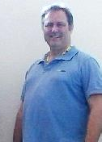
COM615
Service Modelling Introduction
Dr Craig Gallen Eng.D MIEE, C.Eng
Craig Gallen
Email : craig.gallen@solent.ac.uk
Desk : JM506 ( Mondays / Tuesdays)
Mobile: +44 (0) 7789 938012
Craig

Slide 2
Network Management Models
Models
  DMTF Common information model (CIM)
    https://www.dmtf.org/standards/cim/cim_schema_v2550
  Microsoft WMI
    https://learn.microsoft.com/en-us/windows/win32/wmisdk/common-information-model
  DMTF Redfish https://www.dmtf.org/standards/redfish
  TM Forum Information Framework (SID)
    https://www.tmforum.org/MODA/index.htm
The following diagrams are taken from
  Dr John Strassner DEN-NG (Major contribution to SID)
  Policy-Based Network Management,: Solutions for the Next Generation (The Morgan Kaufmann Series in Networking) Hardcover by John Strassner (Author) 2003

Slide 3
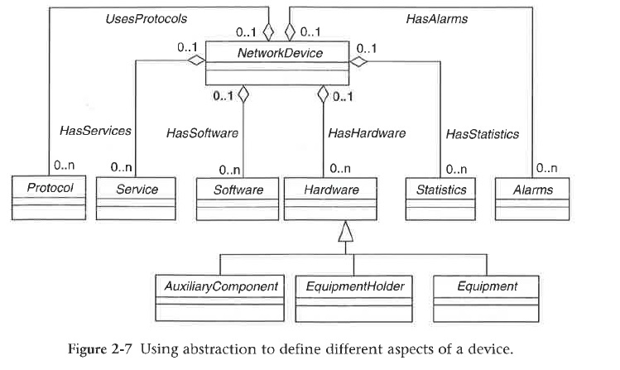
Modelling Network Devices

Slide 4
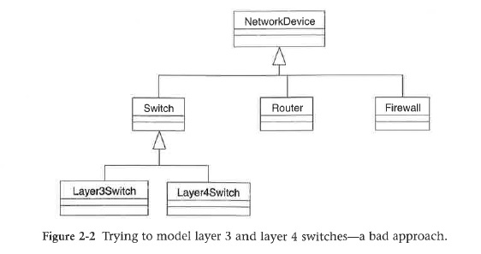
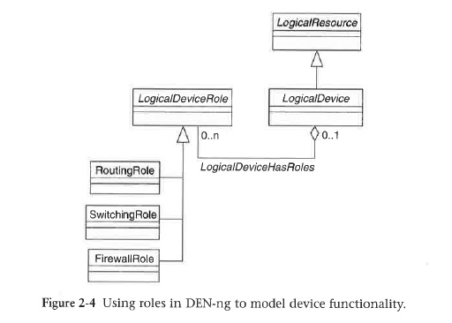
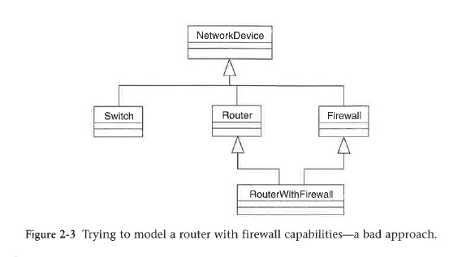
Modelling Good and Bad Approaches

Slide 5
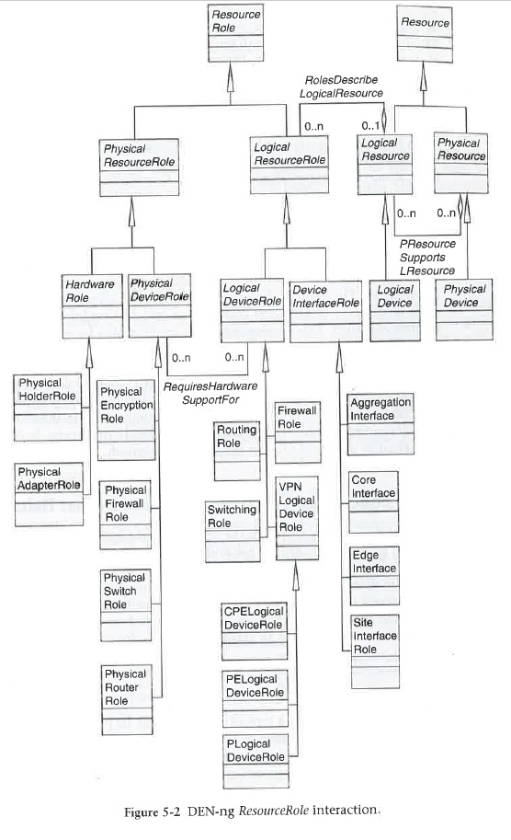
Resource Roles

Slide 6
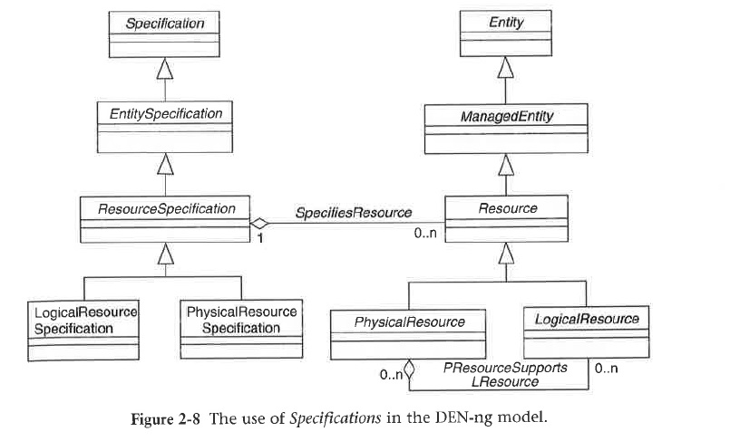
Specifications vs Entities

Slide 7
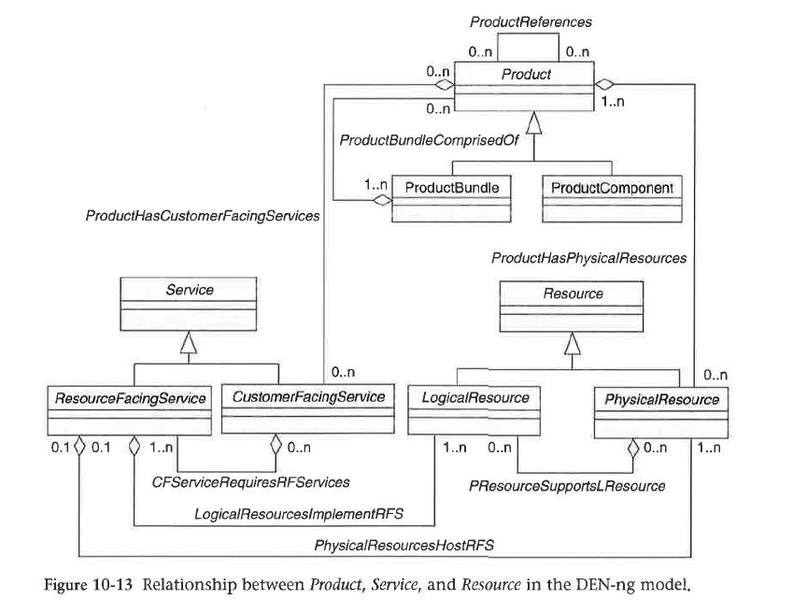
Product Service Resource

Slide 8
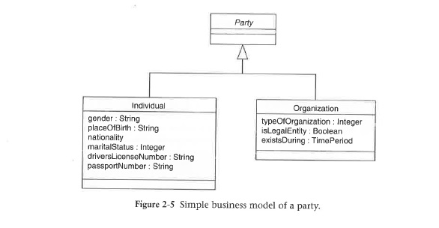
Simple Party Model

Slide 9
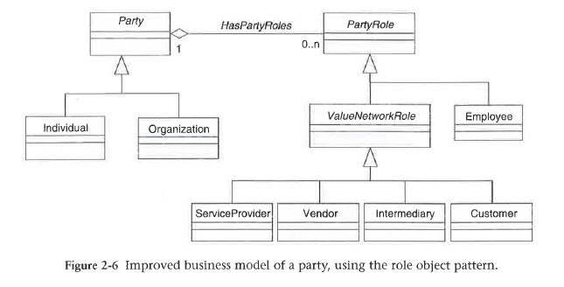
Party Role Pattern

Slide 10
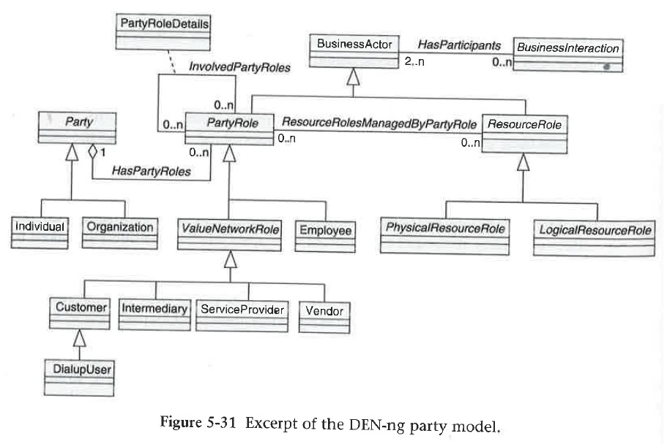
Business interactions and roles

