Slide 1


IoT and OpenNMS
Dr Craig Gallen (OpenNMS UK)
(also Solent University)
Craig Gallen
Email : craig.gallen@entimoss.com
: cgallen@opennms.org
Mobile: +44 (0) 7789 938012
Image: https://en.wikipedia.org/wiki/Internet_of_things

Slide 2
Contents
General discussion of IoT
MQTT
OpenNMS IoT Plugin
Use Cases

Slide 3
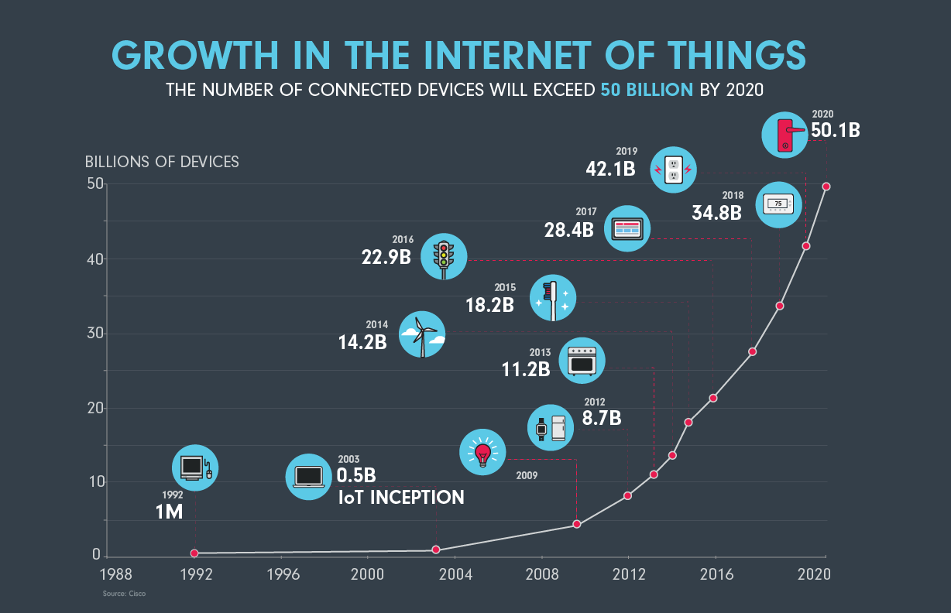
IoT Definition
The Internet of Things is :
"simply the point in time when more 'things or objects' were connected to the Internet than people“ (cisco)
‘Fog Computing’
Cisco Systems estimates that IoT was "born" between 2008 and 2009, with the things/people ratio growing from 0.08 in 2003 to 1.84 in 2010.
Dave Evans (April 2011). "The Internet of Things: How the Next Evolution of the Internet Is Changing Everything" (PDF). CISCO white paper.
https://www.cisco.com/c/dam/en_us/about/ac79/docs/innov/IoT_IBSG_0411FINAL.pdf
https://www.ncta.com/whats-new/the-internet-of-things-continues-transform-the-way-we-live

Slide 4
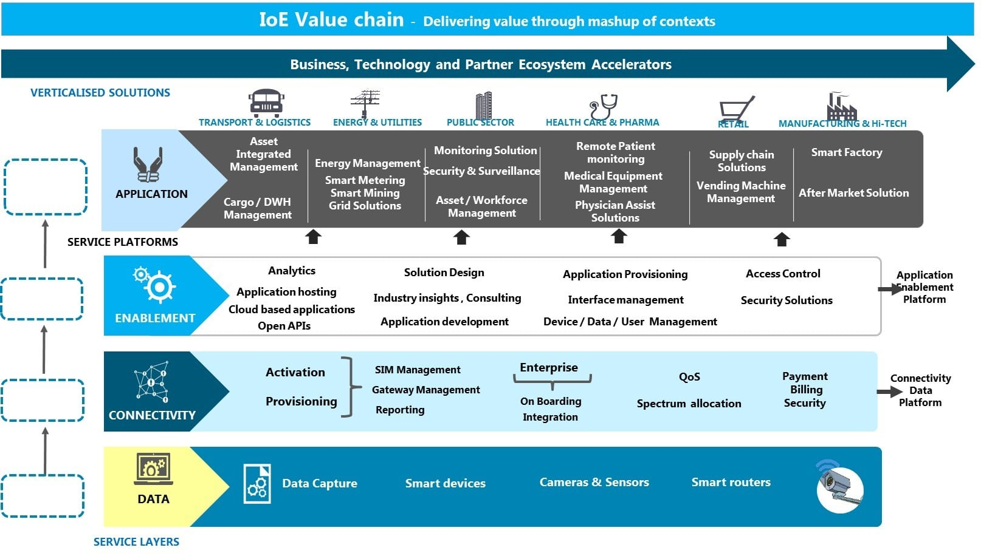
Emerging IoT Ecosystem
Source: TM Forum Internet of Everything

Slide 5
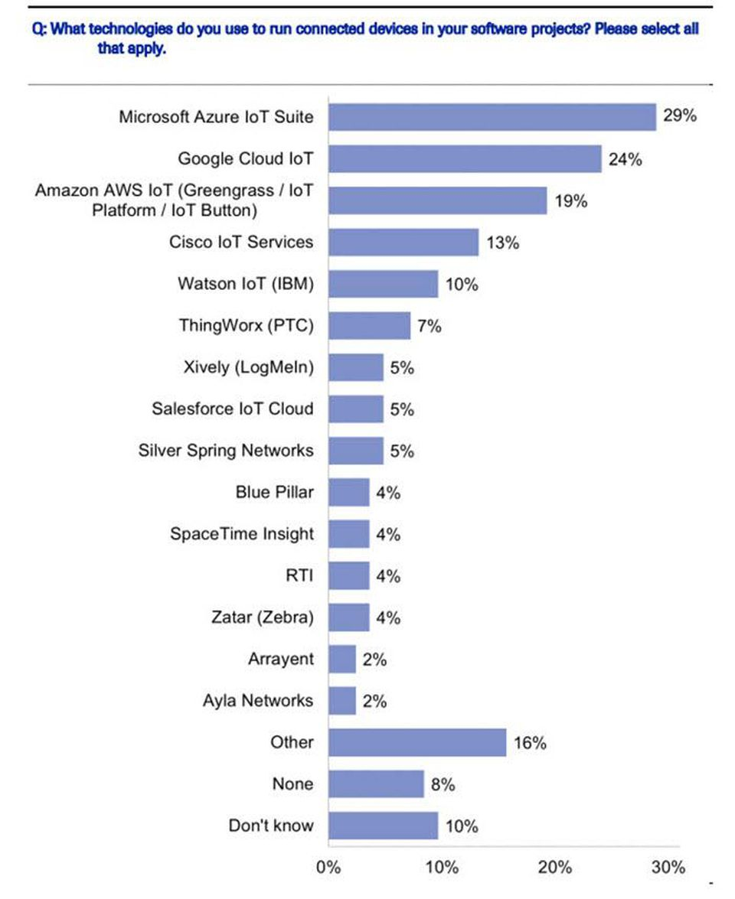
IoT platforms - Big Players
https://www.forbes.com/sites/louiscolumbus/2018/06/06/10-charts-that-will-challenge-your-perspective-of-iots-growth/#2883e1fa3ecc
Cowen Software Developer Survey, Getting In On The Ground Floor: Surveying Software Developers On Key Tech Trends, September 18, 2017

Slide 6
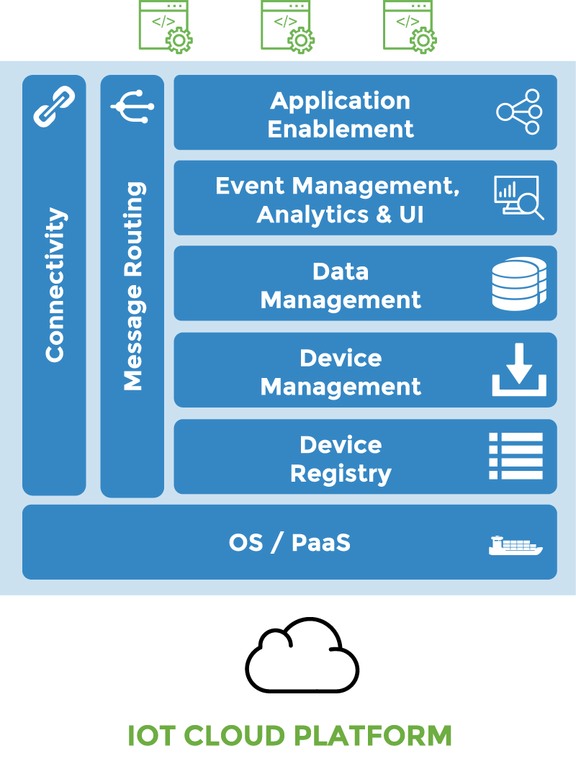
Other Open Source IoT Platform Stacks
Eclipse OM2M
is an IoT Platform specific for the telecommunication industry, based on the oneM2M specification.
https://www.eclipse.org/om2m/
Eclipse Kapua
is a modular platform providing the services required to manage IoT gateways and smart edge devices. Kapua provides a core integration framework and an initial set of core IoT services including a device registry, device management services, messaging services, data management, and application enablement. https://www.eclipse.org/kapua/
Complex and difficult to deploy single purpose platforms

Slide 7
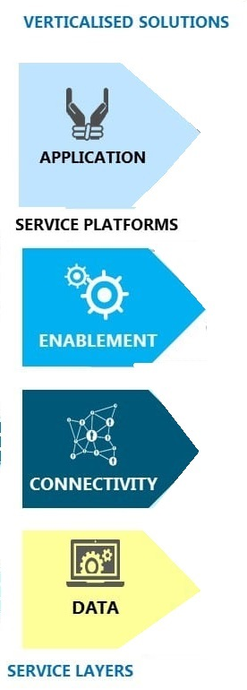







Where could OpenNMS fit?
1. A solution for IoT Systems Monitoring
  Already monitoring large IoT Systems
    Sensus – wireless IoT networks in UK
2. OpenNMS as a Platform for IoT Applications
Big Data IoT
11M smart electric/gas meters UK
100,000 Smart Water Meters London (Thames Water)
Long Tail of Applications with a relatively small numbers of sensors
Applications
Visualisation
Data Storage Processing Alerting
Analytics Security
Connectivity
Wifi / LTE / 5G / LoRaWan
OpenNMS could find a role in the long tail of applications
proven and (relatively) simple to deploy solution
Devices
(Device Platforms)

Slide 8
Contents
General discussion of IoT
MQTT
OpenNMS IoT Plugin
Use Cases

Slide 9
The IoT protocol MQTT
MQTT (Message Queuing Telemetry Transport)
    Andy Stanford-Clark of IBM and Arlen Nipper of Cirrus Link authored the first version of the protocol in 1999
OASIS Standard MQTT v3.1.1
  http://docs.oasis-open.org/mqtt/mqtt/v3.1.1/os/mqtt-v3.1.1-os.html
  ISO standard (ISO/IEC PRF 20922)
Design criteria
  It is designed for connections with remote locations where a "small code footprint" is required or the network bandwidth is limited.
  Can work on top of LaRaWan, Zigbee, Wifi etc
Details
  A publish-subscribe-based messaging protocol requiring a broker
  Built on TCP/IP and can use TLS (secure sockets).
  Application Message : Topic, Qos, Payload
Client
Client
Client
mqtt
Mqtt
Broker
IoT
device
IoT
device
IoT
device
mqtt
IoT
device

Slide 10
MQTT Message
MQTT Message contains <Client Id>< Topic >< QoS (0,1,2) >< Payload >
MQTT QoS
  QoS 0: At most once delivery
    The message is delivered according to the capabilities of the underlying network. No response is sent by the receiver and no retry is performed by the sender. The message arrives at the receiver either once or not at all.
  QoS 1: At least once delivery
    This quality of service ensures that the message arrives at the receiver at least once. ( But may receive duplicates)
  QoS 2: Exactly once delivery
    This is the highest quality of service, for use when neither loss nor duplication of messages are acceptable
Client Identification and authentication
  MQTT Client id
  Username, Password and / or Certificate (e.g. Amazon IoT)

Slide 11
MQTT Topic
Topic Name:
  The label attached to an Application Message which is matched against the Subscriptions known to the Server. The Server sends a copy of the Application Message to each Client that has a matching Subscription.
  Topics follow a hierarchy defined by a Topic level separator ‘/’ e.g GW1/device1/sensorA etc
Topic Filter:
  An expression contained in a Subscription, to indicate an interest in one or more topics. A Topic Filter can include wildcard characters.
    Multi-level wildcard #
    Single level wildcard +
  Examples
    GW2/# selects all messages from GW2
    GW1/device1/+/ selects all messages from any sensor under device 1
    GW1/+/sensorA selects all sensorA messages from any device under GW1
GW1
device1
sensorA
sensorB
sensorC
device2
sensorA
GW2

Slide 12
Contents
General discussion of IoT
MQTT
OpenNMS IoT Plugin
Use Cases

Slide 13

OpenNMS MQTT Plugin
Stand alone OSGi plugin which drops into OpenNMS 22
Code : https://github.com/gallenc/opennms-mqtt-plugin
Installation
  mvn clean install
  drop opennms-mqtt-plugin/kar-package/target//opennms-mqtt-plugin.kar into <OpenNMS>/deploy
  Add <opennms>/etc/mqtt-interface-config.xml
    Example config file
    https://github.com/gallenc/opennms-mqtt-plugin/blob/master/main-module/mqtt-interface-config.xml
    Example configurations for message parsing in unit tests
    https://github.com/gallenc/opennms-mqtt-plugin/tree/master/main-module/src/test/resources
  There is a docker compose project with complete configuration opennms, cassandra, helm and mqtt plugin
Can connect to multiple clients
Mqtt device
Mqtt broker
Mqtt device
OpenNMS
Mqtt device
Mqtt Plugin
Mqtt device
Mqtt device
Mqtt broker
Mqtt device
Mqtt device
Mqtt device

Slide 14
Summary – OpenNMS MQTT
Simple to install plugin – just drop into <deploy> directory and add config file
Can connect (and reconnect) to multiple MQTT Brokers
  Username / Password, TLS authentication
Can automatically add Nodes discovered through MQTT
  With foreign source and foreign id from Topic path or payload data
  Add GIS coordinates to inventory
Can subscribe to filtered topics
  PMc178e3c2.6637eiot-2/type/mosquitto/id/00-08-00-4A-4F-F6/evt/datapoint/fmt/json
  PMc178e3c2.6637eiot-2/type/mosquitto/id/#
Can choose how to handle filtered topics with different configurations
  Events or Data or Both
  PMc178e3c2.6637eiot-2/type/mosquitto/id/+/evt/datapoint/fmt/jso
  PMc178e3c2.6637eiot-2/type/mosquitto/id/+/evt/events/fmt/jso
Can parse multiple payloads
  Compressed, uncompressed, JSON / XML / CSV (Future Protobuf)

Slide 15
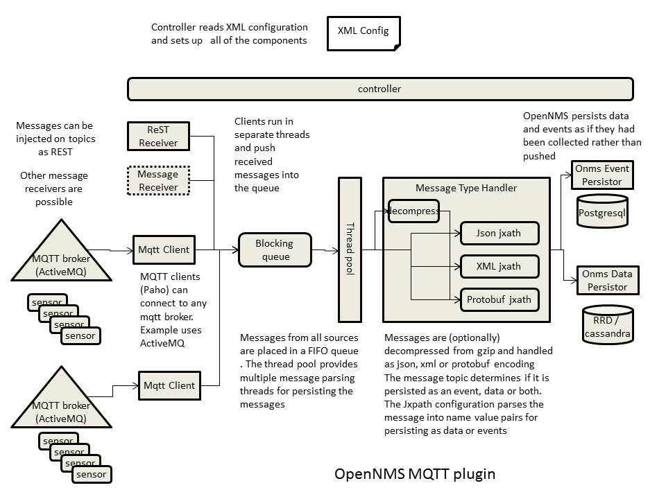
How it works

Slide 16
Basic Structure of Configuration
<opennms>/etc/ mqtt-interface-config.xml
<mqtt-receiver >
<createMissingNodes>true</createMissingNodes>
<createDummyInterfaces>true</createDummyInterfaces>
<createNodeAssetData>true</createNodeAssetData>
<messageDataParsers>
<messageDataParser>
….
<messageDataParser>
</messageDataParsers>
<messageEventParsers>
…..
</messageEventParsers>
<mqttClients>
….
</mqttClients>
</mqtt-receiver>
See https://github.com/gallenc/opennms-mqtt-plugin/blob/ba2138bf8aa9d731dbbb5ede7bed440b0ee0256f/mqtt-docker-compose/etc-overlay/mqtt-interface-config.xml
if true new nodes will be created for messages referencing an unknown node
if true a dummy interface will also be created when the node is created
if true asset information will be copied to the node asset table when the node is created. this particularly applies to latitude and longitude if defined in the message
configuration for data parsers – many parsers can be defined for different topic filters
configuration for event parsers – many parsers can be defined for different topic filters
configuration for clients. Many clients can be defined which connect to multiple topic filters

Slide 17
Setting up the connection
Mqtt broker
Can connect to multiple clients
Mqtt device
The clientinstanceId identifies the client in OpenMS and must be unique
the clientid must be unique for a given mqtt broker
  the clientConnectionMaxWait tetermins the time the client will wait for the broker to respond before abandoning a connection attempt
  the connectionRetryInterval is the interval before the client will try again to connect after failing to connect previously
the topic list determines which topics the client will subscribe to once it has established a connection
The subscribed topic can also be a filter e.g. topic="/+/foo/#
If you are using TLS you must provide both certificate and key files. If both are omitted from the configuration TLS will not be used
with AMAZON IoT, the certificate and key files can be generated for you . These are tied to a specific client id and IoT end point
Mqtt device
OpenNMS
Mqtt device
Mqtt Plugin
Mqtt device
Mqtt device
Mqtt broker
Mqtt device
Mqtt device
Mqtt device
<mqttClients>
<client clientInstanceId="client1">
<brokerUrl>tcp://localhost:1883</brokerUrl>
<clientId>opennms</clientId>
<connectionRetryInterval>3000</connectionRetryInterval>
<clientConnectionMaxWait>20000</clientConnectionMaxWait>
<topicList>
<topic qos="0" topic="mqtt-events/#" />
<topic qos="0" topic="mqtt-data" />
</topicList>
<userName>mqtt-user</userName>
<password>mqtt-password</password>
<certificateFile>put absolute path to certificate.pem file here</certificateFile>
<privateKeyFile>put absolute path to private.key file here</privateKeyFile>
<brokerUrl>ssl://{iot end point}:8883</brokerUrl>
</client>
</mqttClients>

Slide 18
Message Data parsers
message data parsers define how data messages are converted to metrics to be stored in RRD's or Cassandra by OpenNMS
subscriptionTopics defines which topic messages will be passed to this parser. Can be a filter
many messageDataParsers can be defined but only one per topic although events can also be driven off the same topic)
payloadType determines how the payload is parsed; JSON, XML, PROTOBUF or TEXT.
foreignSource defines the foreign source to be used when referencing or creating a new node
compression determines the processing of compressed messages GZIP, UNCOMPRESSED, AUTOMATIC_GZIP
(tries to guess if gzip compressed - small chance of false positives)
<messageDataParsers>
<messageDataParser foreignSource="mqtt" payloadType="JSON" compression="UNCOMPRESSED">
<subscriptionTopics>
<topic>mqtt-data</topic>
to match data topic PMc178e3c2.6637eiot-2/type/mosquitto/id/00-08-00-4A-4F-F6/evt/datapoint/fmt/json
<topic>PMc178e3c2.6637eiot-2/type/mosquitto/id/+/evt/datapoint/fmt/json</topic>
</subscriptionTopics>
<xml-groups>
</xml-groups>
</messageDataParser>
</messageDataParsers>
Similar JXPATH configuration to Alejandro’s XML data collector

Slide 19
Example Complex Payload
{
"zones": [ {
"zone" : {
"id" : 0,
"name" : "global",
"timestamp" : 1299258888,
"parameter" : [
{ "key" : "nproc", "value" : "245" },
{ "key" : "nlwp", "value" : "1455" },
{ "key" : "pr_size", "value" : "2646864" },
{ "key" : "pr_rssize", "value" : "1851072" },
{ "key" : "pctmem", "value" : "0.7" },
{ "key" : "pctcpu", "value" : "0.24" }
]
}
},
{"zone" : {
"id" : 871,
"name" : "zone1",
}
}
]
<?xml version="1.0" encoding="UTF-8" ?>
<xml-groups xmlns="http://xmlns.opennms.org/xsd/config/xml-datacollection">
<xml-group name="solaris-zone-stats" resource-type="solarisZone"
resource-xpath="/zones/zone" key-xpath="@name" timestamp-xpath="@timestamp"
timestamp-format="">
empty format indicates simple timestamp from epoch (Date.toString())
<xml-object name="zoneName" type="string" xpath="@name" />
<xml-object name="timestamp" type="string" xpath="@timestamp" />
<xml-object name="nproc" type="GAUGE" xpath="parameter[@key='nproc']/@value" />
<xml-object name="nlwp" type="GAUGE" xpath="parameter[@key='nlwp']/@value" />
<xml-object name="pr_size" type="GAUGE" xpath="parameter[@key='pr_size']/@value" />
<xml-object name="pr_rssize" type="GAUGE" xpath="parameter[@key='pr_rssize']/@value" />
<xml-object name="pctmem" type="GAUGE" xpath="parameter[@key='pctmem']/@value" />
<xml-object name="pctcpu" type="GAUGE" xpath="parameter[@key='pctcpu']/@value" />
</xml-group>
</xml-groups>
Note each zone in array generates own data set

Slide 20
Extracting Node Id from Topic path
Example Laurawan MQTT payload Herb Garcia Insitu Systems, Inc.
note $topicLevels[5] == 00-08-00-4A-4F-F6 (note starts at 1)
6/15/2018, 6:25:59 PMc178e3c2.6637eiot-2/type/mosquitto/id/00-08-00-4A-4F-F6/evt/datapoint/fmt/json
: msg.payload : Object
{
"d": {
"light": 462,
"moisture": 97.34025,
"temperature": 29.8125,
"x_acc": 0.1875,
"y_acc": 0.375,
"z_acc": 0.8125
}
}
<?xml version="1.0" encoding="UTF-8" ?>
<xml-groups xmlns="http://xmlns.opennms.org/xsd/config/xml-datacollection">
<xml-group name="laurawan" resource-type="laurawan" resource-xpath="/*"
key-xpath="$topicLevels[5]" >
<xml-object name="light" type="GAUGE" xpath="@light" />
<xml-object name="moisture" type="GAUGE" xpath="@moisture" />
<xml-object name="temperature" type="GAUGE" xpath="@temperature" />
<xml-object name="x_acc" type="GAUGE" xpath="@x_acc" />
<xml-object name="y_acc" type="GAUGE" xpath="@y_acc" />
<xml-object name="z_acc" type="GAUGE" xpath="@z_acc" />
</xml-group>
</xml-groups>

Slide 21
Message Event Handling
message event parsers follow the same pattern as message data parsers.
however the Xpath defines which name value pairs are saved as params in the resulting opennms events
<messageEventParsers>
<messageEventParser foreignSource="$topicLevels[5]" payloadType="JSON" compression="UNCOMPRESSED">
<subscriptionTopics>
<topic>iot/type/mosquito/id/+/device/+/app/opennms/fmt/json</topic>
</subscriptionTopics>
It is possible to specify a specific uri to associate with this event
if ueiRoot is not specified then a default generic value is used
<ueiRoot>uei.opennms.org/plugin/MqttReceiver/laurawan</ueiRoot>
<ns2:xml-groups xmlns="http://xmlns.opennms.org/xsd/config/xml-datacollection">
<ns2:xml-group name="laurawan" resource-type="laurawan" resource-xpath="/metrics" key-xpath="$topicLevels[7]“
timestamp-xpath="@timestamp“ timestamp-format="yyyy-MM-dd HH:mm:ss.SSSSSS">
<ns2:xml-object name="gweui" type="string" xpath="@gweui" />
<ns2:xml-object name="deveui" type="string" xpath="@deveui" />
…
if ueiRoot is specified and in addition, the xml-group contains a definition labled "UEI_SUFFIX"
then the value UEI_SUFFIX parsed from the message context will be appended to the ueiRoot
to form a message specific uei. Thus if the following line is added
<ns2:xml-object name="UEI_SUFFIX" type="string" xpath="@deveui" />
the generated event uei will be
uei.opennms.org/plugin/MqttReceiver/laurawan/{@deveui value}
</ns2:xml-group>
</ns2:xml-groups>
</messageEventParser>
</messageEventParsers>

Slide 22
Contents
General discussion of IoT
MQTT
OpenNMS IoT Plugin
Use Cases

Slide 23
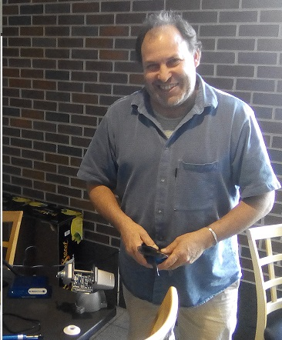

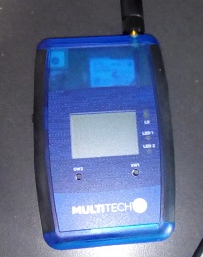
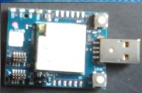
Case Study – Monitoring Tailings
Herb Garcea Insitu Systems, Inc.
www.insitusys.com
Mine tailings
  are the ore waste of mines, and are typically a mud-like material. Worldwide, the storage and handling of tailings is a major environmental issue. Many tailings are toxic and must be kept perpetually isolated from the environment.
  https://www.nps.gov/articles/aps-v13-i2-c8.htm
  Series: Alaska Park Science - Volume 13 Issue 2: Mineral and Energy Development Long-term Risk of Tailings Dam Failure

Slide 24


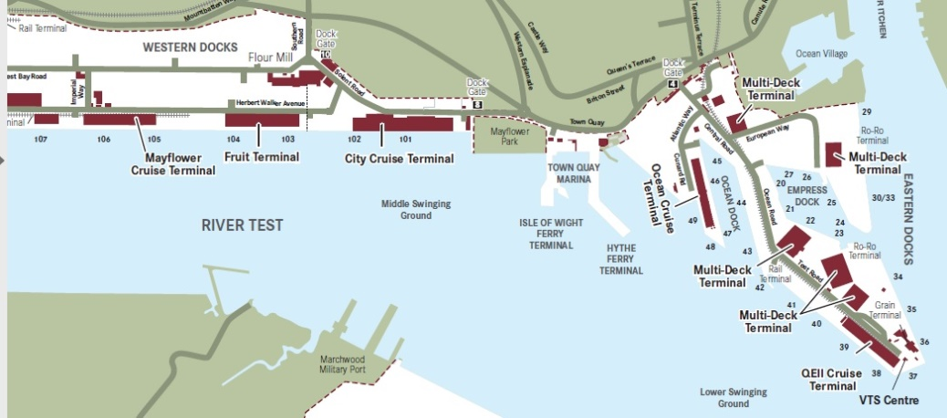
Case Study
Southampton Air Pollution Monitoring
The UK’s number one cruise port, which welcomes 1.7m passengers
Each ship up to 6000 passenger and crew
Ship turn around 1-2 days
Increasing problem of air pollution due to generators running while ships in port
http://www.solentairwatch.co.uk/
  Community air monitoring project
  Not for profit charity run by Southampton volunteers
  Monitor Sniffy – version 1
    https://github.com/SolentAirWatch/sniffy
    Raspberry Pi Zero
    Low cost laser Smoke detector
    Ruggedized container
  Founder Dr Joshua Taylor

Slide 25



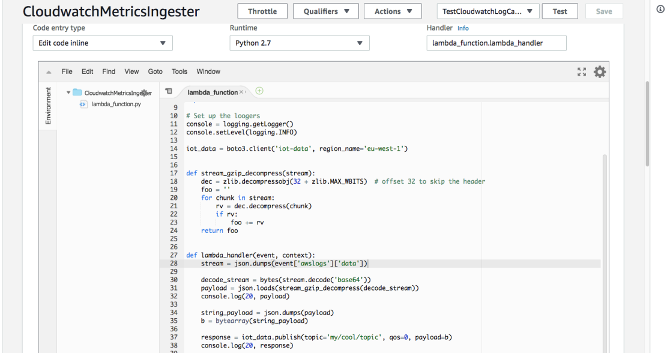
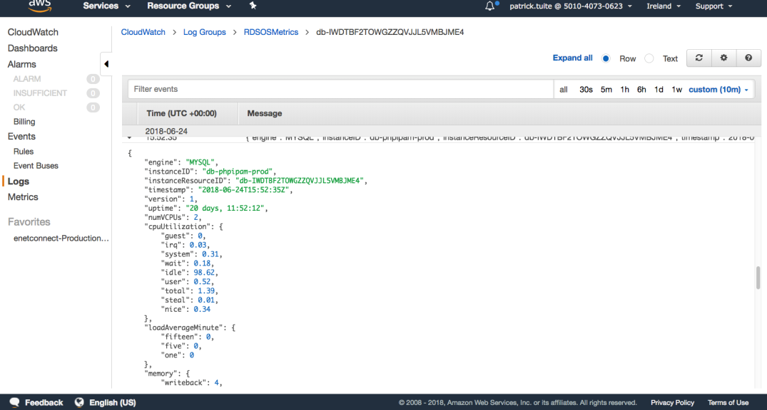
Case Study
Receiving Amazon CloudWatch data via Amazon IoT
Simple message
service
MQTT
Amazon Cloudwatch
Amazon IoT
Broker
OpenNMS
IoT
With Patrick Tuit
AWS VM
AWS Cloud
Stand Alone OpenNMS
AWS VM
AWS VM
AWS VM

Slide 26






IoT Device Platforms Investigation
Benjamin Horton Masters (Msc) Student Solent Uni
Java Based Solutions
Javascript
3. Kura Sniffy 3pp
3b. OpenHAB Sniffy app
4. Node Red Scripting
Python
Eclipse Kura
OpenHAB
2. simple Java Program Sniffy
1. Existing Sniffy Scripts
Node Red / GPIO
OSGi container
Python GPIO Lib
Java PI4J GPIO Lib
Python
NodeJS
Java JDK
Rasbian OS
Pi Hardware
GPIO
SENSORS
SENSORS

Slide 27
Summary
OpenNMS now has a very credible IoT story
  Data collection – Cassandra and Elastic Search
  Drift – streaming protocols
  Minions
  New - MQTT plugin
MQTT plugin - still a prototype but appears to work well
  There is a docker compose project ☺
Please spread the word
Try the plugin yourself
Give us feedback as to what to do next

Slide 28
Thanks for listening
Questions?

