Slide 1
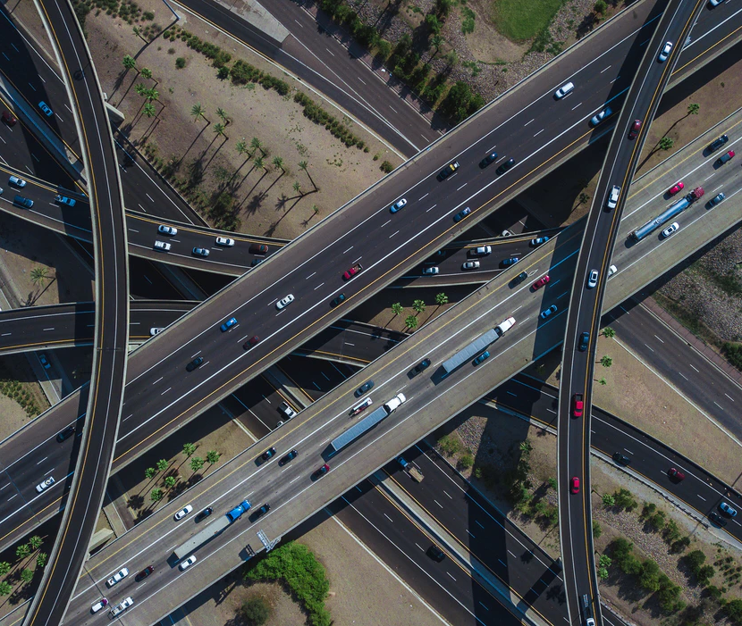
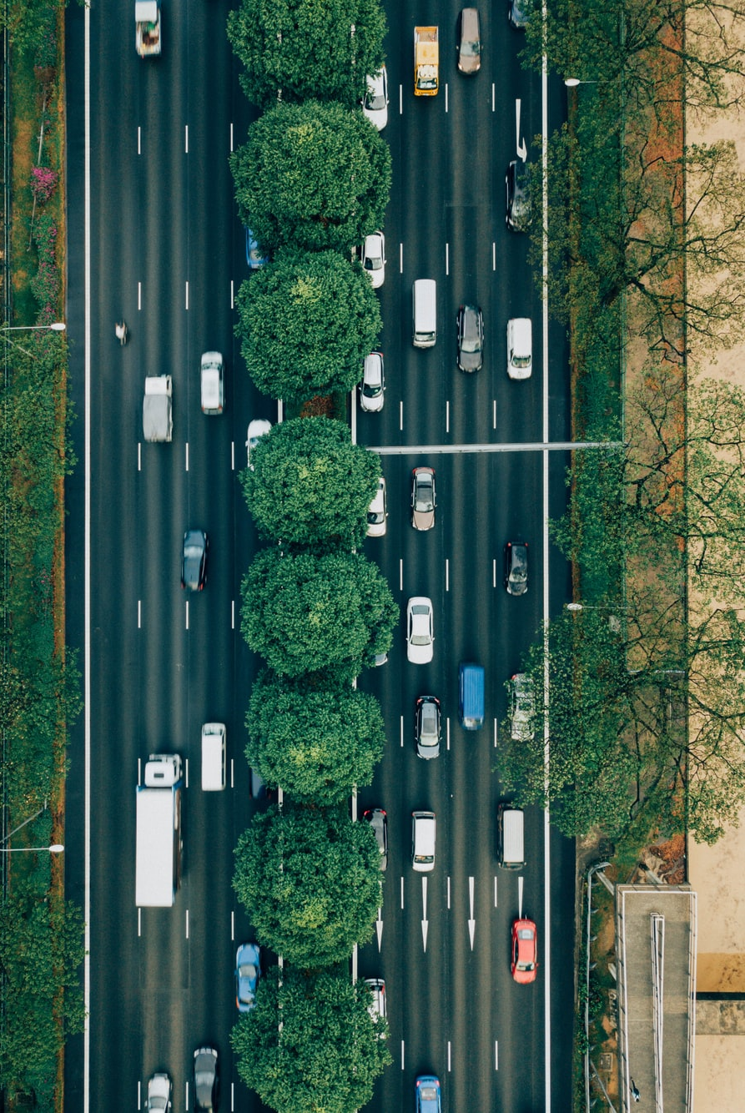
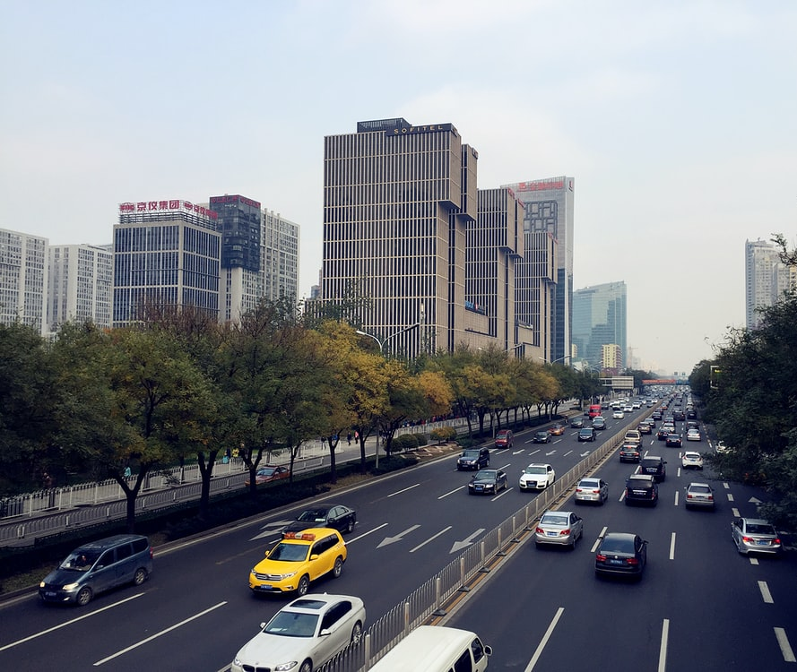
P2 Image Recognition
Sprint 2 - Skeleton Mock Implementation
Team: Emma Sutton, Kieron Gillingham, & Matthew Dear
Notes:
Hello my name is Matthew and I’m here to talk to you on behalf of the P2 image recognition team in charge of creating the automated number plate recognition micro-service for this project.

Slide 2
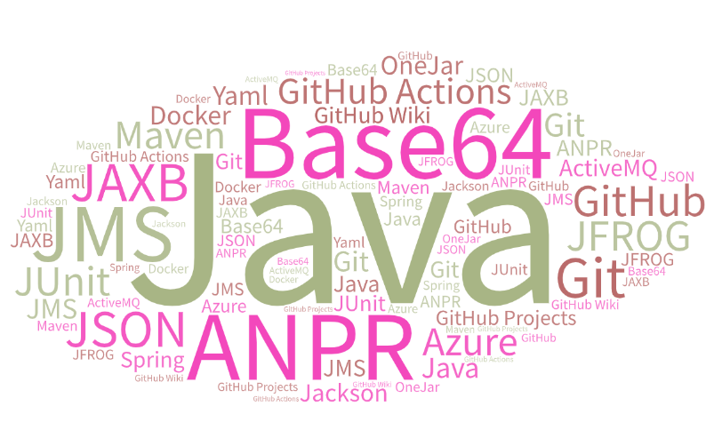
What technologies?
Notes:
So what technologies are we using? In short, a lot. As you can see here.

Slide 3
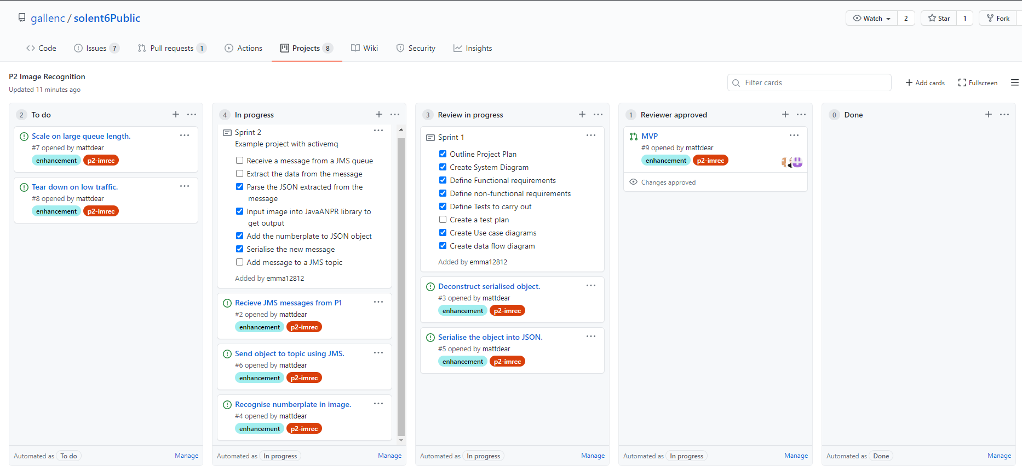
Project Plan
Notes:
Since day one we have used GitHub Projects and issues to plan and keep track of our project. We began by creating issues for all of our system requirements. These were then automatically added to our project plan allowing us to easily see what position we were in.
We created a 6 stage plan of what was to be completed over the four sprints.

Slide 4






The 6 Stages
Research potential system components.
Create a skeleton version that can send and receive JMS messages.
Make a JSON serialisation class.
Integrating the Java ANPR library.
Setup the micro-service to use threading.
Look at scaling with docker.
Notes:
Stage 1 - research components that we would need and test how they worked.
Stage 2 - create a skeleton version of our micro-service that could send and receive JMS messages.
Stage 3 - make a JSON serialisation class allowing us and other teams to extract the data from and add it to the JMS messages.
Stage 4 - integrating the Java ANPR library to automatically recognise number plates from the images in the JMS messages.
Stage 5 - look at setting up the micro-service to use threading so that we could scale on high demand.
Stage 6 - look at scaling with docker containers.

Slide 5




Implementation
Notes:
We started by researching base64 encoding for our images, Java ANPR library’s, Java Messaging Service, GitHub Actions, Jackson, and Docker. To see how they could all be used in our project. Committing all tests and documentation to the GitHub repository so that we could use this for version control.
After this first step we used Craigs initial project to start building our solution.
Using Java, Spring Framework, and JAXB Framework to develop our solution.
Using Maven as the build tool.
Using ActiveMQ for JMS.
And using ActiveMQ plugin for JMS testing.
We also created the JSON Message class to serialize and de-serialize JMS messages for our project.
This has been added to the common artifacts to make it available to all other teams.
During the implementation phase of the project we have taken a paired programming approach to make sure that all members of the team are learning as much about the system as possible.

Slide 6

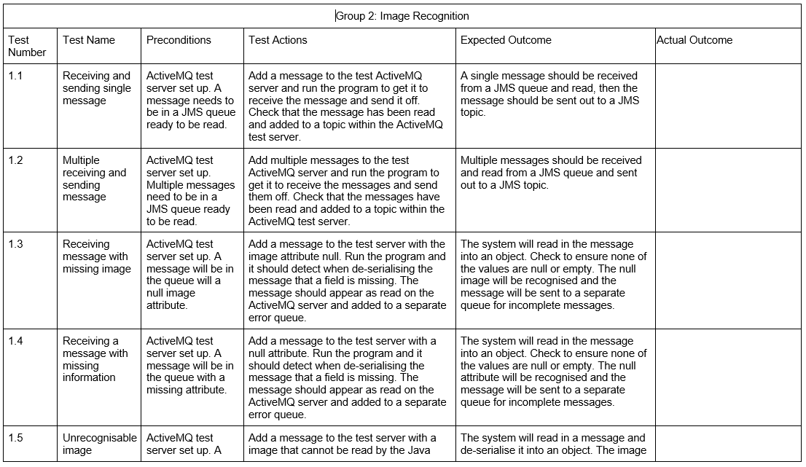
Testing
End to end testing
with a Test Plan
Test driven development
with
Notes:
We decided to develop our solution using test driven development by creating unit tests for all methods and classes using JUnit.
We also constructed a test plan for the end to end testing of our micro-service to cover expected and un-expected scenarios.
All tests state the preconditions, actions to be taken, and expected outcomes. So anyone can run these tests to make sure the system is working.

Slide 7
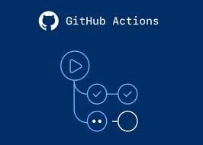
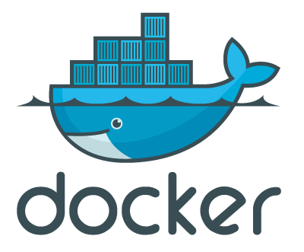



Packaging and Deployment
Notes:
Finally, for packaging and deployment we will be using:
OneJar to package all code and dependencies into a singular jar file.
Github Actions to automatically run unit tests using yaml and maven upon the submission of a pull request.
Once the pull request is approved GitHub Actions will automatically test and deploy snapshots to the Jfrog Artifactory server hosted in Microsoft Azure.
Then once a release has been approved a member of the devops team will manually push the release to the Jfrog Artifactory server.
The final step will be to use Kubernetes to orchestrate the creation of a docker container that will run the OneJar file hosted on the Jfrog server.

Slide 8

Any questions?
Notes:
Does anyone have any questions?

