Slide 1


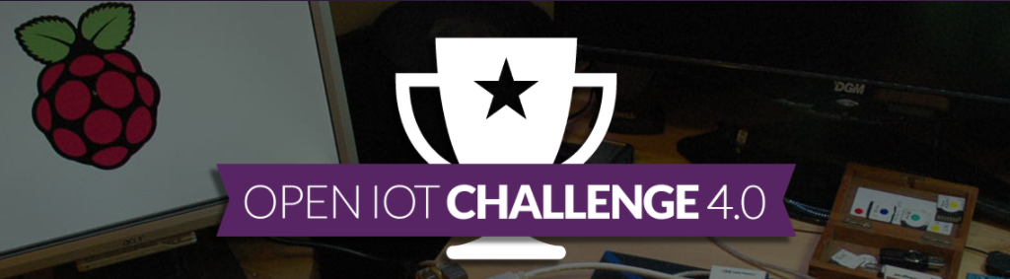
www.opennms.co.uk
Sniffy 2
Dr Craig Gallen, Director Entimoss Ltd (OpenNMS UK)
Email : craig.gallen@entimoss.com
: cgallen@opennms.org
Mobile: +44 (0) 7789 938012

Slide 2

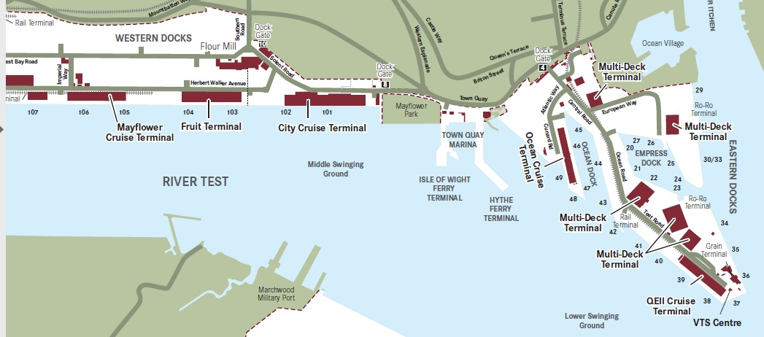
Southampton’s (Smart) Port
The UK’s number one cruise port, which welcomes 1.7m passengers
Each ship up to 6000 passenger and crew
Ship turn around 1-2 days
Increasing problem of air pollution due to generators running while ships in port
Each container ship arriving is like 50 trucks driving through town

Slide 3
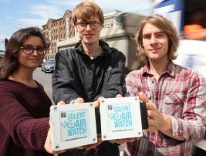
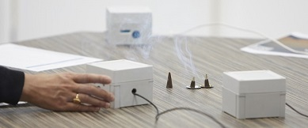
Solent Airwatch
http://www.solentairwatch.co.uk/
Community air monitoring project
Not for profit charity run by Southampton volunteers
With University of Southampton and Solent University
Sniffy – version 1
https://github.com/SolentAirWatch/sniffy
Raspberry Pi Zero
Low cost laser Smoke detector
Ruggedized container

Slide 4
The Solent Airwatch Challenge
The problem
Currently impossible to accurately monitor city wide pollution
Legal enforcement of air quality requires calibrated sensors
Commercial calibrated air quality sensors very expensive
Cheap air quality sensors have wide variation in sensitivity and cant be used for enforcement
The solution
Community sourced low cost air sensors
Gamification – web site to show your sensor data and city wide view
Engage schools, maker space groups , private citizens and city council
The Differentiator - Data Science
Data Science makes low cost sensors viable for accurate measurements
Peer reviewed experiment plan to validate the science behind data processing
Big data processing of city wide sensor data
Neural Network based calibration against commercial sensors

Slide 5
Crowd Sourced IoT Platform
The problem
Lots of attention on platforms for IoT devices themselves – Apache Karaf, Eclipse Kura, OpenHab, NodeRED etc.
Limited progress on common management services across a diversity of IoT devices and services
Deployment and Maintenance of IoT software
Cost of installation and change - maximise reuse of IoT devices for diverse applications
Secure deployment – managing software and authenticating running instances
Service Assurance – managing issues with remote devices
Citizen science – managing the lifecycle of devices built by citizens but connected to our experiment

Slide 6









Java IoT Ecosystem
^{Java IoT Ecosystem}
^{Apache Karaf}
^{Eclipse Kura}
^{OpenHab}
^{OpenNMS Karaf Management}
Minions – remote data collectors
^{Karaf Feature manager}
^{Karaf} ^{Licence manager}
^{Karaf Plugin Manager}
^{JMX Data collection}
Target Hardware; Low cost IoT (e.g. Beaglebone, Raspberry Pi etc.)
Karaf Licence Manager
Karaf Feature Manager
Data collector
Data collector
OpenHab Module
OpenHab Module
OpenNMS Minion
Eclipse Kura
Kura Module
OpenHab
Karaf /OSGi Container
Kura Module
Java
OS

Slide 7
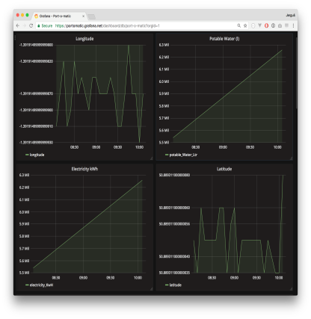
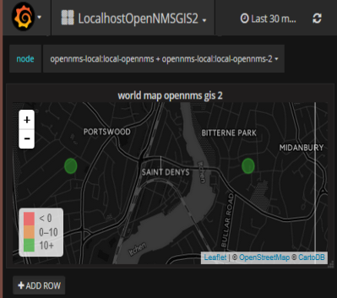





Architecture
User Portal
Crowd Source
Datafill
Data Visualisation
Measurements API
Device
Inventory
OpenNMS
Neural Network Data Processing
TMForum
catalogue
Cassandra
NoSQL
IoT Software
Management
TMForum
Inventory
Port IoT OpenNMS minions
MQTT Broker
IoT Sensor
Authentication
Nexus Repo
Sniffy
Maven
SW repo
Sniffy
Sniffy
Sniffy

Slide 8
www.opennms.co.uk
Sniffy 2
Dr Craig Gallen, Director Entimoss Ltd (OpenNMS UK)
Email : craig.gallen@entimoss.com
: cgallen@opennms.org
Mobile: +44 (0) 7789 938012

