Slide 1


Notes:
Growing Community group

Slide 2
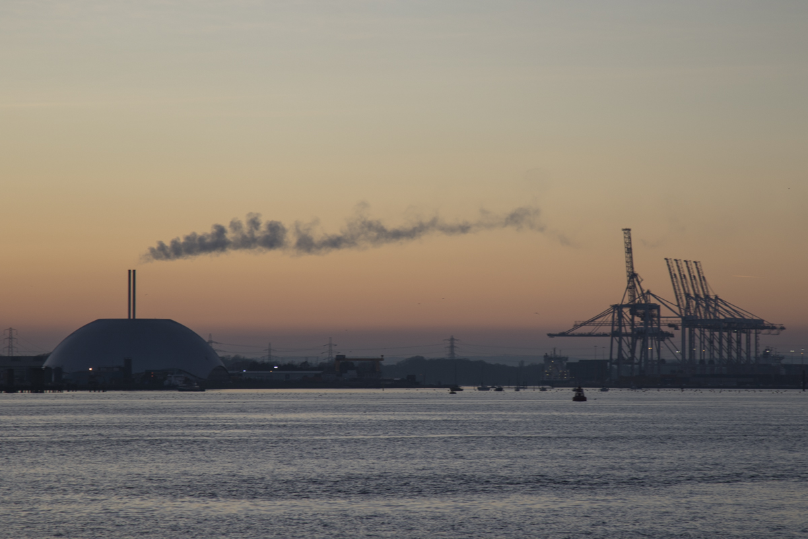
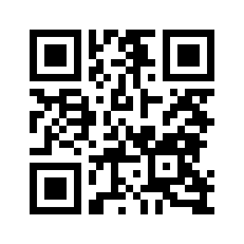
Project Objectives using Citizen Science
Public engagement
Air Quality
Finding alternatives
Identify & compare major pollutant sources
Increase public trust in science
Joshua Taylor
www.solentairwatch.co.uk
info@solentairwatch.co.uk

Slide 3
The Plan
Develop an affordable open-source monitor
Engage the community
Fixed sensors (balcony, school, gardens)
School Campaign
Walking and cycling events
Analyse and disseminate to engaged audience
Measure impact

Slide 4
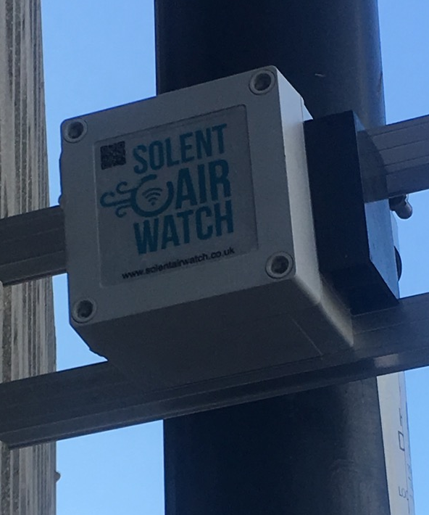
Meet Sniffy
Open-Source Air Quality Monitor
Raspberry Pi / NodeMCU
Particulate Mater PM10, PM2.5, PM1
Resolution ± 1µm/m3
Nitrogen Dioxide
Linearity ±5 ppb

Slide 5
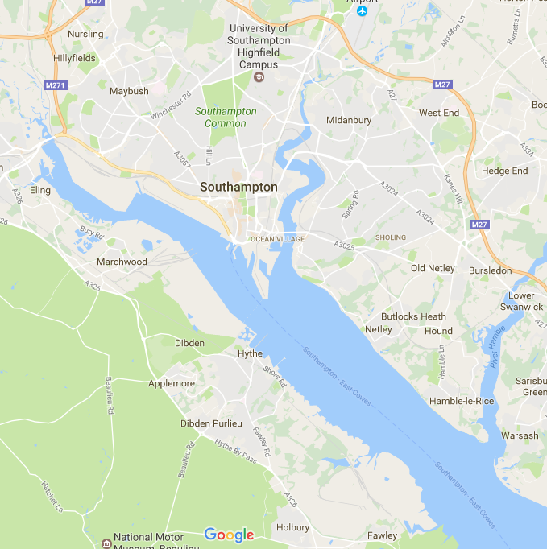
Airport
Docks
Docks
WI ND
No pollution
Pollution
Existing Monitor
Pollution Source
Oil Refinery

Slide 6

Wind variations to validate source
Sensor unaffected by source
Sensor partly affected by source
Sensor very affected by source
Wind direction

Slide 7
Data analysis - Complexities
Smoke plumes from cigarette smoke
Residential flat
Britton Road, DEFRA Reference

Slide 8
Questions / call to action
We’re looking for collaboration and funding opportunities please contact us for more information.
We also need volunteers in PR, visual studies, health sciences, engineering and marketing to help develop our project. These make great student projects and internships. Please encourage your students to contact us .
Many thanks
Joshua Taylor
www.solentairwatch.co.uk
info@solentairwatch.co.uk

Slide 9






Wish to thank:

