Slide 1



Vancouver Airwatch (in collaboration with Solent Airwatch)
TM Forum {open}:hack, Nice France, May 14-16.
Crowd sourced accurate air quality measurements for smart ports and cities using low cost IoT devices

Slide 2
The Challenge
1. Demonstrate a Smart (sea) Port Proof of Concept
Product Catalogue to enhance the economic potential of a major port
Demonstrate a Generalised Product Catalogue IoT service lifecycle management solution
2. Address specific problem of Air Pollution Reduction
Cities hosting major ports (or airports) encounter significant air quality problems
Accurate legally enforceable pollution measurements expensive
Can we used neural networks to increase the accuracy of cheap crowd sourced smoke detectors
3. Demonstrate feasibility of crowd sourced IoT sensor devices
Generalised Crowd Sourced IoT management solution which can be used in ports and cities
Apply a generalised catalogue portal to lifecycle of crowd sourced air quality sensors
4. Build on Previous work
Port-O-Matic - Simulated Drone based IoT sensors for ports (TMForum Nice 2017)
Solent Airwatch ‘Sniffy’ crowd sourced air quality detectors

Slide 3

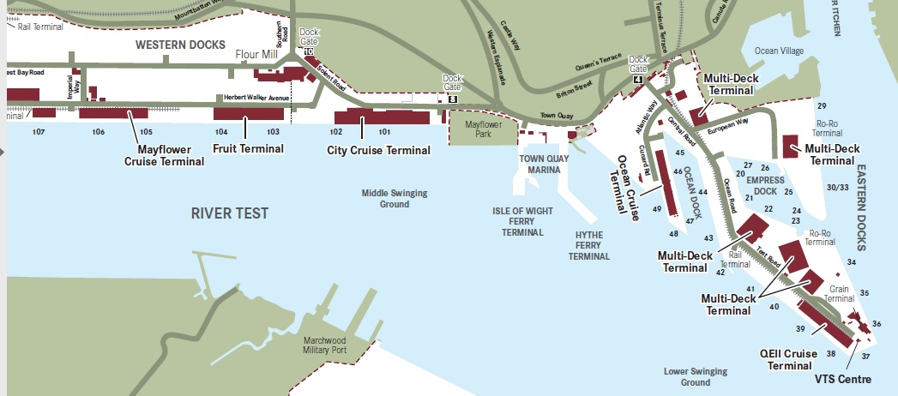
Southampton’s (Smart ) Port
Previous work : port-o-matic
Addressing the 5G and Smart city challenge
The UK’s number one cruise port, which welcomes 1.7m passengers
Each ship up to 6000 passenger and crew
Ship turn around 1-2 days
Increasing problem of air pollution due to generators running while ships in port
Ships need dock side services including
Water, waste, electricity, communications
Smart Ports
What is a Smart Port? no waste of space, time, money and natural resources
an integration of various infrastructures, both physical and IT. That includes different network technologies like radio, LAN, WAN and WLAN, RFID and positioning technologies.”
https://www.porttechnology.org/news/what_is_a_smart_port

Slide 4

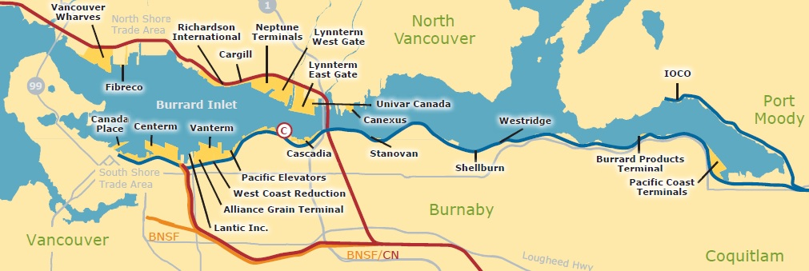
(Smart) Port of Vancouver
https://www.portvancouver.com/
27 major marine cargo terminals
Port activities annually sustain:
$24.2 billion in economic output
$11.9 billion in gross domestic product (GDP)
$7 billion in wages
115,300 jobs in Canada
96,200 jobs in British Columbia
$1.4 billion per year in tax revenues
Known problems with pollution
Ship Shore power saves 2656 tonnes CO²

Slide 5


Solent Airwatch
http://www.solentairwatch.co.uk/
Community air monitoring project
Not for profit charity run by Southampton volunteers
With University of Southampton and Solent University
Sniffy – version 1
https://github.com/SolentAirWatch/sniffy
Raspberry Pi Zero
Low cost laser Smoke detector
Ruggedized container

Slide 6
The Solent Airwatch Challenge
The problem
Currently impossible to accurately monitor city wide pollution
Legal enforcement of air quality requires calibrated sensors
Commercial calibrated air quality sensors very expensive
Cheap air quality sensors have wide variation in sensitivity and cant be used for enforcement
The solution
Community sourced low cost air sensors
Gamification – web site to show your sensor data and city wide view
Engage schools, maker space groups , private citizens and city council
The Differentiator - Data Science
Data Science makes low cost sensors viable for accurate measurements
Peer reviewed experiment plan to validate the science behind data processing
Big data processing of city wide sensor data
Neural Network based calibration against commercial sensors

Slide 7
Crowd Sourced IoT Platform challenge
The problem
Lots of attention on platforms for IoT devices themselves – Apache Karaf, Eclipse Kura, OpenHab, NodeRED etc.
Limited progress on common management services across a diversity of IoT devices and services
Deployment and Maintenance of IoT software
Cost of installation and change - maximise reuse of IoT devices for diverse applications
Secure deployment – managing software and authenticating running instances
Service Assurance – managing issues with remote devices
Citizen science – managing the lifecycle of devices built by citizens but connected to our experiment

Slide 8
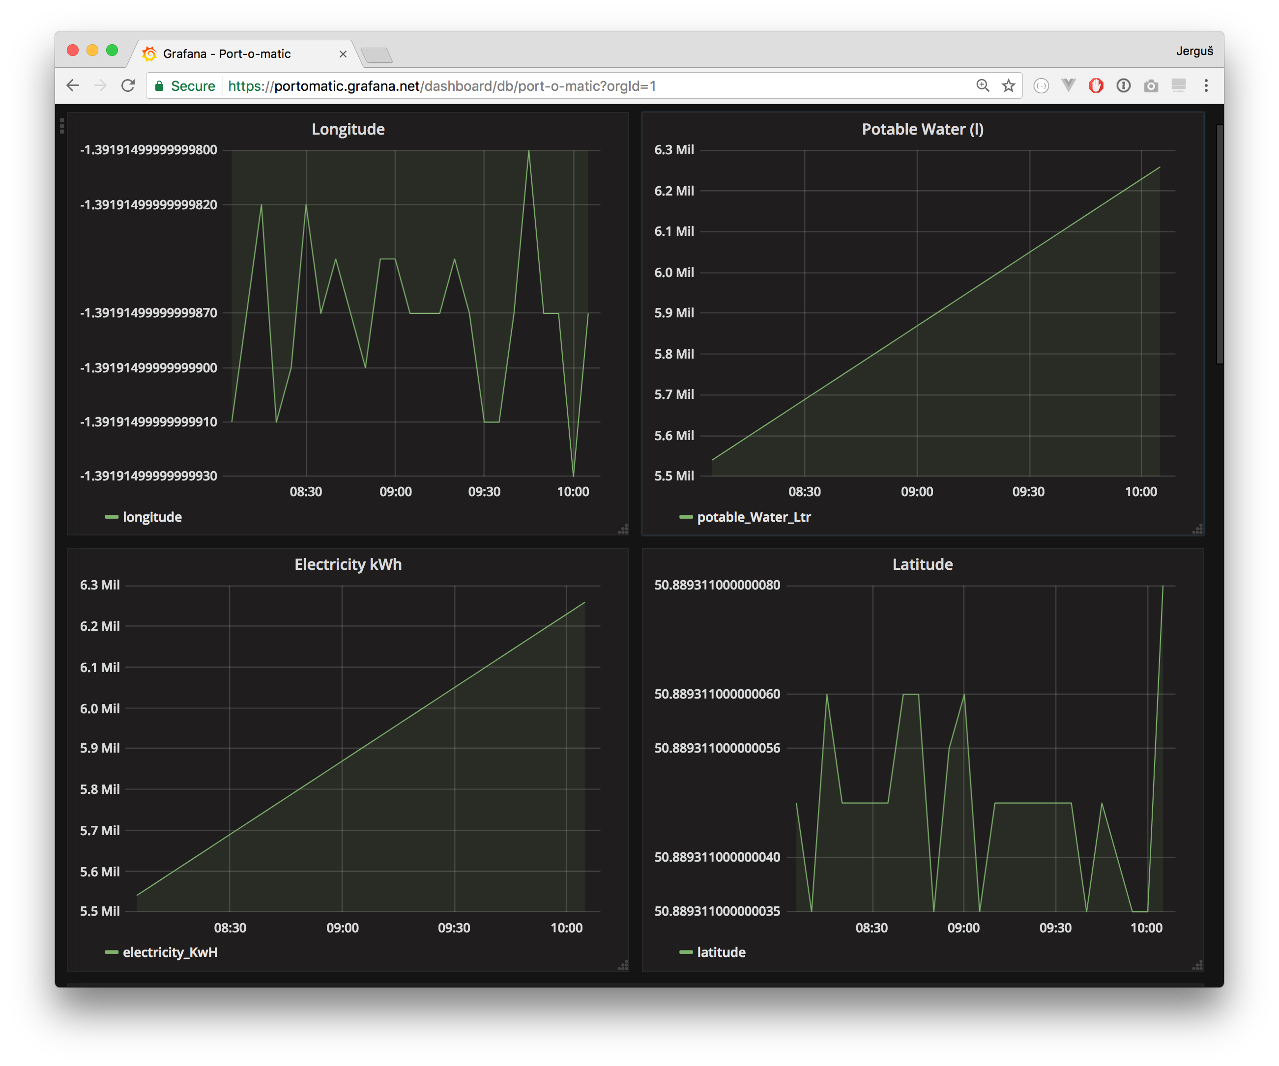
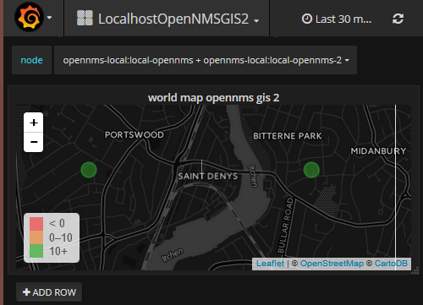



Architecture
User Portal
Crowd Source
Datafill
Data Visualisation
Measurements API
Device
Inventory
OpenNMS
Neural Network Data Processing
TMForum
catalogue
Cassandra
NoSQL
IoT Software
Management
TMForum
Inventory
Port IoT OpenNMS minions
MQTT Broker
IoT Sensor
Authentication
Sniffy
Sniffy
Sniffy
Sniffy

Slide 9




Java IoT Ecosystem
^{Java IoT Ecosystem}
^{Apache karaf}
^{Eclipse Kura}
^{OpenHab}
^{OpenNMS Karaf Management}
Minions – remote data collectors
^{Karaf Feature manager}
^{Karaf} ^{Licence manager}
^{Karaf Plugin Manager}
^{JMX Data collection}
Target Hardware; Low cost IoT (e.g. Beaglebone, Raspberry Pi etc.)
Karaf Licence Manager
Karaf Feature Manager
Data collector
Data collector
OpenHab Module
OpenHab Module
OpenNMS Minion
Eclipse Kura
OpenHab
Kura Module
Karaf /OSGi Container
Kura Module
Java
OS

Slide 10
Licence Manager / App Store
API for creating Public Key
licences
Licence Modules loaded using ‘features.xml’ from private licence module repo
Archetype makes it easy for developers to generate licences and licence authenticators as part of plugin build
Shopping
Cart /
Payment
Gateway
(Wordpress EDD)
Licence Module
Licence Module
Licence Publisher
Karaf OSGi Container
Licence Generator
Archetype
Private
Maven
Licence
Repo
Maven Project generates
Licence Specification
Licence Authenticator
Licence Specification is kept private and stored in local licence spec repo
Licence Publisher
Licences distributed using
Cut/Paste
from User Account in
Payment Gateway
Private Key Licence Authenticator is included in main OSGi Module project
OpenNMS OSGi API
Licence Manager
Config Extender
Module
Module
Karaf /OSGi Container/Bridge
Maven Project generates
OSGi Plugin including
Licence authenticator
Public
Maven
Plugin
Repo
Modules only run if valid licence installed by licence manager.
OSGi Module deployed to plugin repo.
Module can only be activated if Licence manager present and licence installed
OSGi container /
OpenNMS
Product Modules loaded from Maven plugin repo using features.xml

Slide 11
Workflow for Activating Module
End User
Licence Publisher
Shopping Cart
Payment Gateway
Plugin
Repo
Licence Manager
Product Module / Licence Authenticator
Programmer
1. Generate Licence Specification and
Licence Authenticator pair and include Authenticator in Plugin Module
2. Publish Module Including Licence Authenticator
3. Publish Licence Spec
4. Shopping cart asks Licence publisher for list of products
5. User asks shopping cart for list of products
6. User buys product licence from shopping cart
7. Shopping cart requests licence to be created for account
8.User retrieves licence from shopping cart account
9. User deploys product licence in Licence Manager
10. User /Licence manager deploys product from plugin product repo
11. Product Module Licence Authenticator authenticates Licence with Licence Manager
12. Module Starts

Slide 12
backup
TM Forum {open}:hack, Nice France, May 14-16.

Slide 13
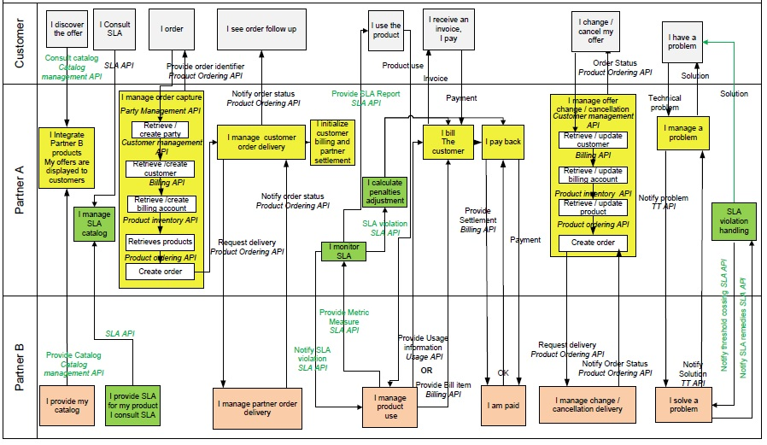
Typical Complex TMF API usage

Slide 14
TM Forum API’s
Activation and Configuration API | The REST API for Activation and Configuration allows the user to retrieve, create, update, delete services and retrieve the monitor resource used to monitor the execution of asynchronous requests on specific resource. Although all the examples given in the API specification are relative to Services, the same API can be used to Activate and Configure Services or Resources.
Address API | The Address API is one of the Pre-Ordering Management APIs. The Address API provides a standardized client interface to an Address management system .It allows to look for worldwide addresses. It can also be used to validate address data, to be sure that it corresponds to a real address.
Agreement API | The Agreement API provides standardized mechanism for managing agreements, especially in the context on partnerships between partners.
Appointment API | The Appointment API is one of the Pre-Ordering Management APIs. The appointment API provides a standardized mechanism to book an appointment with all the necessary appointment characteristics. First, the API consists in searching free slots based on parameters, as for example a party. Then, the appointment is created. The appointment has characteristics such as nature of appointment, place of appointment...
Billing Management API | Provides standardized mechanisms for billing account, bill item and settlement note advice management either in B2B or B2B2C contexts.
Customer Management API | Provides a standardized mechanism for customer and customer account management, such as creation, update, retrieval, deletion and notification of events.
Onboarding API | The Onboarding API provides standardized mechanisms for managing an onboarding process. The API allows the retrieval, creation, update and deletion of partnership type and its owned sub- resources.The intention for partner onboarding in the Digital Ecosystem is to have a lightweight approach similar to an end-user signing-on to terms and conditions for downloadable applications. The onboarding of the “Party”, the role can be Partner, Supplier, Developer, etc. The onboarding of the “Services” could be product offerings.
Party Management API | Provides a standardized mechanism for party management such as creation, update, retrieval, deletion and notification of events. A Party can be an individual or an organization that has any kind of relation with the enterprise.
Performance Management API | Provides a standardized mechanism for performance management such as the creation, partial or full update and retrieval of resources involved in performance management (Measurement Production Job, Measurement Collection Job, and Ad hoc Collection). It also allows notification of events related to performance.
Privacy API | The Privacy management API provides standardized mechanism for privacy profile types, privacy profiles and privacy agreements such as creation, update, retrieval, deletion and notification of events..
Product Catalog Management API | Provides a standardized solution for rapidly adding partners’ products to an existing Catalog. It brings the capability for Service Providers to directly feed partners systems with the technical description of the products they propose to them.
Product Inventory Management API | Provides standardized mechanism for product inventory management such as creation, partial or full update and retrieval of the representation of a product in the inventory. It also allows the notification of events related to product lifecycle.
Product Ordering API | Provides a standardized mechanism for placing a product order with all of the necessary order parameters. The API consists of a simple set of operations that interact with CRM/Order negotiation systems in a consistent manner. A product order is created based on a product offering that is defined in a catalog. The product offering identifies the product or set of products that are available to a customer, and includes characteristics such as pricing, product options and market.
Quote API | The Quote API is one of the Pre-Ordering Management APIs. The customer Quote API provides a standardized mechanism for placing a customer quote with all of the necessary quote parameters.
Service Qualification API | Service Qualification API is one of the Pre-Ordering Management APIs. Service Qualification API goal is to provide service availability at Customer location.
SLA Management API | Provides a standardized interface for Service Level Agreement (SLA) life-cycle Management (SLA Negotiation, SLA configuration SLA Activation/enforcement, SLA Operations, SLA violation / consequence handling, SLA reporting) between a Customer and a Service Provider which provides offers (product with attached SLA in its catalogue) the customer can discover, browse, trigger and order.

Slide 15
TM Forum API’s
Trouble Ticket API | Provides a standardized client interface to Trouble Ticket Management Systems for creating, tracking and managing trouble tickets among partners as a result of an issue or problem identified by a customer or another system. Examples of Trouble Ticket API clients include CRM applications, network management or fault management systems, or other trouble ticket management systems (e.g. B2B).
Usage Management API | Provides standardized mechanism for usage management such as creation, update, retrieval, import and export of a collection of usages. The API manages both rated and non-rated usage. For example, it allows a service provider to 1) retrieve usage generated by a partner service platform in order to rate it and 2) to provide rated usage to a partner for consumption follow up purposes.
Service Problem Management API (SPM) | The SPM API is used to manage service problems. Service problems are generated based on the information declared by a partner or the event information notified from infrastructure providers.The event information includes alarm information, performance anomaly information, trouble ticket information, SLA violation, maintenance information and prediction information.
Service Ordering API | The REST API for Service Order Management provides a standardized mechanism for placing a service order with all of the necessary order parameters. It allows users to create, update & retrieve Service Orders and manages related notifications.
Service Catalog API | The Service Catalog Management API allows the management of the entire lifecycle of the service catalog elements.
Service Test Management API | The Service Test API provides a standardized mechanism for placing a service test with all of the necessary test parameters. The API consists of a simple set of operations that interact with CRM/Service Management systems in a consistent manner. A service test is a procedure intended to check the quality, performance, or reliability of a service.
Change Management API | The Change Management API provides the standard integration capabilities between external applications and Change Management Application. The API consists of a simple set of operations that interact with Change Request in a consistent manner. A Change Request is an IT service management discipline.
Service Inventory API | The intent of this API is to provide a consistent/standardized mechanism to query and manipulate the Service inventory.
Loyalty Management API | The Loyalty API supports the management of loyalty program specifications, loyalty program members, their associated products and loyalty accounts with loyalty balances. The scope of the API also covers the management of loyalty rules and under what conditions the associated loyalty actions must be applied.
Service Quality Management API | Through this API, any Enterprise is able to access a Service Quality Management application and extract Service Level Specifications and associated Service Level Objectives (SLO) and their thresholds.
NFV Entity Provisioning API | REST API for NFV Entity Provisioning i.e. provisioning and lifecycle management of Network Services composed from Physical and Virtual Network Functions
Resource Ordering API | The REST API for Resource Order Management. It includes the model definition as well as all available operations. Possible actions are creating, updating and retrieving Resource Orders (including filtering). A Resource Order API provides a standard mechanism for placing a Resource Order with all necessary order parameters.
Resource Catalog API | The Resource Catalog Management API REST specification allows the management of the entire lifecycle of the Resource Catalog elements, the consultation of resource catalog elements during several processes such as ordering process, campaign management, sales management.
Prepay Balance Management API | REST API for Balance Management. It includes the model definition as well as all available operations for prepay balance management. Prepaid subscribers pay fees before using services. Therefore, the subscribers must have sufficient balances. Operators can provide multiple recharge channels for subscribers. Subscribers can pass credit between different subscriptions, therefore transferring balance from one account to another.

Slide 16

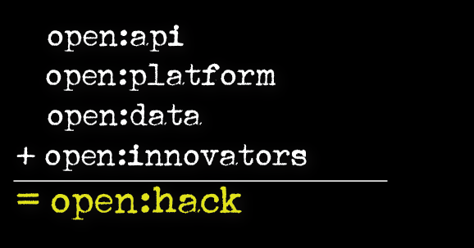
TM Forum OPEN HACK

Slide 17
DRAFT

Slide 18
Requirements
Common IoT platform used across applications
Multiple independent applications/services possible on platform
Independent developers can write and test applications
Applications authenticated to run on specific IoT devices using certificates/licences
Common Management platform controls community of ‘known’ IoT devices
Control software delivery and upgrade
Monitor applications and remote devices
Manage authentication of devices
Technology platform
Java / OSGi
All code Open Source
See: https://github.com/gallenc/tmforumhack2017/tree/master/TMForumNice2017Hack
Configuration
Security
Each Pi can run multipe services
Each service needs autehnticated to run on Pi
Remote managemetn of service

Slide 19


Smart Port API Scenario - utilities
IoT devices
Smoke level violation events and location events
Raspberry PI
Air Polution Sensor (drone)
Raspberry PI
OpenNMS
Water Usage
Waste usage
Usage Statistics
Power usage
Charging events and usage stats to
Update Billing API
Ship Service inventory events

Slide 20
API’s to order service
Use of API’s
Catalog API
List of products available from which we can choose
Service Qualification API
Service Qualification API goal is to show service availability at Customer location. We will use this to see if the desired services are available at a given birth
Appointment API
Booking a time slot in the birth for a given service
Address API
Location of birth
Order API - not clear if Quote API or other
- We will need one other api to place an order

Slide 21
API’s to bill or report problems
Use of API’s
Service Problem Management API / TT api
Show when drone detects excessive smoke from ship
Billing API
Produce bill based upon usage at end of term in birth

Slide 22
TMF Resources
Resources
https://github.com/tmforum/ Has both example code, RI’s Example apps and specification documents
Specs: https://projects.tmforum.org/wiki/display/API/Open+API+Table
Reference implementations
Product catalogue api RI
https://github.com/tmforum/DSPRODUCTCATALOG2
Product catalogue app – in JavaScript
https://github.com/tmforum/DSM-Product-Catalog-API-App
This runs against an RI instance at http://tmforum-test.apigee.net/v1/tm-forum-product-category-api/
Product Order API ( note this is ant build and requires netbeans – haveny yet been able to build)
Product order RI
https://github.com/tmforum/DSPRODUCTORDERING
Product order app – in javascript
https://github.com/tmforum/DSM-Product-Ordering-API-App
Runs against RI instance at http://tmforum-test.apigee.net/v1/tm-forum-product-order-api

Slide 23
Architecture
Raspberry pi
User interfaces
iot
Java Script Apps
Java Script Apps
Java Script Apps
SDN LAB (Solent)
Cloud hosted servers
SDN Networking scenario demo
J2EE (Glassfish server)
Catalog RI
Address RI
etc
opennms
Derby DB

Slide 24
VANCOUVER

