Slide 1
Team Solent
TM Forum {open}:hack, Nice France, May 14-16.

Slide 2


Next Hack Event
Open Hack Nice May 14th - 16th 2017 http://www.tmforumlive.org/open-hack-nice/
Overview
TM Forum’s open hack is a competitive hackathon with prizes
The entire event is designed as a learning and innovation platform. We pride ourselves on the quality expertise provided both as training and 1:1 support.
The Hackathon is designed to help designers & developers to rapidly create new innovative solutions using an open ecosystem platform and open API suite.
The roles specifically being sought are software developer from service providers, solution vendors and SMEs, IoT & Smart City Application Developers, Architects & product designers, Network Engineers & architects, startups, incubators, university students, UX developers and Business Analysts.
General App Requirements
You should create an app or product using combination's of TM Forum Open APIs, Salesforce APIs, Huawei APIs and other digital assets exposed by the partnering sponsors.
You are encouraged to bring any product or service you may already have.
The Open API suite has been collaboratively created with contributions from across industry and these APIs are currently adopted by many communications service providers around the globe

Slide 3



Next Hack Event
challenges
IoT smart city
5G Network Services
Accelerate the incubation of new digital business opportunities in the areas of IoT/Smart City & NFV/SDN
API’s from
TM Forum
Salesforce
Vodafone

Slide 4

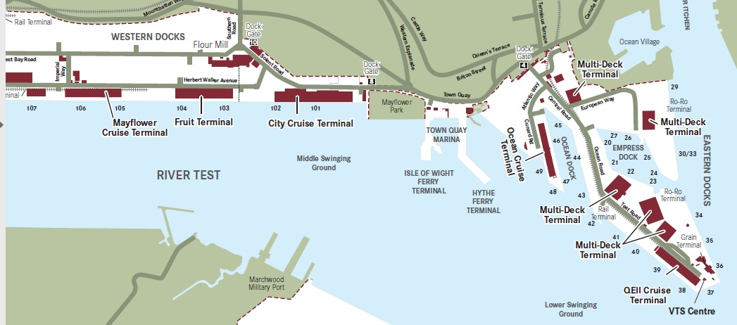
Southampton’s (Smart ) Port
Addressing the 5G and Smart city challenge
The UK’s number one cruise port, which welcomes 1.7m passengers
Each ship up to 6000 passenger and crew
Ship turn around 1-2 days
Increasing problem of air pollution due to generators running while ships in port
Ships need dock side services including
Water, waste, electricity, communications
Smart Ports
What is a Smart Port? no waste of space, time, money and natural resources
an integration of various infrastructures, both physical and IT. That includes different network technologies like radio, LAN, WAN and WLAN, RFID and positioning technologies.”
https://www.porttechnology.org/news/what_is_a_smart_port

Slide 5



Smart Port API Scenario
IoT devices
Using Open Api’s to allow ships to pre-order and receive port services
Communications services
Berth (specification)
Waste water
Fresh water
Electrical Power
Pollution certificates
Service qualification
Which Births offer which services at which date
Service / Product catalogue
Description of services and pricing
Ordering API
Order service in advance
Appointment API - order for when in port
Usage API
Usage of service – related to ship in port
Address API
location of births
Party API
Crew, Dock, Shipping agent
Air Polution Sensor (drone)
Water Usage
Waste usage
Power usage
Ship SDN
Port SDN
Communications
Setup / usage
ReST API
Parties: Ship Purser, Shipping Agent
Port Agent
We wont use all these APIs but these are candidates

Slide 6
Smart Port API Scenario - utilities
IoT devices
Smoke level violation events and location events
Raspberry PI
Air Polution Sensor (drone)
Raspberry PI
OpenNMS
Water Usage
Waste usage
Usage Statistics
Power usage
Charging events and usage stats to
Update Billing API
Ship Service inventory events

Slide 7

Smart Port API Scenario - communications
Communications
Setup / usage
Ship SDN
Port SDN
Simple example VPN’s set up using SDN
To all ow communications between ship and
Specific services.
Ship SDN Controller/Switch
Port SDN Controller/Switch

Slide 8
Architecture
Raspberry pi
User interfaces
iot
Java Script Apps
Java Script Apps
Java Script Apps
SDN LAB (Solent)
Cloud hosted servers
SDN Networking scenario demo
J2EE (Glassfish server)
Catalog RI
Address RI
etc
opennms
Derby DB

Slide 9
API’s to order service
Use of API’s
Catalog API
List of products available from which we can choose
Service Qualification API
Service Qualification API goal is to show service availability at Customer location. We will use this to see if the desired services are available at a given birth
Appointment API
Booking a time slot in the birth for a given service
Address API
Location of birth
Order API - not clear if Quote API or other
- We will need one other api to place an order

Slide 10
API’s to bill or report problems
Use of API’s
Service Problem Management API / TT api
Show when drone detects excessive smoke from ship
Billing API
Produce bill based upon usage at end of term in birth

Slide 11
TMF Resources
Resources
https://github.com/tmforum/ Has both example code, RI’s Example apps and specification documents
Specs: https://projects.tmforum.org/wiki/display/API/Open+API+Table
Reference implementations
Product catalogue api RI
https://github.com/tmforum/DSPRODUCTCATALOG2
Product catalogue app – in JavaScript
https://github.com/tmforum/DSM-Product-Catalog-API-App
This runs against an RI instance at http://tmforum-test.apigee.net/v1/tm-forum-product-category-api/
Product Order API ( note this is ant build and requires netbeans – haveny yet been able to build)
Product order RI
https://github.com/tmforum/DSPRODUCTORDERING
Product order app – in javascript
https://github.com/tmforum/DSM-Product-Ordering-API-App
Runs against RI instance at http://tmforum-test.apigee.net/v1/tm-forum-product-order-api

Slide 12
Information about ports
Port information
http://www.southamptonvts.co.uk/Port_Information/Berths_and_Facilities/
Birth id, Advertised Depth (m) , Length
http://www.southamptonvts.co.uk/Live_Information/Shipping_Movements_and_Cruise_Ship_Schedule/Vessels_Alongside/
Ship Name, Lloyds No, Type, Flag, Actual Arrival Time, Berth, Origin, Side To,Draft ,LOA, DWT, Agent
Port Southampton (locode: GBSOU) (https://www.vesselfinder.com/?p=1723) bassed upon AIS information
Port tarrifs http://www.southamptonvts.co.uk/Port_Information/Commercial/Southampton_Tariff/

Slide 13
backup
TM Forum {open}:hack, Nice France, May 14-16.

Slide 14
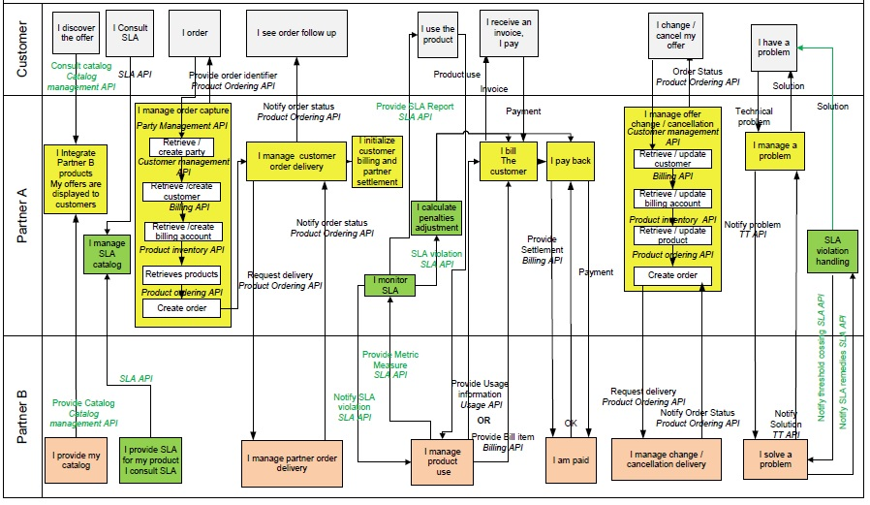
Typical Complex TMF API usage

Slide 15
TM Forum API’s
Activation and Configuration API | The REST API for Activation and Configuration allows the user to retrieve, create, update, delete services and retrieve the monitor resource used to monitor the execution of asynchronous requests on specific resource. Although all the examples given in the API specification are relative to Services, the same API can be used to Activate and Configure Services or Resources.
Address API | The Address API is one of the Pre-Ordering Management APIs. The Address API provides a standardized client interface to an Address management system .It allows to look for worldwide addresses. It can also be used to validate address data, to be sure that it corresponds to a real address.
Agreement API | The Agreement API provides standardized mechanism for managing agreements, especially in the context on partnerships between partners.
Appointment API | The Appointment API is one of the Pre-Ordering Management APIs. The appointment API provides a standardized mechanism to book an appointment with all the necessary appointment characteristics. First, the API consists in searching free slots based on parameters, as for example a party. Then, the appointment is created. The appointment has characteristics such as nature of appointment, place of appointment...
Billing Management API | Provides standardized mechanisms for billing account, bill item and settlement note advice management either in B2B or B2B2C contexts.
Customer Management API | Provides a standardized mechanism for customer and customer account management, such as creation, update, retrieval, deletion and notification of events.
Onboarding API | The Onboarding API provides standardized mechanisms for managing an onboarding process. The API allows the retrieval, creation, update and deletion of partnership type and its owned sub- resources.The intention for partner onboarding in the Digital Ecosystem is to have a lightweight approach similar to an end-user signing-on to terms and conditions for downloadable applications. The onboarding of the “Party”, the role can be Partner, Supplier, Developer, etc. The onboarding of the “Services” could be product offerings.
Party Management API | Provides a standardized mechanism for party management such as creation, update, retrieval, deletion and notification of events. A Party can be an individual or an organization that has any kind of relation with the enterprise.
Performance Management API | Provides a standardized mechanism for performance management such as the creation, partial or full update and retrieval of resources involved in performance management (Measurement Production Job, Measurement Collection Job, and Ad hoc Collection). It also allows notification of events related to performance.
Privacy API | The Privacy management API provides standardized mechanism for privacy profile types, privacy profiles and privacy agreements such as creation, update, retrieval, deletion and notification of events..
Product Catalog Management API | Provides a standardized solution for rapidly adding partners’ products to an existing Catalog. It brings the capability for Service Providers to directly feed partners systems with the technical description of the products they propose to them.
Product Inventory Management API | Provides standardized mechanism for product inventory management such as creation, partial or full update and retrieval of the representation of a product in the inventory. It also allows the notification of events related to product lifecycle.
Product Ordering API | Provides a standardized mechanism for placing a product order with all of the necessary order parameters. The API consists of a simple set of operations that interact with CRM/Order negotiation systems in a consistent manner. A product order is created based on a product offering that is defined in a catalog. The product offering identifies the product or set of products that are available to a customer, and includes characteristics such as pricing, product options and market.
Quote API | The Quote API is one of the Pre-Ordering Management APIs. The customer Quote API provides a standardized mechanism for placing a customer quote with all of the necessary quote parameters.
Service Qualification API | Service Qualification API is one of the Pre-Ordering Management APIs. Service Qualification API goal is to provide service availability at Customer location.
SLA Management API | Provides a standardized interface for Service Level Agreement (SLA) life-cycle Management (SLA Negotiation, SLA configuration SLA Activation/enforcement, SLA Operations, SLA violation / consequence handling, SLA reporting) between a Customer and a Service Provider which provides offers (product with attached SLA in its catalogue) the customer can discover, browse, trigger and order.

Slide 16
TM Forum API’s
Trouble Ticket API | Provides a standardized client interface to Trouble Ticket Management Systems for creating, tracking and managing trouble tickets among partners as a result of an issue or problem identified by a customer or another system. Examples of Trouble Ticket API clients include CRM applications, network management or fault management systems, or other trouble ticket management systems (e.g. B2B).
Usage Management API | Provides standardized mechanism for usage management such as creation, update, retrieval, import and export of a collection of usages. The API manages both rated and non-rated usage. For example, it allows a service provider to 1) retrieve usage generated by a partner service platform in order to rate it and 2) to provide rated usage to a partner for consumption follow up purposes.
Service Problem Management API (SPM) | The SPM API is used to manage service problems. Service problems are generated based on the information declared by a partner or the event information notified from infrastructure providers.The event information includes alarm information, performance anomaly information, trouble ticket information, SLA violation, maintenance information and prediction information.
Service Ordering API | The REST API for Service Order Management provides a standardized mechanism for placing a service order with all of the necessary order parameters. It allows users to create, update & retrieve Service Orders and manages related notifications.
Service Catalog API | The Service Catalog Management API allows the management of the entire lifecycle of the service catalog elements.
Service Test Management API | The Service Test API provides a standardized mechanism for placing a service test with all of the necessary test parameters. The API consists of a simple set of operations that interact with CRM/Service Management systems in a consistent manner. A service test is a procedure intended to check the quality, performance, or reliability of a service.
Change Management API | The Change Management API provides the standard integration capabilities between external applications and Change Management Application. The API consists of a simple set of operations that interact with Change Request in a consistent manner. A Change Request is an IT service management discipline.
Service Inventory API | The intent of this API is to provide a consistent/standardized mechanism to query and manipulate the Service inventory.
Loyalty Management API | The Loyalty API supports the management of loyalty program specifications, loyalty program members, their associated products and loyalty accounts with loyalty balances. The scope of the API also covers the management of loyalty rules and under what conditions the associated loyalty actions must be applied.
Service Quality Management API | Through this API, any Enterprise is able to access a Service Quality Management application and extract Service Level Specifications and associated Service Level Objectives (SLO) and their thresholds.
NFV Entity Provisioning API | REST API for NFV Entity Provisioning i.e. provisioning and lifecycle management of Network Services composed from Physical and Virtual Network Functions
Resource Ordering API | The REST API for Resource Order Management. It includes the model definition as well as all available operations. Possible actions are creating, updating and retrieving Resource Orders (including filtering). A Resource Order API provides a standard mechanism for placing a Resource Order with all necessary order parameters.
Resource Catalog API | The Resource Catalog Management API REST specification allows the management of the entire lifecycle of the Resource Catalog elements, the consultation of resource catalog elements during several processes such as ordering process, campaign management, sales management.
Prepay Balance Management API | REST API for Balance Management. It includes the model definition as well as all available operations for prepay balance management. Prepaid subscribers pay fees before using services. Therefore, the subscribers must have sufficient balances. Operators can provide multiple recharge channels for subscribers. Subscribers can pass credit between different subscriptions, therefore transferring balance from one account to another.

Slide 17

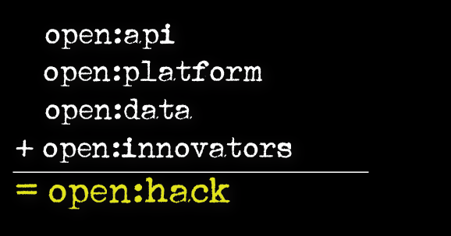
TM Forum OPEN HACK

