Slide 1
Intro to Linear Regression
CS 506

Slide 2
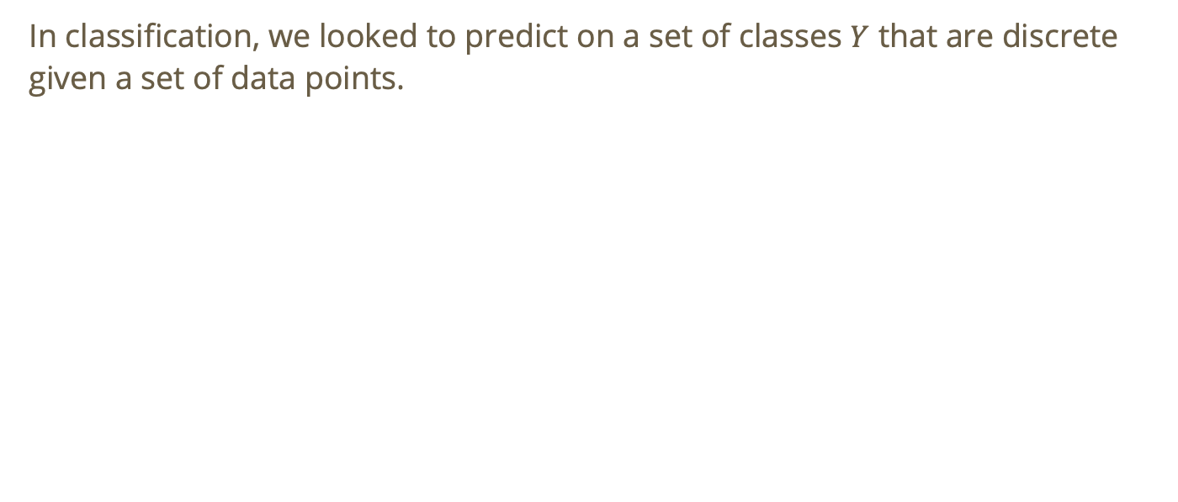
Recall: motivation for regression
In classification, we looked to predict on a set of classes $Y$ that are discrete given a set of data points.

Slide 3
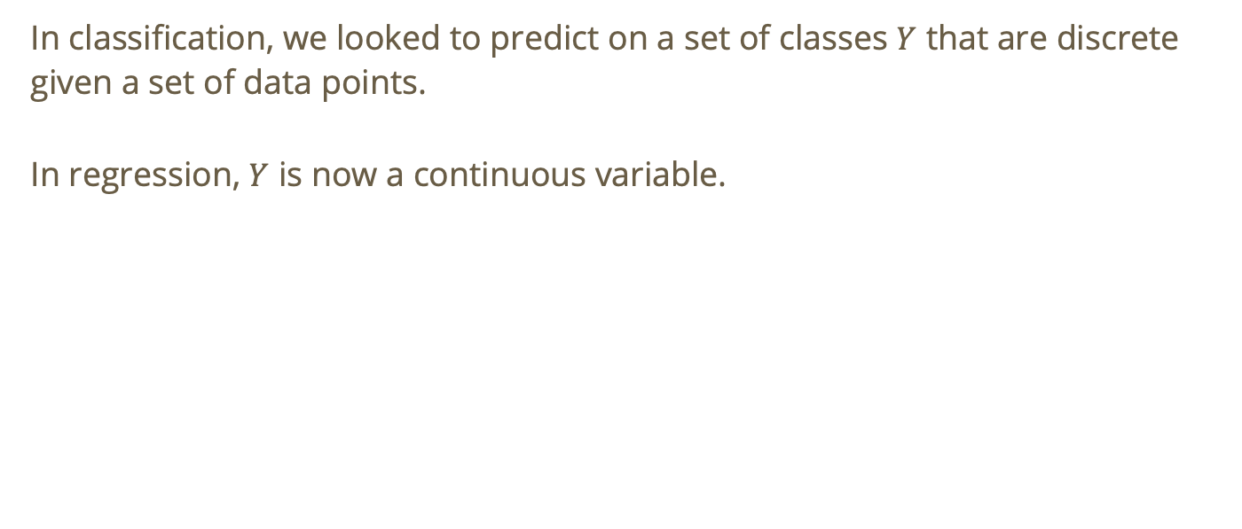
Recall: motivation for regression
In classification, we looked to predict on a set of classes $Y$ that are discrete given a set of data points.
In regression, $Y$ is now a continuous variable.

Slide 4
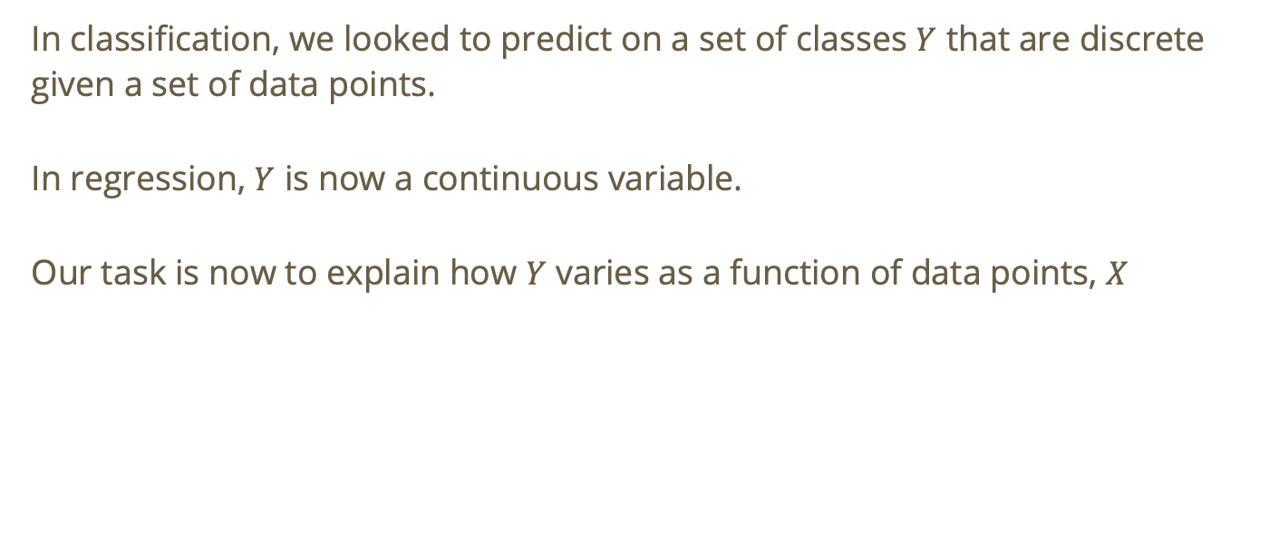
Recall: motivation for regression
In classification, we looked to predict on a set of classes $Y$ that are discrete given a set of data points.
In regression, $Y$ is now a continuous variable.
Our task is now to explain how $Y$ varies as a function of data points, $X$

Slide 5
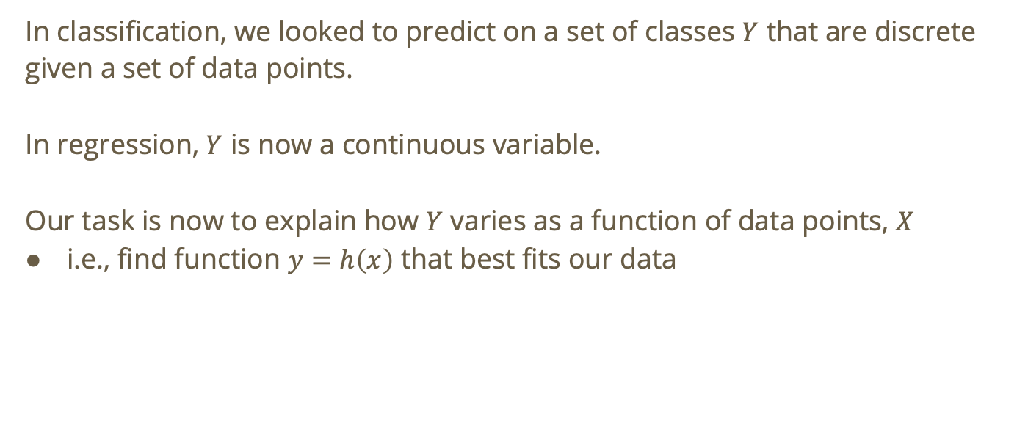
Recall: motivation for regression
In classification, we looked to predict on a set of classes $Y$ that are discrete given a set of data points.
In regression, $Y$ is now a continuous variable.
Our task is now to explain how $Y$ varies as a function of data points, $X$
i.e., find function $y=h\left(x\right)$ that best fits our data

Slide 6
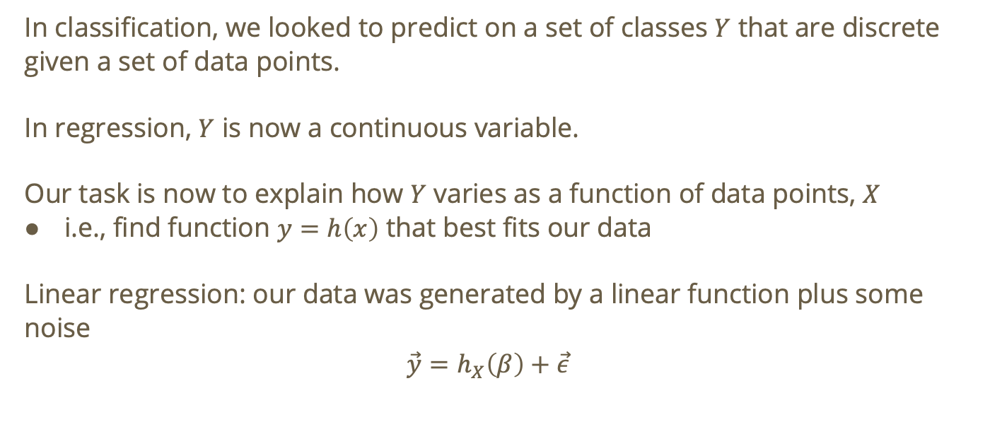
Recall: motivation for regression
In classification, we looked to predict on a set of classes $Y$ that are discrete given a set of data points.
In regression, $Y$ is now a continuous variable.
Our task is now to explain how $Y$ varies as a function of data points, $X$
i.e., find function $y=h\left(x\right)$ that best fits our data
Linear regression: our data was generated by a linear function plus some noise
$$\vec{y}=h_{X}\left(β\right)+\vec{ε}$$

Slide 7
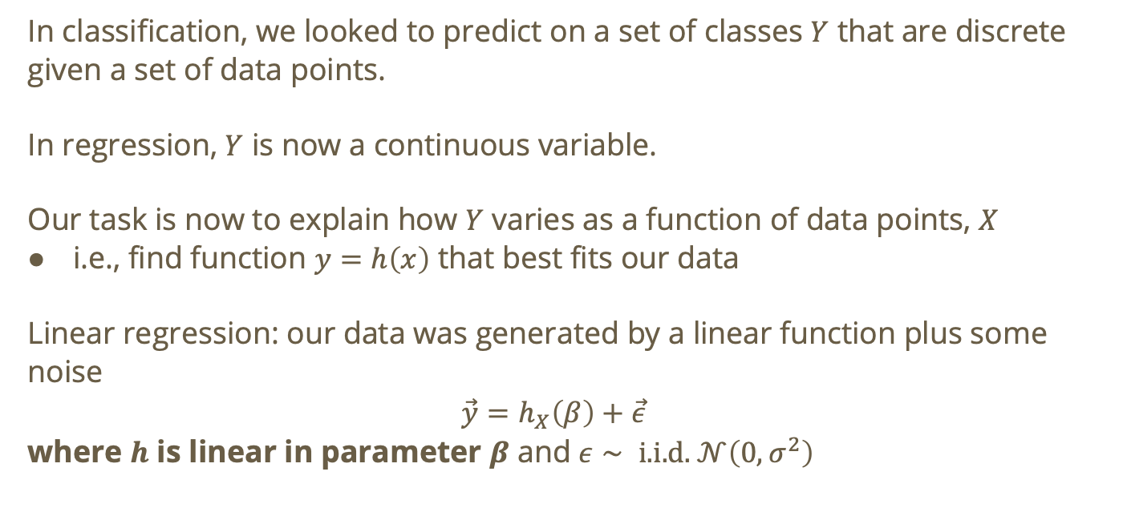
Recall: motivation for regression
In classification, we looked to predict on a set of classes $Y$ that are discrete given a set of data points.
In regression, $Y$ is now a continuous variable.
Our task is now to explain how $Y$ varies as a function of data points, $X$
i.e., find function $y=h\left(x\right)$ that best fits our data
Linear regression: our data was generated by a linear function plus some noise
$$\vec{y}=h_{X}\left(β\right)+\vec{ε}$$
where $h$ is linear in parameter $β$ and $ε∼\text{ i.i.d. }𝒩\left(0,σ^{2}\right)$

Slide 8
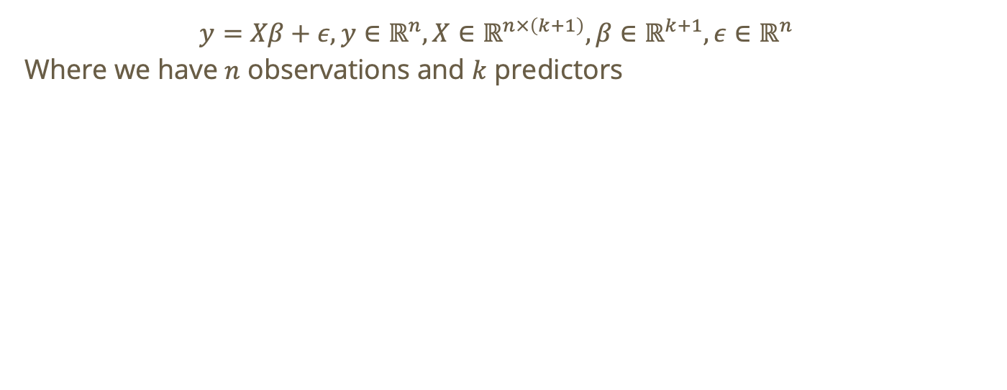
Recall: Linear regression at a high level
$$y=Xβ+ε,y∈ℝ^{n},X∈ℝ^{n×\left(k+1\right)},β∈ℝ^{k+1},ε∈ℝ^{n}$$
Where we have $n$ observations and $k$ predictors
Notes:
Note: the +1s are to account for the intercept ($β_{0}$)

Slide 9
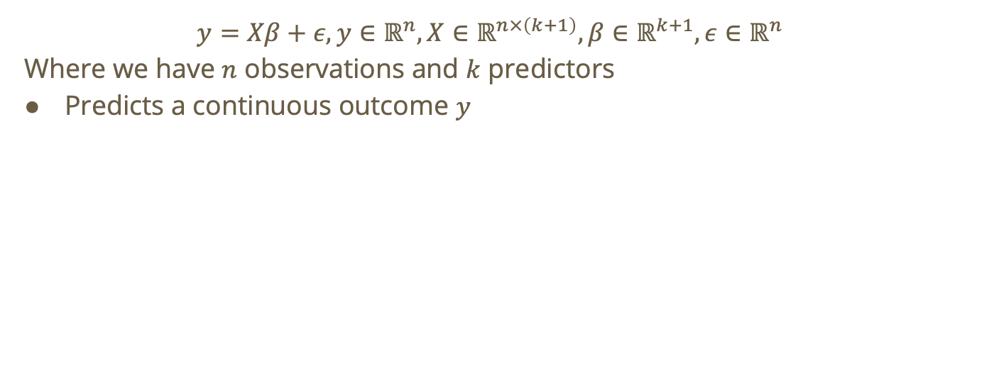
Recall: Linear regression at a high level
$$y=Xβ+ε,y∈ℝ^{n},X∈ℝ^{n×\left(k+1\right)},β∈ℝ^{k+1},ε∈ℝ^{n}$$
Where we have $n$ observations and $k$ predictors
Predicts a continuous outcome $y$
Notes:
Note: the +1s are to account for the intercept ($β_{0}$)

Slide 10
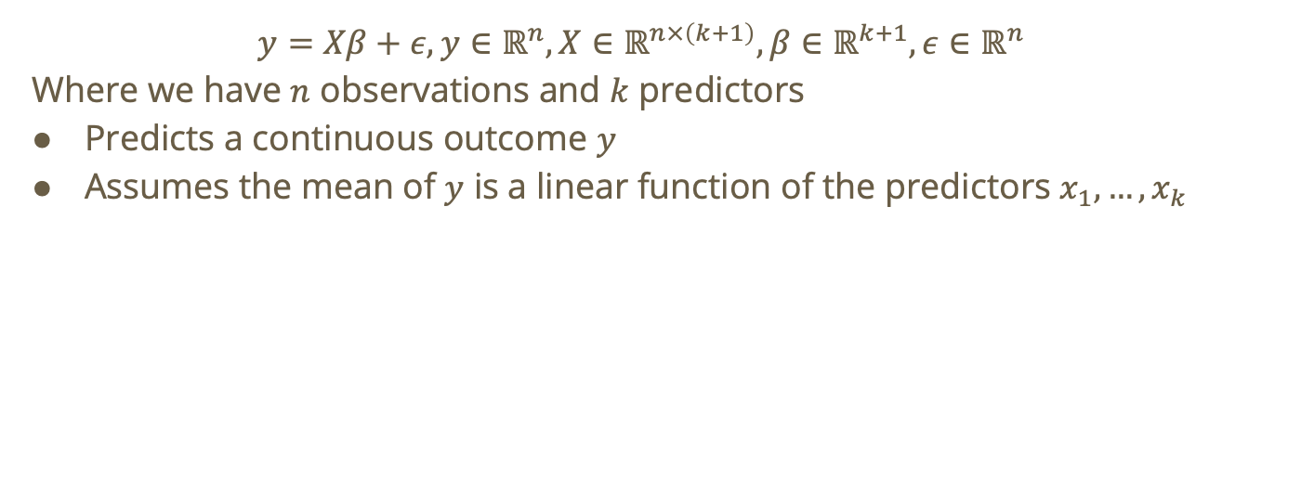
Recall: Linear regression at a high level
$$y=Xβ+ε,y∈ℝ^{n},X∈ℝ^{n×\left(k+1\right)},β∈ℝ^{k+1},ε∈ℝ^{n}$$
Where we have $n$ observations and $k$ predictors
Predicts a continuous outcome $y$
Assumes the mean of $y$ is a linear function of the predictors $x_{1},…,x_{k}$
Notes:
Note: the +1s are to account for the intercept ($β_{0}$)

Slide 11
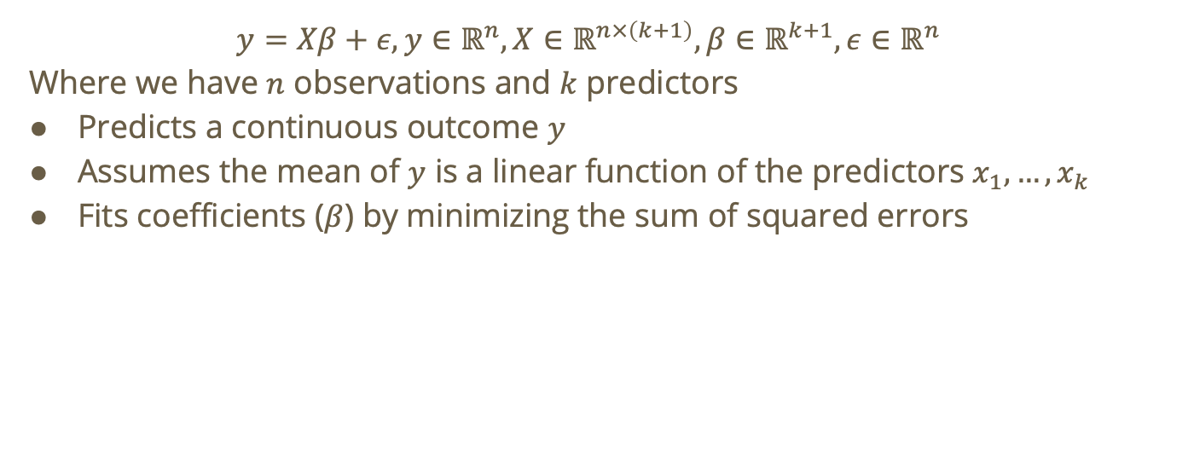
Recall: Linear regression at a high level
$$y=Xβ+ε,y∈ℝ^{n},X∈ℝ^{n×\left(k+1\right)},β∈ℝ^{k+1},ε∈ℝ^{n}$$
Where we have $n$ observations and $k$ predictors
Predicts a continuous outcome $y$
Assumes the mean of $y$ is a linear function of the predictors $x_{1},…,x_{k}$
Fits coefficients ($β$) by minimizing the sum of squared errors
Notes:
Note: the +1s are to account for the intercept ($β_{0}$)

Slide 12
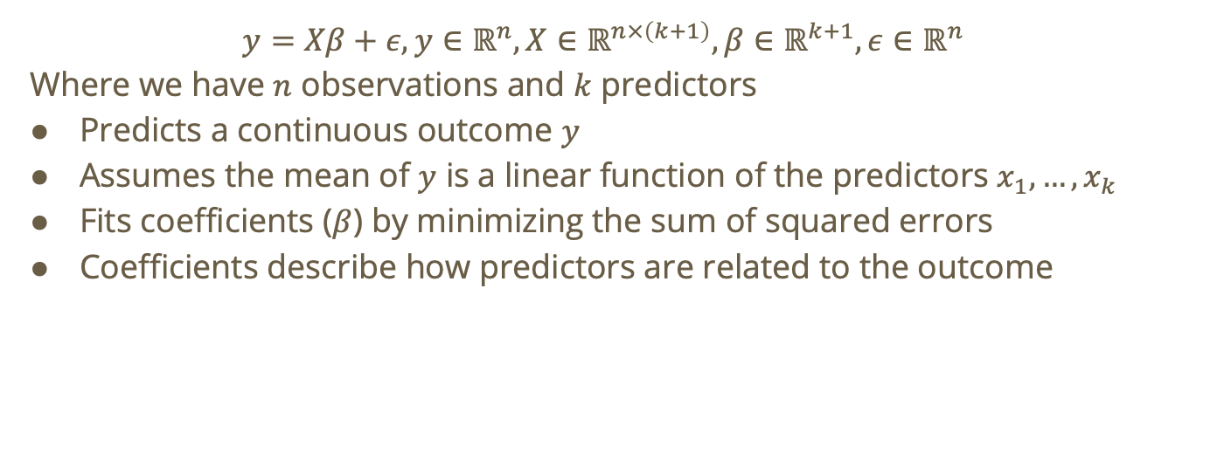
Recall: Linear regression at a high level
$$y=Xβ+ε,y∈ℝ^{n},X∈ℝ^{n×\left(k+1\right)},β∈ℝ^{k+1},ε∈ℝ^{n}$$
Where we have $n$ observations and $k$ predictors
Predicts a continuous outcome $y$
Assumes the mean of $y$ is a linear function of the predictors $x_{1},…,x_{k}$
Fits coefficients ($β$) by minimizing the sum of squared errors
Coefficients describe how predictors are related to the outcome
Notes:
Note: the +1s are to account for the intercept ($β_{0}$)

Slide 13
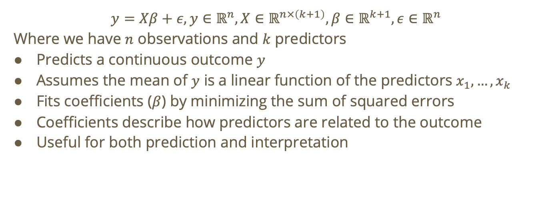
Recall: Linear regression at a high level
$$y=Xβ+ε,y∈ℝ^{n},X∈ℝ^{n×\left(k+1\right)},β∈ℝ^{k+1},ε∈ℝ^{n}$$
Where we have $n$ observations and $k$ predictors
Predicts a continuous outcome $y$
Assumes the mean of $y$ is a linear function of the predictors $x_{1},…,x_{k}$
Fits coefficients ($β$) by minimizing the sum of squared errors
Coefficients describe how predictors are related to the outcome
Useful for both prediction and interpretation
Notes:
Note: the +1s are to account for the intercept ($β_{0}$)

Slide 14
Linear Regression Cost Function

Slide 15
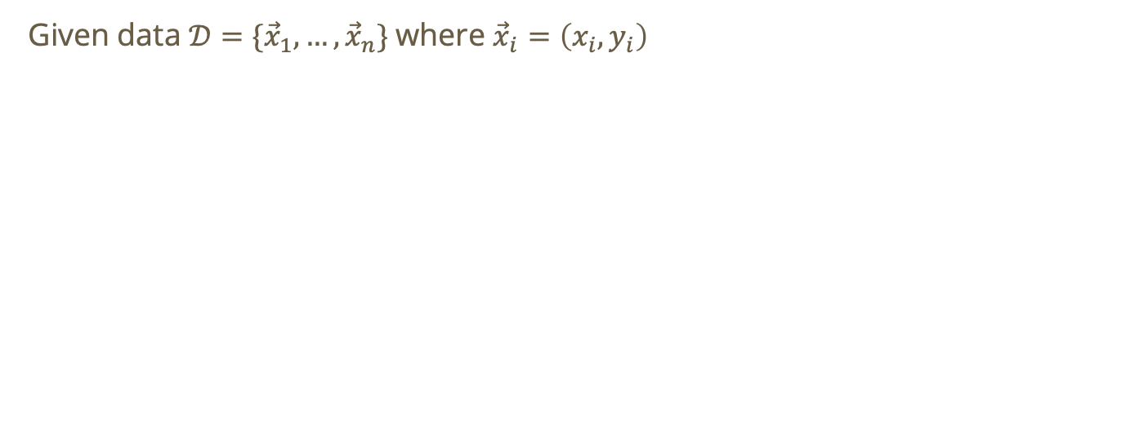
Linear regression cost function (single feature case)
Given data $𝒟=\{{\vec{x}}_{1},…,{\vec{x}}_{n}\}$where ${\vec{x}}_{i}=\left(x_{i},y_{i}\right)$

Slide 16
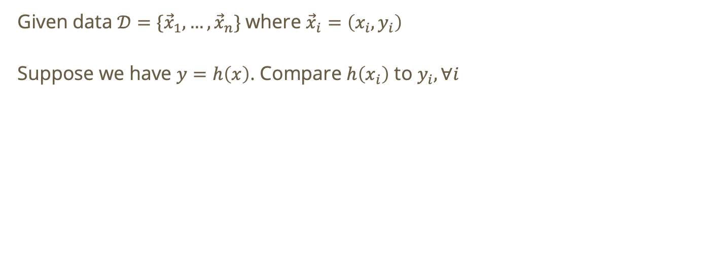
Linear regression cost function (single feature case)
Given data $𝒟=\{{\vec{x}}_{1},…,{\vec{x}}_{n}\}$where ${\vec{x}}_{i}=\left(x_{i},y_{i}\right)$
Suppose we have $y=h\left(x\right)$. Compare $h\left(x_{i}\right)$ to $y_{i}, ∀i$

Slide 17
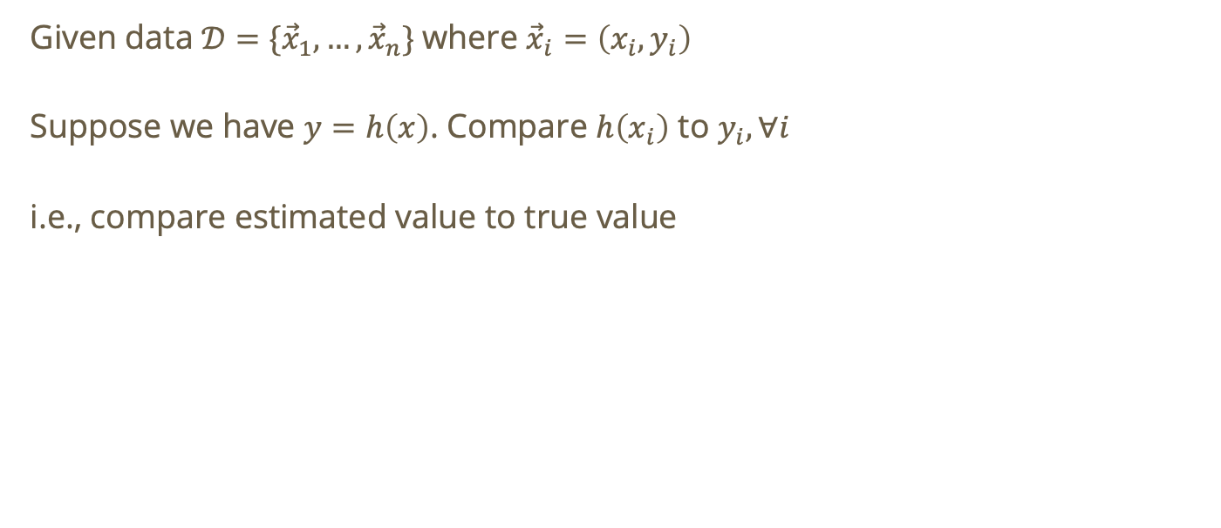
Linear regression cost function (single feature case)
Given data $𝒟=\{{\vec{x}}_{1},…,{\vec{x}}_{n}\}$where ${\vec{x}}_{i}=\left(x_{i},y_{i}\right)$
Suppose we have $y=h\left(x\right)$. Compare $h\left(x_{i}\right)$ to $y_{i}, ∀i$
i.e., compare estimated value to true value

Slide 18
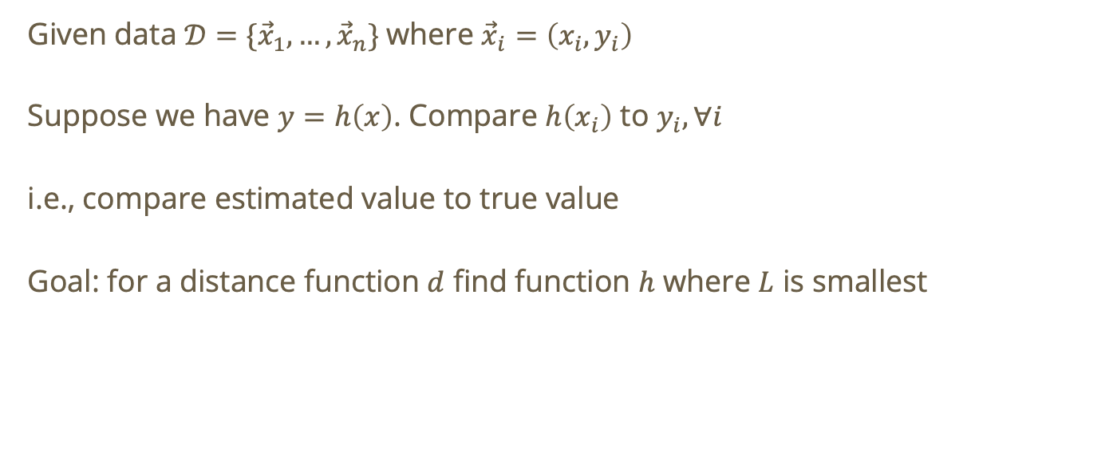
Linear regression cost function (single feature case)
Given data $𝒟=\{{\vec{x}}_{1},…,{\vec{x}}_{n}\}$where ${\vec{x}}_{i}=\left(x_{i},y_{i}\right)$
Suppose we have $y=h\left(x\right)$. Compare $h\left(x_{i}\right)$ to $y_{i}, ∀i$
i.e., compare estimated value to true value
Goal: for a distance function $d$ find function $h$ where $L$ is smallest

Slide 19
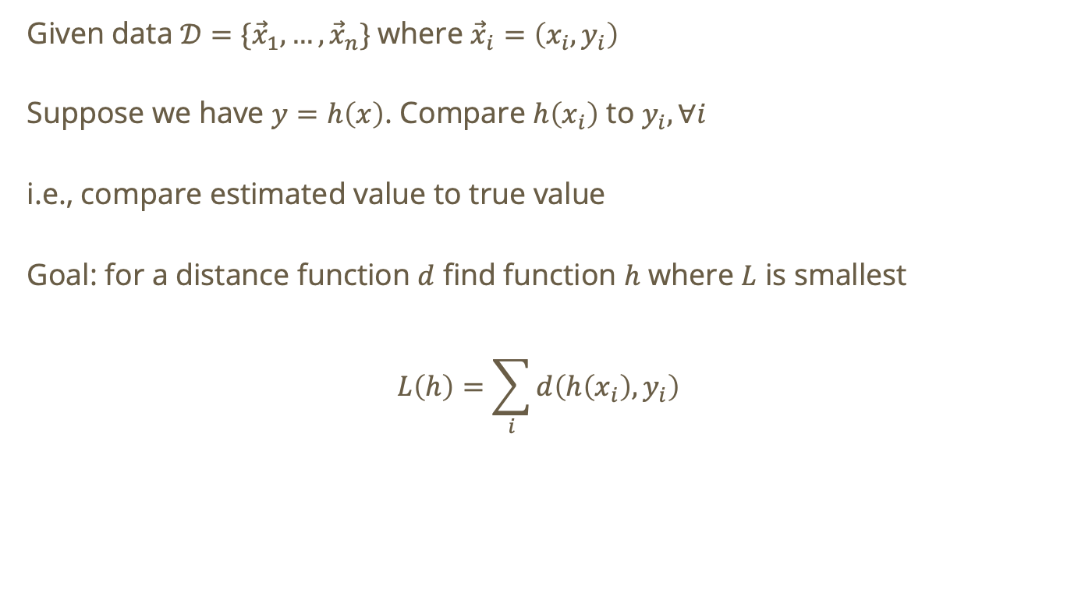
Linear regression cost function (single feature case)
Given data $𝒟=\{{\vec{x}}_{1},…,{\vec{x}}_{n}\}$where ${\vec{x}}_{i}=\left(x_{i},y_{i}\right)$
Suppose we have $y=h\left(x\right)$. Compare $h\left(x_{i}\right)$ to $y_{i}, ∀i$
i.e., compare estimated value to true value
Goal: for a distance function $d$ find function $h$ where $L$ is smallest
$$L\left(h\right)=\sum_{i}{d\left(h\left(x_{i}\right),y_{i}\right)}$$

Slide 20
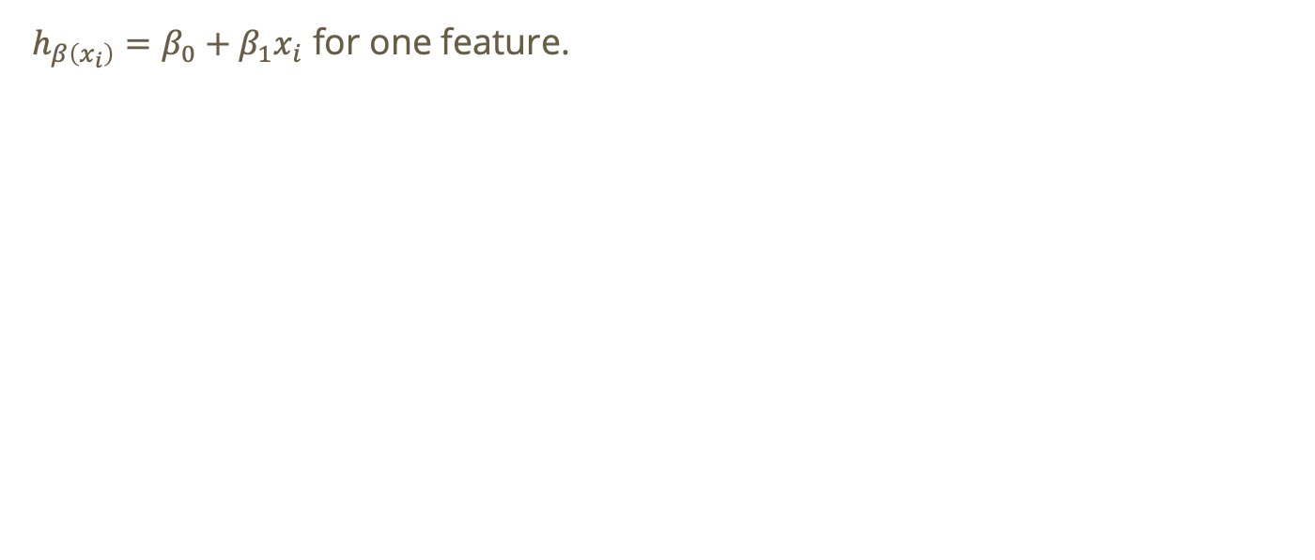
Linear regression cost function
$h_{β\left(x_{i}\right)}=β_{0}+β_{1}x_{i}$ for one feature.

Slide 21
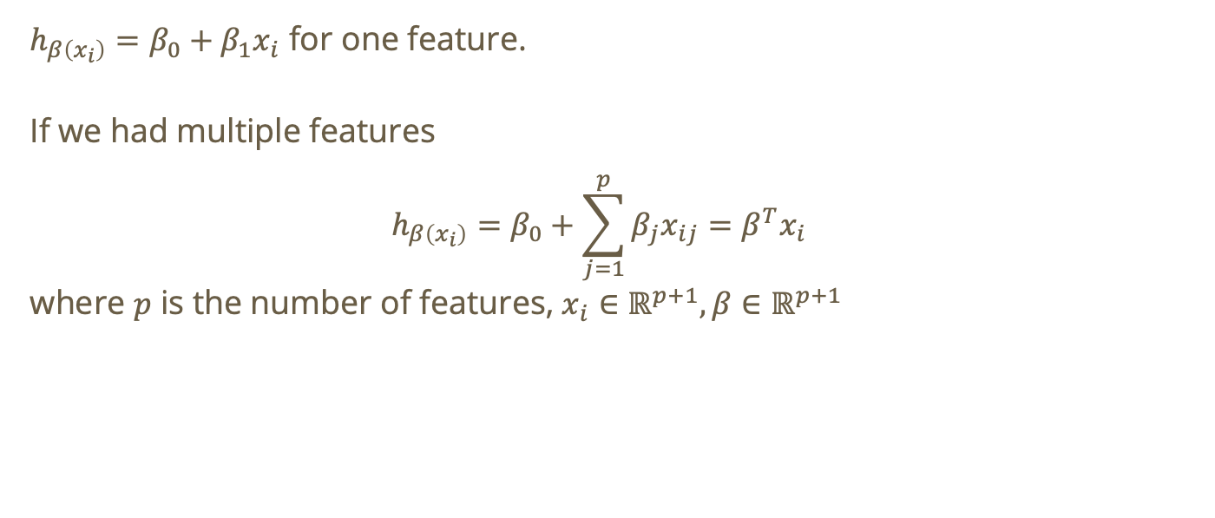
Linear regression cost function
$h_{β\left(x_{i}\right)}=β_{0}+β_{1}x_{i}$ for one feature.
If we had multiple features
$$h_{β\left(x_{i}\right)}=β_{0}+\sum_{j=1}^{p}{β_{j}x_{ij}}=β^{T}x_{i}$$
where $p$ is the number of features, $x_{i}∈ℝ^{p+1},β∈ℝ^{p+1}$
Notes:
Multiple features is also called MLR (multiple linear regression)
$x_{i}$is called the feature vector

Slide 22
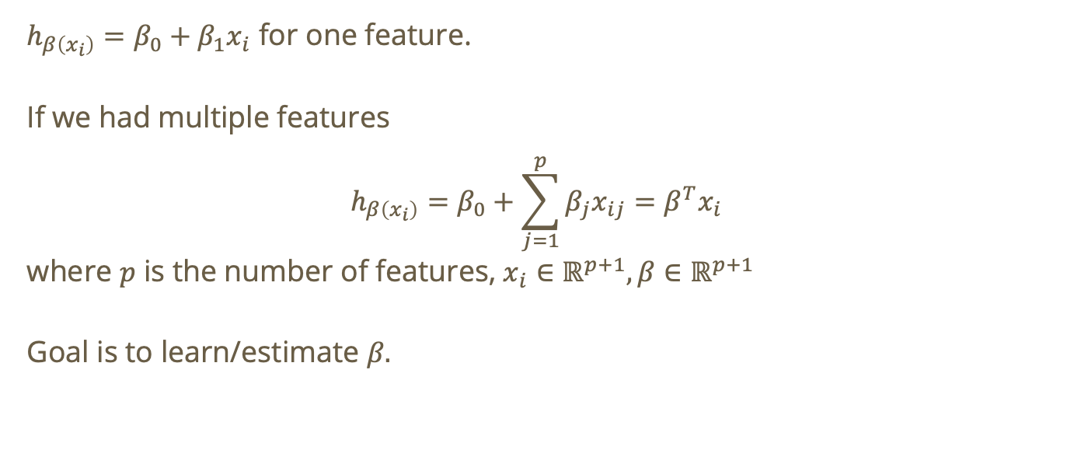
Linear regression cost function
$h_{β\left(x_{i}\right)}=β_{0}+β_{1}x_{i}$ for one feature.
If we had multiple features
$$h_{β\left(x_{i}\right)}=β_{0}+\sum_{j=1}^{p}{β_{j}x_{ij}}=β^{T}x_{i}$$
where $p$ is the number of features, $x_{i}∈ℝ^{p+1},β∈ℝ^{p+1}$
Goal is to learn/estimate $β$.
Notes:
Multiple features is also called MLR (multiple linear regression)

Slide 23
Least Squares Parameter Estimation

Slide 24
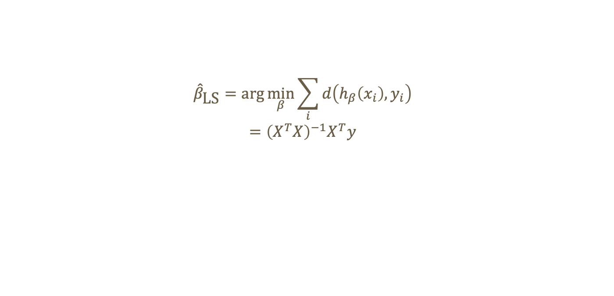
Least squares regression
$${\hat{β}}_{\text{LS}}=\text{arg}\min_{β}{\sum_{i}{d\left(h_{β}\left(x_{i}\right),y_{i}\right)}}$$
$$={\left(X^{T}X\right)}^{−1}X^{T}y$$

Slide 25
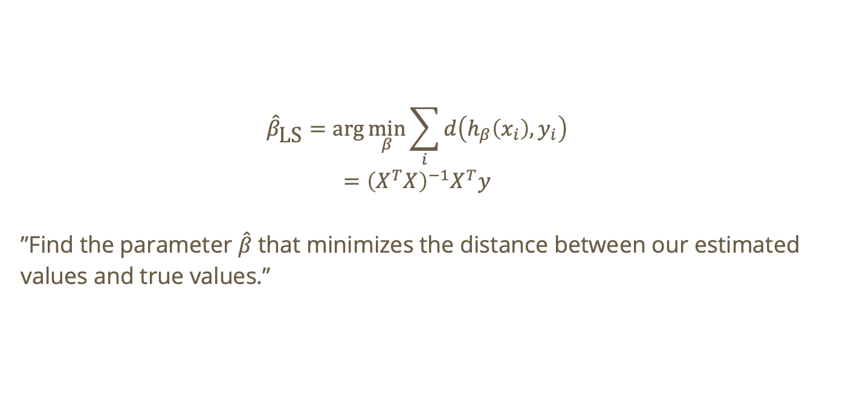
Least squares regression
$${\hat{β}}_{\text{LS}}=\text{arg}\min_{β}{\sum_{i}{d\left(h_{β}\left(x_{i}\right),y_{i}\right)}}$$
$$={\left(X^{T}X\right)}^{−1}X^{T}y$$
”Find the parameter $\hat{β}$ that minimizes the distance between our estimated values and true values.”

Slide 26
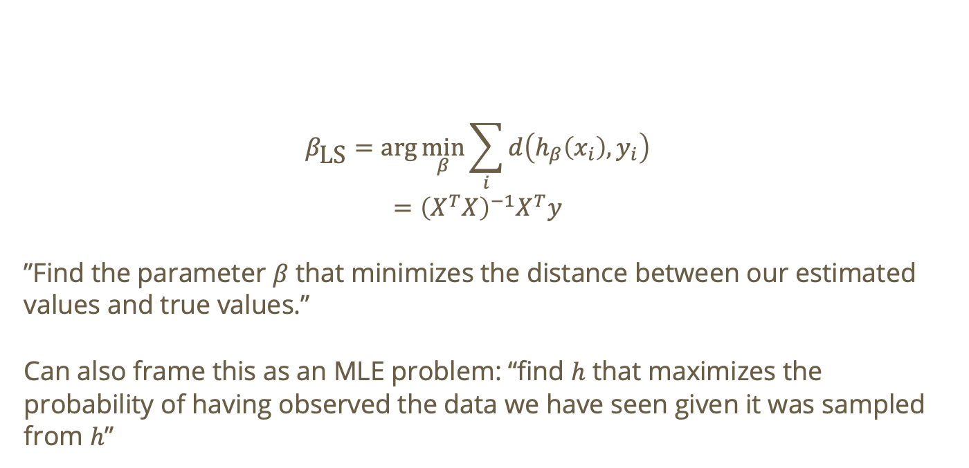
Least squares regression
$$β_{\text{LS}}=\text{arg}\min_{β}{\sum_{i}{d\left(h_{β}\left(x_{i}\right),y_{i}\right)}}$$
$$={\left(X^{T}X\right)}^{−1}X^{T}y$$
”Find the parameter $β$ that minimizes the distance between our estimated values and true values.”
Can also frame this as an MLE problem: “find $h$ that maximizes the probability of having observed the data we have seen given it was sampled from $h$”

Slide 27

Unbiased Estimator
$$𝔼\left({\hat{β}}_{\text{LS}}\right)=β$$

Slide 28
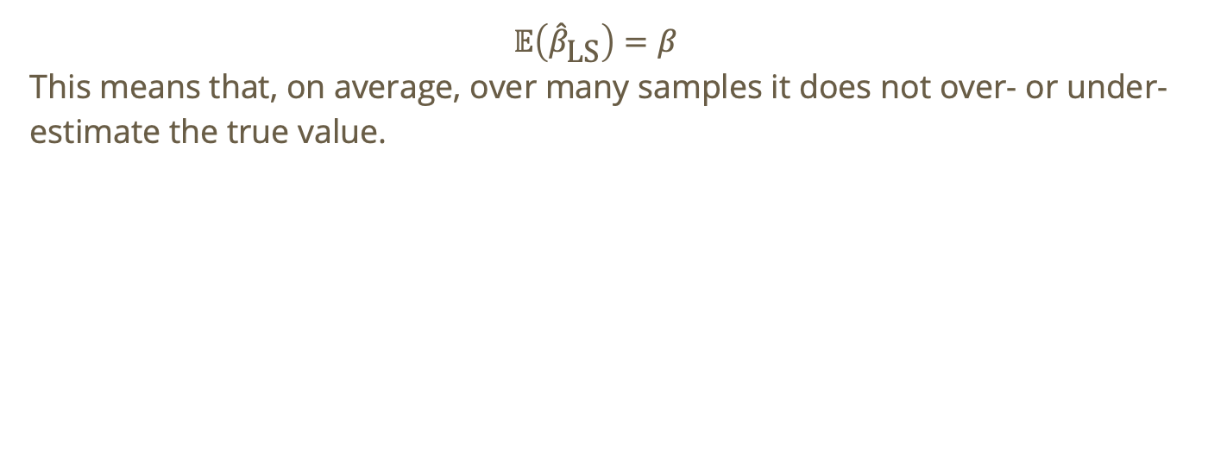
Unbiased Estimator
$$𝔼\left({\hat{β}}_{\text{LS}}\right)=β$$
This means that, on average, over many samples it does not over- or under-estimate the true value.

Slide 29
Do not edit
How to change the design
The estimate beta_hat is a random variable with mean beta
The Slido app must be installed on every computer you’re presenting from

Slide 30
Do not edit
How to change the design
According to linear regression, the follwing is a linear model:
Y_hat = b_0 + b_1X + b_2X^2
The Slido app must be installed on every computer you’re presenting from

