Slide 1
Clustering
Boston University CS 506 - Lance Galletti

Slide 2
What is a Clustering
A clustering is a grouping / assignment of objects (data points) such that objects in the same group / cluster are:
similar to one another
dissimilar to objects in other groups

Slide 3
The Clustering Problem
Given a collection of data points
Find a clustering such that:
Similar data points are in the same cluster
Dissimilar data points are in different clusters
Questions:
What does similar mean?
How do we find a clustering?
How do we know if we have found a good clustering?

Slide 4
Clusters can be Ambiguous

Slide 5
Types of Clusterings
Partitional
Each object belongs to exactly one cluster
Hierarchical
A set of nested clusters organized in a tree
Density-Based
Defined based on the local density of points
Soft Clustering
Each point is assigned to every cluster with a certain probability

Slide 6
Partitional Clustering

Slide 7
Partitional Clustering
Given n data points and a number k of clusters: partition the n data points into k clusters.
Suppose we are given all possible ways of distributing these n data points into these k buckets / clusters. How would we find the best such partition?
Recall our goal: similar items should belong to the same cluster & dissimilar items should belong to different clusters.
A good partition is one where the total dissimilarity of points within each cluster is small.

Slide 8
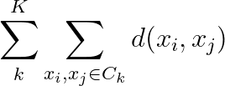
Example
VS
Clearly the clustering on the left has smaller intra-cluster distances than the one on the right. That is:
Is a smaller quantity

Slide 9
Example
VS
Given a distance function d, we can find points (not necessarily part of our dataset) for each cluster called centroids that are at the center of each cluster.

Slide 10
Example
VS
Q: When d is Euclidean, what is the centroid (also called center of mass) of m points {x₁, … , x_{m}} ?
A: The mean / average of the points

Slide 11
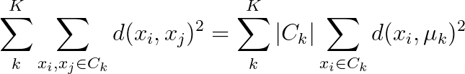
Example
VS
Turns out when d is Euclidean:

Slide 12

K-means
Given X = {x₁, … , x_{n}} our dataset and k
Find k points {𝝻₁, … , 𝝻_{k}} that minimize the cost function:
When k=1 and k=n this is easy. Why?
When x_{i} lives in more than 2 dimensions, this is a very difficult (NP-hard) problem

Slide 13
K-means - Lloyd’s Algorithm
Randomly pick k centers {𝝻₁, … , 𝝻_{k}}
Assign each point in the dataset to its closest center
Compute the new centers as the means of each cluster
Repeat 2 & 3 until convergence

Slide 14
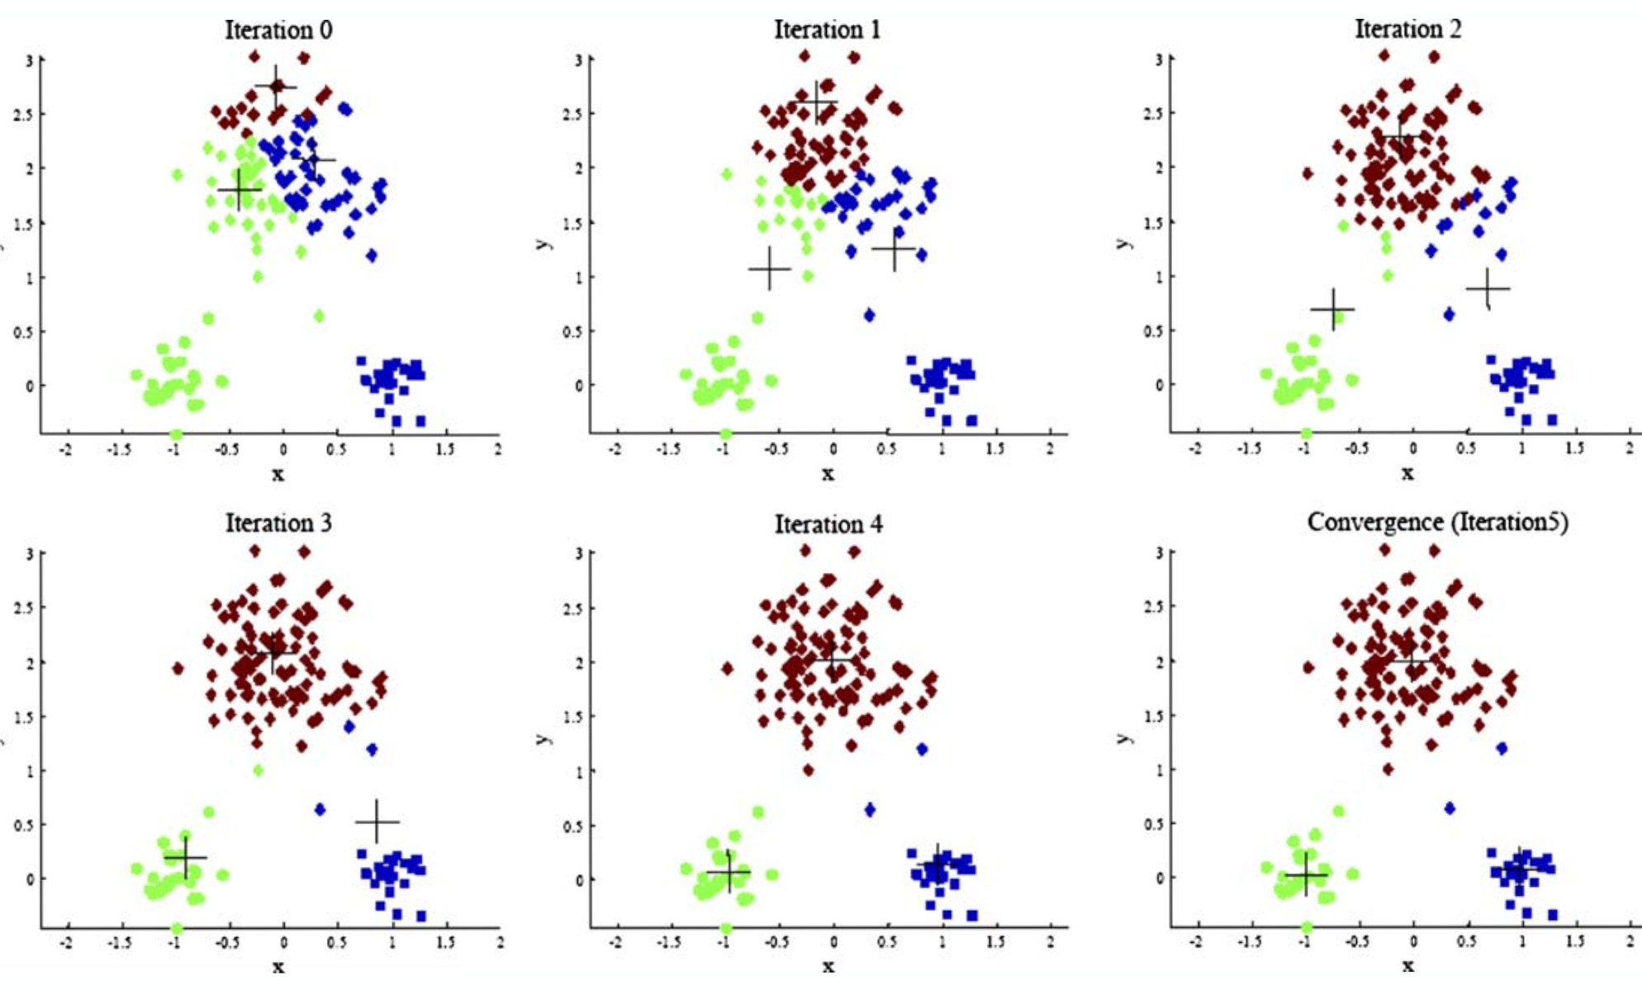
K-means - Lloyd’s Algorithm

Slide 15
K-means - Lloyd’s Algorithm
Will this algorithm always converge?
Proof (by contradiction): Suppose it does not converge. Then, either:
The minimum of the cost function is only reached in the limit (i.e. after an infinite number of iterations).
Impossible because we are iterating over a finite set of partitions
The algorithm gets stuck in a cycle / loop
Impossible since this would require having a clustering that has a lower cost than itself and we know:
If old ≠ new clustering then the cost has improved
If old = new clustering then the cost is unchanged
Conclusion: Lloyd’s Algorithm always converges!

Slide 16
K-means - Lloyd’s Algorithm
Will this always converge to the optimal solution?

Slide 17
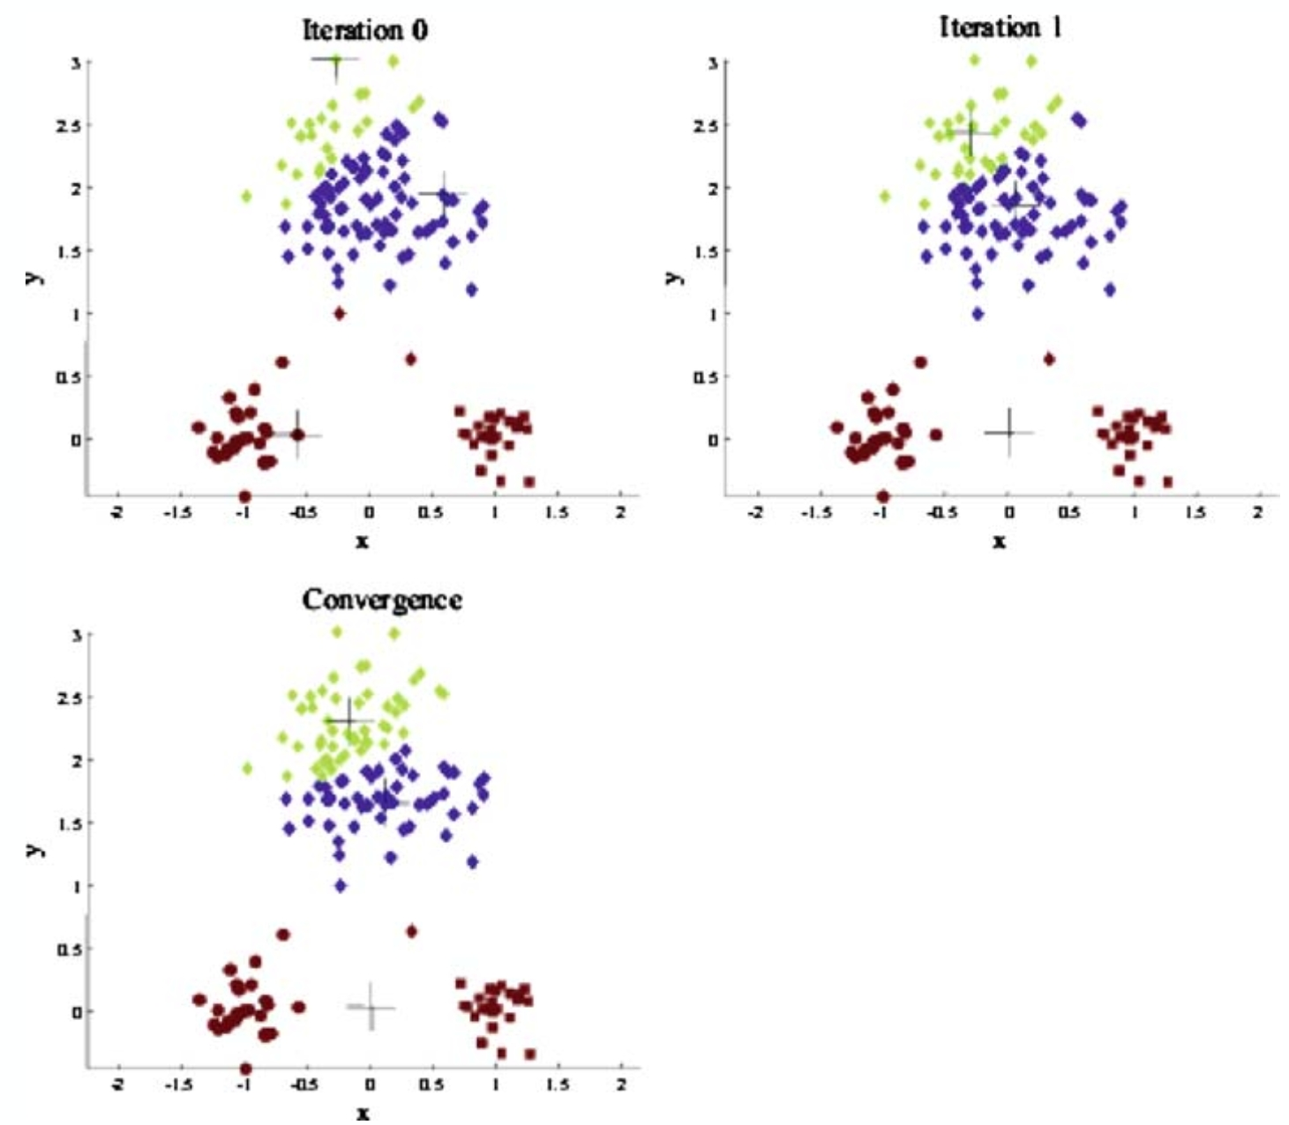
K-means - Lloyd’s Algorithm
The choice of initial points has a large influence on the resulting clustering

Slide 18
K-means - Initialization
One solution: Run Lloyd’s algorithm multiple times and choose the result with the lowest cost.
This can still lead to bad results because of randomness.
Another solution: Try different initialization methods

Slide 19
K-means - Random

Slide 20
K-means - Random
Starting with initialization points too close to each other may problematic

Slide 21
K-means - Farthest First Traversal

Slide 22
K-means - Farthest First Traversal
Pick the first center at random

Slide 23
K-means - Farthest First Traversal
Pick the next center to be the point farthest from all previous

Slide 24
K-means - Farthest First Traversal
Pick the next center to be the point farthest from all previous

Slide 25
K-means - Farthest First Traversal

Slide 26
K-means - FFT and outliers

Slide 27
K-means - FFT and outliers

Slide 28
K-means - FFT and outliers

Slide 29
K-means - FFT and outliers

Slide 30
K-means - FFT and outliers
Random might have worked better here

Slide 31
K-means++
Initialize with a combination of the two methods:
Start with a random center
Let D(x) be the distance between x and the centers selected so far. Choose the next center with probability proportional to D(x)ª
When:
a = 0 : random initialization (all points have equal probability)
a = ∞ : farthest first traversal
a = 2 : K-means++

Slide 32
K-means++

Slide 33
K-means++
No reason to use k-means over k-means++

Slide 34
K-means++
Suppose we are given a black box that will generate a uniform random number between 0 and any N. How can we use this black box to select points with probability proportional to D(x)ª?

Slide 35
K-means++
Suppose we are given a black box that will generate a uniform random number between 0 and any N. How can we use this black box to select points with probability proportional to D(x)ª?

Slide 36
K-means++
Suppose we are given a black box that will generate a uniform random number between 0 and any N. How can we use this black box to select points with probability proportional to D(x)²?
Let’s set a = 2
x
D(x)² = 3² = 9
D(y)² = 2² = 4
D(z)² = 1² = 1
y
z

Slide 37
K-means++
Suppose we are given a black box that will generate a uniform random number between 0 and any N. How can we use this black box to select points with probability proportional to D(x)²?
Let’s set a = 2
x
D(x)² = 3² = 9
D(y)² = 2² = 4
D(z)² = 1² = 1
y
z
0
N

Slide 38
K-means++
Suppose we are given a black box that will generate a uniform random number between 0 and any N. How can we use this black box to select points with probability proportional to D(x)²?
Let’s set a = 2
x
D(x)² = 3² = 9
D(y)² = 2² = 4
D(z)² = 1² = 1
y
z
z
0
N

Slide 39
K-means++
Suppose we are given a black box that will generate a uniform random number between 0 and any N. How can we use this black box to select points with probability proportional to D(x)²?
Let’s set a = 2
x
D(x)² = 3² = 9
D(y)² = 2² = 4
D(z)² = 1² = 1
y
z
z
y
y
y
y
0
N

Slide 40
K-means++
Suppose we are given a black box that will generate a uniform random number between 0 and any N. How can we use this black box to select points with probability proportional to D(x)²?
Let’s set a = 2
x
D(x)² = 3² = 9
D(y)² = 2² = 4
D(z)² = 1² = 1
y
z
z
y
y
y
y
x
x
x
x
x
x
x
x
x
0
N

Slide 41
K-means++
Suppose we are given a black box that will generate a uniform random number between 0 and any N. How can we use this black box to select points with probability proportional to D(x)²?
Let’s set a = 2
x
D(x)² = 3² = 9
D(y)² = 2² = 4
D(z)² = 1² = 1
y
z
z
y
y
y
y
x
x
x
x
x
x
x
x
x
0
N
= D(x)² + D(y)² + D(z)² = 14

Slide 42
K-means++
Suppose we are given a black box that will generate a uniform random number between 0 and any N. How can we use this black box to select points with probability proportional to D(x)²?
Using the black box, we can generate a number between 0 and N to determine which point to pick next. It will be chosen with probability proportional to D(x)².
z
y
y
y
y
x
x
x
x
x
x
x
x
x
0
N
= D(x)² + D(y)² + D(z)² = 14

Slide 43
K-means++
What happens if the black box can only generate numbers between 0 and 1?

Slide 44
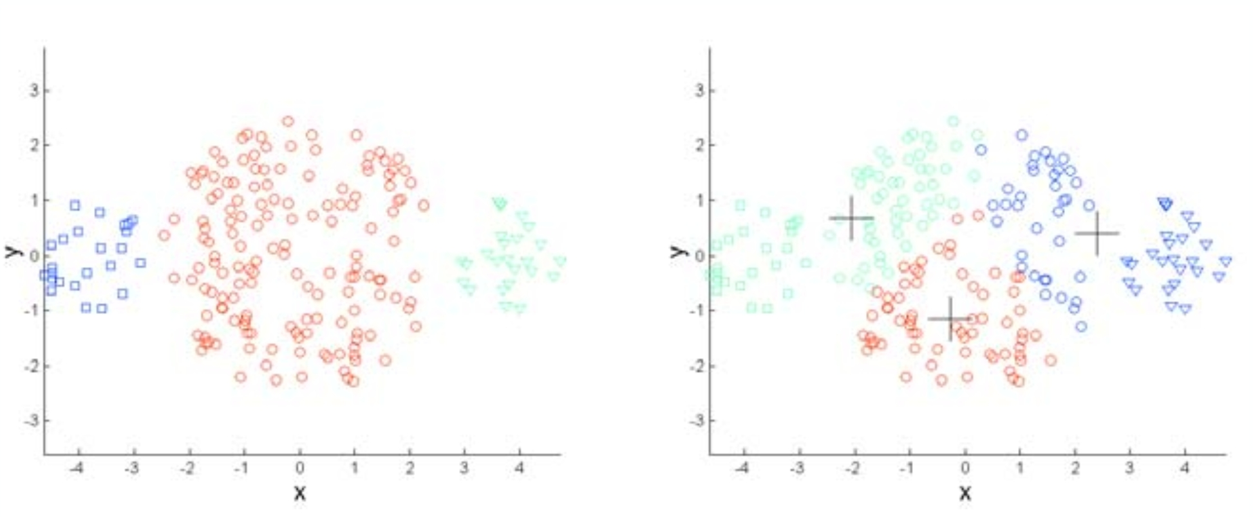
K-means - Limitations

Slide 45
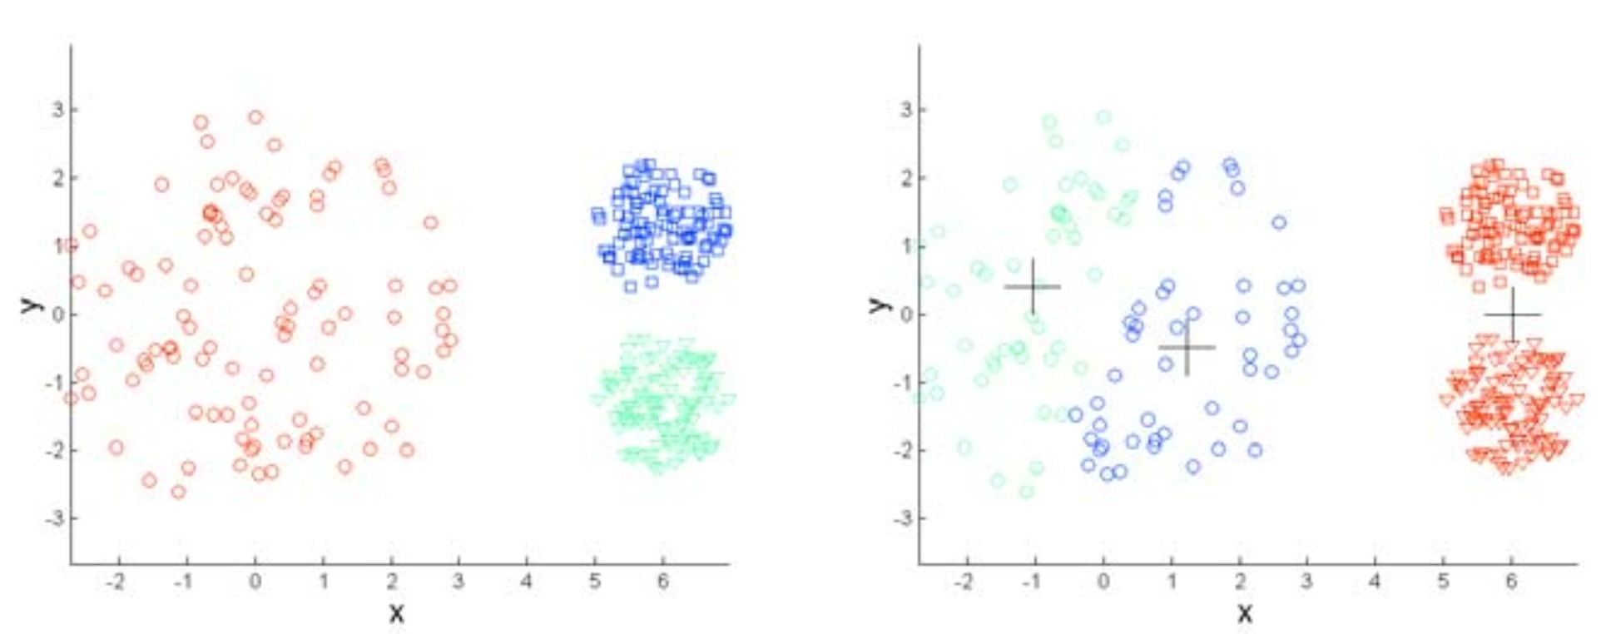
K-means - Limitations

Slide 46
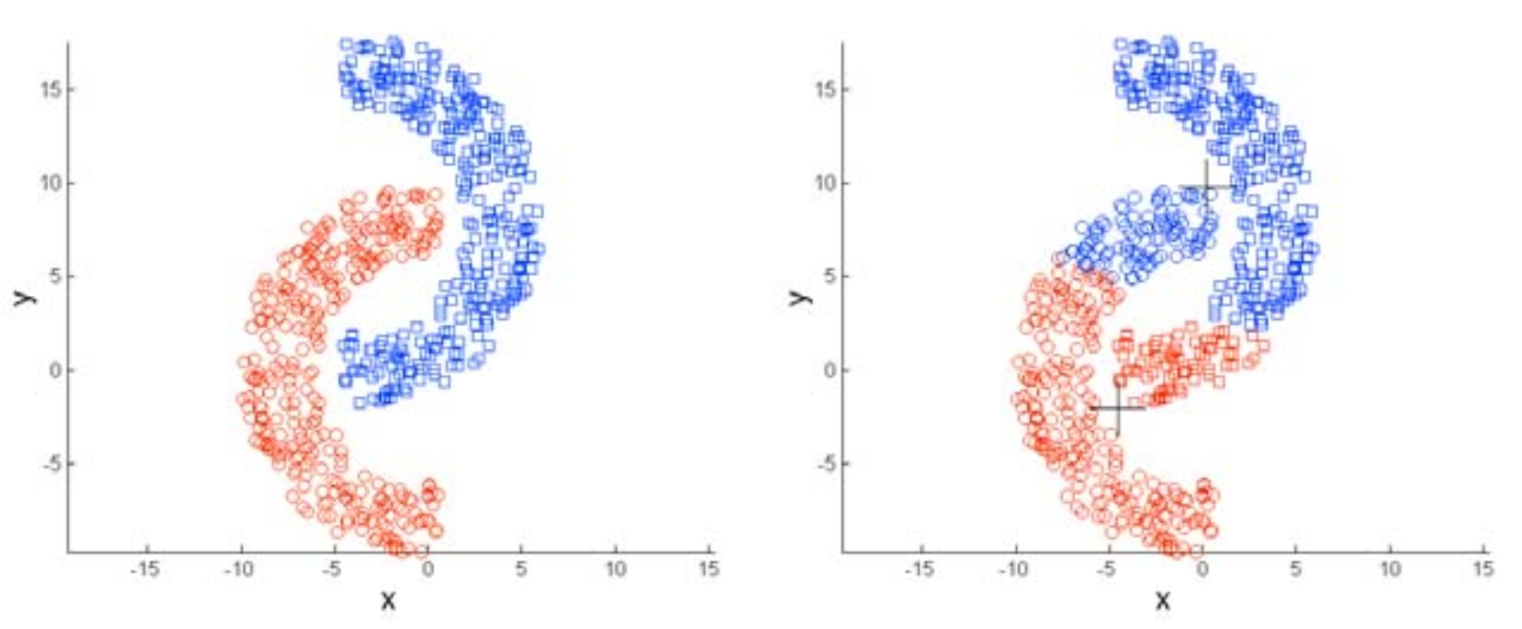
K-means - Limitations

Slide 47
How to choose the right k?
Iterate through different values of k (elbow method)
Use empirical / domain-specific knowledge
Example: Is there a known approximate distribution of the data? (K-means is good for spherical gaussians)

Slide 48
K-means Variations
K-medians (uses the L₁ norm / manhattan distance)
K-medoids (any distance function + the centers must be in the dataset)
Weighted K-means (each point has a different weight when computing the mean)

