Slide 1
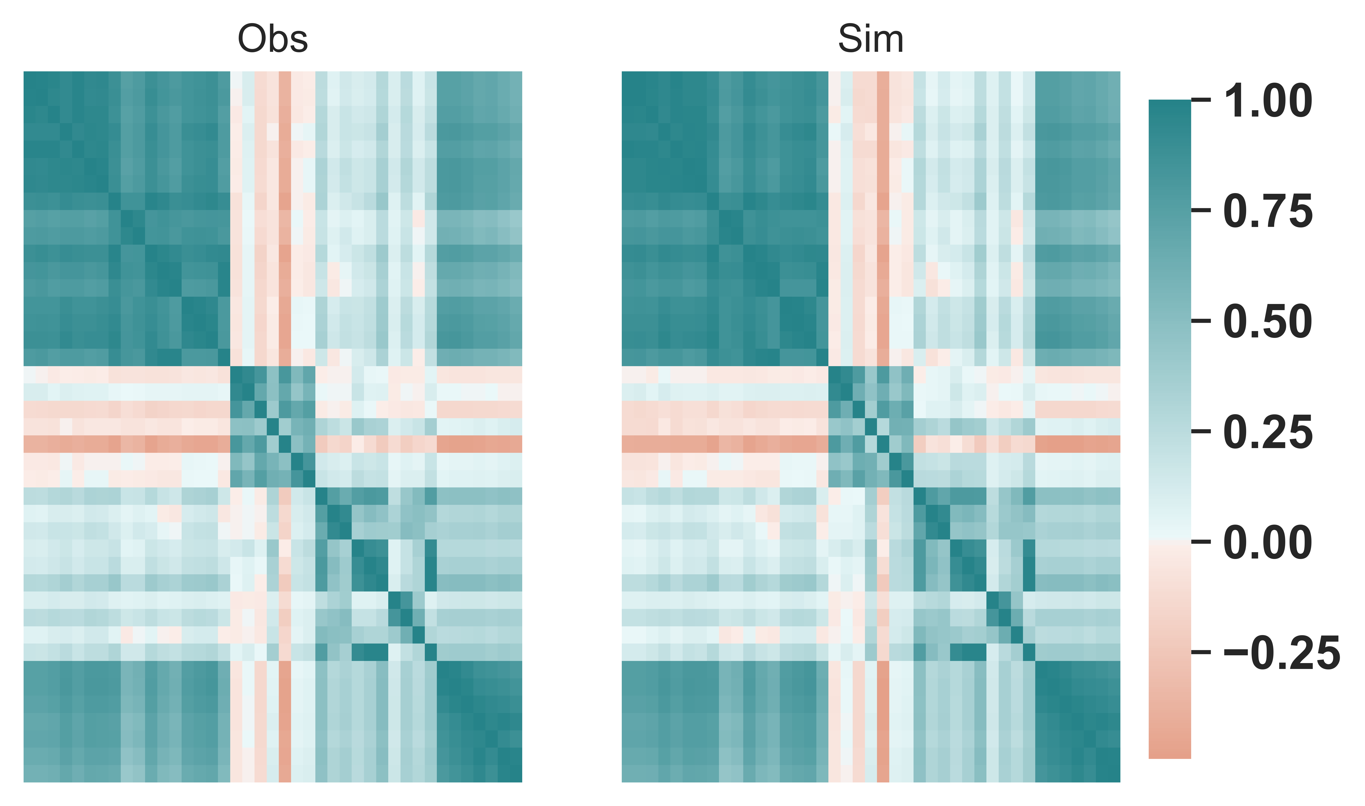
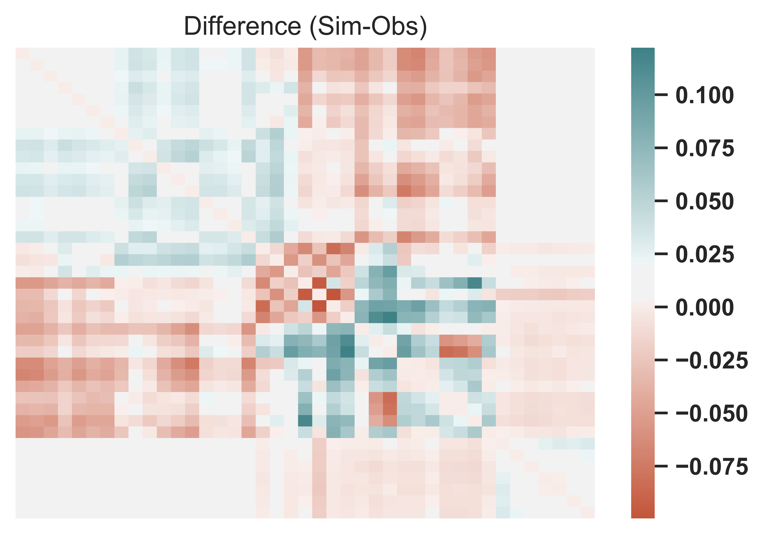
Fig. 1 Correlation matrix of daily weather (temperature and wind speed) data in 17 sites and daily irradiance data in 7 sites

Slide 2
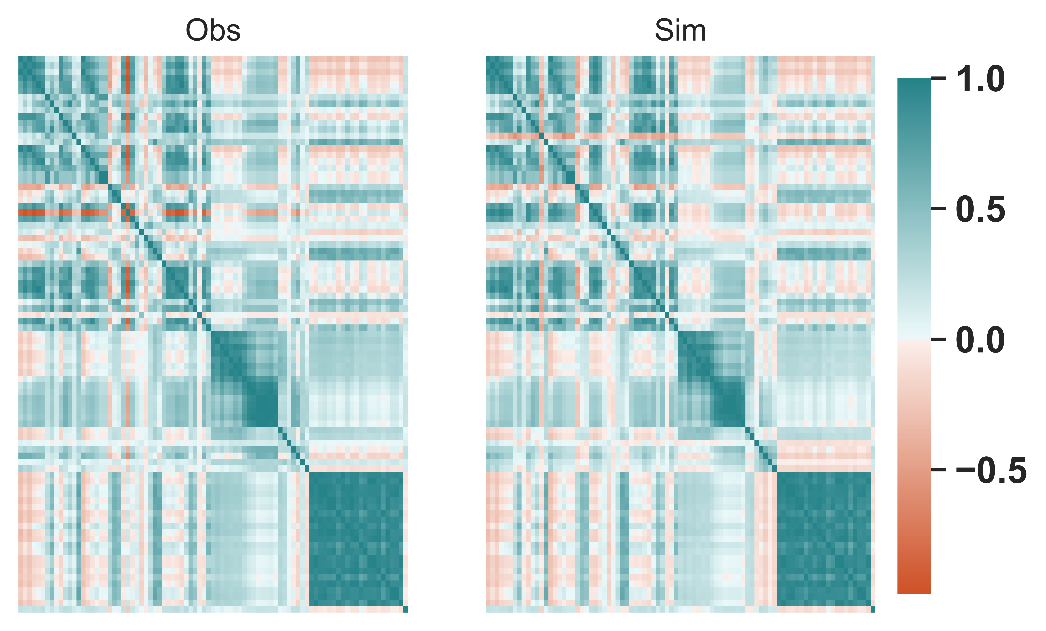
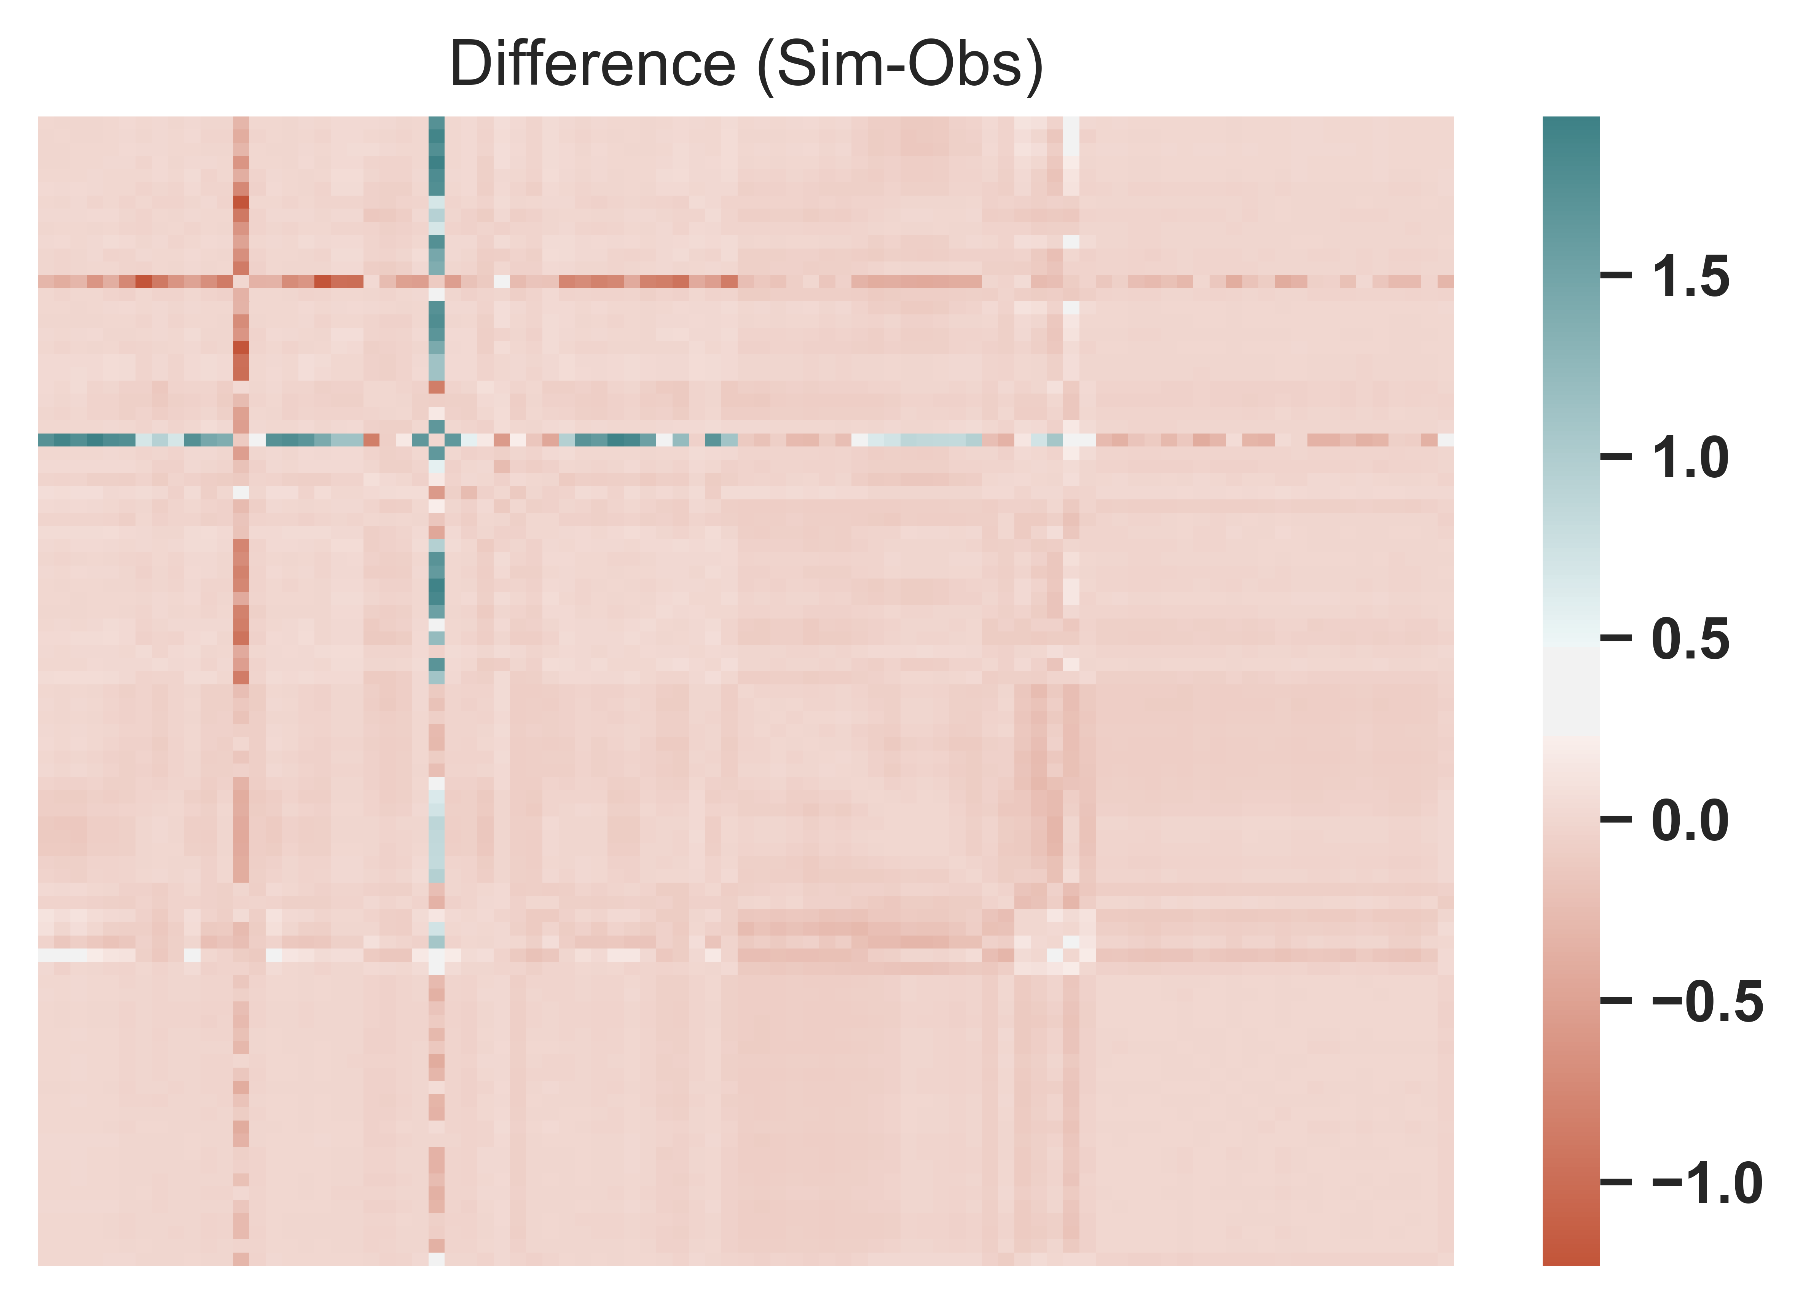
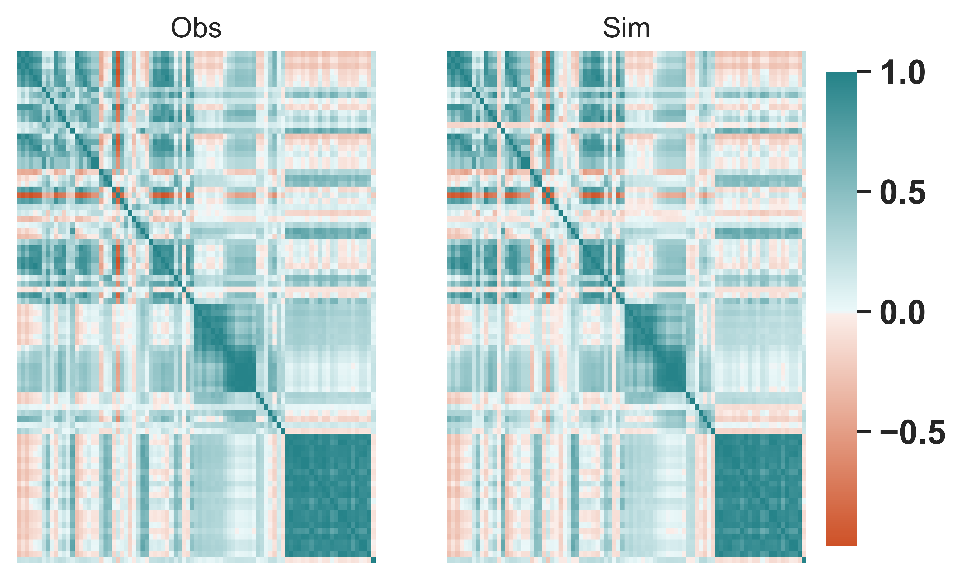
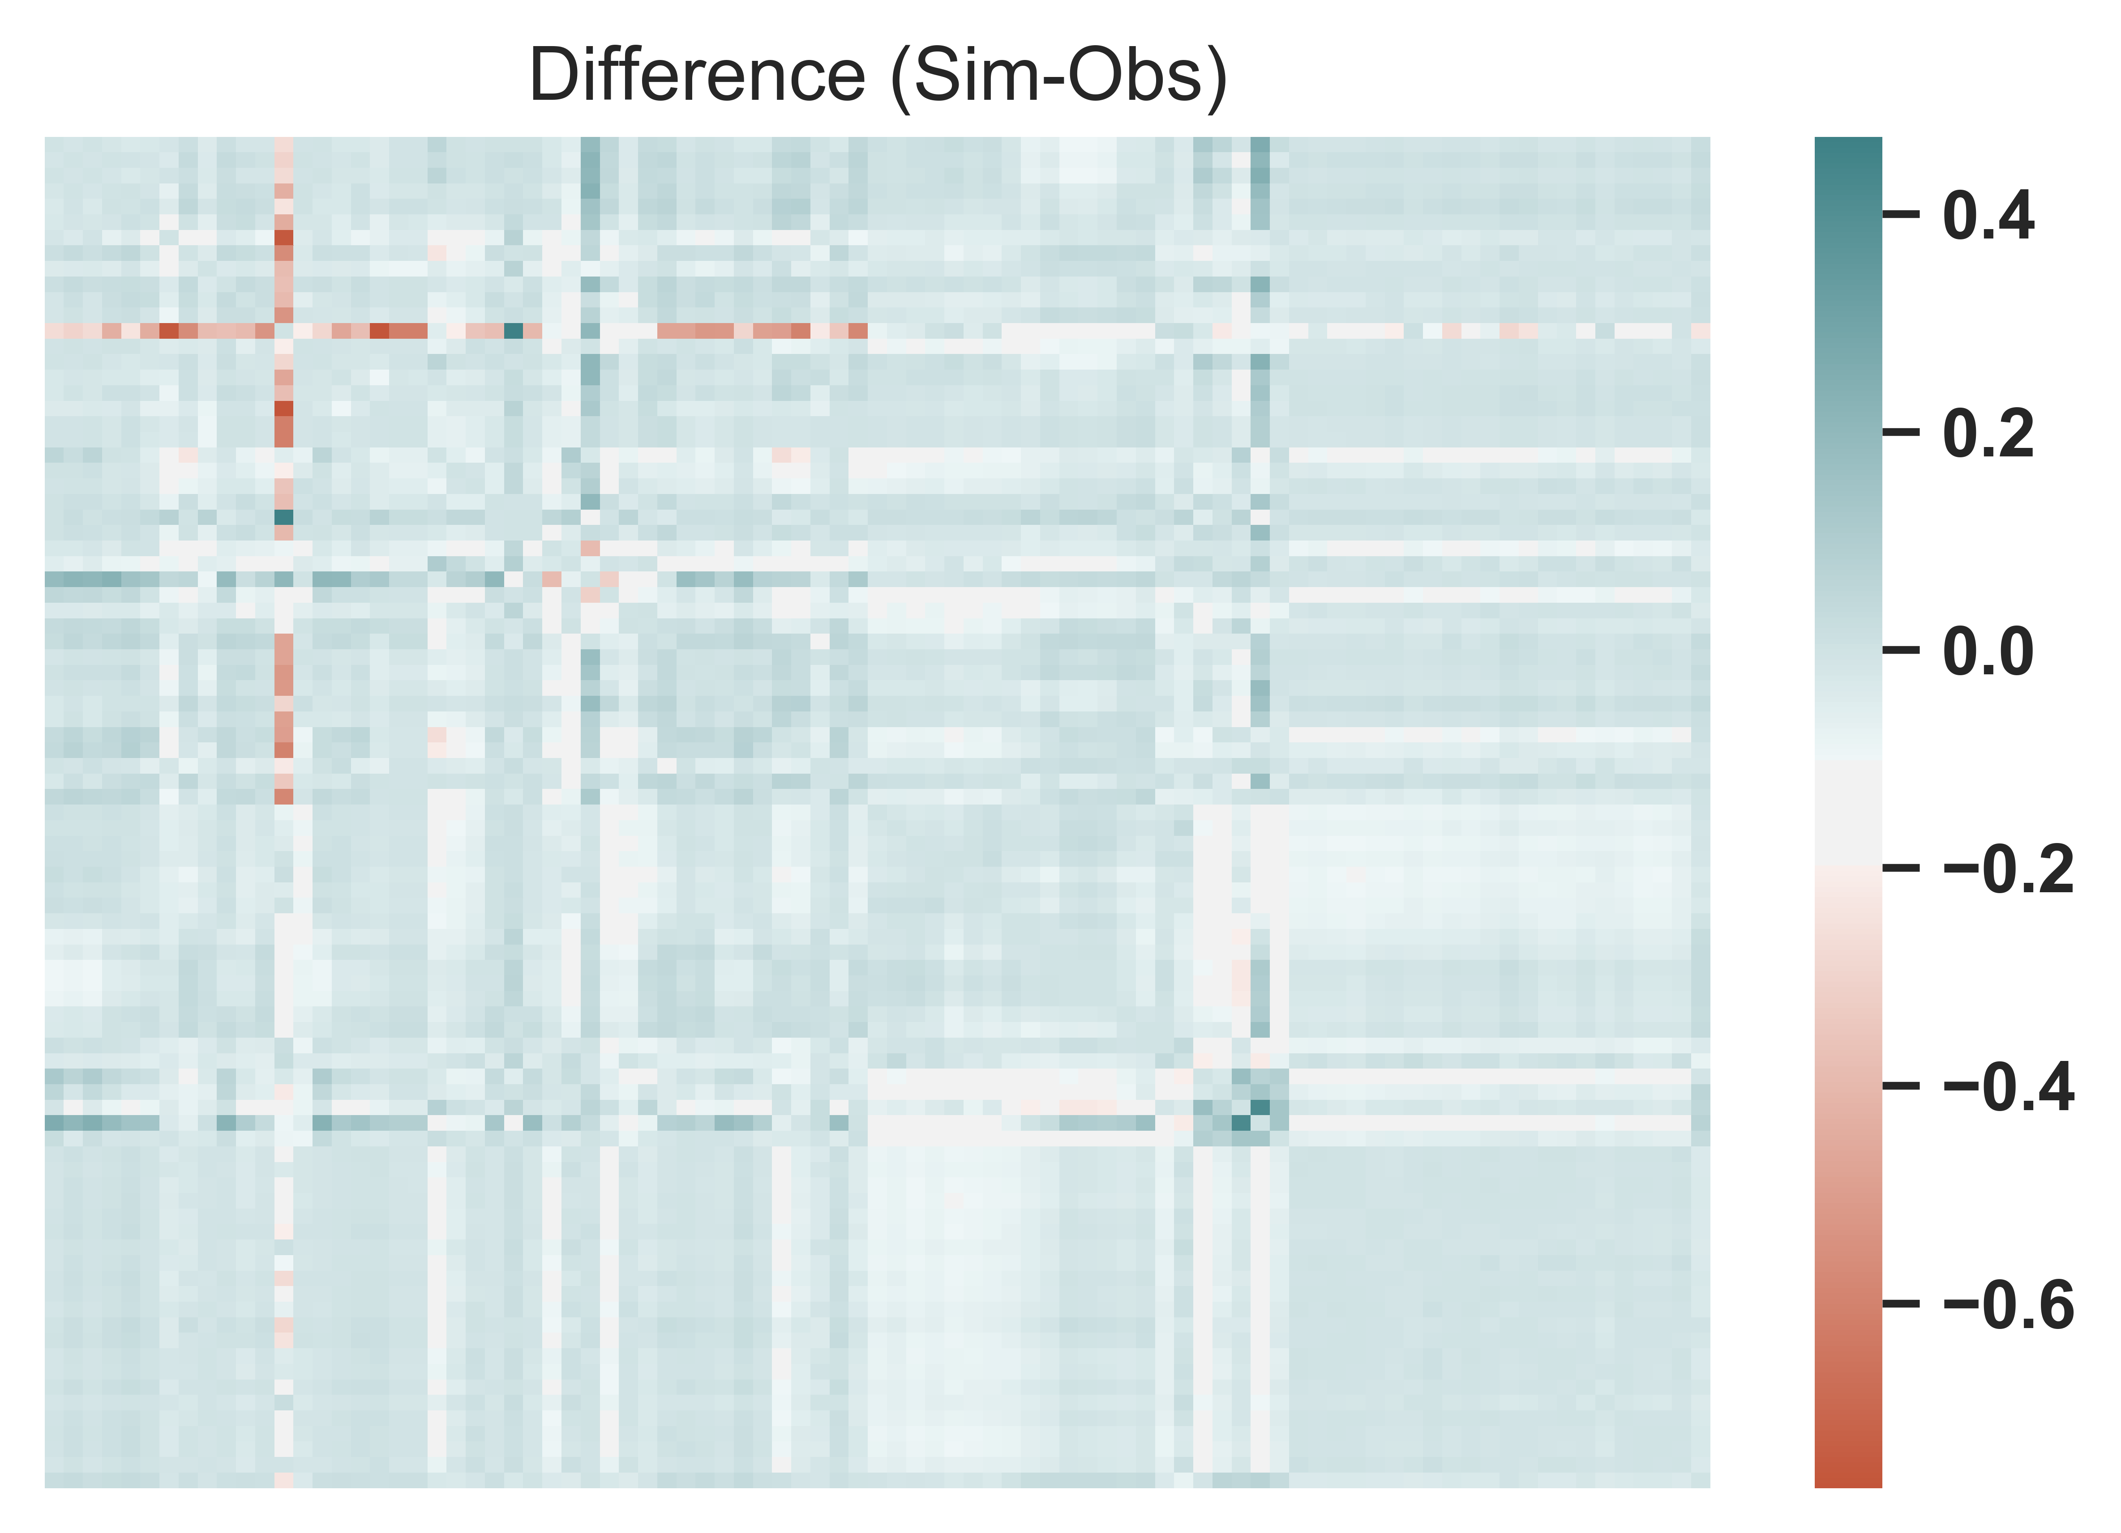
Fig2. Correlation matrix of daily streamflow data in 87 sites (original code)
Fig3. Correlation matrix of daily streamflow data in 87 sites (revised code)

Slide 3
Fig.4 Daily streamflow records in station "38L“
(station "38L" (columns 17 ) in "synthetic_streamflows_BPA.csv “ during 2005-2034 in climate scenario 2)

Slide 4
