Slide 1
Finding Shear Modulus With A Torsional Experiment
By: Evan Galloway, Alex Huynh, Dale Loveland, Tyson Patterson
ME321: Measurement Systems
1/16/2026
Notes:
- Speaking evan
()
- YOU HAVE A MAX OF 1 MIN PER SLIDE

Slide 2
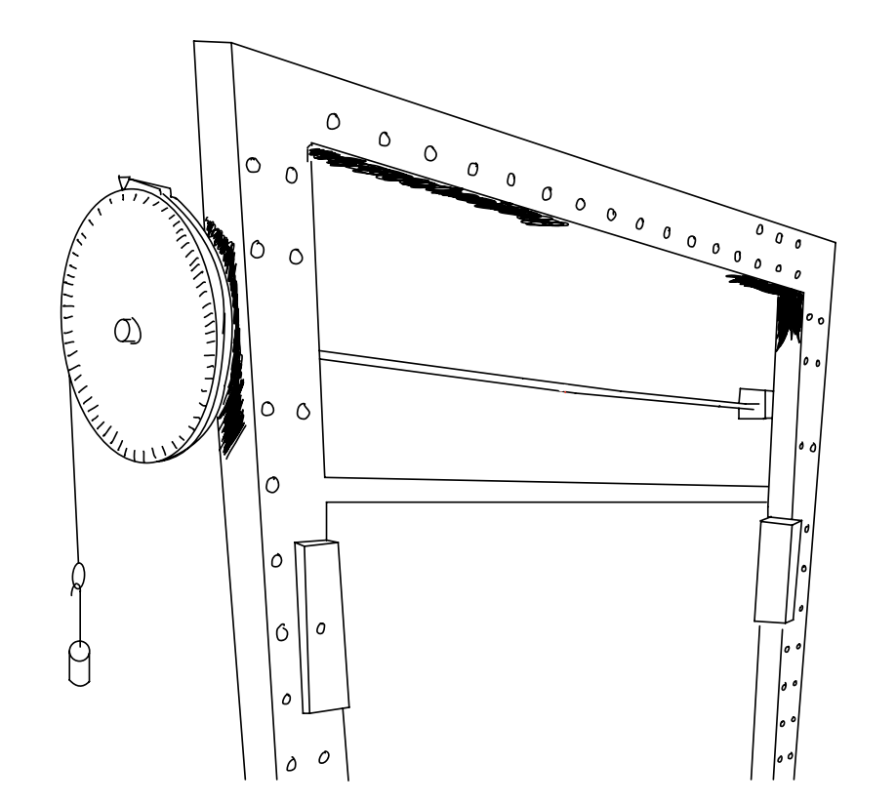
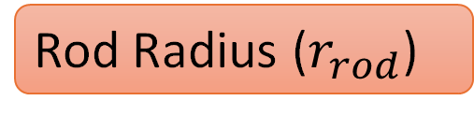
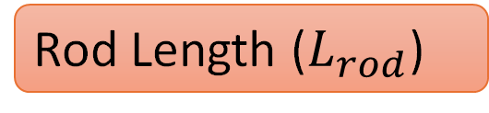
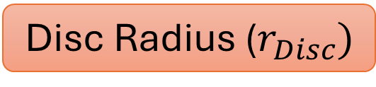
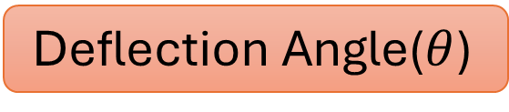
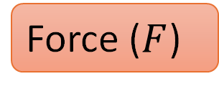
A torsional beam tester was used to find the shear modulus of a metal rod.
Deflection Angle($θ$)
Rod Length ($L_{rod}$)
Disc Radius ($r_{Disc})$
3
Rod Radius ($r_{rod}$)
2
Force ($F$)
1
Notes:
Speaking
(Person 1)
Go from left to right
From top to bottom
Explain how each one is a measurand and how the symbols are used to refer to each one in the project

Slide 3
The following procedure was used to collect the experimental data.
Measured the length and diameter of the metal testing rod
Measured diameter of disc and recorded the zero balance
Applied a controlled constant force of 4.4 lbf by hanging the weight as seen in the previous diagram
Recorded the angular displacement in degrees and compensated for the zero balance
Repeated Steps 3 and 4 for 8 total trials
Notes:
Speak
Person 2
Don’t explain too much since you should mostly explain this on the slide before
Maybe go into the zero balance a bit
Mention how step five was not completed until a shakedown had been done and validated

Slide 4

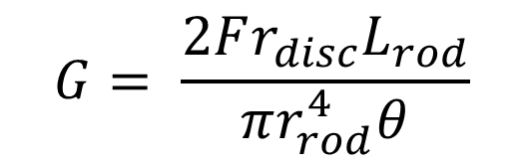
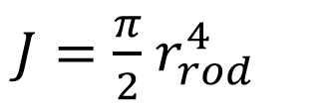

We started with a shear modulus equation that fit our apparatus to derive our Data Reduction Equation to fit with our measurands.
$$G=\frac{τL}{Jθ}$$
$$τ=Fr_{disc}$$
$J=\frac{π}{2}$ $r_{rod}^{4}$
$$G= \frac{2Fr_{disc}L_{rod}}{πr_{rod}^{4}θ}$$
G : Shear modulus
τ : torque applied to the rod
L : length of the rod
J : polar moment of inertia of a cylinder
θ : angular displacement
Notes:
(Person 2) Potentially add in another picture of our apparatus
Mention how this is from statics 2 and how this equation is actually derived from another one
We are implying that we derived our DRE to fit our measurands

Slide 5
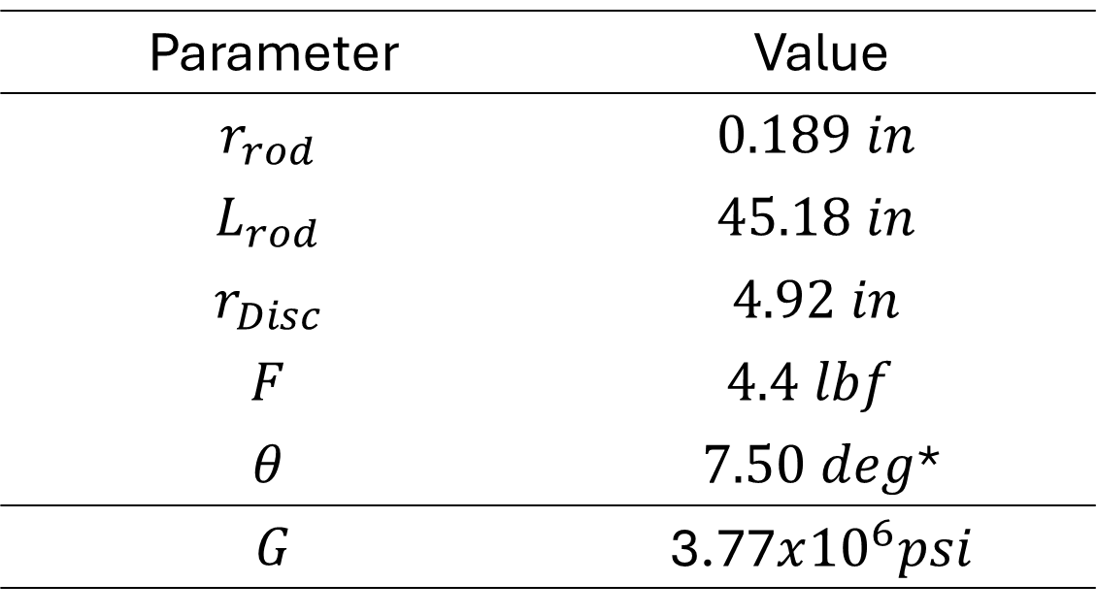

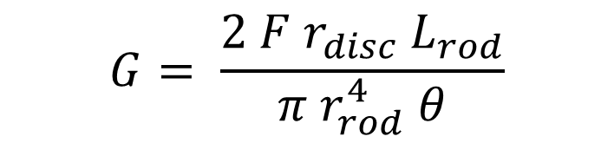
After recording a value for each measurand from the data reduction equation, a resultant was found for shear modulus.
$$G= \frac{2 F r_{disc}{ L}_{rod}}{π{ r}_{rod}^{4} θ}$$
Parameter | Value
$$r_{rod}$$ | $$0.189 in$$
$$L_{rod}$$ | $$45.18 in$$
$$r_{Disc}$$ | $$4.92 in$$
$$F$$ | $$4.4 lbf$$
$$θ$$ | $7.50 deg$*
$$G$$ | 3.77$x{10}^{6}psi$
$$G=3.77x{10}^{6}psi$$
*Degrees were converted to radians for this calculation
Notes:
Person 1
Quick slide that can mention our shakedown values and systematic uncertainty resultant

Slide 6
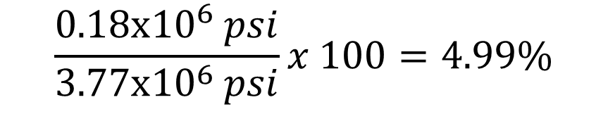

The relative systematic uncertainty was found to be reasonable enough to proceed with multiple measurements.
$$\frac{ω_{sys}}{G}x 100=ω_{rel,sys}$$
$$\frac{0.18x{10}^{6} psi}{3.77x{10}^{6} psi}x 100=4.99\%$$
Notes:
Person 1
- Explain how this was just under the 5% standard so we felt it was appropriate to conduct more trials

Slide 7
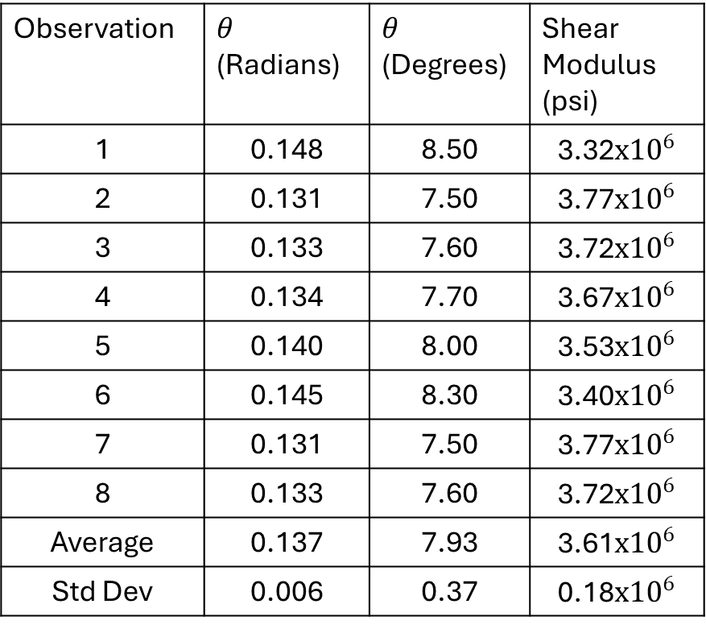
After 8 trials, multiple different deflection angles (deg) were measured to find the random uncertainty.
Observation | $θ$ (Radians) | $θ$ (Degrees) | Shear Modulus (psi)
1 | 0.148 | 8.50 | 3.32$x{10}^{6}$
2 | 0.131 | 7.50 | 3.77$x{10}^{6}$
3 | 0.133 | 7.60 | 3.72$x{10}^{6}$
4 | 0.134 | 7.70 | 3.67$x{10}^{6}$
5 | 0.140 | 8.00 | 3.53$x{10}^{6}$
6 | 0.145 | 8.30 | 3.40$x{10}^{6}$
7 | 0.131 | 7.50 | 3.77$x{10}^{6}$
8 | 0.133 | 7.60 | 3.72$x{10}^{6}$
Average | 0.137 | 7.93 | 3.61$x{10}^{6}$
Std Dev | 0.006 | 0.37 | 0.18$x{10}^{6}$
Notes:
Person 2
- Hit on the graphic and standard deviation

Slide 8
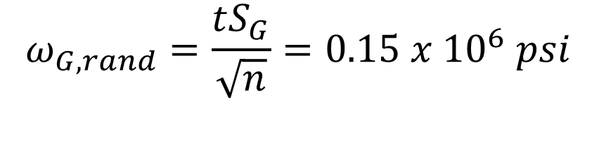
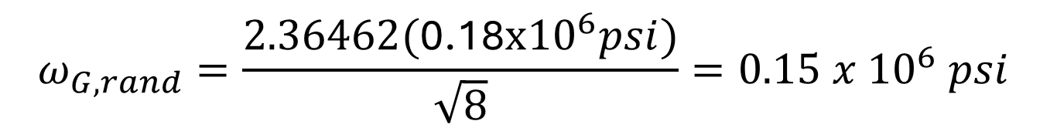
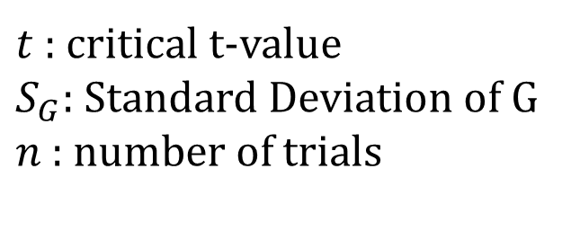
After collecting the results from multiple trials, the random uncertainty was calculated.
$$ω_{G,rand}=\frac{tS_{G}}{\sqrt{n}}=0.15 x {10}^{6} psi$$
$$ω_{G,rand}=\frac{2.36462\text{(}\text{0.18}x{10}^{6}psi)}{\sqrt{8}}=0.15 x {10}^{6} psi$$
$t$: critical t-value
$S_{G}$: Standard Deviation of G
$n$: number of trials
Notes:
Person 2
- Quick slide to show how random was calculated
With a t-value of 2.365, the standard deviation of G from the previous slide, and for 8 trials, we calculated the random uncertainty.

Slide 9
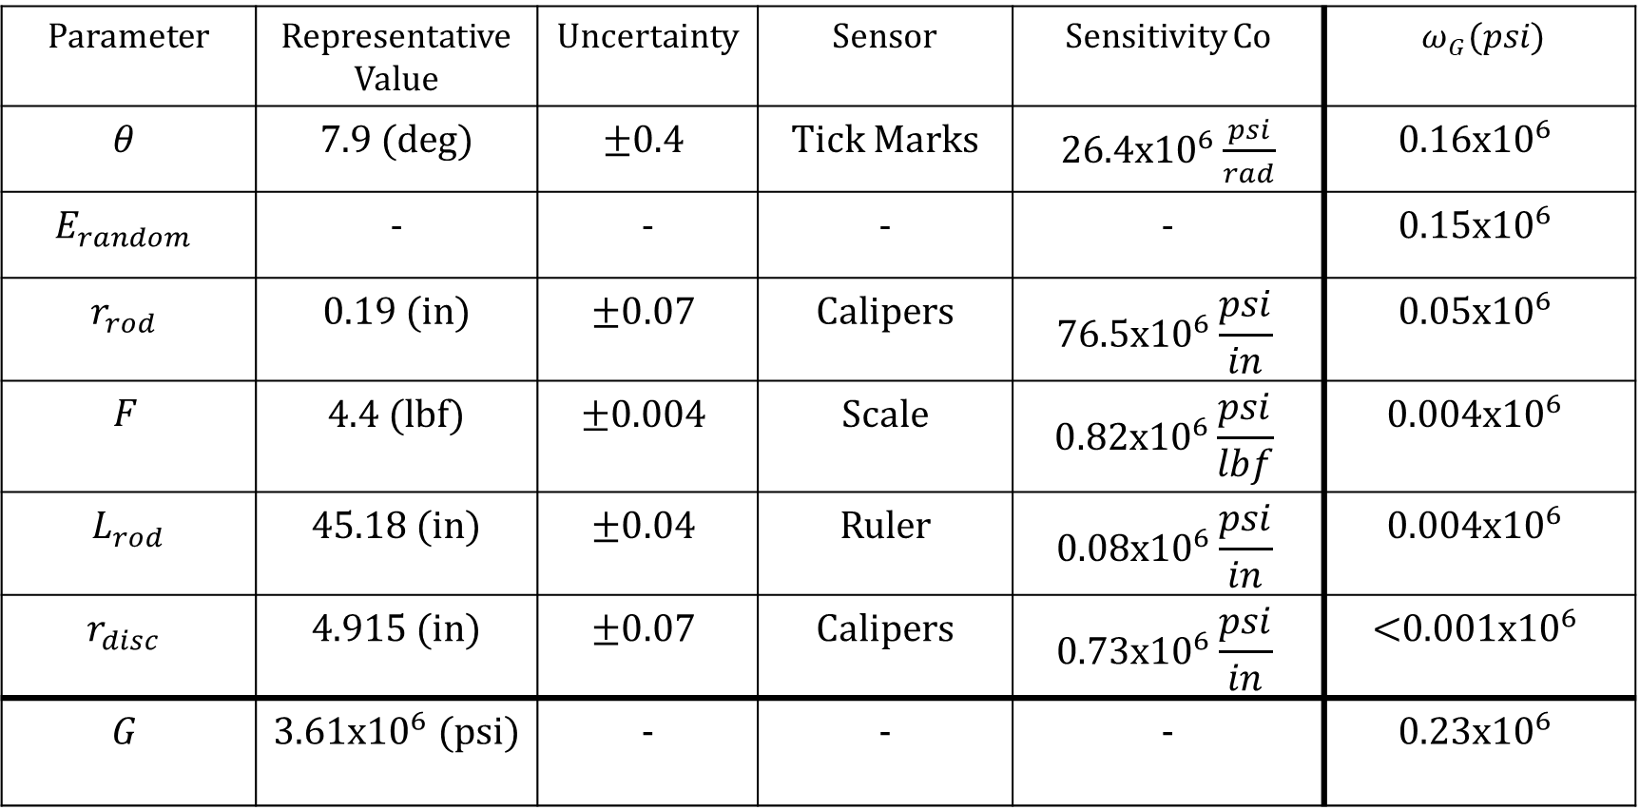
The deflection angle and random were the greatest sources of uncertainty.
Parameter | Representative Value | Uncertainty | Sensor | Sensitivity Co | $ω_{G}(psi$)
$$θ$$ | 7.9 (deg) | $$±0.4$$ | Tick Marks | $26.4x{10}^{6}\frac{psi}{rad}$ | $$0.16x{10}^{6}$$
$$E_{random}$$ | - | - | - | - | $$0.15x{10}^{6}$$
$$r_{rod}$$ | 0.19 (in) | $$±0.07$$ | Calipers | $$76.5x{10}^{6}\frac{psi}{in}$$ | $$0.05x{10}^{6}$$
$$F$$ | 4.4 (lbf) | $$±0.004$$ | Scale | $$0.82x{10}^{6}\frac{psi}{lbf}$$ | $$0.004x{10}^{6}$$
$${ L}_{rod}$$ | 45.18 (in) | $$±0.04$$ | Ruler | $$0.08x{10}^{6}\frac{psi}{in}$$ | $$0.00\text{4}\text{x}{10}^{6}$$
$$r_{disc}$$ | 4.915 (in) | $$±0.07$$ | Calipers | $$0.73x{10}^{6}\frac{psi}{in}$$ | $$\text{<}\text{0}\text{.00}\text{1}\text{x}{10}^{6}$$
$$G$$ | 3.61x${10}^{6}$ (psi) | - | - | - | $${0.23x10}^{6}$$
Notes:
Person 2
Make sure to mention theta and random for sure
Mention that the disc had an insignificant role in the total uncertainty

Slide 10
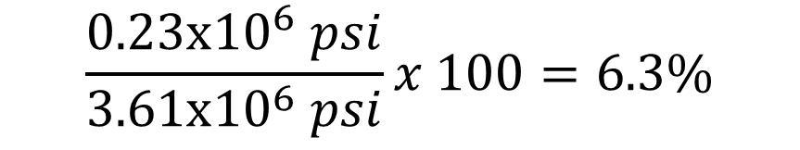

After taking multiple trials and accounting for the random uncertainty, the total relative uncertainty was calculated and divided by the shear modulus.
$$\frac{ω_{G,Total}}{G}x 100=ω_{rel,tot}$$
$$\frac{0.23x{10}^{6} psi}{3.61x{10}^{6} psi}x 100=6.3\%$$
Notes:
Person 1
Expected it to be higher as we added a lot of random uncertainty
Feel it was appropriate still and get ready to show why with out conclusion

Slide 11
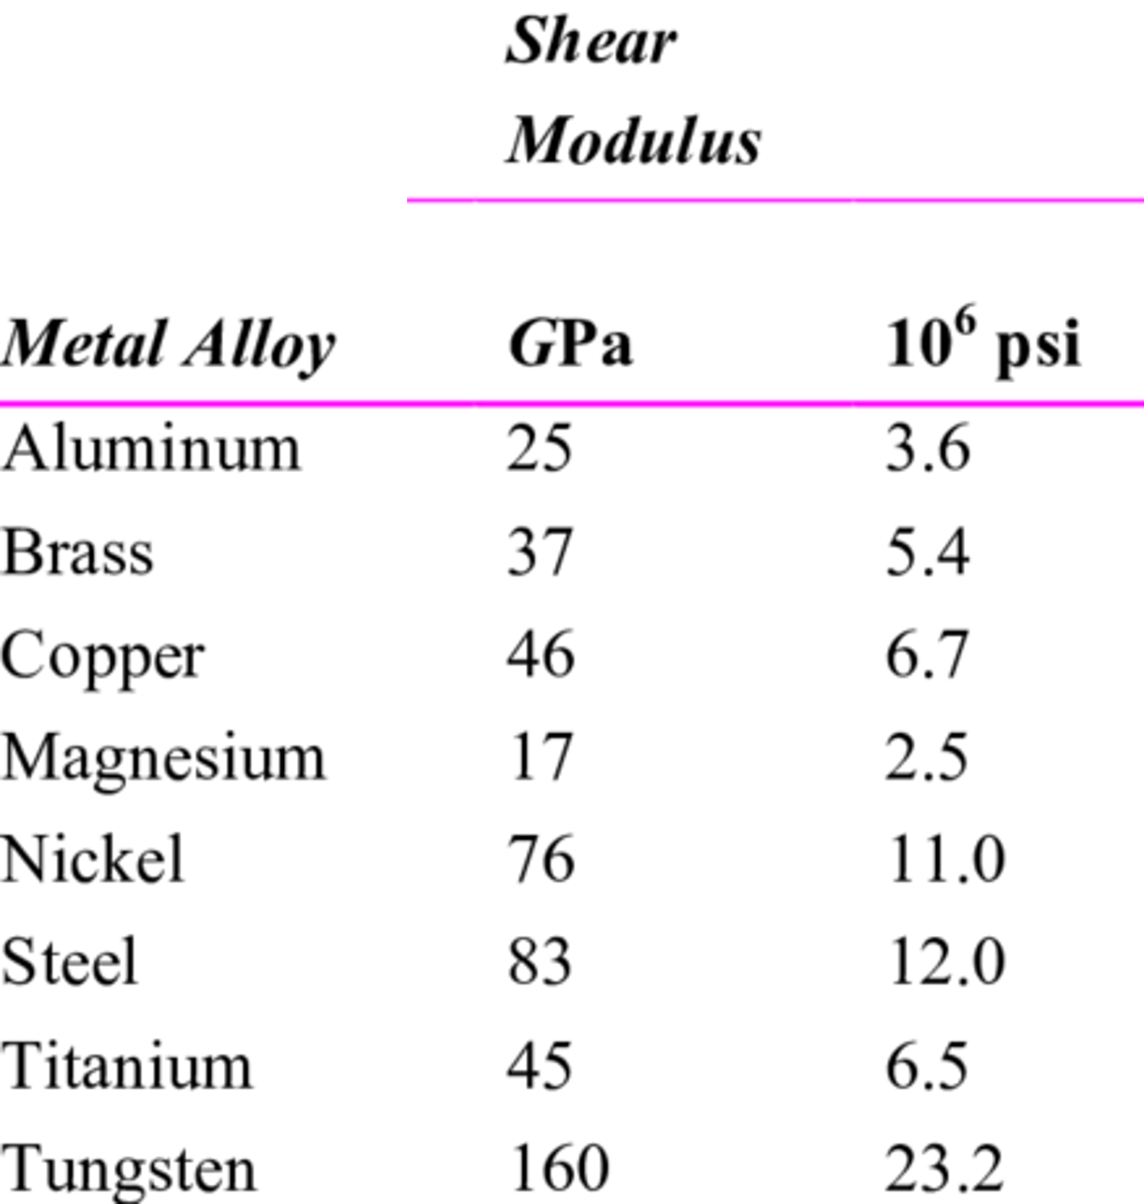
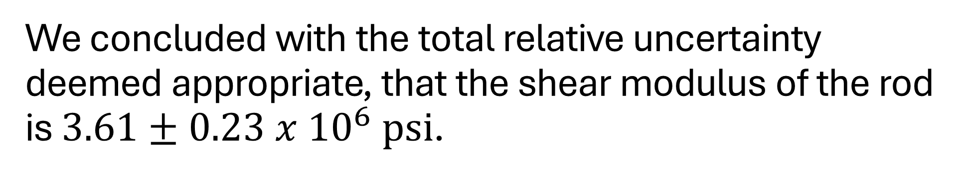
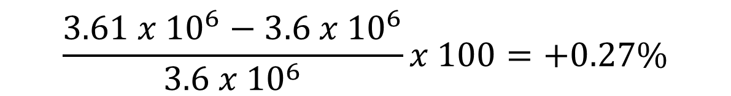
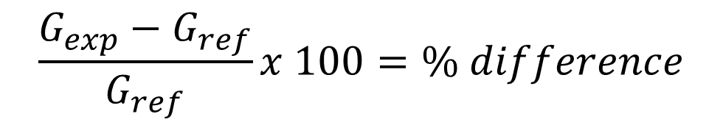
We concluded with the total relative uncertainty deemed appropriate, that the shear modulus of the rod is $3.61±0.23 x {10}^{6} psi$.
$$\frac{G_{exp}−G_{ref}}{G_{ref}}x 100=\% difference$$
$$\frac{3.61 x {10}^{6}−3.6 x {10}^{6}}{3.6 x {10}^{6}}x 100=+0.27\%$$
We recommend using a more precise way to measure the deflection angle to lower uncertainty.
Notes:
Person 2
- Deflection angle had the worst sensor to it, which would help a lower random and systematic uncertainty if it were better

Slide 12
The End
Questions?

Slide 13
Q/A Slides
First Shakedown Attempt
Calibration of Weight Scale
Uncertainty Tree
DRE Derivation
Apparatus Breakdown
Specific Aluminum Alloy
Sensitivity Coefficients
Notes:
“Back-Up” Slide with links

Slide 14
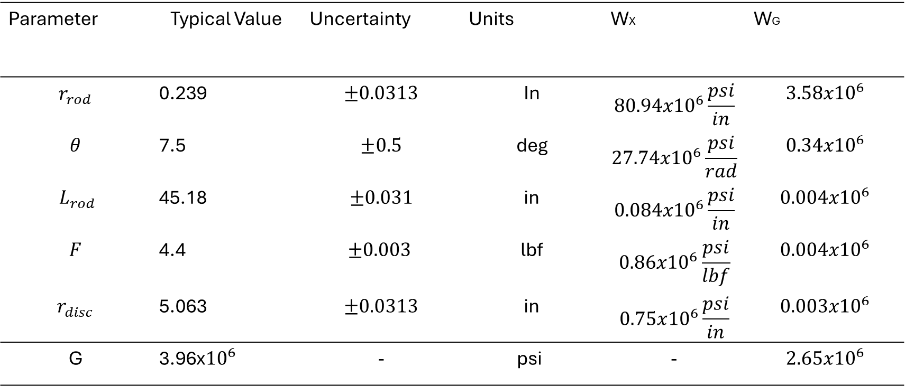
Back
Our values from our first shakedown attempt before switching to calipers.
Parameter | Typical Value | Uncertainty | Units | WX | WG
$$r_{rod}$$ | 0.239 | $$±0.0313$$ | In | $$80.94x{10}^{6}\frac{psi}{in}$$ | $${3.58x10}^{6}$$
$$θ$$ | 7.5 | $$±0.5$$ | deg | $$27.74x{10}^{6}\frac{psi}{rad}$$ | $${0.34x10}^{6}$$
$${ L}_{rod}$$ | 45.18 | $$±0.031$$ | in | $$0.084x{10}^{6}\frac{psi}{in}$$ | $${0.004x10}^{6}$$
$$F$$ | 4.4 | $$±0.003$$ | lbf | $$0.86x{10}^{6}\frac{psi}{lbf}$$ | $${0.004x10}^{6}$$
$$r_{disc}$$ | 5.063 | $$±0.0313$$ | in | $$0.75x{10}^{6}\frac{psi}{in}$$ | $${0.003x10}^{6}$$
G | 3.96x${10}^{6}$ | - | psi | - | $${2.65x10}^{6}$$
Notes:
Need to put partial dif
Add link

Slide 15
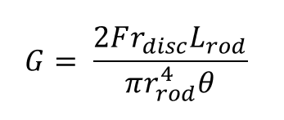
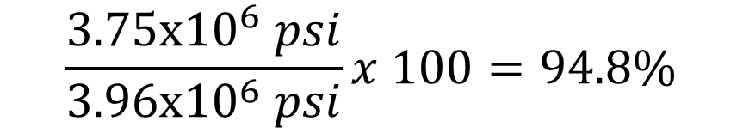
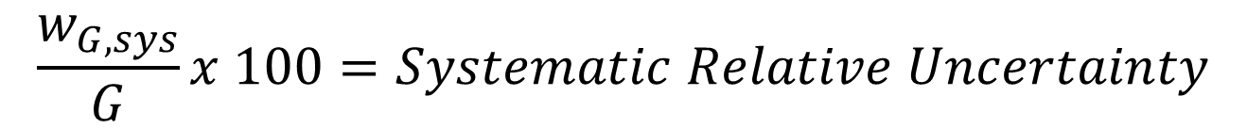
This is our systematic relative uncertainty before switching to calipers to measure the rod radius.
Back
$$\frac{w_{G,sys}}{G}x 100=Systematic Relative Uncertainty$$
$$\frac{3.75x{10}^{6} psi}{3.96x{10}^{6} psi}x 100=94.8\%$$
Notes:
- Tie in shear modulus equation at the bottom to show how a systematic uncertainty in the rod radius propagates so far

Slide 16
Uncertainty Tree
Back
W_{G}
0.23x10⁶ psi
W_{r,rod}
0.05x10⁶ psi
W_{L,rod}
0.004x10⁶ psi
W_{r,Disc}
<0.001x10⁶ psi
W_{θ}
0.16x10⁶ psi
W_{G,rand}
0.15x10⁵ psi
W_{F}
0.004x10⁶ psi
W_{G,sys}
0.17x10⁶ psi
Notes:
Add link

Slide 17

Sensitivity Coefficients (Partial Derivatives)
Back
$\frac{∂G}{∂F}=\frac{2r_{disc}L_{rod}}{πr_{rod}^{4}θ}$
$\frac{∂G}{∂r_{D}}=\frac{2FL_{rod}}{πr_{rod}^{4}θ}$
$\frac{∂G}{∂θ}=−\frac{2Fr_{disc}L_{rod}}{πr_{rod}^{4}θ^{2}}$
$\frac{∂G}{∂r_{rod}}=−\frac{8Fr_{disc}L_{rod}}{πr_{rod}^{5}θ}$
$\frac{∂G}{∂L_{rod}}=\frac{2Fr_{disc}}{πr_{rod}^{4}θ}$

Slide 18
6061 Aluminum was the closest specific aluminum alloy that could be found.
Back
We found that Aluminum rods are commonly made using 6061 Aluminum*
From Matweb* 6061-T6 Datasheet:
Calculated Shear Modulus: $3610 x {10}^{3}±23 x {10}^{3} ksi$
*McMaster-Carr
**Matweb

Slide 19
Calibration of weight scale used to find accuracy.
Back
Notes:
Add link

Slide 20
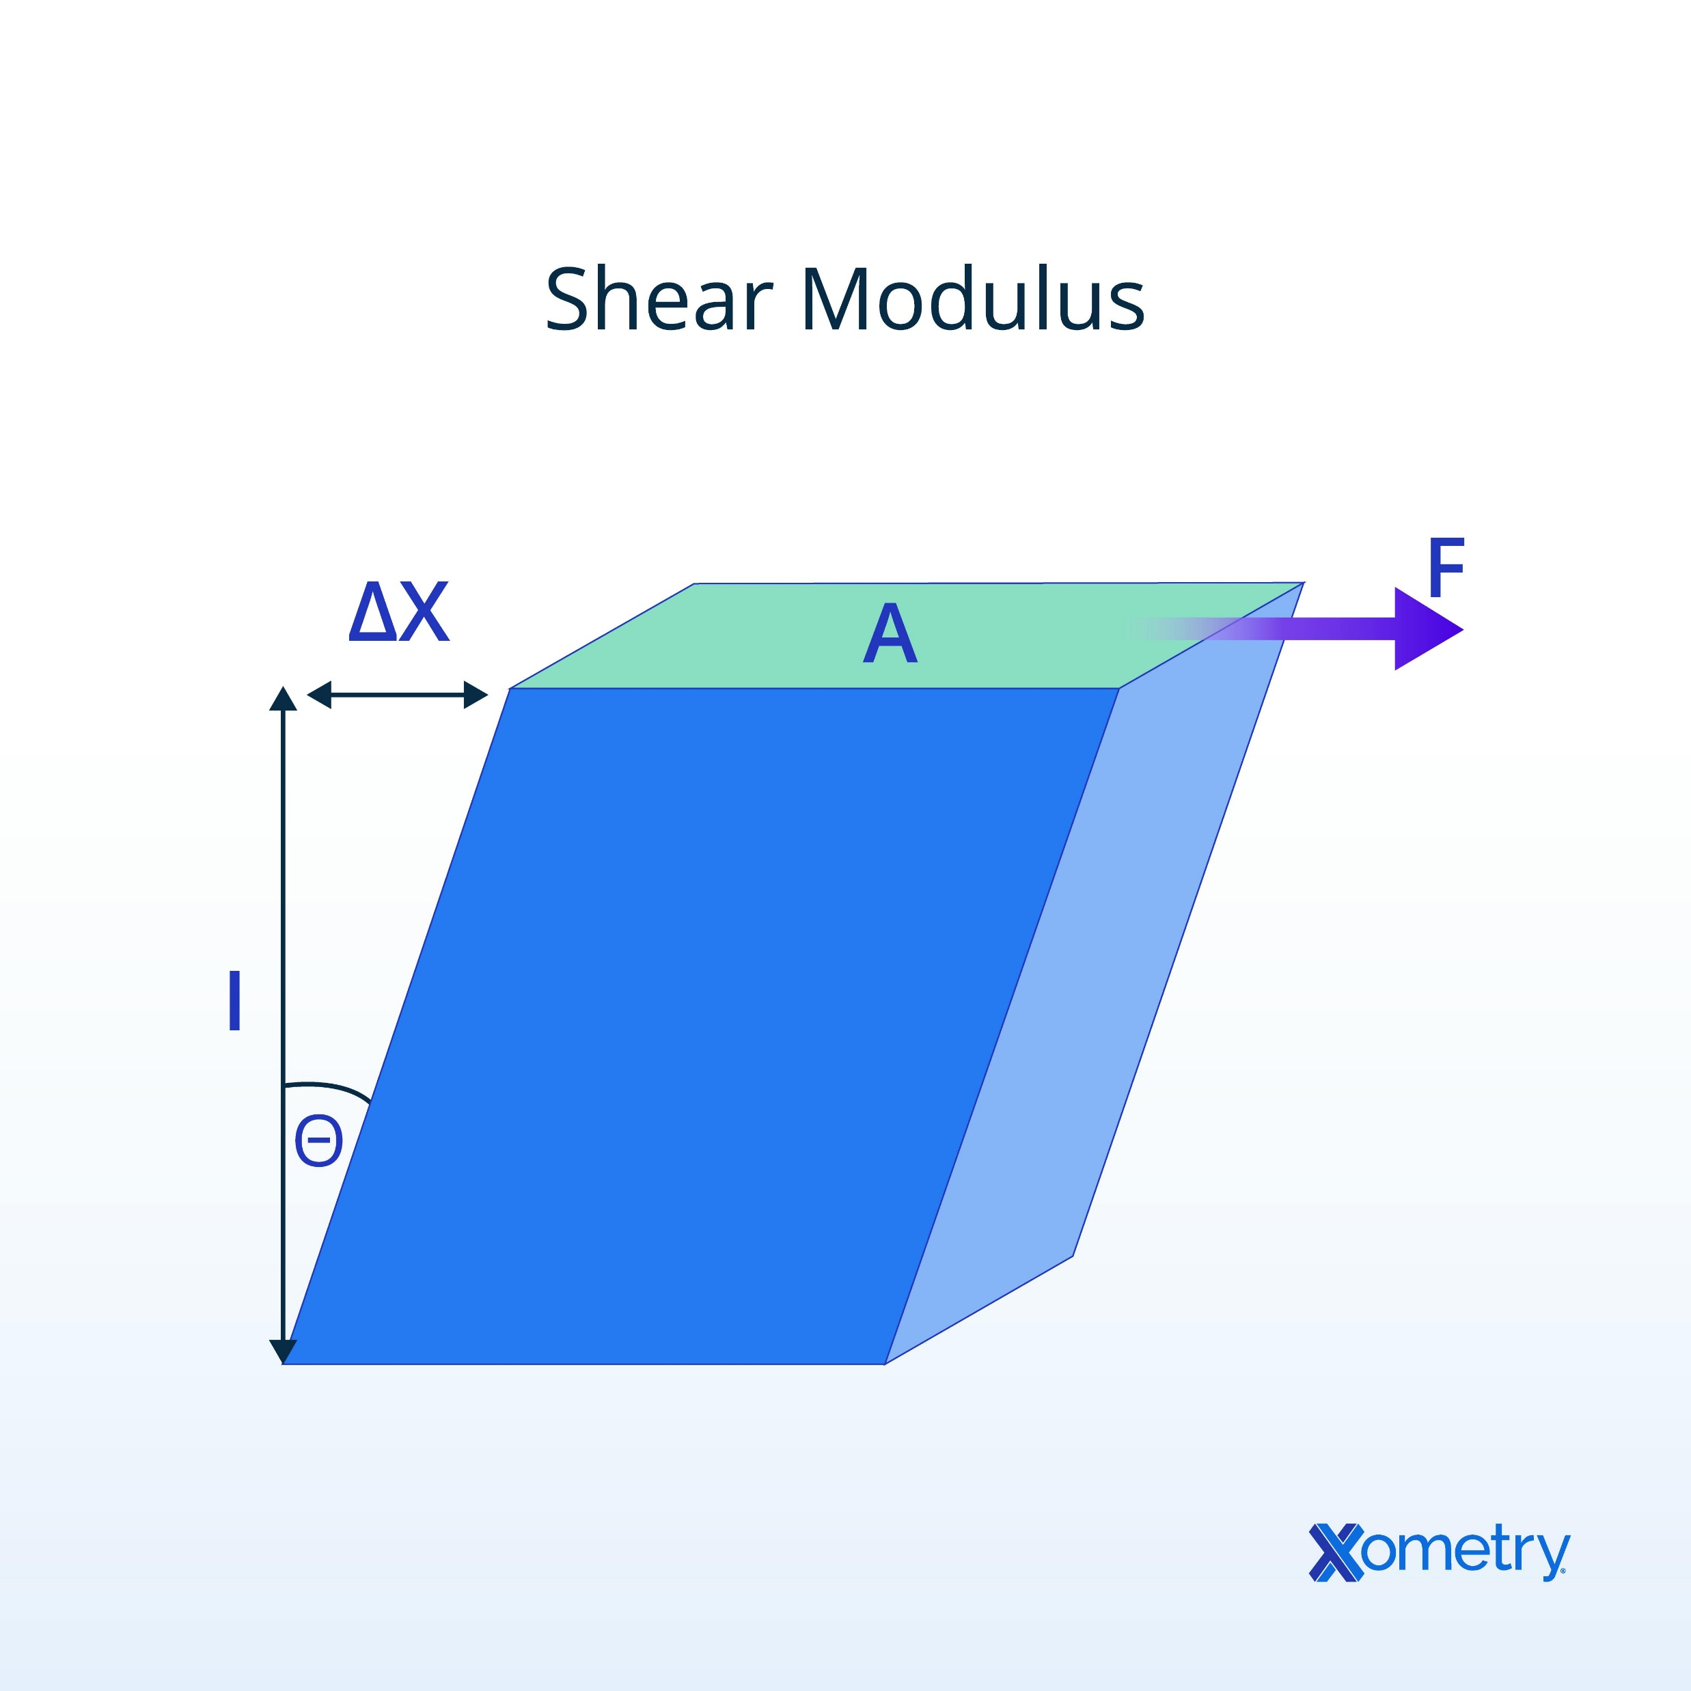
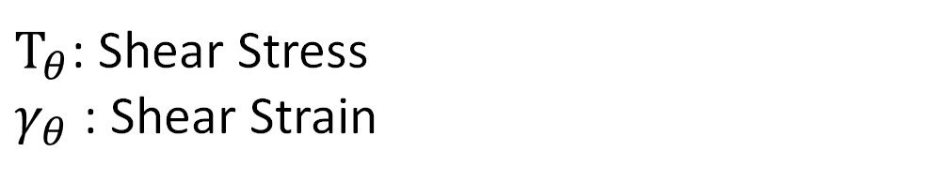
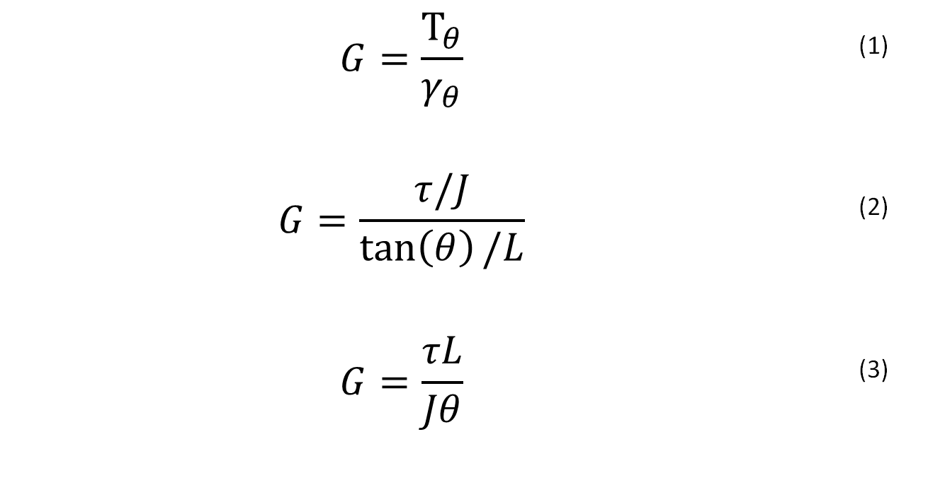
Steps to derive the Shear Modulus Equation used for our DRE.
Back
$$G=\frac{Τ_{θ}}{γ_{θ}}$$ | (1)
$$G=\frac{τ/J}{\tan\left(θ\right)/L}$$ | (2)
$$G=\frac{τL}{Jθ}$$ | (3)
*
$Τ_{θ}$: Shear Stress
$γ_{θ}$ : Shear Strain
DRE
* Small-angle approximation assumed
Notes:
Tau/J is just F/A
Tan(theta)/L is just change in length over original length
You can explain this and just mention its circular instead of square

Slide 21
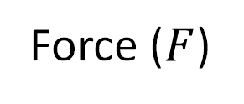
Hang a known mass off the disk
Back
Force ($F$)
Notes:
link

Slide 22
Use a disk with tick marks to measure the degree change.
Back
Disk Reading (deg)

Slide 23
Measure the radius of the disk for the use in the Shear Modulus equation
Back
Disk Radius (in)

Slide 24
Measure the rod length to include it as a measurand.
Back
Rod Length (in)

Slide 25
Measure the rod radius with calipers for the equation.
Back
Rod Radius (in)

Slide 26
Sources
https://www.researchgate.net/publication/334465619_MATERIALS_SCIENCE_AND_ENGINEERING
https://www.xometry.com/resources/3d-printing/what-is-shear-modulus

