Slide 1
TeleCar
A License To Connect
By Gal Ogdan, Orel Dayari and Oron Mozes

Slide 2
Table Of Contents
01
02
03
04
05
06
Introduction
Requirements
Goals & Metrics
Literature Review
Competitor Research
Detailed Design & Architecture

Slide 3
01
Introduction

Slide 4
Introduction
Our Motive
Our idea
In an evolving and fast-paced digital age, transportation is an integral part of our everyday life.
Sadly, it is also a factor of constant struggle, causing problems that only have overcomplicated solutions, if any.
There is a demand for a new efficient and convenient way of communicating between vehicle owners.
We intend to develop an application that will provide a social platform for vehicle owners. The application will be based on the identification of vehicle owners, using direct and indirect connection features.
The main goal is to help establish quick and effortless communication between vehicle owners - a key to many capabilities in the automotive world, that just don't exist today.

Slide 5
02
Requirements

Slide 6

Functional Requirements
Authentication
Carpools
Register & Log-in
Drive with others
Chat
Profile Tab
Based on the vehicle’s license plate number
View & edit your information
Car Marketplace
Notifications
Search for your next car, or list your own
Manage your notification settings

Slide 7
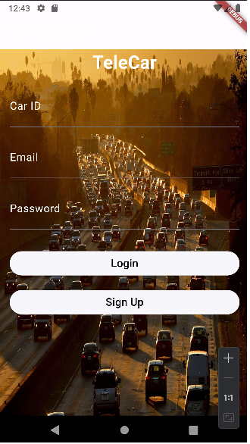
Functional Requirements
Authentication
• Users can register an account using their email and plate number.
• Users can log in to their account using their credentials.
Chat
• Users can enter their car ID to join the chat corresponding to their car.
• Users can send text messages in the chat room.
• Users can receive real-time updates for new messages.

Slide 8
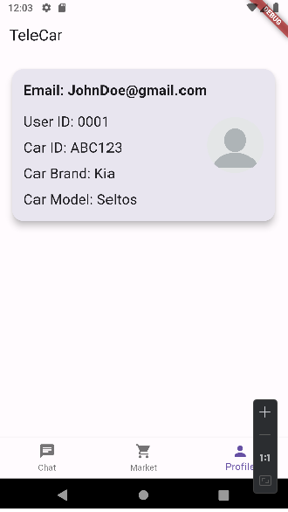
Functional Requirements
Profile Tab
• Users can view and edit their profile information, including name, contact details, and car details.
• Users can upload a profile picture.
• Users can view their activity history within the app (e.g., past car sales, carpool participation).
Notifications
• Users receive notifications for new chat messages, car sale inquiries, carpool requests, and other relevant activities.
• Users can manage notification preferences in their account settings.

Slide 9
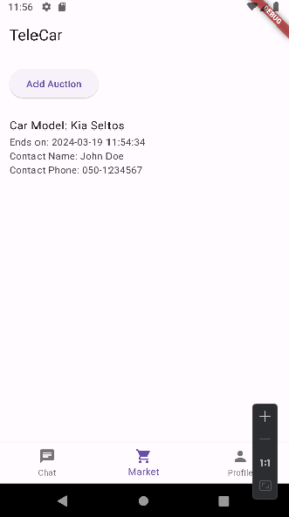
Functional Requirements
Car Marketplace
• Users can list their cars for sale, providing details such as make, model, year, price, and condition.
• Users can search for cars listed for sale based on various criteria (make, model, price range, etc.).
• Users can contact sellers through the application for inquiries or purchase negotiations.
Carpools
• Users can post carpool offers, specifying their starting location, destination, available seats, and departure time.
• Users can search for carpool offers based on their own commuting needs.
• Users can request to join a carpool.

Slide 10

Non-Functional Requirements
Performance
Reliability
Security
Usability

Slide 11
Non-Functional Requirements
Performance
Real-Time Communication
• Chat messages should be delivered with minimal latency (< 1 second).
• The system should be capable of handling concurrent chat sessions efficiently.
Response Time
• The application should respond to user interactions within 2 seconds on average.
• The maximum acceptable response time for any action is 5 seconds.

Slide 12
Non-Functional Requirements
Security
Authentication and Authorization
• User authentication should be secure, employing industry-standard encryption techniques.
• Access to certain features (e.g., selling cars, posting carpool offers) should require user authorization.
Data Protection
• User data should be stored securely, adhering to best practices for data protection.
• Sensitive data transmission should be encrypted using HTTPS.

Slide 13
Non-Functional Requirements
Reliability
Availability
• Chat messages should be delivered with minimal latency (< 1 second).
• The system should be capable of handling concurrent chat sessions efficiently.
Backup and Recovery
• Regular backups of the database should be performed to prevent data loss.
• Procedures for data recovery in case of system failures should be in place.

Slide 14
Non-Functional Requirements
Usability
User Interface
• The user interface should be intuitive and user-friendly, facilitating easy navigation.
• Adequate feedback should be provided to users for their actions (e.g., successful car listing, error messages).
Compatibility
• The application should be compatible with popular mobile platforms (iOS, Android).
• Responsive design principles should be followed to ensure usability across different screen sizes.

Slide 15
03
Goals & Metrics

Slide 16

Goals & Objectives
Social Platrorm
Emergency Support
Provide a social platform that will allow, for the first time, establishing contact using a vehicle's license number.
The application will offer several options to help users in case of an emergency.
Parking Solution
Vehicle Marketplace
P
The application will channel real-time data provided by users into solving parking problems and offer a place to organize carpools.
In addition, the application will provide an efficient platform for selling and buying vehicles.

Slide 17



Long-Term Goals
Going Official
Dash-boarding
Interfacing with government and municipal offices, allowing users to easily manage all aspects of owning a car, including payments and licensing.
Integrating with smart vehicle systems allowing users to access the app directly from their vehicle's dashboard.
Co-App
Hands-Free Operations
Integrating with popular navigation systems, allowing use on the road without distractions.
Introduce speech-controlled interfaces, allowing users to operate the app using only their voice.

Slide 18
Metrics
Downloads
Use-Frequency
Surveys & Reviews
The number of new users in the application will be on the rise. An increasing number of downloads will indicate the spread of the application and the familiarity with its advantages.
Frequent use by existing users will testify to the quality of the application.
Ratings and reviews will be received from the users.

Slide 19
04
Literature Review

Slide 20




Literature Review
Lack Of Supply
The Base Is There
Currently, only a few apps support chat via the vehicle license number.
Existing apps are missing key features, have limited availability and a limited number of users.
Smart vehicle systems, chat apps, and navigation systems already exists, separately.
Design
Challenges
Minimalist design principles and voice-controlled interfaces minimize driver distraction.
Hands-free operations and context-aware messaging enhance usability and safety.
• Regulatory compliance.
• Data privacy.
• Widespread adoption.

Slide 21
05
Competitor Research

Slide 22

CarChat
An application that allows communication between drivers using vehicle plate numbers.
Offers real-time chat, allowing users to communicate with each other based on their plate numbers
Advantages
Disadvantages
• User-friendly interface
Easy for drivers to connect.
• Advanced Privacy
Uses advanced encryption to ensure secure communication.
• Integration
Integrates with popular navigation systems, allowing use on the road without distractions.
• Limited availability
CarChat is currently available in a few selected regions, which may limit its user-reach.
• Additional Features
while CarChat facilitates communication between drivers well, it lacks additional features.

Slide 23

AutoConnect!
AutoConnect is a dynamic platform designed to connect drivers based on their vehicle plate numbers.
It offers a variety of features aimed at improving communication and collaboration between users.
Advantages
Disadvantages
• Multiple Communication Channels
Text, Voice and Video calls available.
• Wide User Base
Spanning multiple regions, improves the chances of finding other drivers.
• Integration
Integrates seamlessly with smart vehicle systems, allowing users to access the app directly from their vehicle's dashboard.
• Interface
Some users find AutoConnect's interface a bit complex, especially those who are less tech-savvy.
• Connectivity Issues
AutoConnect may experience occasional connectivity issues in areas with poor network coverage.

Slide 24

Carcom
A simple platform focused on facilitating communication between drivers based on their vehicle's plate numbers.
Its purpose is to provide a simple but effective solution for connecting drivers on the road.
Advantages
Disadvantages
• Minimalistic Interface
Easy to navigate and initiate conversations with other drivers.
• Quick Start
Getting started is quick and hassle-free, allowing users to start communicating with other drivers almost immediately.
• Efficiency
Consumes minimal resources.
• Small User Base
Users have fewer opportunities for interactions compared to other platforms.
• Lack of Features
Lacks advanced features such as multimedia messaging or voice calls.

Slide 25
06
Detailed Design & Architecture

Slide 26
Requirements
• Allow drivers to register and create accounts.
• Implement chat functionality via car ID.
• Enable users to buy and sell cars.
• Facilitate carpooling arrangements.
• Admins should be able to manage user accounts, chat records, and car listings.

Slide 27
Technologies
• Frontend: Flutter for UI components.
• Backend: FastAPI for API endpoints.
• Database: MongoDB for data storage connected to AWS.
• Cloud Platform: AWS for hosting and deployment.

Slide 28
Programming Languages and Tools
Languages
Tools
Frontend
Dart for Flutter
Backend
Python for FastAPI
Database Queries
MongoDB's query language.
IDEs
Pycharm & Android Studio for development.
Version Control
Git for code versioning.
Documentation
JSDoc for API documentation
README for setup instructions.

Slide 29

Components
• User Authentication Module
Handles user registration and authentication.
• Chat Module
Manages real-time communication via car ID.
• Car Marketplace Module
Facilitates buying and selling of cars.
• Carpooling Module
Organizes carpooling arrangements.
• Admin Module
Allows admins to manage user accounts, chat records, and car listings.

Slide 30

Common Utilities & Libraries
• FastAPI's authentication features for user authentication.
• WebSocket libraries for real-time chat functionality.
• MongoDB's Python driver for database access.

Slide 31
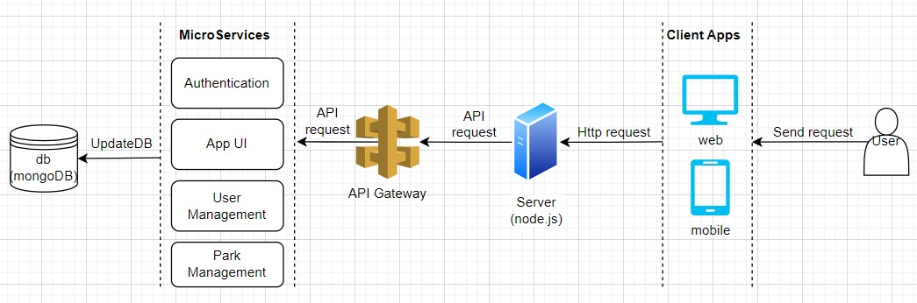
System Architecture Diagram

Slide 32
Questions?

Slide 33
Thanks!

