Slide 1

PROJECT
ORCA
Organize. Resolve. Coordinate. Align.
Presented By
LILIANNE SALORIO / 8 JASMINE

Slide 2

PROBLEM
STATEMENT
people... are still struggling? (Ex. Me)
Even with advanced tools, people still struggle to avoid schedule conflicts- using multiple platforms only adds to the hassle.

Slide 3
PROJECT OBJECTIVES
500+
Project Orca aims to develop a unified planner that lets the user log tasks, weekly schedules, and can detect time conflicts.
The system will display schedules, accept task inputs, and will automatically check for conflicts!
this is pretty tricky for me so im still in the trial and error phase as of now hahahahhaa

Slide 4
PLANNED FEATURES
1
2
3
Unified Planning Workspace
Weekly Schedule Visualization
Real-Time Conflict Detection & Notification
Combines task input and weekly scheduling into one interface.
Displays a weekly calendar where tasks can be assigned.
Automatically identifies overlapping tasks, and displays a visual warning upon entry.

Slide 5

INPUTS AND OUTPUTS
INPUTS
OUTPUTS
user’s name
schedule name
input activity and time of
desired day
a visual of the schedule
notification if conflicts in time are present.

Slide 6
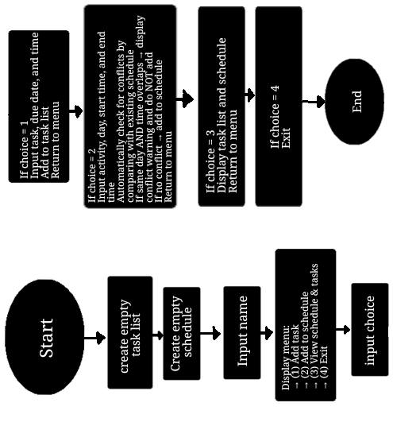
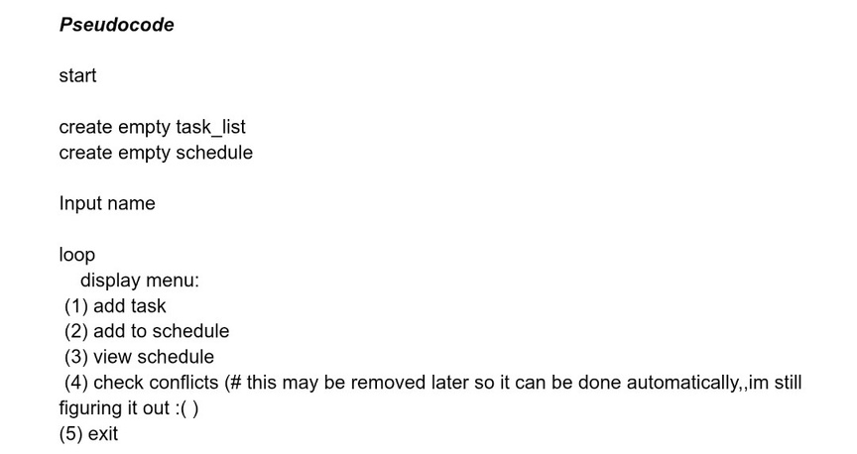
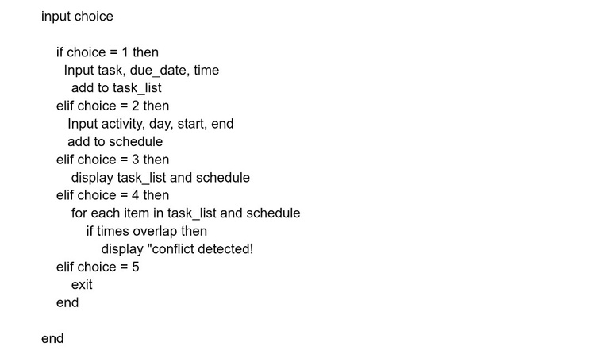
PSEUDOCODE
FLOWCHART

Slide 7
THANK YOU.

