Slide 2
Practical Hacking How I would hack you and what you can do about it

Slide 3

Gary Lobermier
Adversarial Security Engineer
OSCP, OSWP, GWAPT

Slide 4
Why?
Bridge gap between InfoSec community and SMB SysAdmins
Shed light on techniques that are frequently used but easily preventable
Want to actually show how these things let me get in!
Secure your network by getting back to the basics!

Slide 5
Starting Point No credentials
Internal device attacking network
Lobby- public area for visitor – wifi network attacks
One step 'harder' than social engineering
When a user is involved, I usually have their username or password
The internal attacking device generally doesn't have this information

Slide 6
#1 Compromising with Responder

Slide 7
Responder
Letting your network do the work
Before we see it – an explanation of name resolution
Hosts file, DNS, broadcast packet in NBNS and LLMNR
Broadcasts are inherently trusting packets
What if we … respond?
The Responder Listener then challenges the client and tricks it into attempting to authenticate with us
https://attack.mitre.org/techniques/T1557/001

Slide 8
The Demo
Home Lab - ESXi server with several VMs
The setup – there was an old file server – New Windows 10 fully up to date system has shortcuts to that old file server
Name services no longer exist in the network for that Server
Listen – show Wireshark – show responder – capturing password hash

Slide 9
What does an attacker do with this information?
Take the Password Hash offline and attempt to crack it to uncover the plaintext password
Then I can login to more resources
Relay the credentials to another system to attempt to authenticate to that resource
Without ever actually knowing the password!
Even better, some protocols might give away a plaintext password from the start, so I can instantly see your password

Slide 10
Mitigations for Responder
Just disable the services
LLMNR GPOs -- NBTNS dhcp options
Extra Credit – read about WPAD here too
https://www.4armed.com/blog/llmnr-nbtns-poisoning-using-responder/
Super worried about breaking something ?
Leave them on but alert on it
CanaryPi is a raspberry pi project on GitHub that sends email alerts if anything ever 'responds' to it
https://github.com/hackern0v1c3/CanaryPi

Slide 11
#2 Old Devices Outdated and Unpatched

Slide 12

Old Devices Outdated or Unpatched
Love XP machines
Instant full admin access – password hashes, years of abuse and leftover documents, hardcoded passwords in batch files and database connection strings
Still needed Manufacturing equipment, PLC Systems, Old HR software
Of course, now on Windows 7 machines that haven't been properly updated

Slide 13
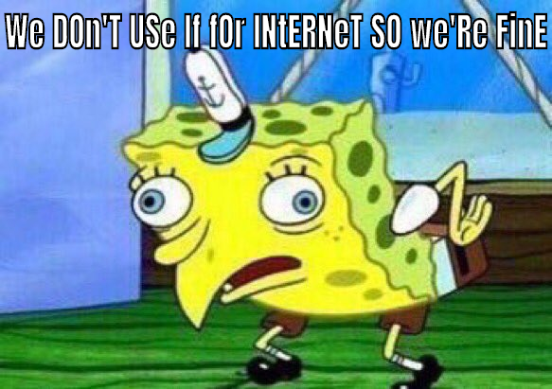
Old Devices Outdated or Unpatched
We won’t attack it that way anyway
...but please don't try
MS17-010 Eternal Blue

Slide 14
Mitigations Old Devices
SMB protocol
Listening on port 445 (139 IPC) - does it need to be listening for remote access to the file system?? Close the ports
Network Segmentation – ACLs to prevent communication to and from locations
Specifically to the one network resource it might need?
LAPS implemented yet? Why Not?
I just received hashes for local admin accounts, am I admin everywhere now?
https://blog.thesysadmins.co.uk/deploying-microsoft-laps-part-1.html

Slide 15
#3 Default Credentials

Slide 16
Default Credentials
Seems innocuous at the time
Switches, printers, software installed on PC’s
These have all given me more access than I should have as an attacker
SNMP strings
Equivalent of admin credentials but often overlooked
Software Installations
Dev’s also get a mindset of "behind authentication" and let their guard down – RCE's result in full access after logging in

Slide 17
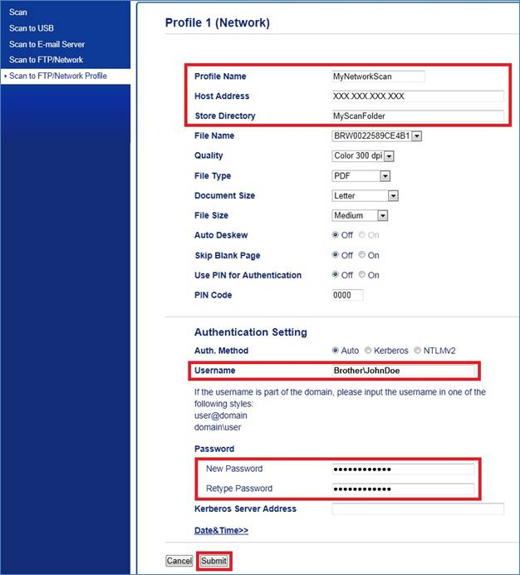
Default Credentials
Didn’t have a good way to virtualize a printer interface
Wife would not have appreciated a 4-foot-tall Multi-Function for the sake of this demo
Scan to network profiles
After what we’ve seen with responder… what if I changed the destination to my attacking server?
I would get your username and password hash!

Slide 18
Default Credentials
Demo
Internal Web server – WordPress
Authenticated RCE – like PRTG Feb 2019 – prtgadmin:prtgadmin
Authenticated – TomCat Manager– tomcat:tomcat

Slide 19
Default Credentials
Pretty simple mitigation, right?
It’s not that we don’t know we should do this, it’s just that we often don’t realize just how detrimental it can be.
I’ve never had a penetration testing engagement where I didn’t find a device using default credentials… you definitely have something setup like this

Slide 20
Internal with Credentials

Slide 21
Internal with Credentials
Equivalent of Social Engineering stage
Access at the level of the user now – we're on a user machine (Up to Date Win 10)
Could attempt password spraying internally – check for every LDAP user and look for “SeasonYEAR” password on each account
Group Policy Passwords is a common old attack – Don't set passwords on endpoints with GPOs – use LAPS!
Kerberoasting is a common attack that still works well so we'll demo this
Service Principal Names are registered accounts in AD that run services – most often I see MSSQL Service accounts – Also often they are over privileged accounts

Slide 22
Kerberoasting Mitigations
The best mitigation is a long complex password on these service accounts
…This is an issue we’ve dodged around this whole time

Slide 23
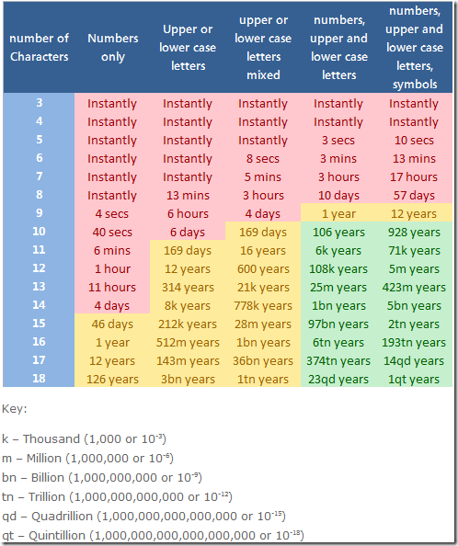
Weak Passwords
These charts you see around LinkedIN are horribly outdated
My personal machine can process your 8 and 9 character passwords
My password cracking rig can crack your 12 character password

Slide 24
Simple Takeaways
Default Credentials
NEVER
LLMNR – NBTNS- WPAD services and settings
Updates – for everything
Weak Passwords – Recommend 16 CHARaracters

Slide 25
Links and References
Cred Defense Toolkit
https://www.blackhillsinfosec.com/the-creddefense-toolkit/
Responder
https://www.4armed.com/blog/llmnr-nbtns-poisoning-using-responder/
https://github.com/hackern0v1c3/CanaryPi
Kerberoasting
See Cred Defense Toolkit
LAPS
https://blog.thesysadmins.co.uk/deploying-microsoft-laps-part-1.html
Password Recommendations
https://www.secplicity.org/2019/05/01/three-updated-password-best-practices-for-world-password-day-2019/

Slide 26



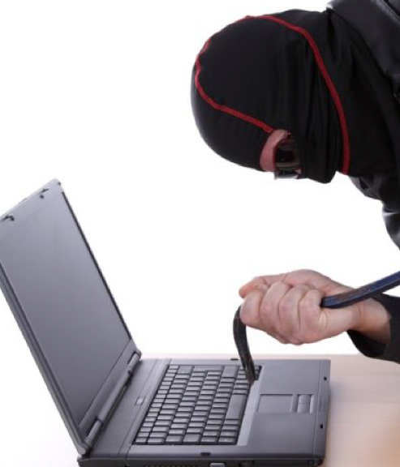
Questions?
Gary Lobermier
Gary.Lobermier@globetech.biz
Spiceworks Username
“gary lobermier”
LinkedIn
https://www.linkedin.com/in/garylobermier

Slide 27
Last Minute Reference Additions
Free way to create Honey Pot style deception
https://canarytokens.org/generate
Password Generator
https://www.lastpass.com/password-generator
Password Manager
https://keepass.info/download.html
Framework of attack methods and mitigations
https://attack.mitre.org/

