Slide 1


Bypass EDR by DLL Sideloading in C#

Slide 2
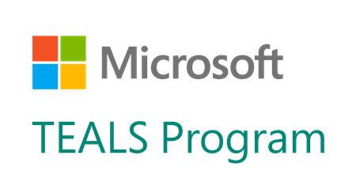

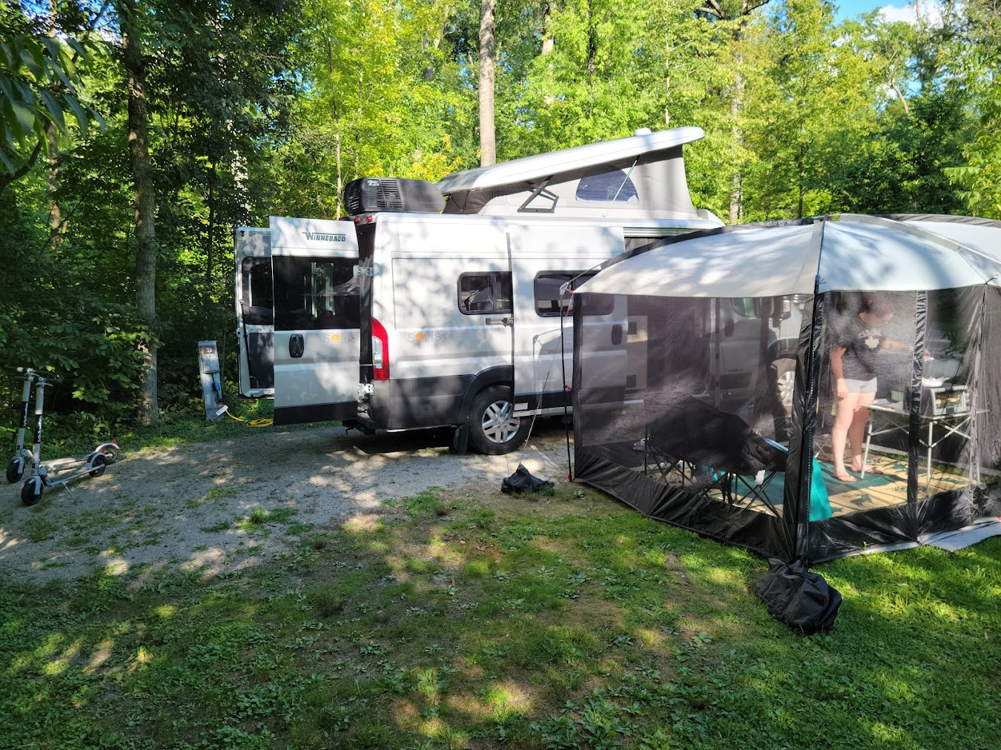


Red Teamer
Penetration Tester
Musician
Class B #VanLife
Volunteer Computer Science Teacher
3D Printer hobbyist
Cat Dad #CatTax
Gary Lobermier
Senior Adversarial Security Engineer
Northwestern Mutual

Slide 3

Overview
What technique are we using
How to review a DLL structure
How to find an EXE that will load your DLL
How to find exports for functionality
Writing DLL Exports in C#
Tools that will do these things for you

Slide 4
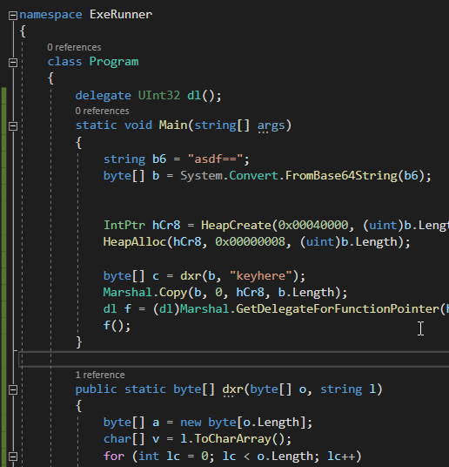
What Do I Mean Bypass EDR
Same source code shellcode runner
Compiled as an EXE
Nope, EDR tools ID and kill it
Compiled as a DLL
EDR says… sure why not
Just need a way to load and execute my DLL now.

Slide 5
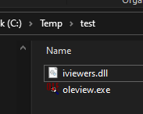
What is DLL Sideloading
Depends on who you ask
Refers to an EXE that will load a DLL sitting alongside it
What are we going to do?
Find a Microsoft Signed EXE that will ‘sideload’ DLLs
Place our DLL in the same directory to get execution through the DigSig binary.
Conflated with DLL Search Order Hijacking
How do we get the search order hijack?
WinSxS, LoadLibrary, …
Adjacent DLL gets executed
Mandiant, hijacklibs.net, CyberReason

Slide 6
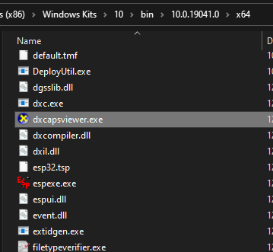
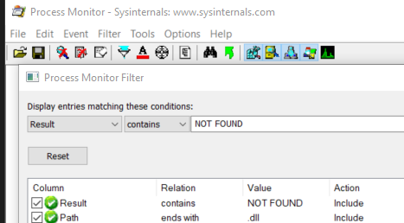
Finding a vulnerable EXE
Get some signed binaries
I like the Microsoft SDK for signed EXEs
Run EXE while watching SysInternals Procmon
Check for .DLL and result NOT FOUND
Or monitor C:\Temp\exe Location only

Slide 7
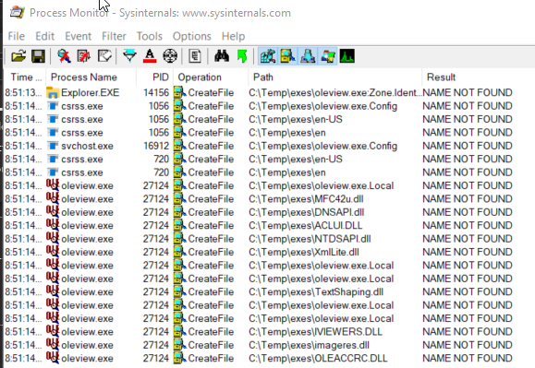
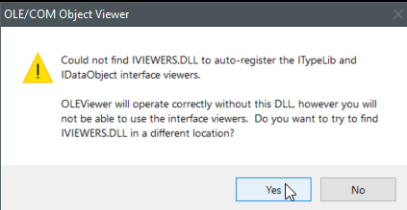
Testing OleView.exe
Copy oleview to C:\temp\exes
Monitor that directory only for NOT FOUND

Slide 8
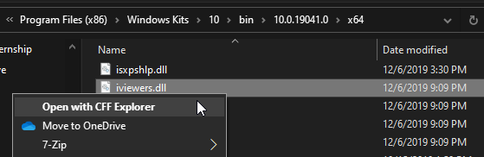
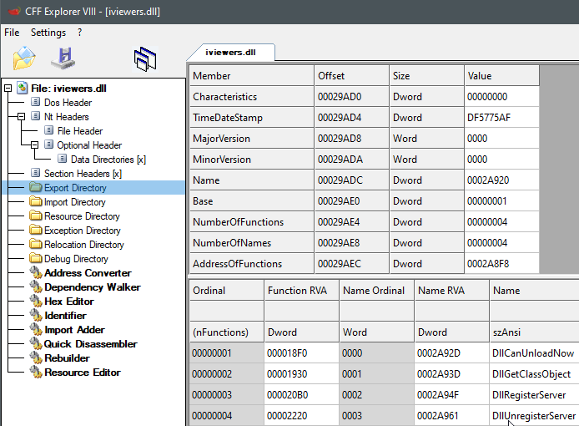
Inspecting the original DLL
DLLs export functionality to a program
Our exe expects certain functionality
We can explore the Export Address Table in a DLL to know what functions it exports
CFF Explorer, PE-Bear, objdump

Slide 9
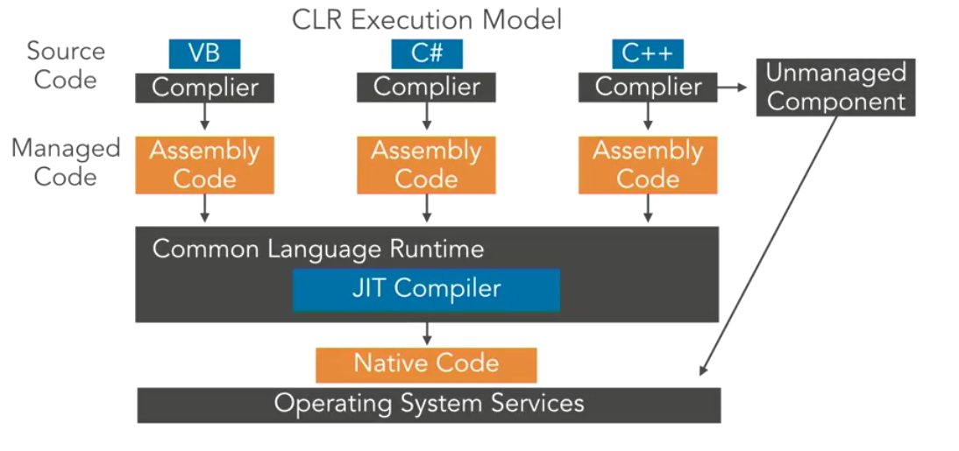
Writing a DLL
Example DLLs often written in C / C++
I like C#
Machine code
Unmanaged Code, Native Code
Byte Code
Managed Code, Intermediate Language
Requires CLR to translate to machine code
The result?
Methods that we create in C# dlls won’t exist in the export address table.
Will applications be able to run the methods without entries in the EAT?
No, oleview will check for the exports and see that they are missing.

Slide 10
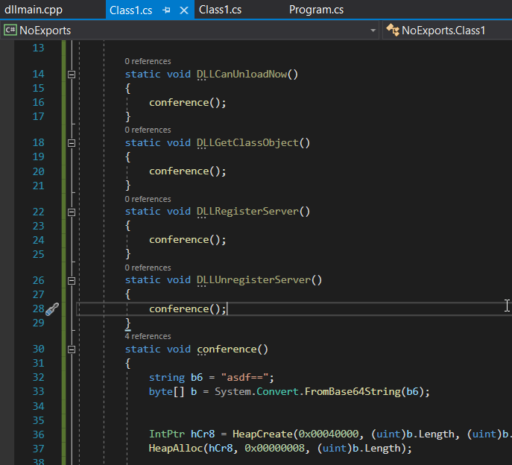
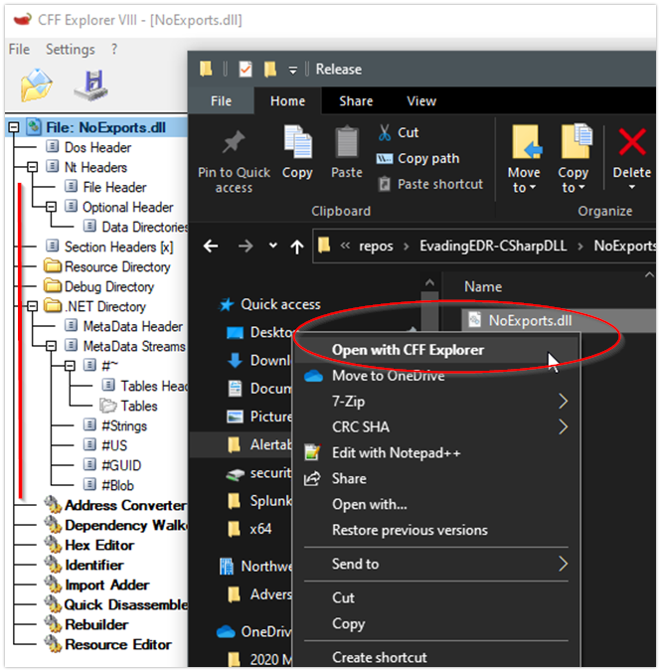
C# DLL - Same Functions – No Exports

Slide 11
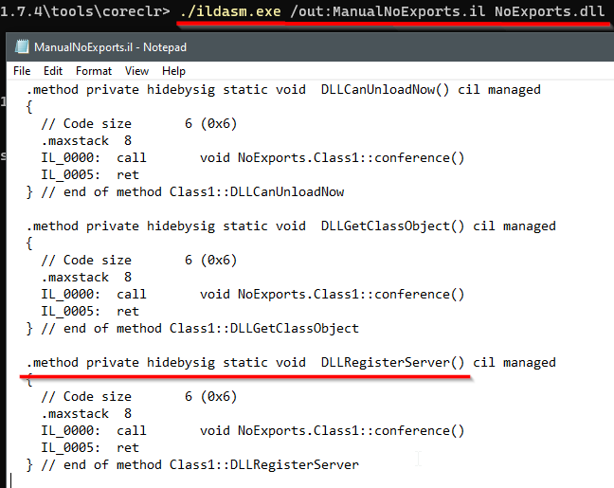
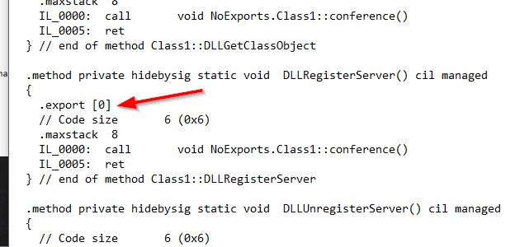
C# DLL - Manually Exporting Methods
Use an IL Disassembler
We see our methods inside
If we add our own “export” descriptor
re-assemble…

Slide 12
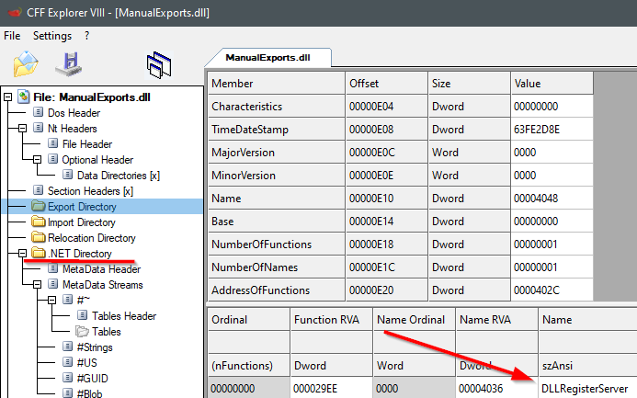
C# DLL Exported Function
Still a .NET Assembly of course
Now we have an export

Slide 13
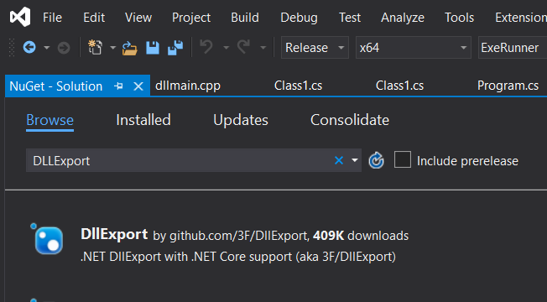
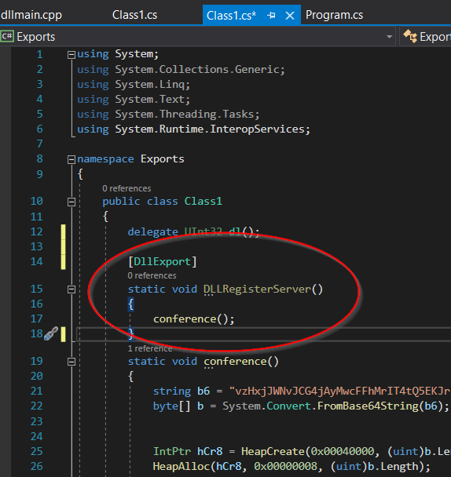
C# - DLLExport Nuget Package

Slide 14

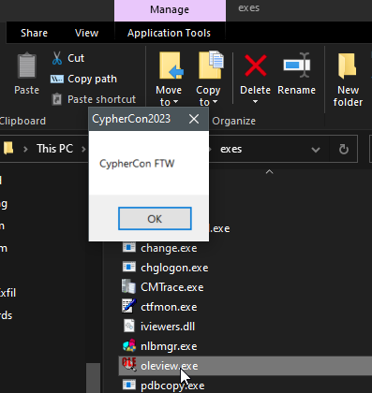
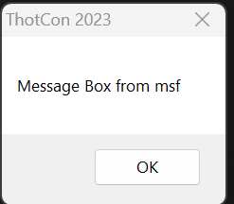
Oleview PoC
Double click oleview
Finds the adjacent iviewers.dll
Loads our msfvenom MsgBox

Slide 15
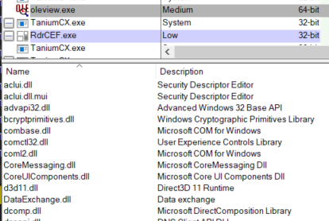
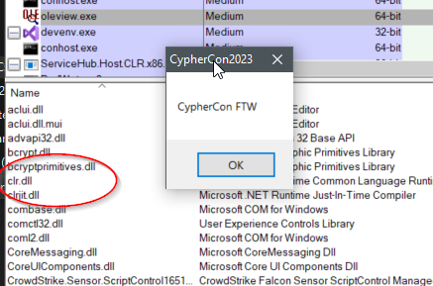
Why would this work?
Just because we created an export?
Why would unmanaged machine code know how to execute bytecode?
Machine code doesn’t know anything about bytecode or the CLR
Hola, mi nombre is Gary.
This is kinda what happens.
OS recognizes, “Hey isn’t that bytecode?”
Auto loads the CLR

Slide 16

Cool, but I don’t write code
Under the hood, that’s how it works
There are toolkits that do this for you.
Optiv “Freeze” - github
Tell it to create a DLL named iviewers.dll with the export “whatever” and use shellcode from MSFVenom
Creates AES encrypted shellcode in a dll format for you.
Current pull request has a feature that allows you to create multiple DLL Exports
https://github.com/optiv/Freeze

Slide 17
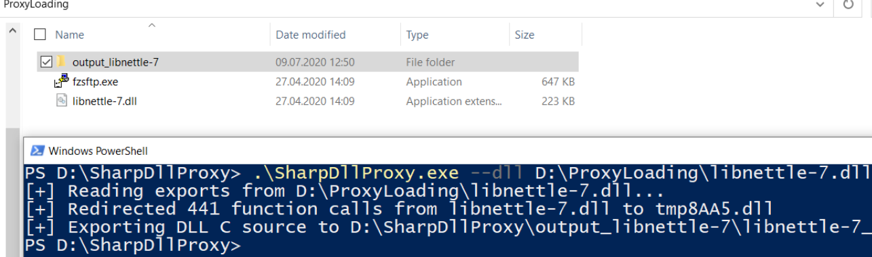
Didn’t this just break oleview?
Yes, but we only wanted beacon execution
What if we wanted to maintain application functionality? --> DLL Proxy.
Concept is the same, create a DLL that exports the functionality
Pass functions to the ACTUAL DLL, functionality is still present.
App is proxying through our DLL, we can load shellcode, but proxy normal execution to a copy of the original DLL.
SharpDLLProxy - github
https://github.com/Flangvik/SharpDllProxy

Slide 18
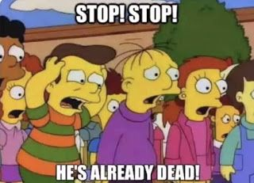
Blue Team
If exe normally lives in System32, why would we call it from somewhere else
Especially if there is an adjacent dll…
MS Signed exe’s - good chance the loaded DLLs should also be MS Signed
C# specific
Does CLR.dll normally get loaded into that process?
If not, why is it now?
Export Data, baseline where executables (exe name AND originalFileName) run from non-standard dirs.
Do the same with dlls, which is harder but can be reviewed with imageload events.

Slide 19
Questions
Contact Information
https://www.linkedin.com/in/garylobermier/
https://twitter.com/GaryLobermier

