Slide 1

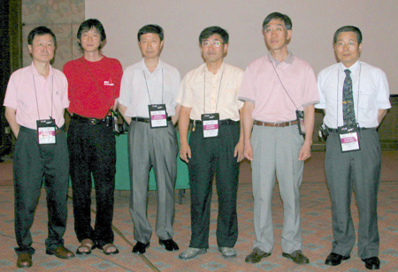
Experimental Competition
Mechanical Black Box
Academic Committee Members for Experimental Competition
Chair : Prof. Insuk Yu (SNU)
Members : Chung Ki Hong, Moo-hyun Cho (POSTECH)
Soonchil Lee, Yong Hee Lee (KAIST),
Jean Soo Chung (CBNU)

Slide 2
Comprehensive Understanding of Physics
Simple but Challenging …
1. Identification of Issues
2. Design of Experiments
3. Experimental Skills
4. Analyses
- Experimental Data (A, B, C) + Physics

Slide 3
Black Box
2D
3D

Slide 4
1- D Black Box
1D
3 unknowns

Slide 5
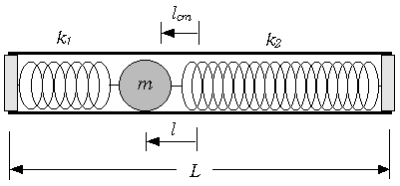
What’s inside ??
Mass
Spring Constant
Position of the ball
Radius of the ball
Combination experiments based on physical understanding.

Slide 6
Overall Picture
To find m, one has to combine results from Part A and Part B.
PART-A
Center of Mass Measurement
m x l
PART-B
Rotation of Rigid Body
Experimental equation
containing m and l
Measurements
PART-C
Harmonic Oscillation
Spring Constants
To find k, one needs results from Part A and Part B.

Slide 7
Physical Concepts
Mechanics
  Newton's laws, conservation of energy
  Elastic forces, frictional forces
Mechanics of Rigid Bodies
  Motion of rigid bodies, rotation, angular velocity
  Moment of inertia, kinetic energy of a rotating body
Oscillations and waves
  Simple harmonic oscillations
Additional requirements for practical problems
  Simple laboratory instruments
  Identification of error sources and their influence
  Transformation of a dependence to the linear form

Slide 8
PART-A m × l
Product of Mass and Position of Ball
A1. Suggest and justify a method allowing to obtain the product m×l.
A2. Experimentally determine the value of m×l.

Slide 9
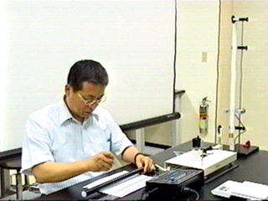
PART-A Product of Mass and Position
Center of Mass Measurement
Measured
Unknowns
m l = (M +m) l_{cm}

Slide 10
PART-A m x l
1D

Slide 11
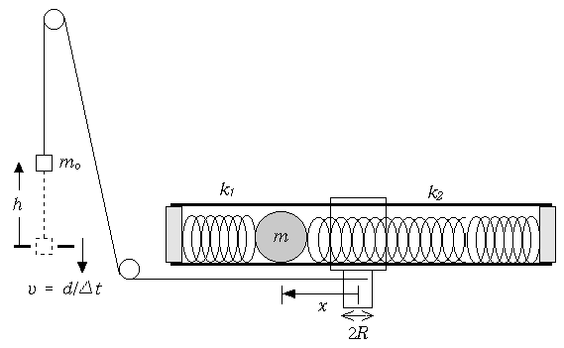
PART-B The Mass of the Ball
B1. Measure v for various h. Identify the slow and fast rotation regions.
B2. From your measurement, show that h=Cv² in the slow rotation region and h= Av² + B in the fast rotation region.
B3. Relate the coefficient C to the parameters such as m, l, etc.
B4. Relate the coefficients A and B to the parameters such as m, l, etc.
B5. Determine the value of m.

Slide 12
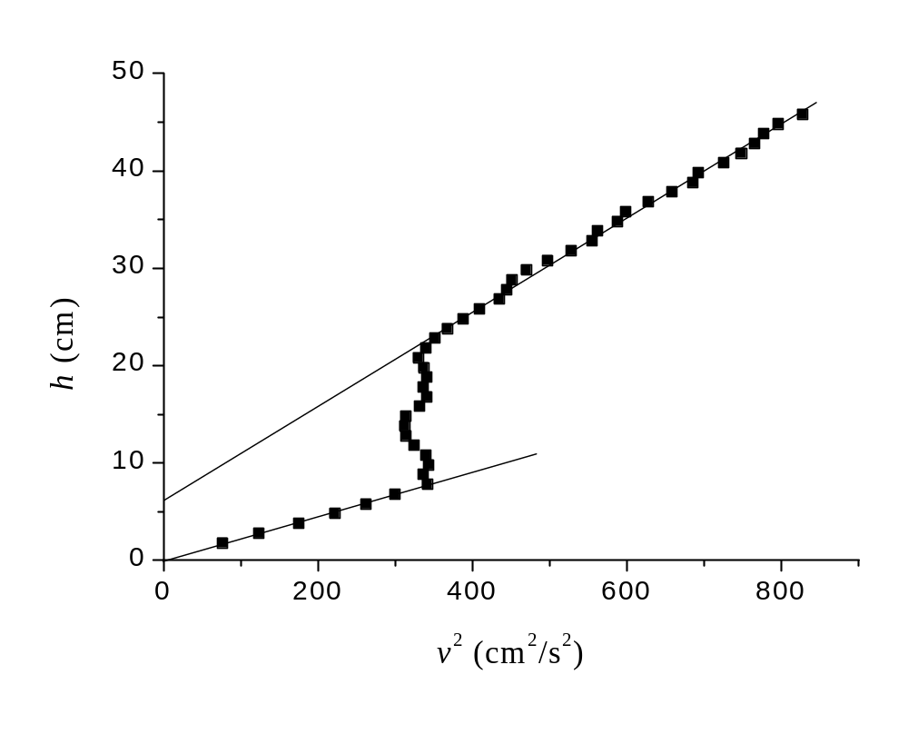
PART-B Data Plotting
h = A_{f} v² + B
h = A_{s} v²

Slide 13
PART-B The Mass of the Ball
Physics
[Slow Rotation Regime] h = A_{s} v²
ΔK + ΔU = 0, Energy Conservation
ΔK = ½ [ m₀ + I/R² + m(l² + 2r²/5)/R² ] v² , ΔU = - m₀ g h
[Fast Rotation Regime] h = A_{f} v² + B
ΔK + ΔU + ΔU_{e}= 0, Energy Conservation
ΔK = ½ [ m₀ + I/R² + m {(L/2 – δ - r)² + 2r²/5}/R² ] v²
ΔU_{e}= ½[ -k₁(L/2 – l – δ - r)² + k₂ {(L -2δ - 2r)² – (L/2 + l – δ - r)²}]
ΔU = - m₀ g h
δ
L/2+l-δ-r
L-2δ-2r

Slide 14
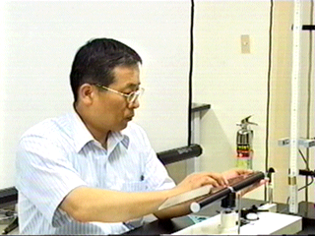
PART-B The Mass of the Ball
Preparation I

Slide 15
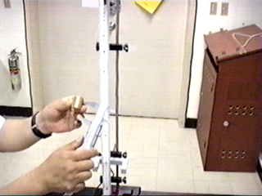
PART-B The Mass of the Ball
Preparation I

Slide 16
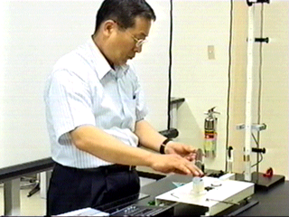
PART-B The Mass of the Ball
Test of Setup

Slide 17
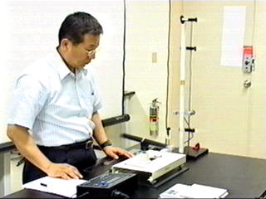
PART-B The Mass of the Ball
Measurement

Slide 18
PART-B m , l
1D

Slide 19
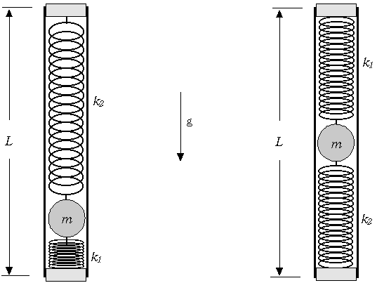
PART-C The Spring Constants k₁ and k₂
C1 Measure the periods T₁ and T₂ of small oscillation.
C2 Explain why the angular frequencies ω₁ and ω₂ are different.
C2 Find an equation that can be used to evaluate Δl.
C4 Find the value of the effective total spring constant k.
C5 Obtain the respective values of k₁ and k₂.

Slide 20
PART-C The Spring Constants
Original Position2
Center of MBB
Δl
l
Δl
Original Position1
ω₁² = [MgL/2 + mg(L/2 + l + Δl)] / [I₀ + m { (L/2 + l + Δl)² + 2r²/5}]
ω₂² = [MgL/2 + mg(L/2 - l + Δl)] / [I₀ + m { (L/2 - l + Δl)² + 2r²/5}]
Elliminate I₀ and obtain Δl !!

Slide 21
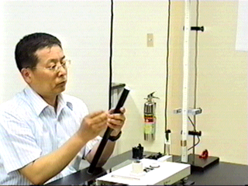
PART-C The Spring Constants
Preparation

Slide 22
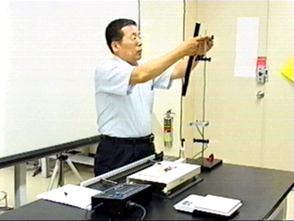
PART-C The Spring Constants
Setup & Measurement

Slide 23
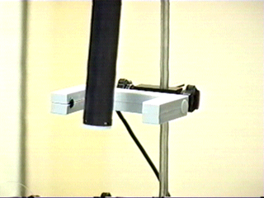
PART-C The Spring Constants
Measurement of Period

Slide 24
PART C: m, l, k₁, k₂
1D

Slide 25
Thanks !!

Slide 26
Additional Information

Slide 27
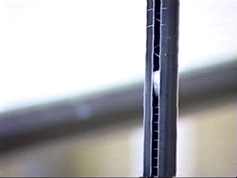
The Mechanical Black Box
See-through MBB

Slide 28
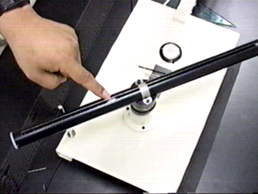
The Mechanical Black Box
Rotation

Slide 29
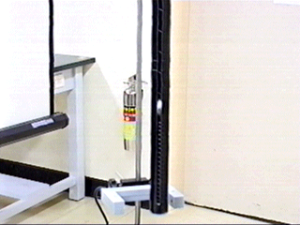
The Mechanical Black Box
Small Oscillation

Slide 30
PART-B The Mass of the Ball
Theory with friction
[Slow Rotation Regime] h = A_{s} v²
ΔK + ΔU + ΔW= 0, Energy Conservation
ΔK = ½ [ m₀ + I/R² + m(l² + 2r²/5)/R² ] v² , ΔU = - m₀ g h, ΔW = f_{r} h
[Fast Rotation Regime] h = A_{f} v² + B
ΔK + ΔU + ΔU_{e} + ΔW = 0, Energy Conservation
ΔK = ½ [ m₀ + I/R² + m {(L/2 – δ - r)² + 2r²/5}/R² ] v²
ΔU_{e}= ½[ -k₁(L/2 – l – δ - r)² + k₂ {(L -2δ - 2r)² – (L/2 + l – δ - r)²}]
ΔU = - m₀ g h , ΔW = f_{r} h
Frictional energy loss is 8-10% of the gravitational energy.

