Slide 1



Planck’s constant in the light of an incandescent lamp

Slide 2
Introduction

Slide 3
The idea of light quanta
Planck (1900): emission of radiant energy by matter does not take place continuously, but in finite “quanta of energy” hν (h= Planck’s constant 6.63x10⁻³⁴ J.s, ν =frequency)
Einstein (1905): light quanta (photons) as inherent in the nature of radiation itself

Slide 4
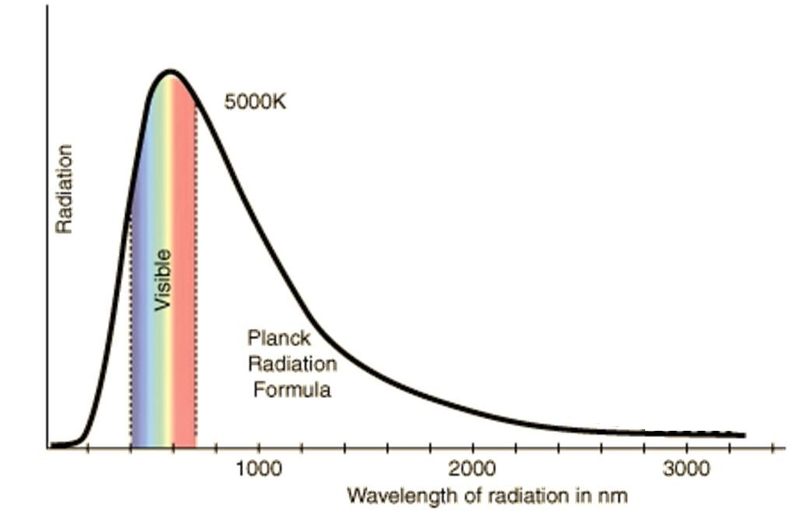
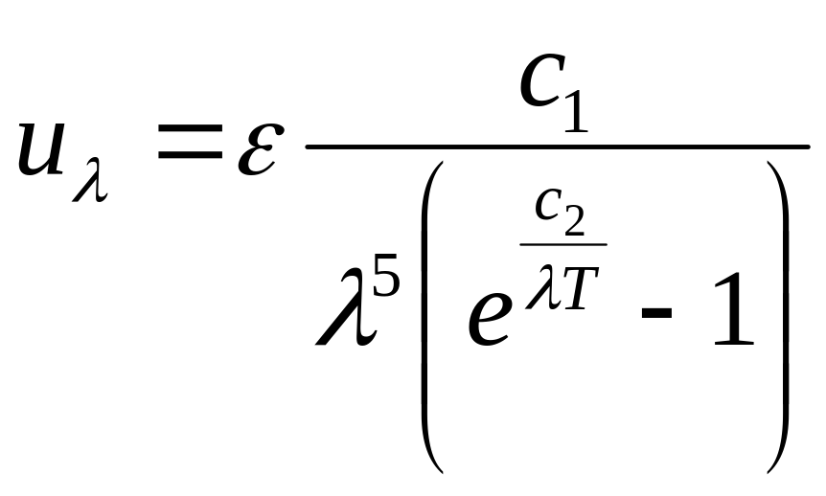
Distribution of intensity of heat radiation as a function of the wavelength
ε :
Emissivity (=1 for perfect black-body radiation)
C₁, C₂ :
Constant parameters

Slide 5
Planck’s radiation law Radiation energy per time unit for the wavelength λ
Where c₂=hc/k
h: Planck’s constant
c: velocity of light
k: Boltzmann’s constant
Main objective of this experiment

Slide 6
Report on the experiment

Slide 7
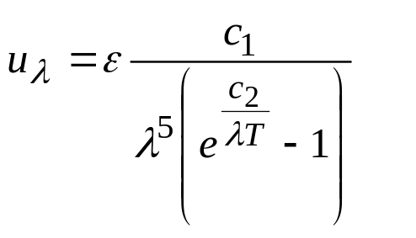
Emission of a 12 V tungsten lamp
u_{λ}
wavelength, λ

Slide 8
The light spectrum emitted by the filament is continuous.
u_{λ}
wavelength, λ

Slide 9
A narrow band of the visible spectrum is selected with a combination of Orange II and Copper Sulphate solution (it absorbs infrared strongly).
u_{λ}
wavelength, λ
λ₀
Liquid filter

Slide 10
We will assume that the selected band is nearly monochromatic.
u_{λ}
wavelength, λ
λ₀
Liquid filter

Slide 11
The wavelength of the selected band is in the spectral response range of a Light Dependent Resistor (LDR)
u_{λ}
wavelength, λ
λ₀
Liquid filter

Slide 12
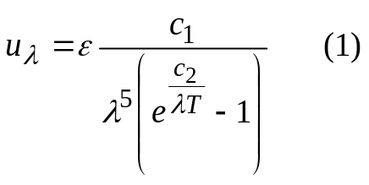
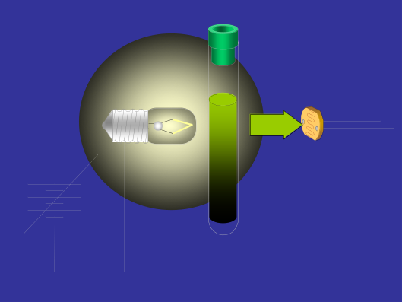

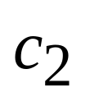
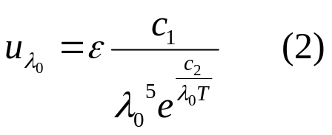
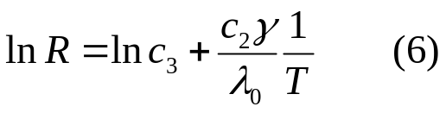


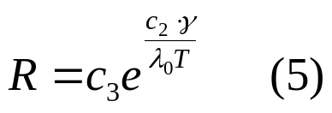
From the formula:
Block diagram
For small λ
lnR_{ldr}
lllumination E on the LDR is
proportional to the transmitted energy
1/ T
Plotting
Resistance R of LDR
is related to illumination as:
Taking logarithms
Combining (2), (3) and (4):
b: constant
γ : parameter

Slide 13
Experimental setup

Slide 14
GENERAL DIAGRAM
Solution filter
Potentiometer
LDR
Ohmeter
Lamp
Battery
Voltmeter
Ω
V
A
Ammeter

Slide 15
COMPONENTS
Battery
Cover
Potentiometer
LDR
Lamp
Platform
Solution filter
Holder
Ω
V
A
Grey filter
Ruler
Ohmeter
Voltmeter
Ammeter

Slide 16
INSTALLING
THE
EQUIPMENT

Slide 17
1
Turn the potentiometer knob anticlockwise up to the limit

Slide 18
Turn slowly the tube holder aligning the lateral holes between the lamp and the LDR.
2

Slide 19
Move the LDR towards its lateral hole, positioning its surface as the figure shows.
3

Slide 20
4
Insert the solution filter tube in its holder.

Slide 21
Put the cover onto the platform to protect from the outside light.
In order to ensure the correct initial conditions, LDR should keep in total darkness for at least 10 minutes before the measurements.
5

Slide 22
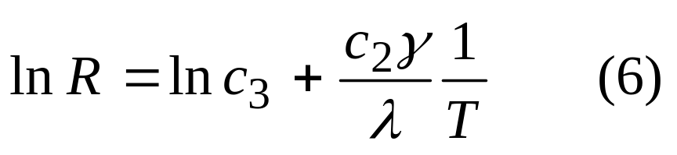
Procedure
Some previous measurements are needed before using Equation (6)
R
T
γ
λ₀

Slide 23
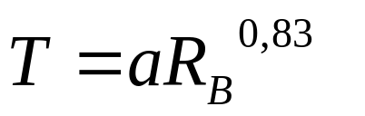
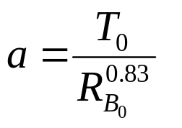
T→ Temperature of the emmitting filament
Relation between the resistance of the filament (R_{B}) and its temperature (T)
R_{B}
R
Experimental data fit
R₀
R_{B0}
I
a can be derived from the filament resistance (R_{B0}) at room temperature (T₀)
Using the multimeter as a thermometer.
V
R_{B0} can be extrapolated to I = 0 from measurements of V and I,
A

Slide 24
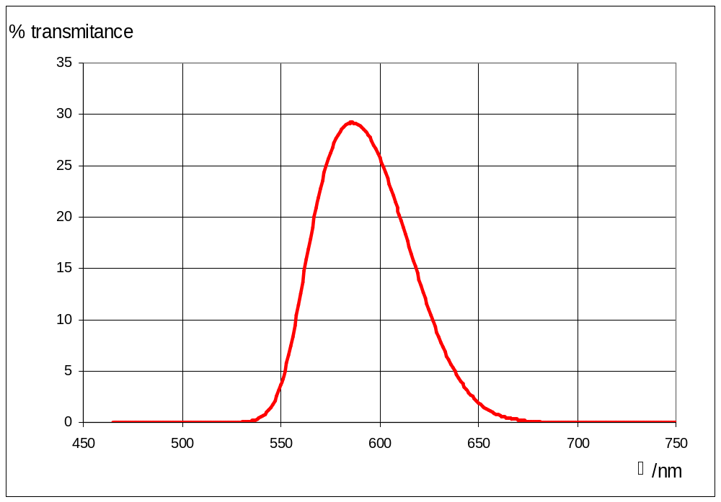
λ→ transmission of the filter
Solution of:
Orange II.
CuSO₄ (it absorbs the infrared light).
λ₀ = 590 nm
λ/nm

Slide 25
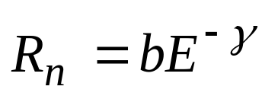
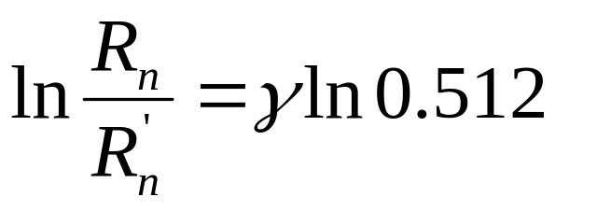
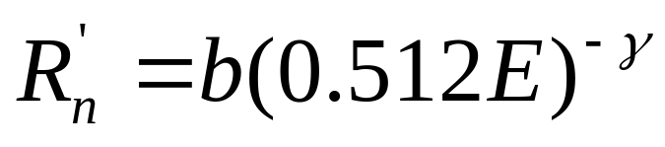
γ→ Parameter of the LDR
E_{n}
R_{n}
Grey filter
0.512E_{n}
R_{n}’

Slide 26
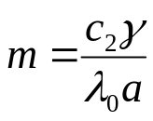
COLLECTING DATA
V
R
A
I
V
R_{B}=V/I
T = aR_{B}^{0.83}
R_{B}^{-0.83}
R
lnR
I₁
V₁
R_{B1}
T₁
R_{B1}^{-0.83}
R₁
lnR₁
I₂
V₂
R_{B2}
T₂
R_{B2}^{-0.83}
R₂
lnR₂
I₃
V₃
R_{B3}
T₃
R_{B3}^{-0.83}
R₃
lnR₃
I_{n}
V_{n}
R_{Bn}
T_{n}
R_{Bn}^{-0.83}
R_{n}
lnR_{n}
lnR
R_{B}^{-0.83}

Slide 27
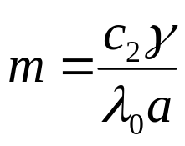
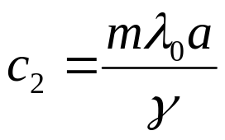
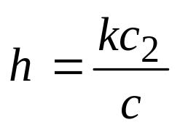
From the slope
lnR
R_{B}^{-0.83}
We obtain
And finally the Planck´s constant:
h: Planck´s constant.
k: Boltzmann´s constant.
c: speed of light.

Slide 28
End of presentation

