Slide 1
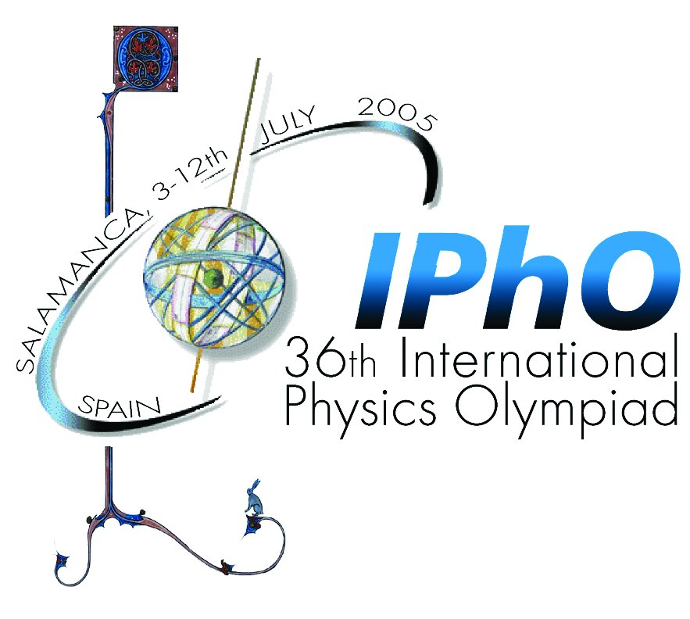




THEORETICAL QUESTION 1
36th International Physics Olympiad
Theoretical competition, Tuesday July 5, 2005

Slide 2
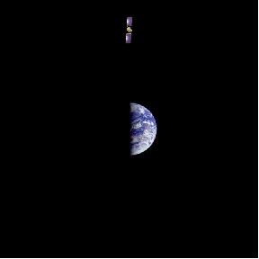


An ill fated satellite
Objective:
Study the orbital parameters of a geostationary satellite
and its orbit after a misfiring of the apogee engine.
THEORETICAL QUESTION 1
36th International Physics Olympiad
Theoretical competition, Tuesday July 5, 2005

Slide 3
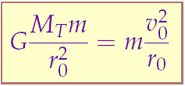
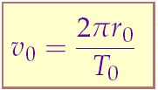
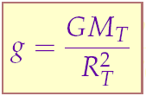
An ill fated satellite
Question 1: Determination of orbital parameters,
velocity, energy, and angular momentum of a satellite in a
geoestationary orbit.
THEORETICAL QUESTION 1
Definitions of energy and angular momentum
36th International Physics Olympiad
Theoretical competition, Tuesday July 5, 2005

Slide 4
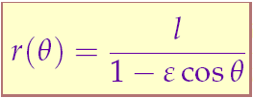
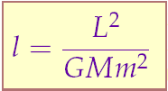
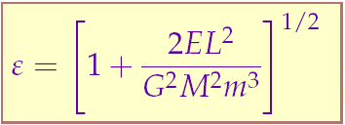
An ill fated satellite
Question 2: Determination of orbital data after a
misfiring of the engine; orientation, maximum and minimum
radii, and period.
m
r
Third Kepler law
l
THEORETICAL QUESTION 1
θ
M
Provided as a hint
36th International Physics Olympiad
Theoretical competition, Tuesday July 5, 2005

Slide 5
An ill fated satellite
Questions 3 and 4:
Determination of the minimum boost parameter that allows
the satellite to escape and the resulting orbital data (orienta-
tion, impact parameter, minimum distance to the Earth).
THEORETICAL QUESTION 1
Energy conservation.
Angular momentum conservation.
Polar equation for conics (hint).
36th International Physics Olympiad
Theoretical competition, Tuesday July 5, 2005

Slide 6
An ill fated satellite
Physical requirements:
Mechanics:
Newton’s laws.
Conservation of energy and angular momentum.
Centripetal acceleration, Kepler’s laws.
THEORETICAL QUESTION 1
Mathematical hints:
Geometry of conics.
36th International Physics Olympiad
Theoretical competition, Tuesday July 5, 2005

Slide 7
An ill fated satellite
On the record:
(Precedents in previous editions)
XI International Physics Olympiad (Moskow, 1979):
....Moon landing.
THEORETICAL QUESTION 1
XXX International Physics Olympiad (Padova, 1999):
....A space probe to Jupiter.
36th International Physics Olympiad
Theoretical competition, Tuesday July 5, 2005

Slide 8
THEORETICAL QUESTION 1
36th International Physics Olympiad
Theoretical competition, Tuesday July 5, 2005

