Slide 1

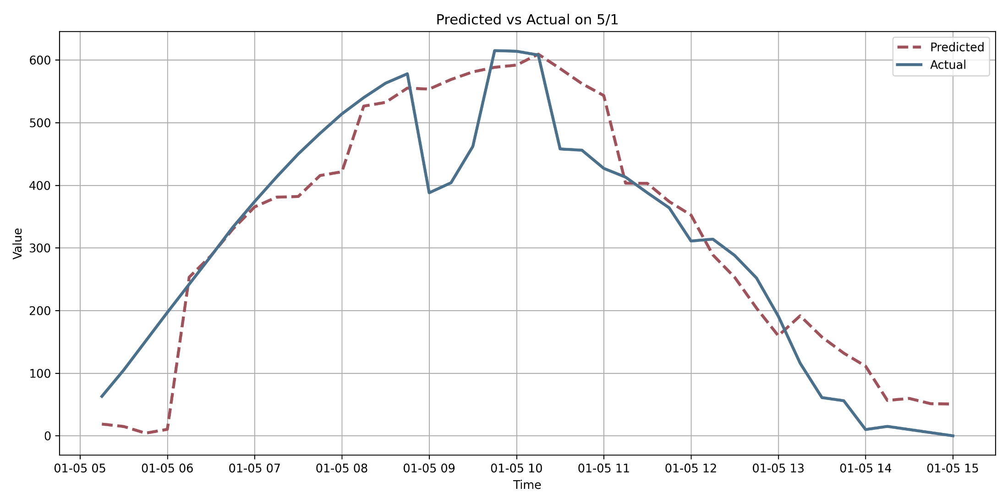
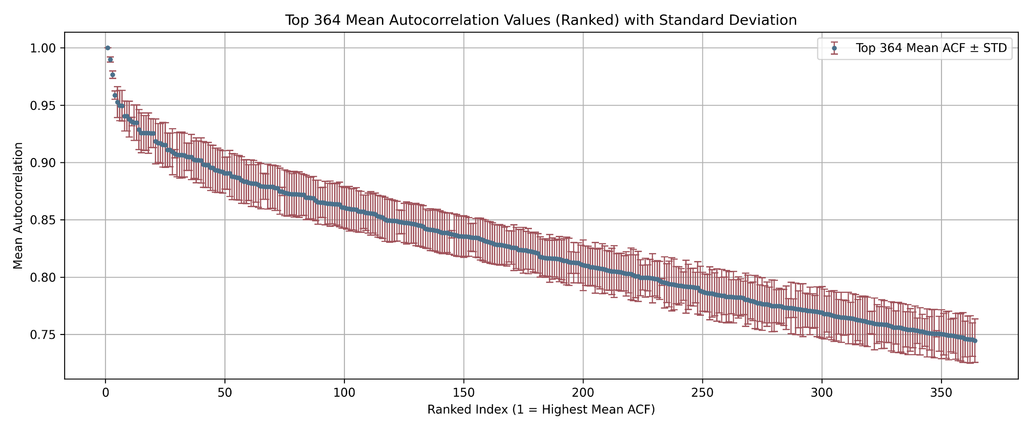
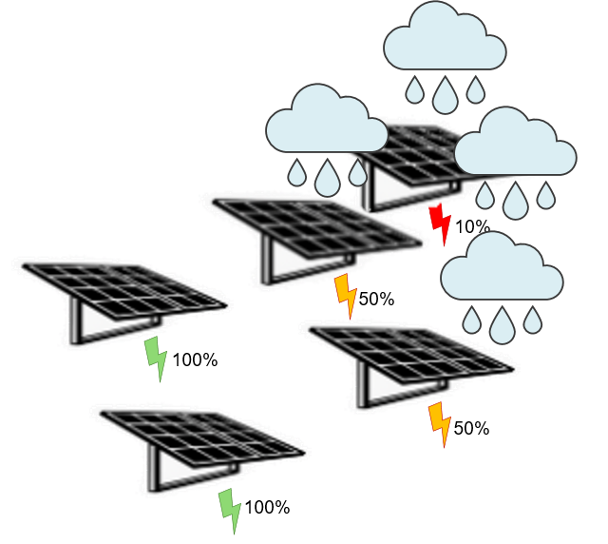
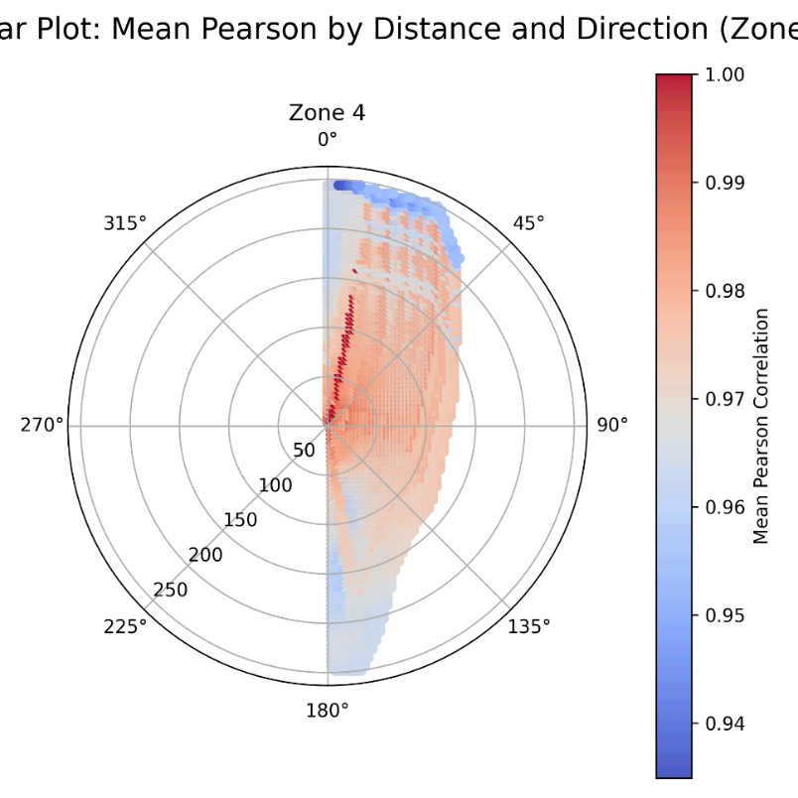
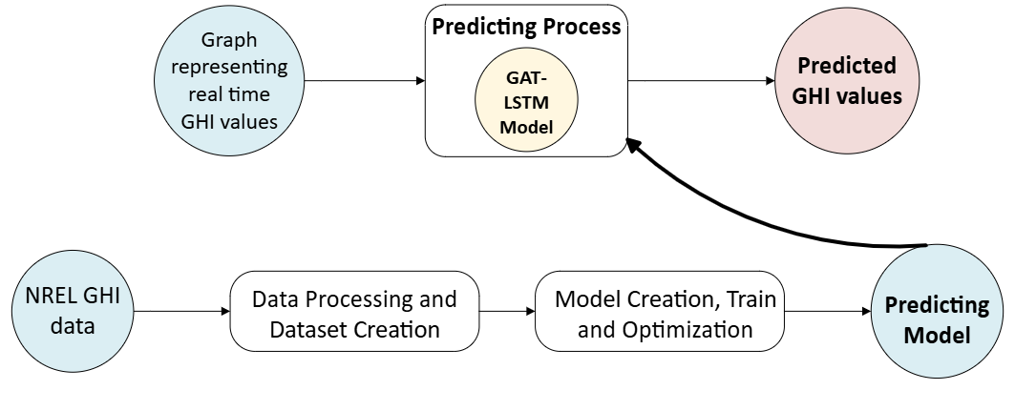
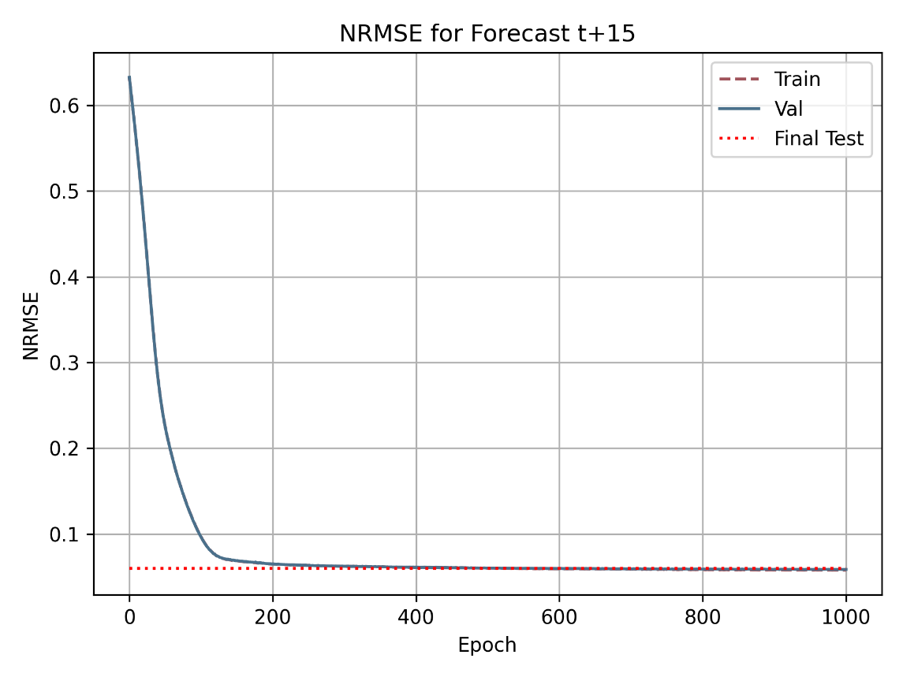
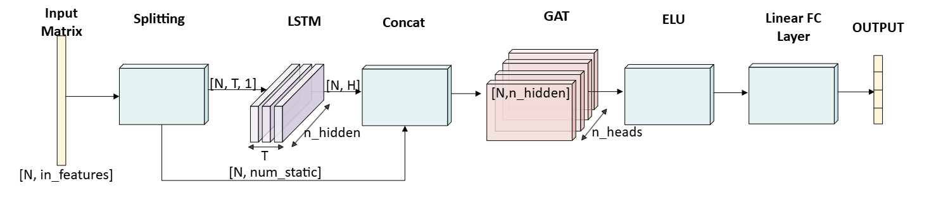
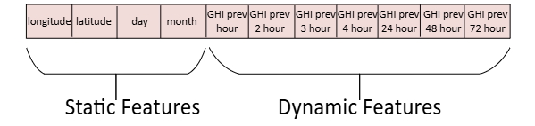
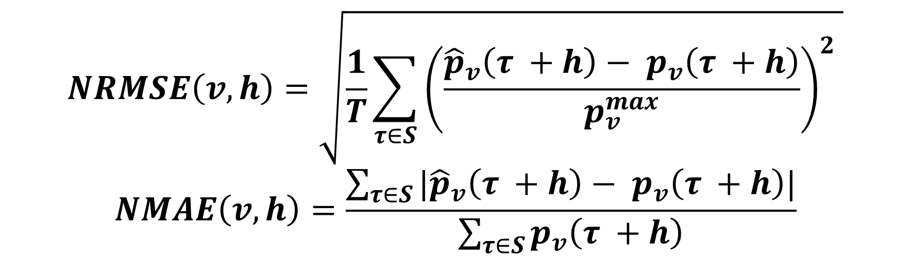
Improving Solar Power Forecasting
Using Graph Neural Networks
Project Number: 3022
Names: Hadar Levy and Gal Schwartz
Advisors: Khen Cohen and Dr. Jonatan Ostrometzky
Introduction Solar energy is a leading renewable source, but its variability creates uncertainty in power generation. Traditional grids, designed for stable energy sources, struggle to adapt to this challenge. To enable reliable smart grid operations high-resolution, real-time forecasting is critical [1]. This project aims to improve the accuracy of short-term solar irradiance (GHI) forecasting using internal sensor data - without relying on external weather sources. We developed a deep learning model based on Graph Attention Networks (GAT) and LSTM to predict solar irradiance for four future time horizons (15, 30, 45, 60 minutes), with a spatial resolution of 4×4 km across Israel. Implementation Block level diagram: Data Processing The dataset contains multiple graphs that each one is a Snapshot in time of GHI values. Nodes: each Panel (PV) is a node in the graph. Edges: defined by Euclidean distance between PV locations. *K-Nearest Neighbors (KNN) algorithm was applied to retain edges only between the 30% closest neighboring nodes. 3. Nodes Features: | Features were selected via Correlation Analysis: - Auto Correlation: Strong correlations were found within the past 4 hours, as well as at 24, 48, and 72-hour intervals - Person Correlation: Nearby nodes exhibit high correlation. Model’s Implementation 1. Model's Architecture: 2. Metrices: | Results Forecasted vs. Actual GHI throughout a single day: The following table compares our LSTM-GAT model with state-of-the-art baselines [2]: NRMSE convergence over epochs: Conclusions The model improved short-term GHI forecasting using only internal data, without relying on external weather sources Achieved lower NRMSE than previous models—for example, 6.04% at 30 minutes compared to 6.25–7.8%. Showed stable training, generalized well to unseen graphs. Bibliography [1] Ajith, M., & others. (2023, May 29). Deep learning algorithms for very short term solar irradiance forecasting: A survey. Renewable and Sustainable Energy Reviews. Elsevier. [2] Simeunović, J., Schubnel, B., Alet, P.-J., Carrillo, R. E., & Frossard, P. (2022). Interpretable temporal-spatial graph attention network for multi-site PV Power Forecasting. Applied Energy, 327, 120127.
SimVPv2 | PredRNN++ | TSM-GAT | LSTM-GAT | H [min]
6.6 | 5.3 | 4.75 | 5.58 | 15
7.8 | 7.2 | 6.25 | 6.04 | 30
8.6 | 8.3 | 6.25 | 6.53 | 45
9.2 | 9.1 | 8 | 6.85 | 60
$$NRMSE\left(v,h\right)=\sqrt{\frac{1}{T}\sum_{τ∈S}{{\left(\frac{{\hat{p}}_{v}\left(τ +h\right)− p_{v}\left(τ +h\right)}{p_{v}^{max}}\right)}^{2}} }$$
$$NMAE\left(v, h\right)=\frac{\sum_{τ∈S}{|{\hat{p}}_{v}\left(τ +h\right)− p_{v}\left(τ +h\right)|}}{\sum_{τ∈S}{p_{v}\left(τ +h\right)}}$$

