Slide 1
Kells
Session 5
12 May 2018

Slide 2
Wifi
KPRC Training – kprc2000

Slide 3
CoderDojo Session
Dojo updates
Motto Recap
Warm Up
Outline the Tasks/Challenges for the Session
Brainstorm
Get Coding
Show your Work

Slide 4
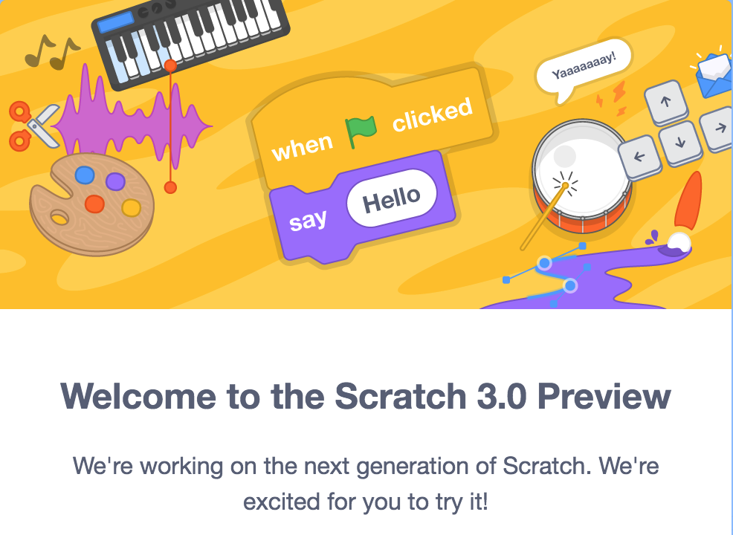
Dojo updates
Scratch 3.0 is coming
Tablet Support!!!
Try a preview now at
https://preview.scratch.mit.edu/

Slide 5
Our Dojo Mottos
One rule, be cool
Ask 3 then me
If you made it, you can play it
Parents, pitch in

Slide 6
Other small rules….
No open drink containers
Watch the wires!

Slide 7
Warm Up
5-10 mins

Slide 8
Get Into Teams
5 mins

Slide 9
This Week Session Challenges
Scratchers:
Make a game with a “gravity” mechanic
We need:
some Ground
a player character (something you control)
a jump-height variable

Slide 10
Brainstorm
5-10 mins

Slide 11
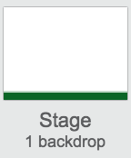
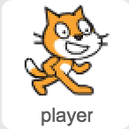
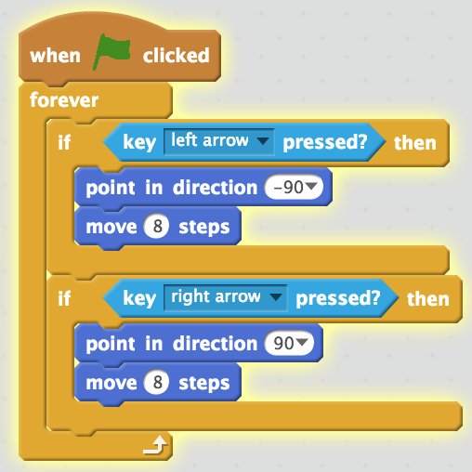
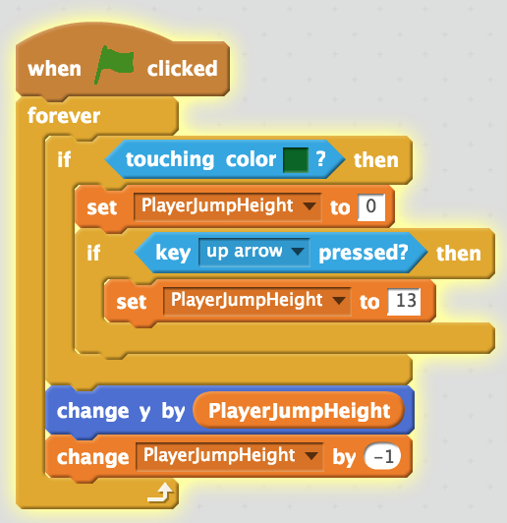
Get Coding
45-60 mins
3. Add some more controls!
Touching color should be the color of the ”ground”
1. Create the ground using a colour rectangle on our stage
2. Add ”gravity” to the player character (we use a variable here)

Slide 12
Showtime

