Slide 1
Pharmacy Information System
Advance Web Programming – Wirda Astari galvani natasya

Slide 2
Description
This system used to manage activities at online pharmacy.
For example transaction, restock activity, manage data supplier, consumer, product, reporting payment each month, and so on.

Slide 3
Features
Login admin
Manage Master Data
Transaction
Restock
Consumer
Supplier
Product
Manage Payment
Reporting
Daily Report Payment
Monthly Report Payment
Printout Reporting

Slide 4
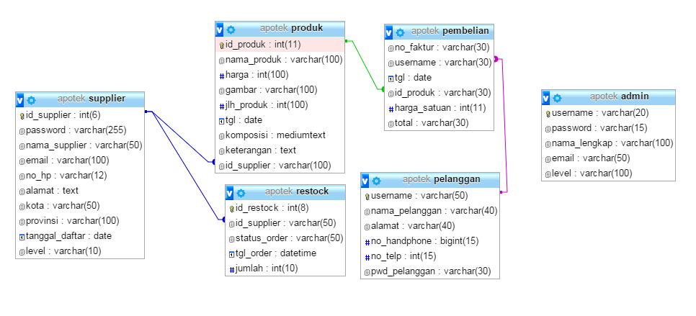
ERD
There are 4 tables for this application
Admin
Restock
Pelanggan
Supplier
Produk
Pembelian

Slide 5
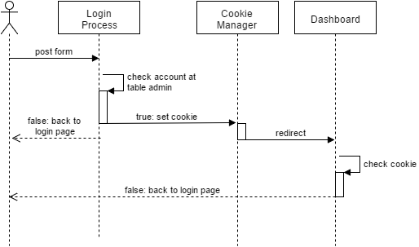
Login Process
Controllers file :
index.php as login page, contains form and auth process. Declaring cookie also write at this file after user submit login form
Dashboard.php as dashboard admin page

Slide 6
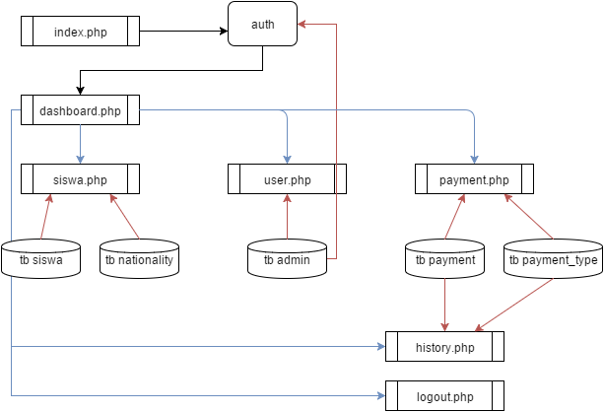
PHP File Diagram
index.php -> auth -> set cookie -> dashboard
Dashboard link to: home, admin page, consumers, suppliers, products, transaction and logout
Home a.k.a profile page contains home.php
Suppliers uses tb supplier
Dashboad Admin uses tb admin
Products uses tb product
Restock uses tb restock
Transaction uses tb pembelian
Logout -> clear cookie

