Slide 1

A first introduction
TANUL GUPTA

Slide 2
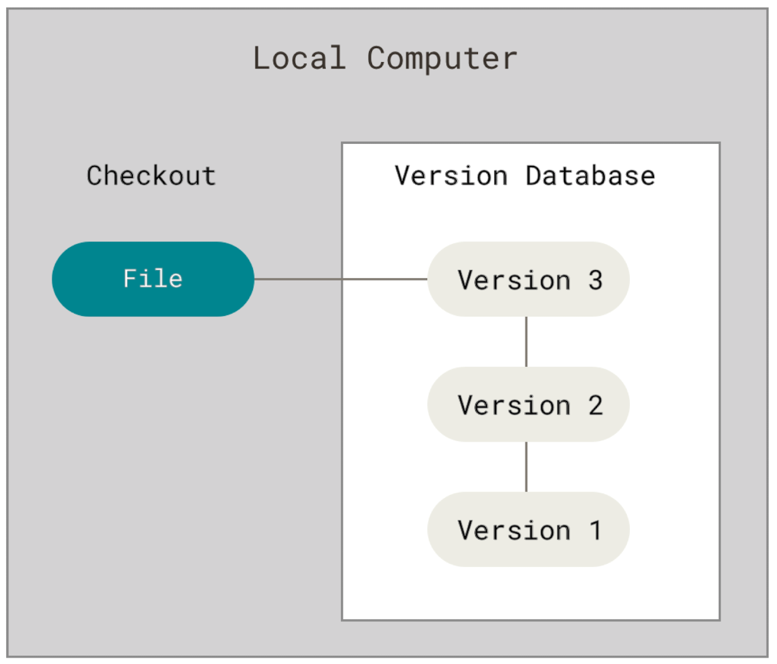
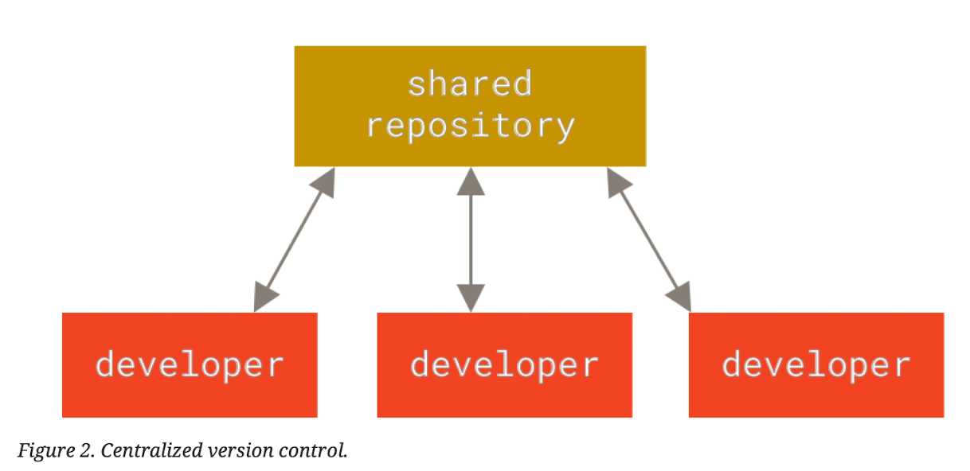
Notes:
Q. Why is a version control important?
Look at old snapshots of a project
Log of why certain changes were made
Work on parallel branches
For us COLLABORATION.

Slide 3
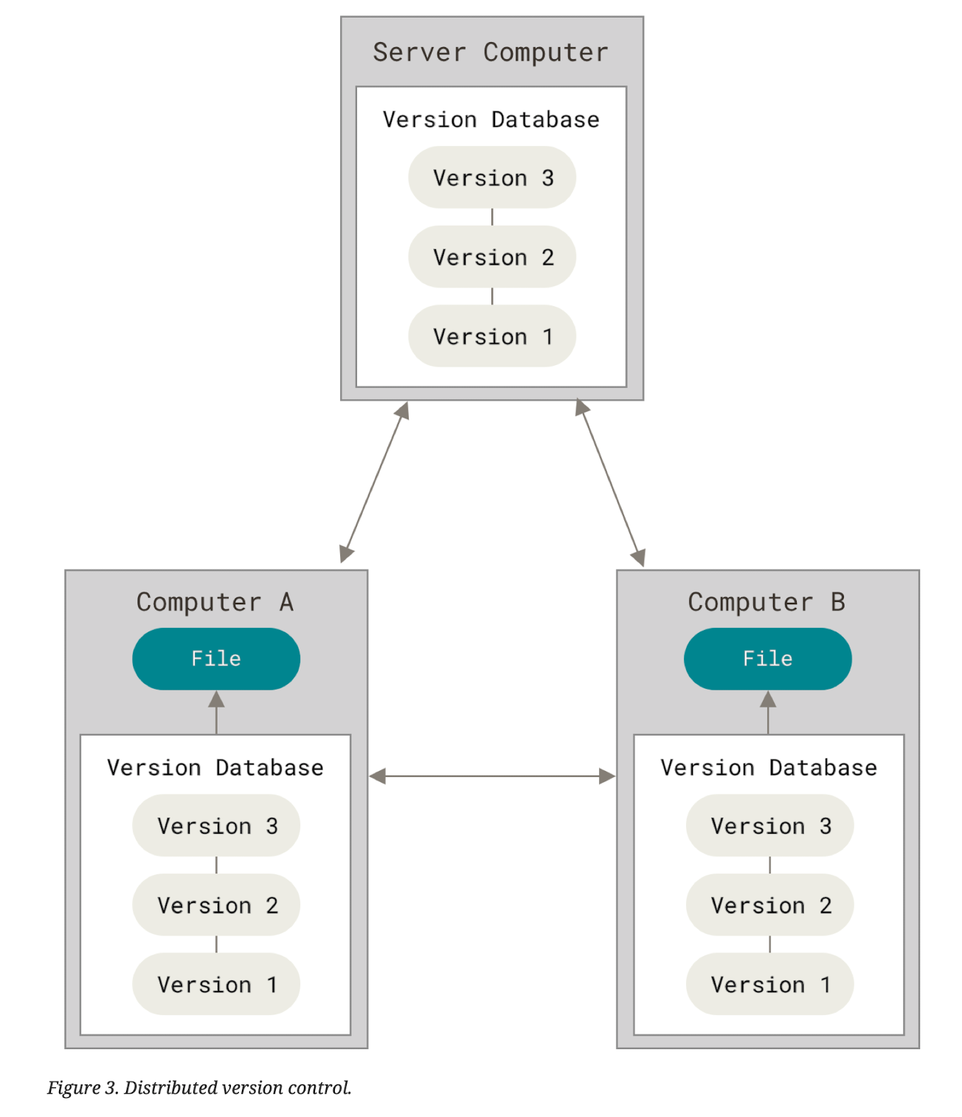

Slide 4
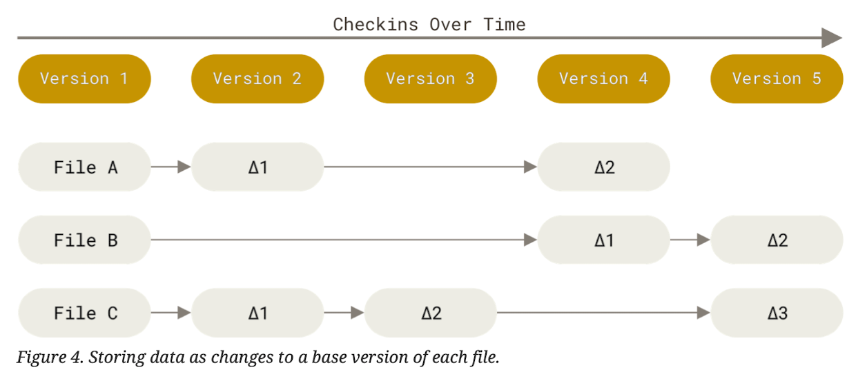

Slide 5
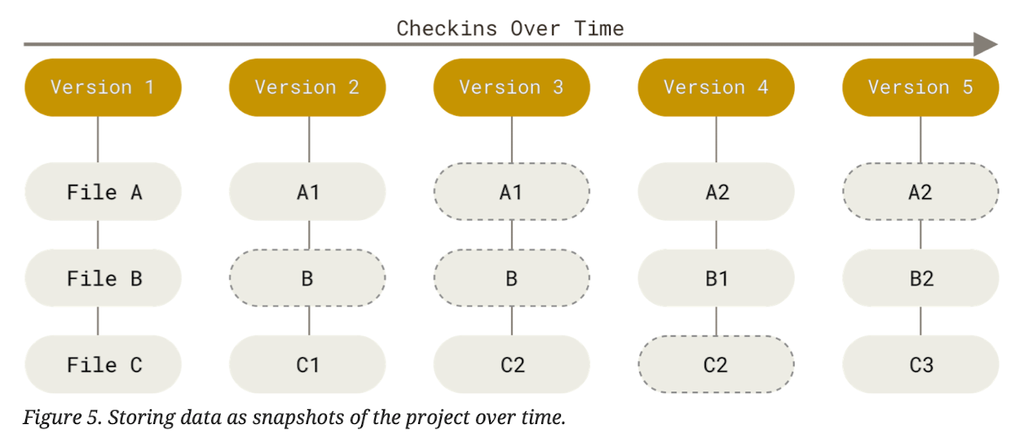

Slide 6
Basic git principles
Everything in Git is checksummed.
Git generally only adds data.
The three states: modified, staged, and committed.
Basic Git workflow: modify -> stage -> commit -> repeat
Notes:
Everything in Git is checksummed before it is stored and is then referred to by that checksum. Git stores everything in its database not by filename but by the hash value of its contents.
It’s difficult to do dangerous things in Git
Basic Git workflow
You modify your files in your working tree.
You selectively stage just those changes you want to be part of your next commit, which adds only those changes to the staging area.
You do a commit, which takes the files as they are in the staging area and stores that snapshot permanently to your Git directory.

Slide 7
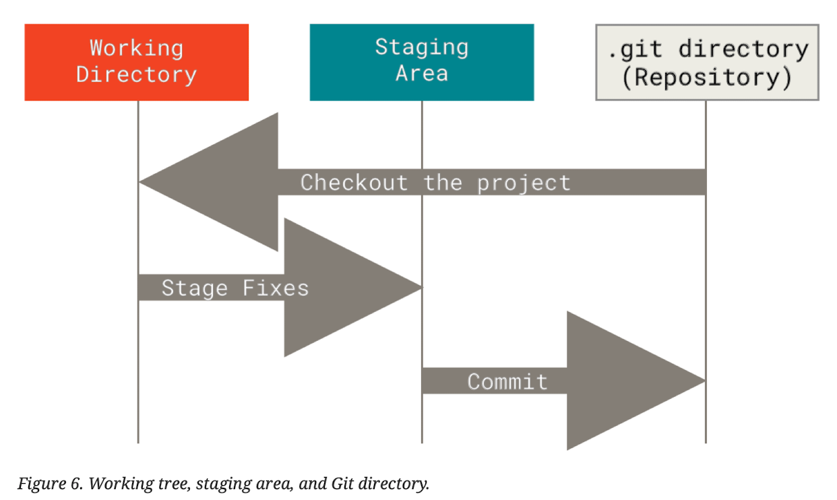
The three states: modified, staged, and committed.
Notes:
Modified means you have changed the file but have not committed it to your database yet.
Staged means that you have marked a modified file in its current version to go into your next commit snapshot.
Committed means that the data is safely stored in your local database.
Basic Git workflow
You modify your files in your working tree.
You selectively stage just those changes you want to be part of your next commit, which adds only those changes to the staging area.
You do a commit, which takes the files as they are in the staging area and stores that snapshot permanently to your Git directory.

Slide 8
Git’s data model
Notes:
Everything in Git is checksummed before it is stored and is then referred to by that checksum. Git stores everything in its database not by filename but by the hash value of its contents.
It’s difficult to do dangerous things in Git.

Slide 9
Commands to explore
Interactive staging
$ git add -p <filename>
Shallow cloning
$ git clone --shallow <repository_url>
Whom to blame?
$ git blame <filename>
Getting info of a particular commit
$ git show <commit_hash>
Store your changes in the working directory temporarily somewhere
$ git stash
$ git stash pop
Pull requests

Slide 10
Commands to explore
Interactive staging
$ git add -p <filename>
Shallow cloning
$ git clone --shallow <repository_url>
Whom to blame?
$ git blame <filename>
Getting info of a particular commit
$ git show <commit_hash>
Store your changes in the working directory temporarily somewhere
$ git stash
$ git stash pop
Pull requests

Slide 11
THANKS!

