Slide 1
Multiple Accelerometer through NRF24
Trace Stewart, Guillermo Galvez
Email:stewat3@unlv.nevada.edu
Email:galveg1@unlv.nevada.edu

Slide 2
AIM & ACCOMPLISHMENT
AIM:
The goal of this project was to interface multiple accelerometers and send the accelerometer and gyro data through a NRF24 chip to be received by another NRF24 chip and display the values onto a terminal.
ACCOMPLISHMENT
We were successful in using I2C protocol to receive the data of two MPU6050’s into one AVR.
Sending multiple data streams from the MPU6050’s through the NRF24 and received and displayed onto a terminal.

Slide 3
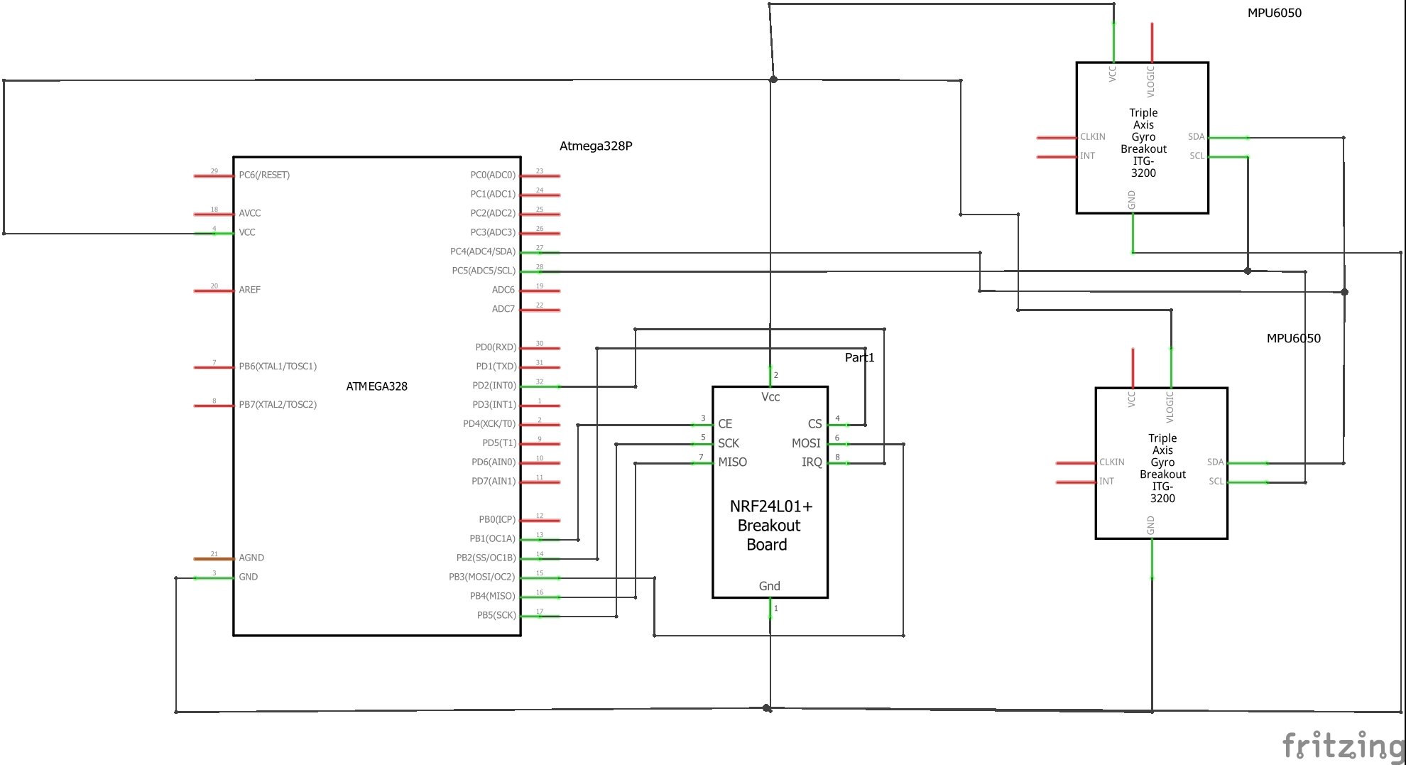
SCHEMATICS
Transmitter:

Slide 4
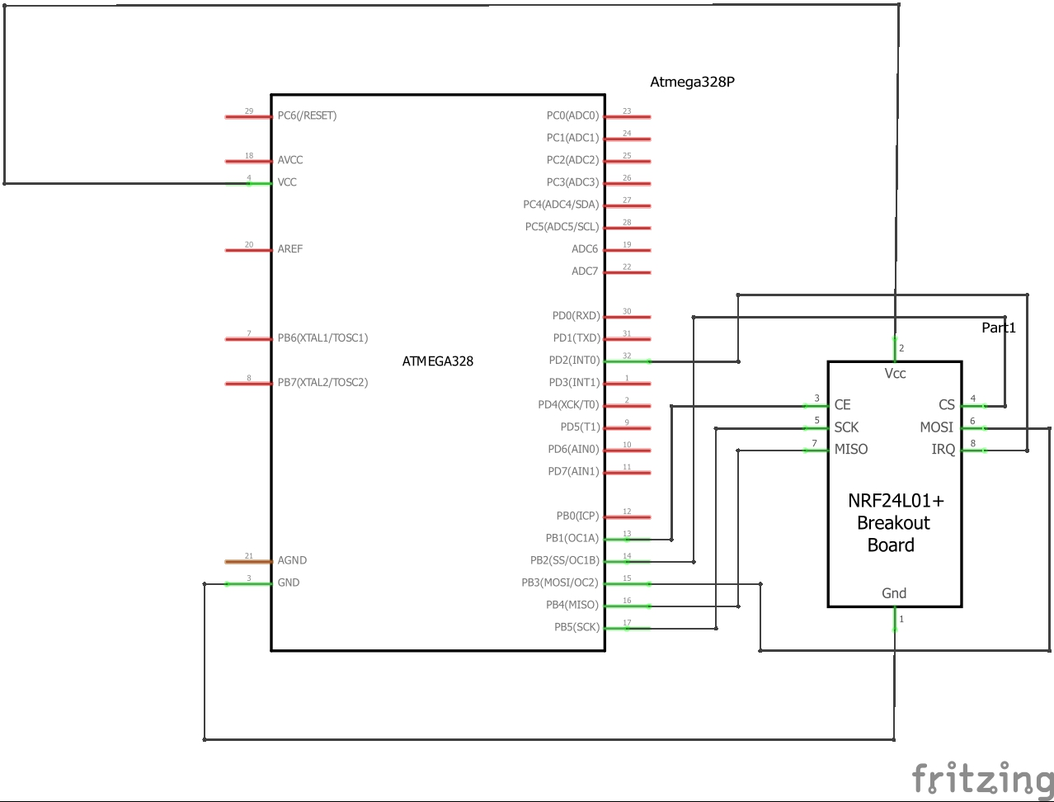
SCHEMATICS
Receiver:

Slide 5
DESIGN STAGES
Components
AVR ATMEGA328p
MPU 6050
nRF24l01+
Interfaces
Atmega328p – MPU6050 using I2C – Address (0x68)
Atmega328p – MPU6050 using I2C – Address (0x69)
Atmega328p - nRF24L01 using SPI
Atmega328p – Display to terminal using USART

Slide 6
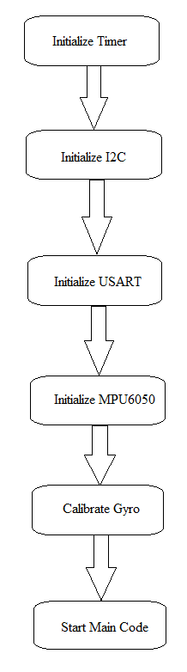
CODE DEVELOPMENT
Initialization
Code was created to use I2C and
SPI Protocol as well as using USART.
2. I2C code was adapted from UTGimbal’s
repository on Github.
3. MPU6050 header file used to define
registers available on IMU.

Slide 7
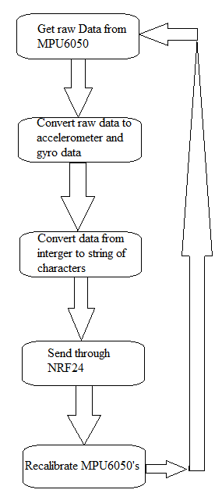
CODE DEVELOPMENT
Data Collection
The MPU6050’s raw data were collected
using I2C interface.
The raw data was then sent through various
calculations to obtain the correct values.
Those values are then sent through the NRF24
using SPI protocol to be received by the other
NRF24.
The receiving NRF24 collected the data sent
over then proceeds to display the data onto a
terminal using USART.

Slide 8
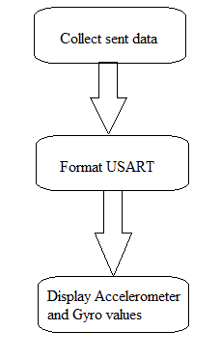
CODE DEVELOPMENT
Receiving Data
The data is received by the receiving
NRF24.
The USART is formatted to display
the values accordingly onto a terminal.
The Accelerometer and Gyro values are
then displayed onto the terminal.

Slide 9
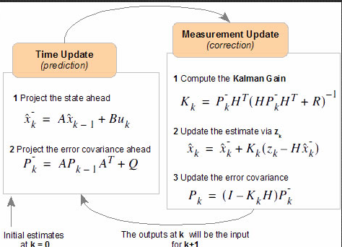
CODE DEVELOPMENT
Smoothening
To help with getting noise we were to implement
Kalman filtering.

Slide 10
CODE DEVELOPMENT
Networking/Visualization

Slide 11
DEMO SNAPSHOT/VIDEO
Just Provide Links

Slide 12
Group Projects
Student Name: Trace Stewart
Task Completed:
Using SPI protocol to communicate the MPU6050 data between NRF devices
Coding, Testing, and Debugging
Documentation
Contribution % towards the project: 50%
Coding (%): 40%
Implementation (%): 40%
Testing/Demo (%): 50%
Documentation (%): 60%
Presentation (%): 60%

Slide 13
Group Projects
Student Name: Guillermo Galvez
Task Completed:
Using I2C protocol to communicate with two MPU6050’s
Coding, Testing, and Debugging
Documentation
Contribution % towards the project: 50%
Coding (%): 60%
Implementation (%): 60%
Testing/Demo (%): 50%
Documentation (%): 40%
Presentation (%): 40%

