Slide 1
CPE 403 Final Project BBB & TI WSN
Guillermo Gálvez
Trace Stewart

Slide 2
Goal
Main Goal
The goal will be to interface a sensor (I2C/SPI/ADC) etc to the sensor node and transmit the data using TI-15.4 stack RF to the co-processor. The co-processor CC1350 interfaced to the BBB collects the data and the BBB displays or visualizes the data.
Objectives
The goal(s) were accomplished by interfacing a temperature sensor that was included in the sensor program that collected the data in Celsius then would send the data to the co-processor which would receive that data and send it to the BBB.

Slide 3
Outcome - Accomplishments
Outcome – result of your project?
That outcome of our project was successful. We were able to interface a temperature sensor to the sensor board that had code written for it already. The sensor board then sent that data to the co-processor which would process the data and send it to the BBB. The BBB would then upload the data to an online source to show the temperature. We attempted to try and use Humidity and Lux since those were in the code as well but failed when we didn’t have the sensors to use.
This project has a lot of uses from short to long term. It is a very universal way of transmitting data. From home projects to something that could be made into a business.

Slide 4
Components Used in Design
The main hardware that we used was 2 CC1350 boards, 1 Beagle Bone Black, and FTDI to talk to the BBB through uart. We also used a temperature sensors and other hardware stuff to make the project fully work. The online visualization tool we used was the TI-15.4 stack collector app. This visualized the data we were collecting and displayed it onto the web.

Slide 5
Tools used in Design
CCS8 - http://processors.wiki.ti.com/index.php/Download_CCS
TI UniFlash - http://www.ti.com/tool/uniflash
TI Stack15.4 SDK - http://www.ti.com/tool/SIMPLELINK-CC13X0-SDK

Slide 6
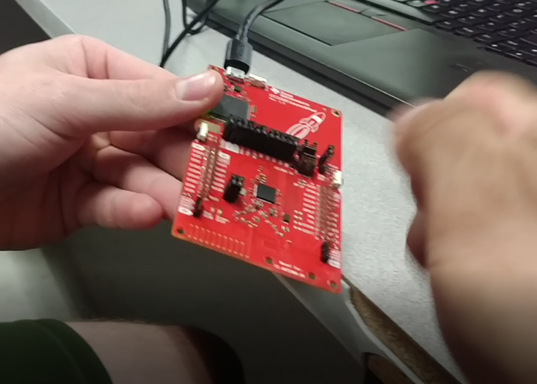
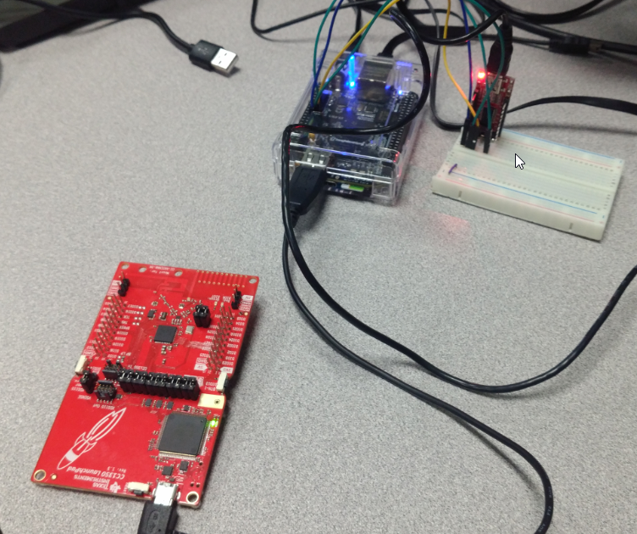
Actual project set-up

Slide 7
Pre-requisites used in Design
Components: 2x CC1350 Launch Pads, BBB, FTDI, jumper wires
Tools: needle nose pliers, Laptops
Software: CCS8, VM, Ubuntu Linux, TI15.4 Stack SDK, TI UniFlash
Commands to install prerequisites
$ cd ~/ti/simplelink/ti-15.4stack-x.xx.xx.xx/prebuilt
scp bbb_prebuilt.tar.gz root@<bbb-ip-address>:/home/root/ - copied file to PI
./run_demo.sh – launched gateway for web interface

Slide 8
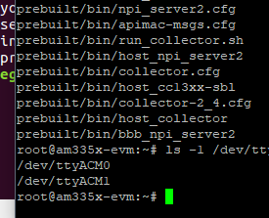
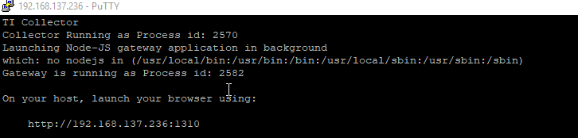
Implementation Details
Steps used in design:
Import necessary CCS files build and load hex files to launchpads
Download TI15.4 SDK flash on to an SD card
Build SDK in VM transfer gateway to PI

Slide 9
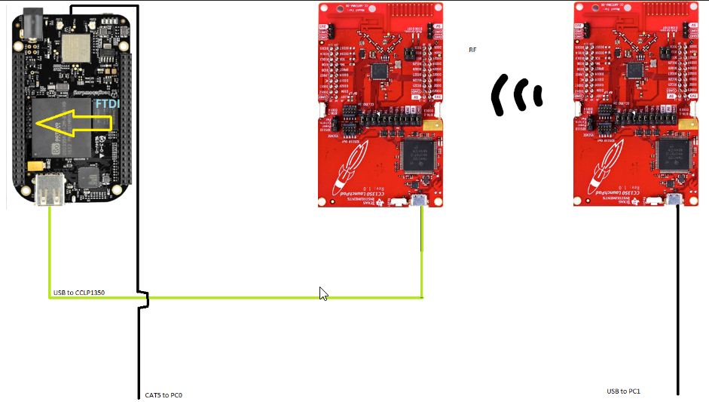

Schematics
Screenshot of the project will all components

Slide 10
Demo
Video link only – don’t embed video #2 better
You can see temp change at ~1:05
https://youtu.be/82zgfGb6sko
https://youtu.be/mKcyk8Mlp8E

Slide 11
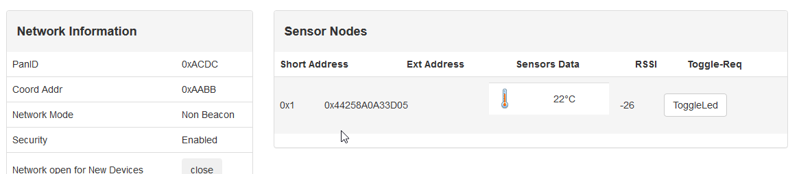
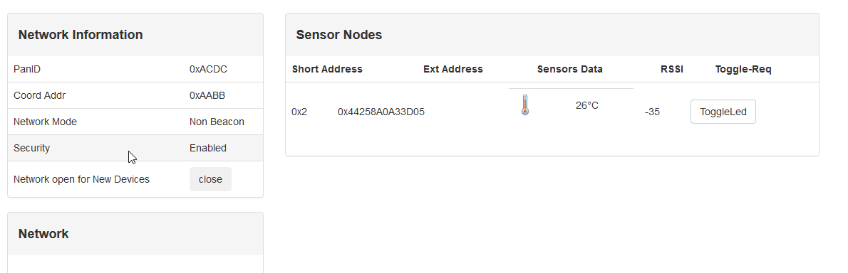
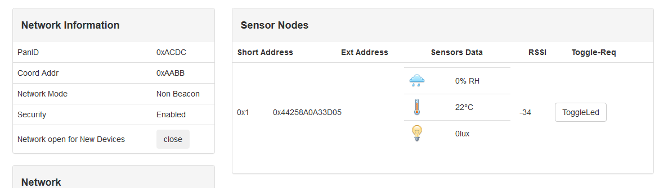
Results and Conclusions
Fig 1: Shows the gateway layout from hex file give in sample.
Fig 2: Shows gateway layout from hex file compiled in CCS

Slide 12
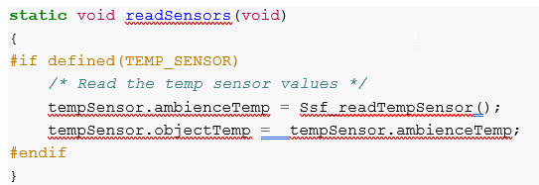
Results and Conclusions
Since we did not have a sensor booster pack we did not receive any data for the lux and humidity. However, by changing the following code and interfacing stand alone sensors with the ADC on the CC1350 it is possible to utilize the additional categories in the gateway. Do to time restraints we did not have the opportunity to experiment with this. Posssible future work.

Slide 13
Reference
Google
StackOverflow
TI website and forum
Internet

