Slide 1
Chapter 4
The Market Forces of Supply and Demand
Professor Galvez-Soriano lecture notes. Based on N. Gregory Mankiw, Principles of Microeconomics, 9th Edition.

Slide 2
Markets and Competition
Market
Where buyers and sellers of a particular good or service meet.
Buyers
Determine the demand for the product
Sellers
Determine the supply of the product
Professor Galvez-Soriano lecture notes. Based on N. Gregory Mankiw, Principles of Microeconomics, 9th Edition.

Slide 3
Markets and Competition
Competitive market
Market in which there are many buyers and many sellers
Each has a negligible impact on market price
Price and quantity are determined by all buyers and sellers
As they interact in the marketplace
Professor Galvez-Soriano lecture notes. Based on N. Gregory Mankiw, Principles of Microeconomics, 9th Edition.

Slide 4
Markets and Competition
Perfectly competitive market
Goods offered for sale are all exactly the same
Many buyers and sellers
No single buyer or seller has any influence over the market price
Price takers
At the market price
Buyers can buy all they want
Sellers can sell all they want
Professor Galvez-Soriano lecture notes. Based on N. Gregory Mankiw, Principles of Microeconomics, 9th Edition.

Slide 5
Markets and Competition
Monopoly
The only seller in the market
Sets the price
Other markets
Between perfect competition and monopoly
Professor Galvez-Soriano lecture notes. Based on N. Gregory Mankiw, Principles of Microeconomics, 9th Edition.

Slide 6
Demand
Law of demand
Other things equal
When the price of a good rises, the quantity demanded of the good falls
When the price falls, the quantity demanded rises
Professor Galvez-Soriano lecture notes. Based on N. Gregory Mankiw, Principles of Microeconomics, 9th Edition.

Slide 7
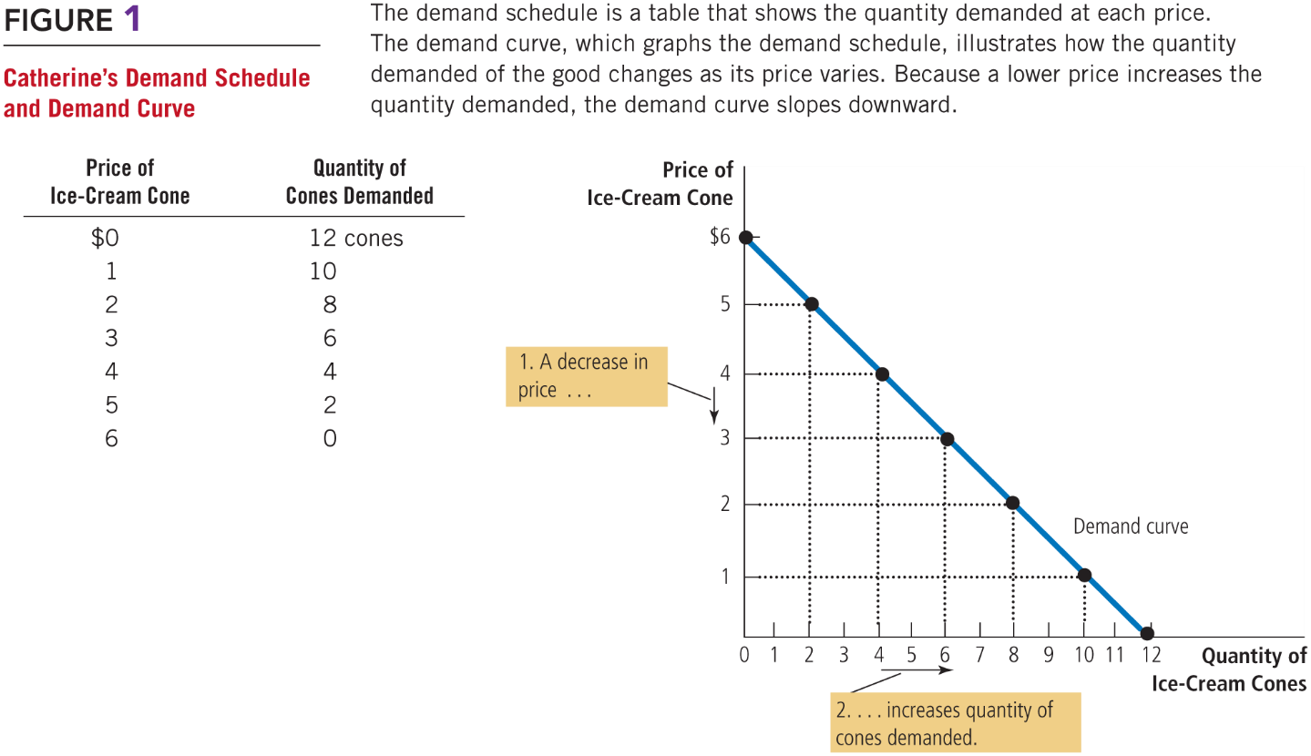
Figure 1 Catherine’s Demand Schedule and Demand Curve
Professor Galvez-Soriano lecture notes. Based on N. Gregory Mankiw, Principles of Microeconomics, 9th Edition.

Slide 8
Demand
Market demand
Sum of all individual demands for a good or service
Market demand curve
Sum the individual demand curves horizontally
Professor Galvez-Soriano lecture notes. Based on N. Gregory Mankiw, Principles of Microeconomics, 9th Edition.

Slide 9
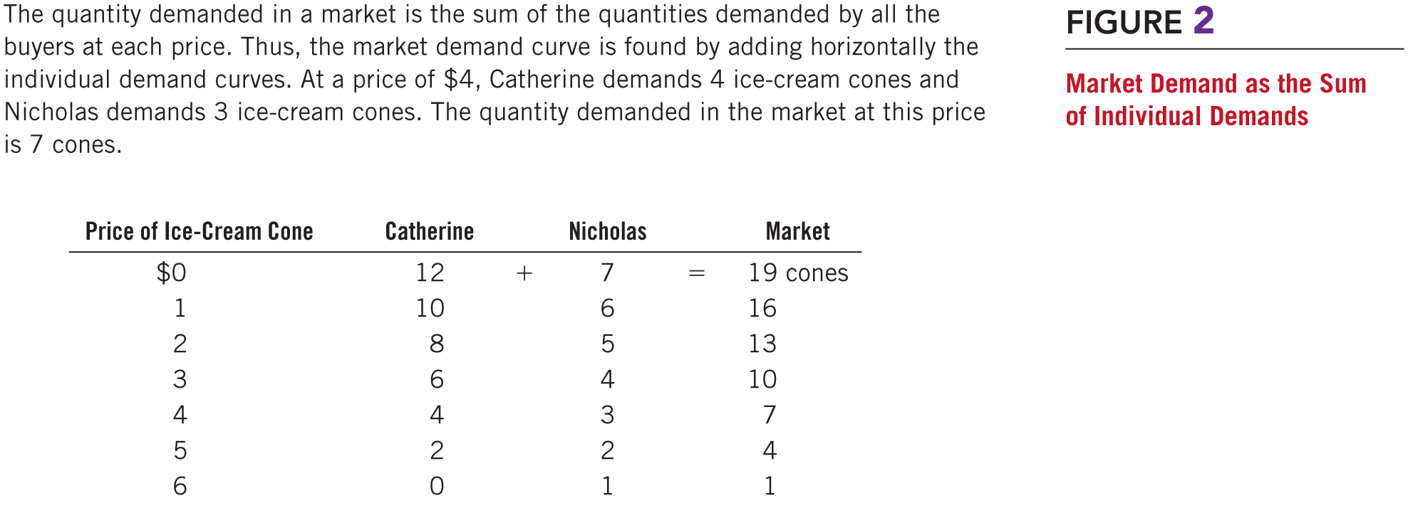
Figure 2 Market Demand as the Sum of Individual Demands, Part 1
Professor Galvez-Soriano lecture notes. Based on N. Gregory Mankiw, Principles of Microeconomics, 9th Edition.

Slide 10
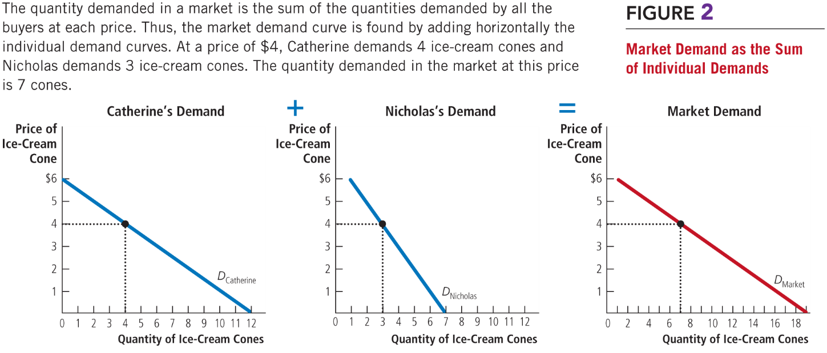
Figure 2 Market Demand as the Sum of Individual Demands, Part 2
Professor Galvez-Soriano lecture notes. Based on N. Gregory Mankiw, Principles of Microeconomics, 9th Edition.

Slide 11
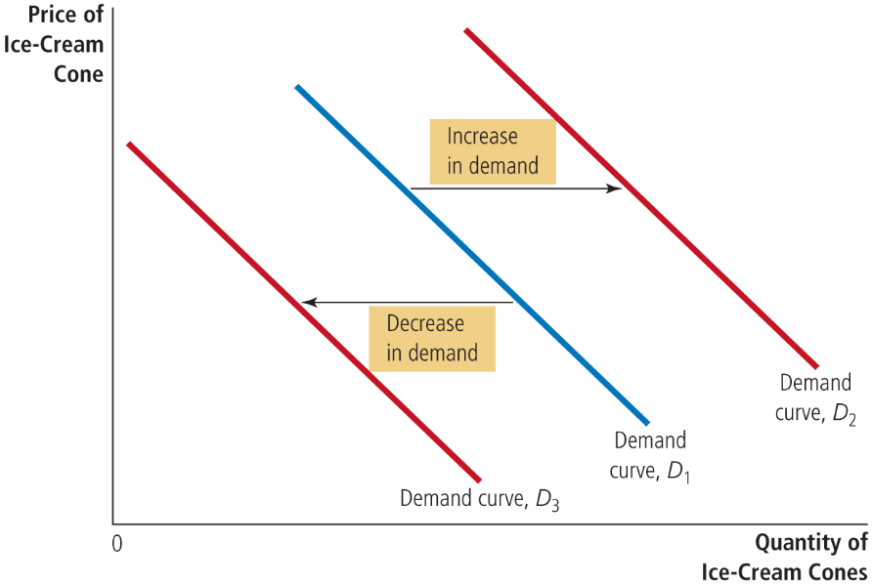
Figure 3 Shifts in the Demand Curve
Any change that raises the quantity that buyers wish to purchase at any given price shifts the demand curve to the right.
Any change that lowers the quantity that buyers wish to purchase at any given price shifts the demand curve to the left.
Professor Galvez-Soriano lecture notes. Based on N. Gregory Mankiw, Principles of Microeconomics, 9th Edition.

Slide 12
Demand
Variables that can shift the demand curve
Income
Prices of related goods
Tastes
Expectations
Number of buyers
Professor Galvez-Soriano lecture notes. Based on N. Gregory Mankiw, Principles of Microeconomics, 9th Edition.

Slide 13
Demand
Income
Normal good
Other things constant
An increase in income leads to an increase in demand
Inferior good
Other things constant
An increase in income leads to a decrease in demand
Professor Galvez-Soriano lecture notes. Based on N. Gregory Mankiw, Principles of Microeconomics, 9th Edition.

Slide 14
Demand
Prices of related goods
Substitutes, two goods
An increase in the price of one
Leads to an increase in the demand for the other
Complements, two goods
An increase in the price of one
Leads to a decrease in the demand for the other
Professor Galvez-Soriano lecture notes. Based on N. Gregory Mankiw, Principles of Microeconomics, 9th Edition.

Slide 15
Demand
Tastes
Change in tastes: changes the demand
Expectations about the future
Expect an increase in income
Increase in current demand
Expect higher prices
Increase in current demand
Number of buyers, increases
Market demand increases
Professor Galvez-Soriano lecture notes. Based on N. Gregory Mankiw, Principles of Microeconomics, 9th Edition.

Slide 16
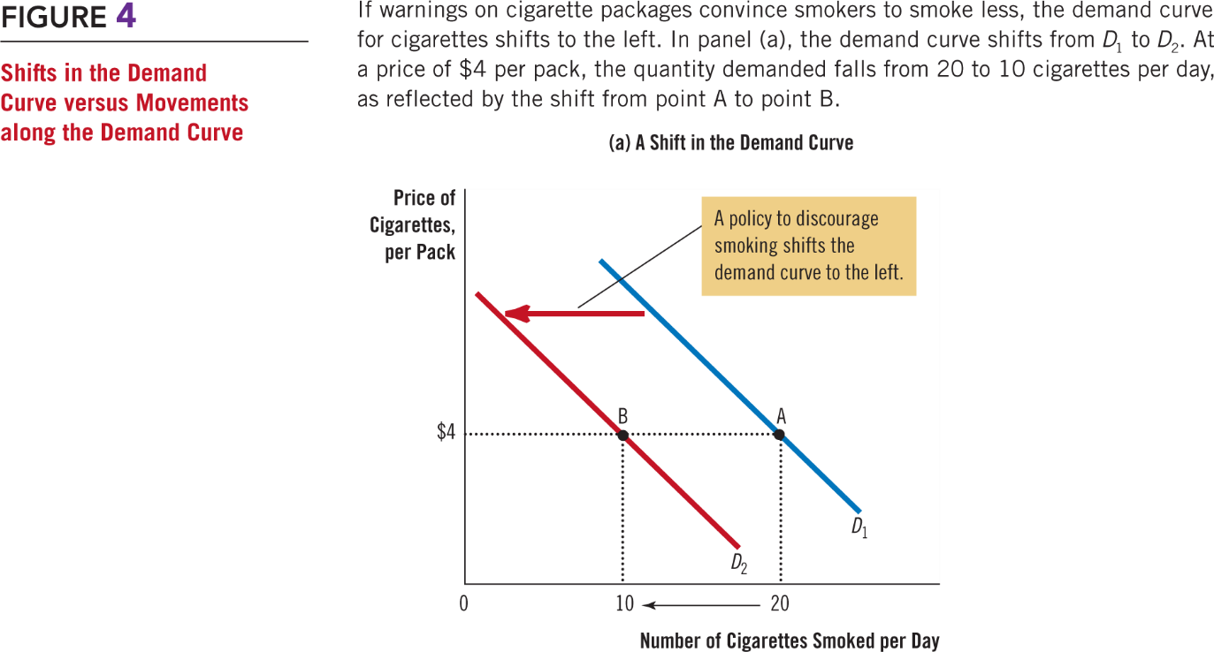
Figure 4 Shifts in the Demand Curve versus Movements along the Demand Curve (a)
Professor Galvez-Soriano lecture notes. Based on N. Gregory Mankiw, Principles of Microeconomics, 9th Edition.

Slide 17
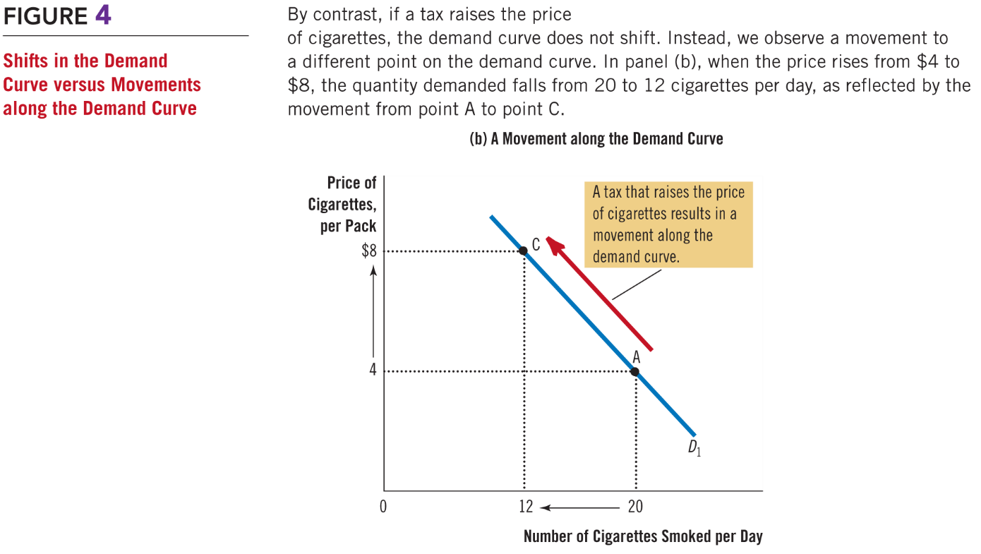
Figure 4 Shifts in the Demand Curve versus Movements along the Demand Curve (b)
Professor Galvez-Soriano lecture notes. Based on N. Gregory Mankiw, Principles of Microeconomics, 9th Edition.

Slide 18
Supply
Law of supply
Other things equal
When the price of a good rises, the quantity supplied of the good also rises
When the price falls, the quantity supplied falls as well
Professor Galvez-Soriano lecture notes. Based on N. Gregory Mankiw, Principles of Microeconomics, 9th Edition.

Slide 19
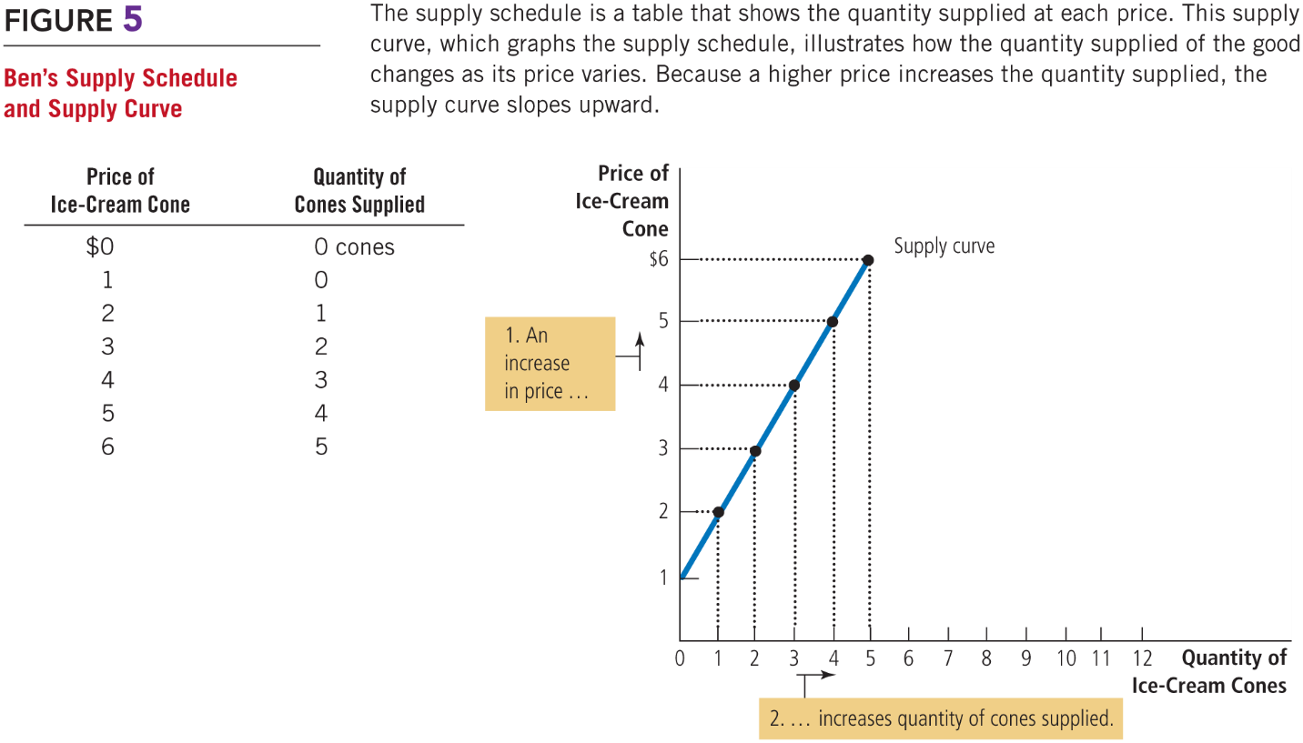
Figure 5 Ben’s Supply Schedule and Supply Curve
Professor Galvez-Soriano lecture notes. Based on N. Gregory Mankiw, Principles of Microeconomics, 9th Edition.

Slide 20
Supply
Market supply
Sum of the supplies of all sellers for a good or service
Market supply curve
Sum of individual supply curves horizontally
Professor Galvez-Soriano lecture notes. Based on N. Gregory Mankiw, Principles of Microeconomics, 9th Edition.

Slide 21
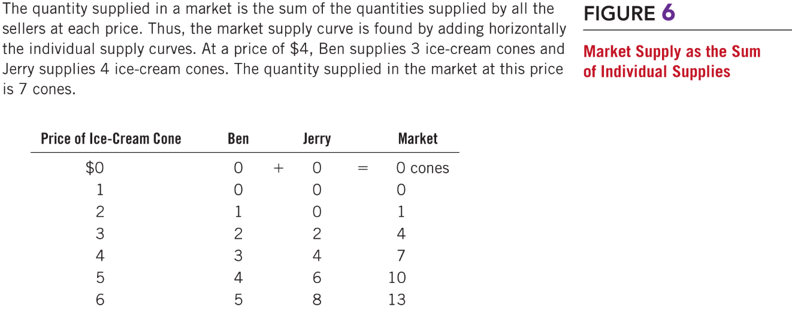
Figure 6 Market Supply as the Sum of Individual Supplies, Part 1
Professor Galvez-Soriano lecture notes. Based on N. Gregory Mankiw, Principles of Microeconomics, 9th Edition.

Slide 22
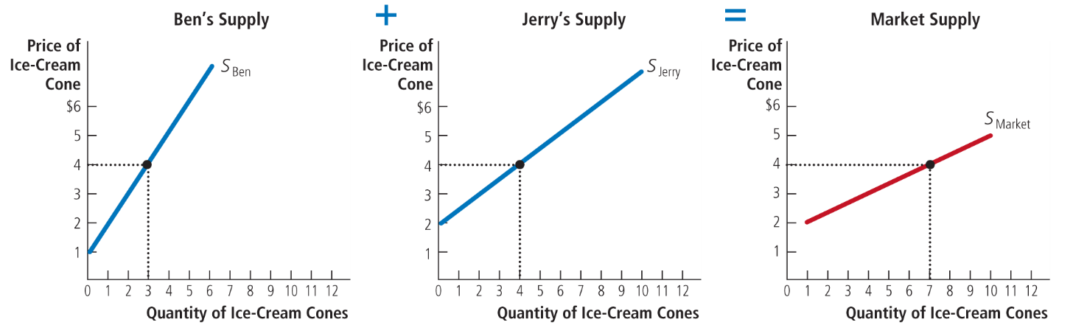
Figure 6 Market Supply as the Sum of Individual Supplies, Part 2
Professor Galvez-Soriano lecture notes. Based on N. Gregory Mankiw, Principles of Microeconomics, 9th Edition.

Slide 23
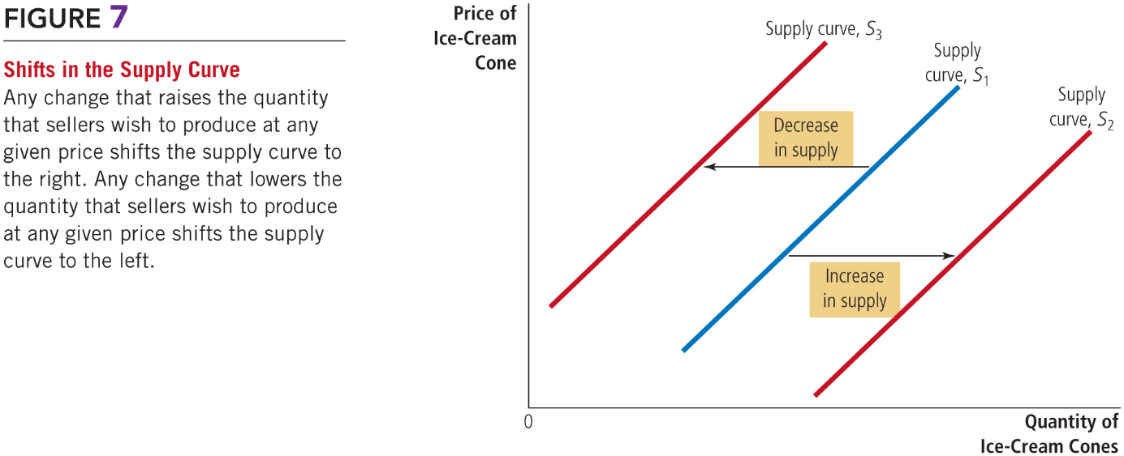
Exhibit 7 Shifts in the Supply Curve
Professor Galvez-Soriano lecture notes. Based on N. Gregory Mankiw, Principles of Microeconomics, 9th Edition.

Slide 24
Supply
Variables that can shift the supply curve
Input prices
Technology
Expectations about future
Number of sellers
Professor Galvez-Soriano lecture notes. Based on N. Gregory Mankiw, Principles of Microeconomics, 9th Edition.

Slide 25
Supply
Input prices
Supply is negatively related to prices of inputs
Higher input prices: decrease in supply
Technology
Advance in technology: reduces firms’ costs: increase in supply
Professor Galvez-Soriano lecture notes. Based on N. Gregory Mankiw, Principles of Microeconomics, 9th Edition.

Slide 26
Supply
Expectations about future
Affect current supply
Expected higher prices
Decrease in current supply
Number of sellers, increases
Market supply increases
Professor Galvez-Soriano lecture notes. Based on N. Gregory Mankiw, Principles of Microeconomics, 9th Edition.

Slide 27
Supply and Demand Together
Equilibrium
Supply and demand curves intersect
Professor Galvez-Soriano lecture notes. Based on N. Gregory Mankiw, Principles of Microeconomics, 9th Edition.

Slide 28
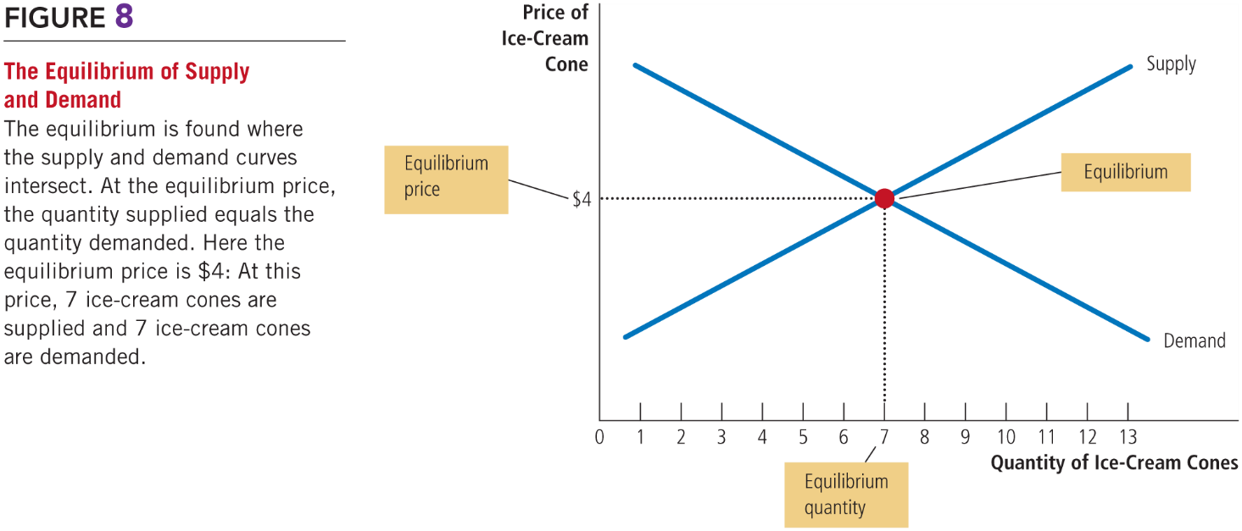
Figure 8 The Equilibrium of Supply and Demand
Professor Galvez-Soriano lecture notes. Based on N. Gregory Mankiw, Principles of Microeconomics, 9th Edition.
Notes:
At these equilibrium price the market clears, which means that the quantity supplied is equal to the quantity demanded.

Slide 29
Supply and Demand Together
Surplus
Quantity supplied > Quantity demanded
Excess supply
Downward pressure on price
Professor Galvez-Soriano lecture notes. Based on N. Gregory Mankiw, Principles of Microeconomics, 9th Edition.
Notes:
But just for a moment let’s suppose that the market does not clear immediately. And that the quantity supplied is greater than the quantity demanded. Then we say that there is and excess supply or a surplus in this market. Hence, there will be a downward pressure on price.

Slide 30
Supply and Demand Together, Part 4
Shortage
Quantity demanded > Quantity supplied
Excess demand
Upward pressure on price
Professor Galvez-Soriano lecture notes. Based on N. Gregory Mankiw, Principles of Microeconomics, 9th Edition.
Notes:
We could also have the opposite case. That the quantity demanded…

Slide 31
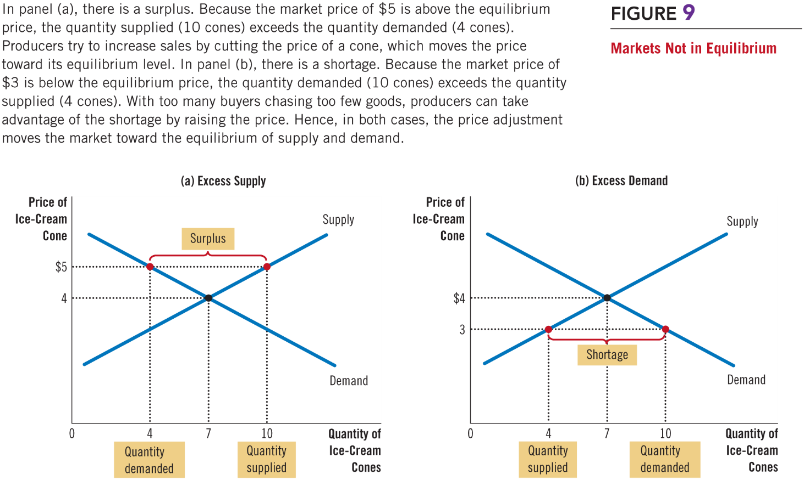
Figure 9 Markets Not in Equilibrium
Professor Galvez-Soriano lecture notes. Based on N. Gregory Mankiw, Principles of Microeconomics, 9th Edition.

Slide 32
Supply and Demand Together
Three steps to analyzing changes in equilibrium
Decide whether the event shifts the supply curve, the demand curve, or, in some cases, both curves
Decide whether the curve shifts to the right or to the left
Use the supply-and-demand diagram
Compare the initial and the new equilibrium
Effects on equilibrium price and quantity
Professor Galvez-Soriano lecture notes. Based on N. Gregory Mankiw, Principles of Microeconomics, 9th Edition.

Slide 33
Supply and Demand Together
A change in market equilibrium due to a shift in demand
One summer, very hot weather
Effect on the market for ice cream?
Hot weather: shifts the demand curve (tastes)
Demand curve shifts to the right
Higher equilibrium price; higher equilibrium quantity
Professor Galvez-Soriano lecture notes. Based on N. Gregory Mankiw, Principles of Microeconomics, 9th Edition.

Slide 34
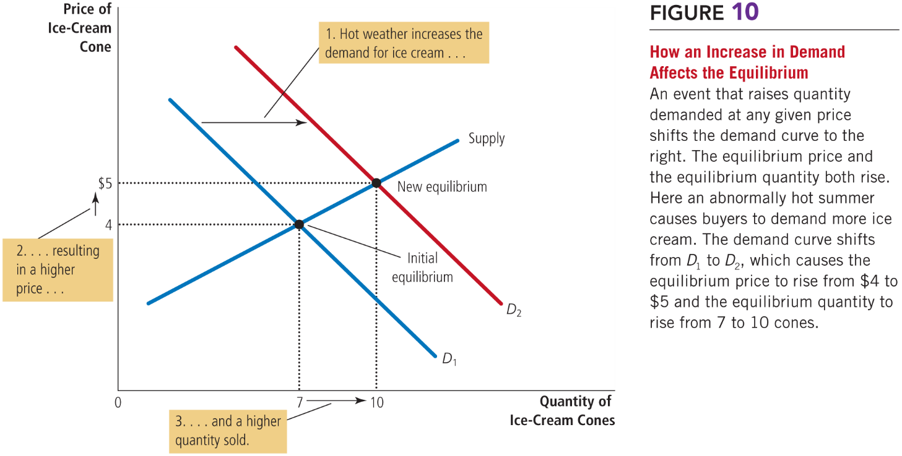
Figure 10 How an Increase in Demand Affects the Equilibrium
Professor Galvez-Soriano lecture notes. Based on N. Gregory Mankiw, Principles of Microeconomics, 9th Edition.

Slide 35
Supply and Demand Together
A change in market equilibrium due to a shift in supply
One summer, a hurricane destroys part of the sugarcane crop: higher price of sugar
Effect on the market for ice cream?
Change in price of sugar: supply curve
Supply curve: shifts to the left
Higher equilibrium price; lower equilibrium quantity
Professor Galvez-Soriano lecture notes. Based on N. Gregory Mankiw, Principles of Microeconomics, 9th Edition.

Slide 36
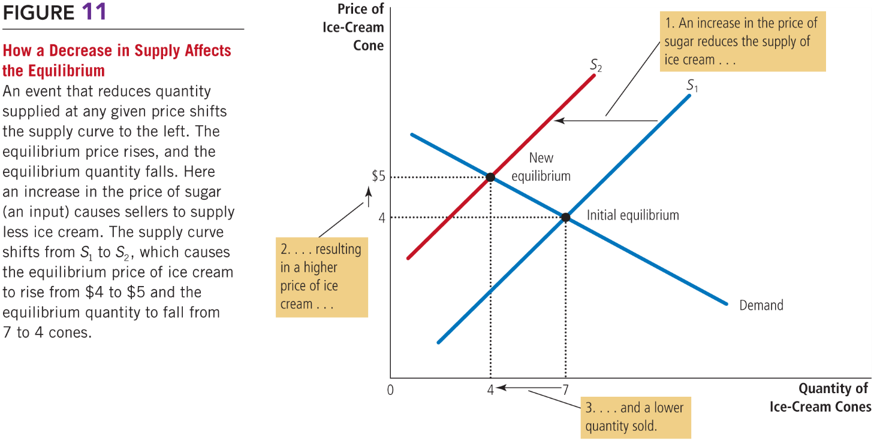
Figure 11 How a Decrease in Supply Affects the Equilibrium
Professor Galvez-Soriano lecture notes. Based on N. Gregory Mankiw, Principles of Microeconomics, 9th Edition.

Slide 37
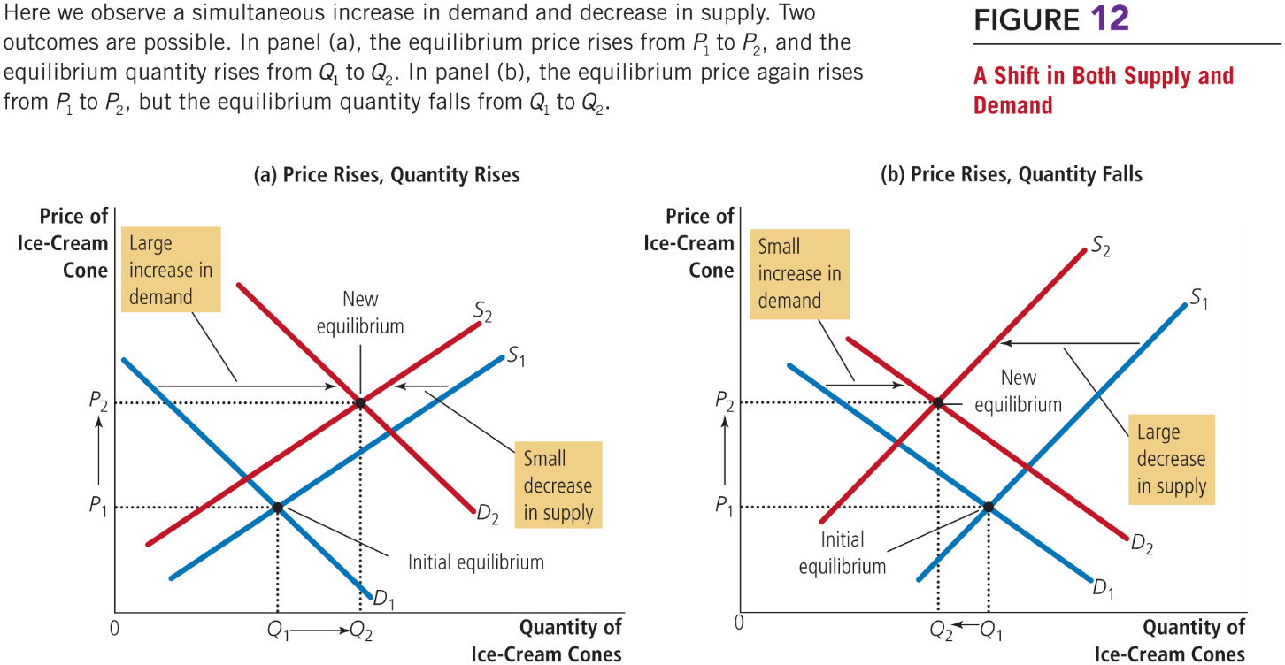
Figure 12 A Shift in Both Supply and Demand
Professor Galvez-Soriano lecture notes. Based on N. Gregory Mankiw, Principles of Microeconomics, 9th Edition.

