Slide 1

CampusConnect: Bridging Students to Opportunity
Student Name(s): F GALVIN SAM NITHEESH
RAHUL RAJ M
JASPAL GUNDLA
Unique ID: E0222057,E0222034,E0222046
Date: 27 / 07 / 25

Slide 2



Introduction & Motivation: Empowering Student Success
CampusConnect is designed to revolutionize the campus placement process, making it more efficient and equitable for all.
Project Vision
Why This Project?
Impact Potential
A unified platform for seamless job matching, communication, and skill development, empowering students for successful careers.
Addressing fragmented placement processes, limited industry exposure, and the need for personalized career guidance.
Enhance student employability, streamline recruitment for employers, and foster a supportive campus community.

Slide 3
Problem Statement: Navigating the Placement Maze
The current campus placement ecosystem often presents significant challenges for both students and recruiters.
Key Challenges:
Lack of centralized job information and communication channels.
Inefficient matching between student skills and job requirements.
Limited access to preparatory resources and personalized feedback.
CampusConnect aims to serve university students seeking placements and employers looking for talent, overcoming these limitations of existing disparate systems.

Slide 4




Proposed Solution & Objectives: CampusConnect
CampusConnect is a comprehensive web application designed to centralize and optimize the campus placement journey.
Centralized Platform
Enhanced Matching
A single hub for all placement-related activities, from job postings to interview scheduling.
Leveraging AI for intelligent job recommendations, connecting students with relevant opportunities.
Skill Development
Streamlined Communication
Providing resources and support for students to enhance their technical and soft skills.
Integrated tools for seamless interaction between students, faculty, and employers.
Technologies:
Built on the MERN Stack: MongoDB, Express.js, React.js, Node.js.

Slide 5
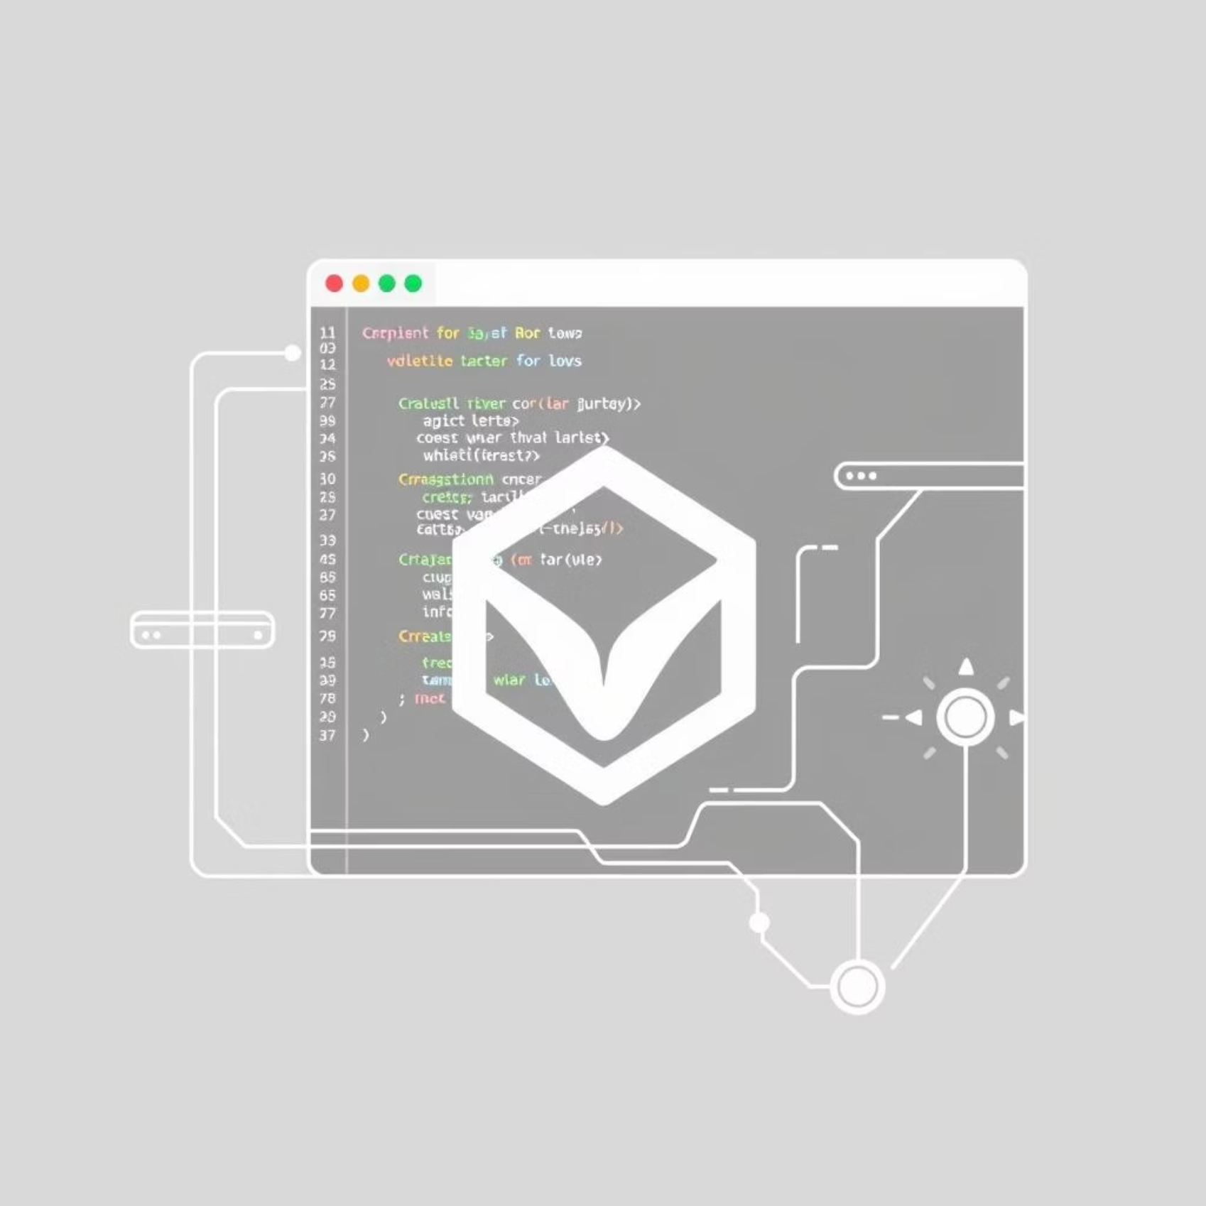
Technology Stack Justification: Why MERN?
The MERN stack offers a robust and scalable foundation for CampusConnect, ensuring a seamless user experience and efficient development.
Advantages of MERN:
Full-stack JavaScript: Consistent language across client and server, simplifying development.
Scalability: Handles large user bases and data volumes efficiently.
Performance: React.js for fast, responsive UIs; Node.js for high-throughput backend.
Community & Support: Large, active communities and extensive documentation.
Flexibility: MongoDB's NoSQL database adapts to evolving data needs.

Slide 6

System Architecture: How CampusConnect Works
CampusConnect follows a client-server architecture, with distinct layers for robust functionality.
User Interface (React.js): Frontend for students and employers.Backend API (Node.js & Express.js): Handles business logic, data processing, and routing.Database (MongoDB): Stores all application data, including user profiles, job postings, and analytics.

Slide 7






Modules & Key Features: Empowering Every User
CampusConnect integrates a comprehensive suite of modules designed to cater to the diverse needs of students and employers.
User Profiles
Job Matching
Personalized profiles for students (academic, skills, resume) and employers (job posts, company info).
Advanced filters and AI-driven recommendations for tailored job opportunities.
Interview Tools
Analytics Dashboards
In-app scheduling, automated reminders, and integrated communication (chat, video).
Track application progress for students; view recruitment stats for employers.
Feedback Mechanism
Senior Experience
Post-interview feedback for student improvement and company ratings for transparency.
Dedicated section for alumni advice, mentor-mentee models, and success stories.

Slide 8
Expected Outcomes: Impacting Futures
CampusConnect is poised to deliver significant benefits, fostering a more effective and supportive placement ecosystem.
25%
30%
Increased Placements
Reduced Recruitment Time
A more efficient system leading to higher student placement rates.
Streamlined processes for employers, saving time and resources.
40%
100%
Enhanced Skill Development
Improved User Experience
Students gain practical skills and confidence through tailored resources.
A user-friendly platform for both students and employers.
For the development team, this project offers invaluable experience in full-stack development, AI integration, and project management.

Slide 9
Timeline & Milestones: Our Roadmap
Our project will progress through distinct phases, culminating in a fully functional CampusConnect platform.
Phase
Timeline
Key Milestones/Deliverables
Phase 1: Planning & Design
Weeks 1-3
Detailed Requirement Analysis
System Architecture Finalization
Database Schema Design
Phase 2: Core Development
Weeks 4-10
User Authentication Module
Profile Management (Student & Employer)
Basic Job Posting & Search
Phase 3: Advanced Features & Integration
Weeks 11-14
AI Job Matching Algorithm
Interview Scheduling & Communication Tools
Analytics Dashboard Integration
Phase 4: Testing & Deployment
Weeks 15-16
User Acceptance Testing (UAT)
Bug Fixing & Performance Optimization
Deployment to Production Environment

Slide 10
Conclusion & Future Scope
CampusConnect offers a promising solution to the complexities of campus placements, fostering student success and streamlining recruitment.
Project Summary
Future Enhancements
A MERN-stack platform addressing current placement inefficiencies through centralized access, AI-matching, and skill-building resources.
Gamification features (badges, points)
Interactive Resume Builder with AI scoring
Real-time company interaction (virtual fairs)
Mock Interview Feedback System
Job Shadowing/Internship Opportunities
Group Study & Collaboration Tools
CampusConnect is designed for continuous evolution, adapting to the dynamic needs of the academic and professional landscape.

