Slide 1
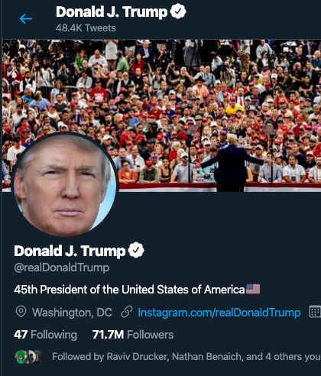
Does Donald Trump increase hate speech?
Tomer Levy and Gal Yankovitz
Causal Inference project presentation

Slide 2
Research Question
What is the effect of Trump’s tweets on other users’ discourse?
Too big of a question, we offer two simplifications:
Does the polarity of a tweet affect the retweets’ sentiment?
Does exposure to Trump tweets causes users’ sentiment shift?
We wish to infer the conditional treament effect on the treated

Slide 3
Target Experiment #1
Self Controlled Case Series / Matching
Experiement Design:
User get randomally a neutral or negative Trump tweet.
User is forced to retweet.
The sentiment of the retweet is measured.
Assumptions For Observational
Same / similar users retweet both neutral and negative tweets (overlap).
The probablity to retweet is not affected by Trump’s tweet.
Challanges
SUTVA does not apply.

Slide 4
Target Experiment #2
Self Controlled Case Series
Experiement Design:
A user is unwillingly exposed to any trump tweets at a random time, to which they must respond.
User unrelated tweets setiments are measured before and after the exposure.
Assumptions For Observational
Effect of Trump’s tweet on a user wear off before the next retweet.
Users are not exposed to tweets they didn’t respond to.
Challanges
SUTVA does not apply
Exposure is a hidden confounder

Slide 5
Data Collection
Downloaded ~1000 of Trump's tweets, going back to ??th, December.
For a sampled ~4000 users who retweeted Trump, downloaded all their tweets.
Labeled data of ~100,000 tweets categorized as hate speech / abuse / spam / normal provided by ???

Slide 6
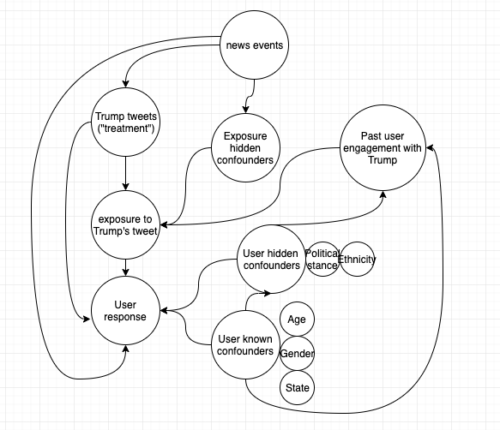
Causal Model
User possible responses
Retweet
Positive/negative at a certain time
Toxicity as a certain time
Activity
Trump Tweet Treatment
Positive/negative tweet
Compared to no-tweet

Slide 7
Project Plan
Collect data from Trump and his retweeters (done)
Apply sentiment analysis model for Trump and retweeters tweets
Used for treatment / response estimation
Can be learned from hatespeech dataset
Experiment 1:
Use only the retweet to Trump data.
Estimate ITE based on retweet sentiment after neutral and negative Trump tweets.
Experiment 2:
Use all the data of the retweeters.
Estimate ITE based on regression discontinuity before and after a retweet.

Slide 8
Perliminary Analysis

