Slide 1
下世代物聯網應用技術工作坊 - 機器學習
助教: 吳仁傑
聯絡資訊: reinwu.cs09g@nctu.edu.tw

Slide 2

Setting
下載教材檔案 ML_workshop.zip
https://reurl.cc/35zg2j
將檔案解壓縮後把整個ML_workshop資料夾上傳到自己的google雲端硬碟

Slide 3
Course Summary
Validation
K-fold cross validation (*optional)
Leave-one-out cross validation
Holdout validation
Evaluation
Confusion matrix

Slide 4
Course Summary
Supervised learning algorithm
Naive Bayes
Decision tree
Linear regression
Logistic regression
SVM
Unsupervised learning algorithm
KNN

Slide 5
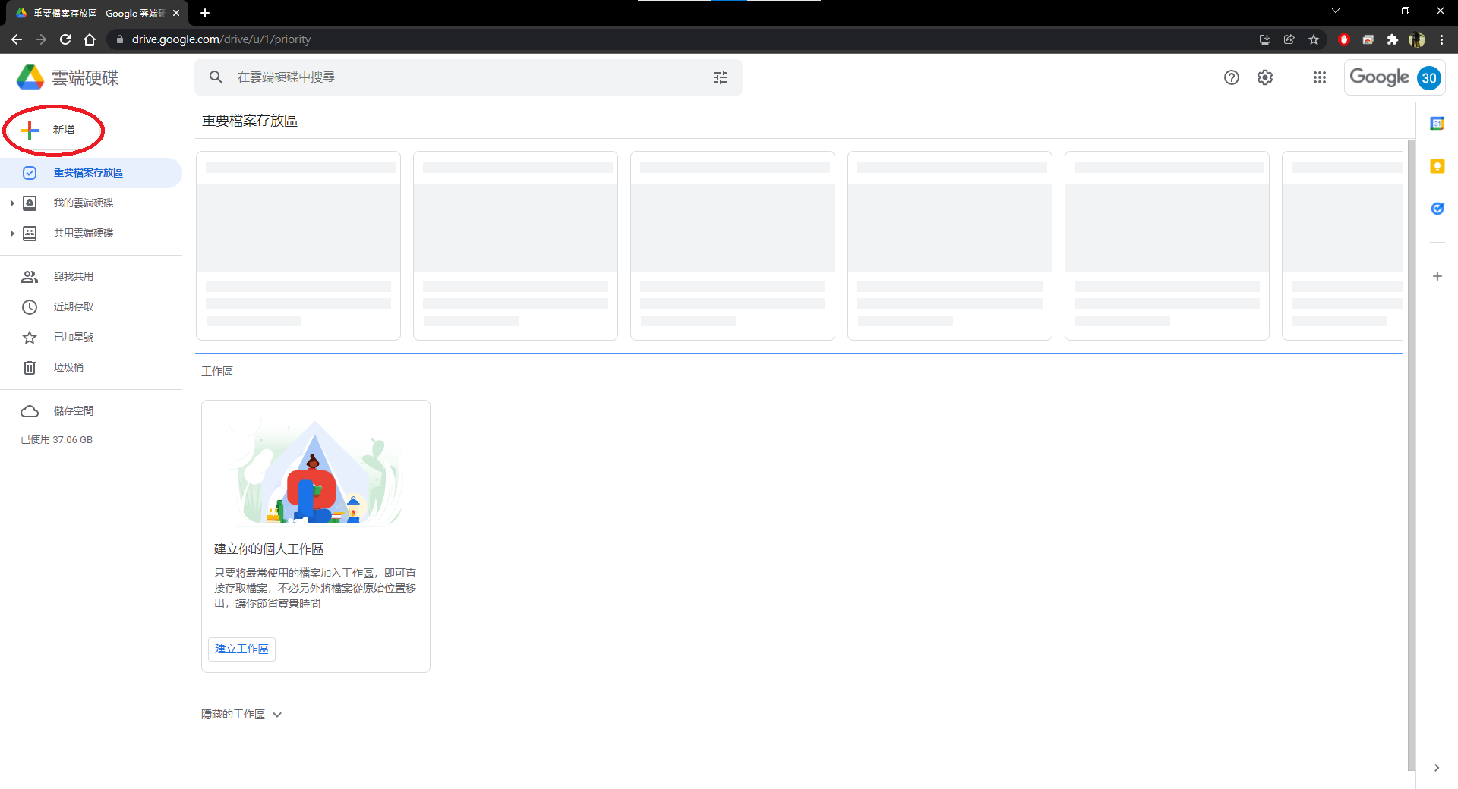
Setting (安裝Google Colaboratory)

Slide 6
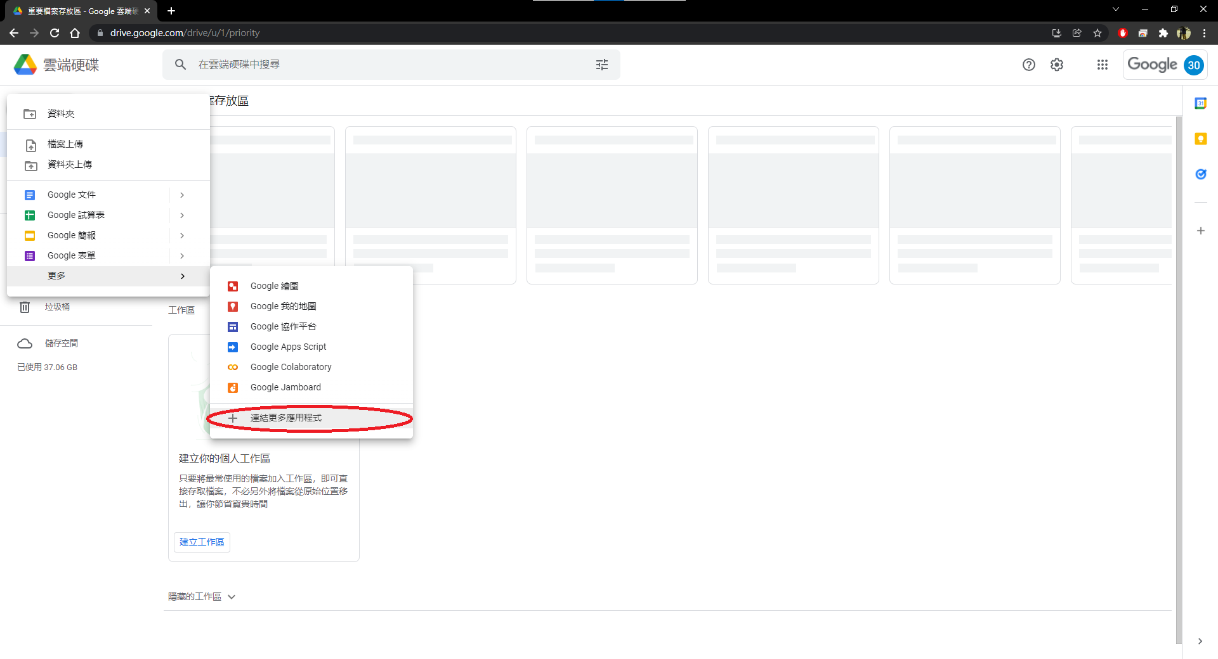
Setting (安裝Google Colaboratory)

Slide 7
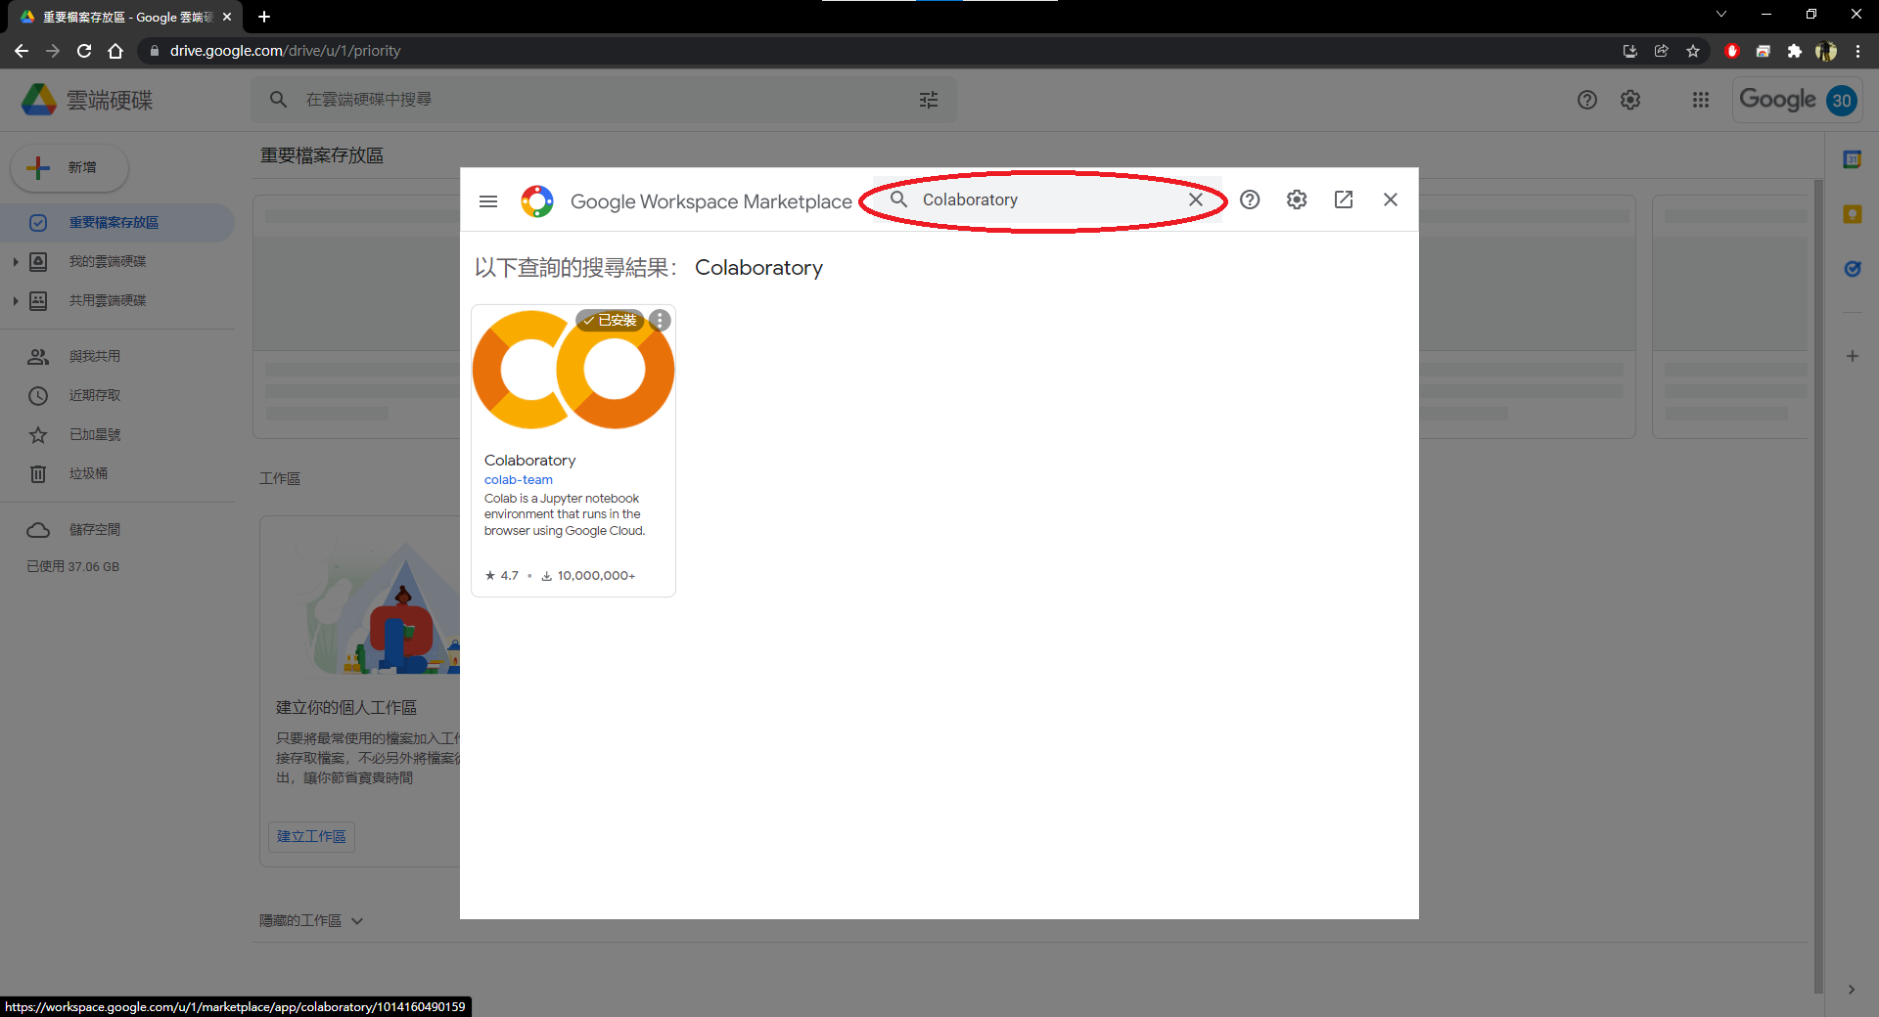
Setting (安裝Google Colaboratory)

Slide 8
如何學習model使用方法
重點
Model是針對哪種任務 (回歸? 二元分類? 多元分類? …)
Model對feature的要求 (是不是量化特徵? 是不是離散資料? …)
Model建立的數學公式與背後的假設
可以忽略
訓練演算法的過程

Slide 9

Linear regression
學期成績計算公式 $= w_{1}x_{1}+⋯+w_{5}x_{5}$
3次作業成績$x_{1},x_{2},x_{3}$
期中成績$x_{4}$
期末成績$x_{5}$
各項占比$w_{1},⋯,w_{5}$

Slide 10

Linear regression
Input : $X=[x_{1}, ⋯,x_{n}]$ $\left(∈ℝ^{n}\right)$
Every $x_{k}$is a quantitative variable
Output : $\hat{Y} ∈ℝ$
Parameters : $W=[w_{0},w_{1},⋯,w_{n}]$ $(∈ℝ^{n+1})$

Slide 11
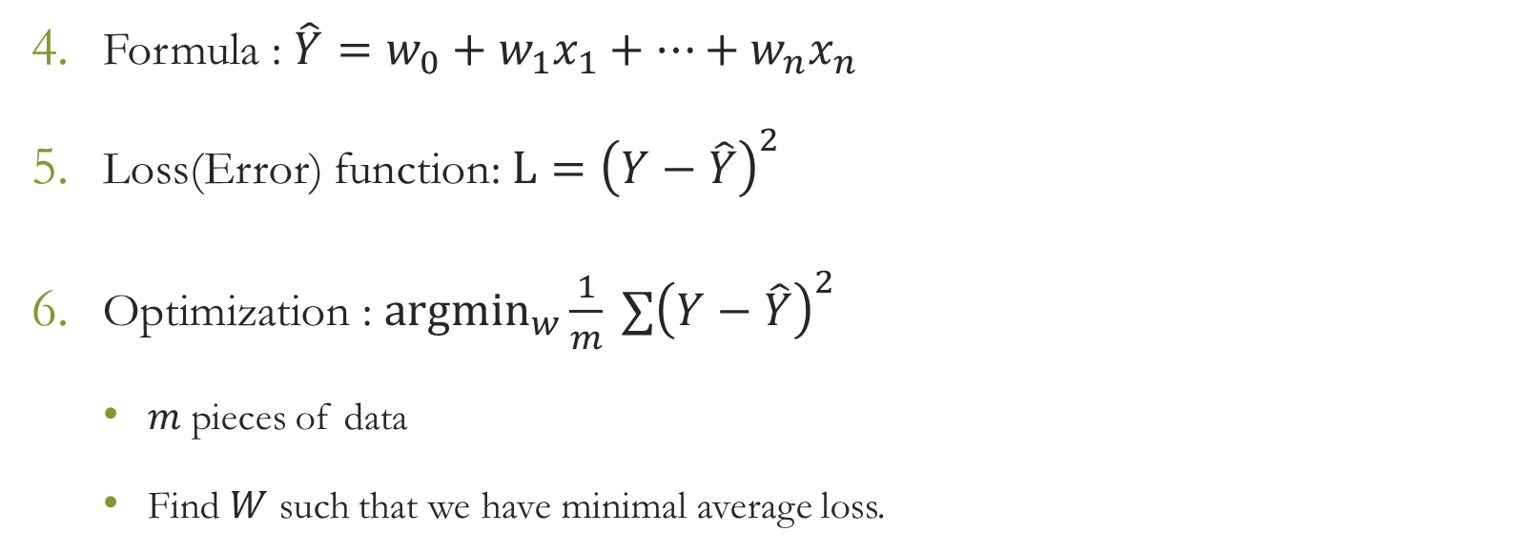
Linear regression
Formula : $\hat{Y}=w_{0}+w_{1}x_{1}+⋯+w_{n}x_{n}$
Loss(Error) function: $L={\left(Y−\hat{Y}\right)}^{2}$
Optimization : ${argmin}_{w}\frac{1}{m} ∑{\left(Y−\hat{Y}\right)}^{2}$
$m$ pieces of data
Find $W$ such that we have minimal average loss.

Slide 12
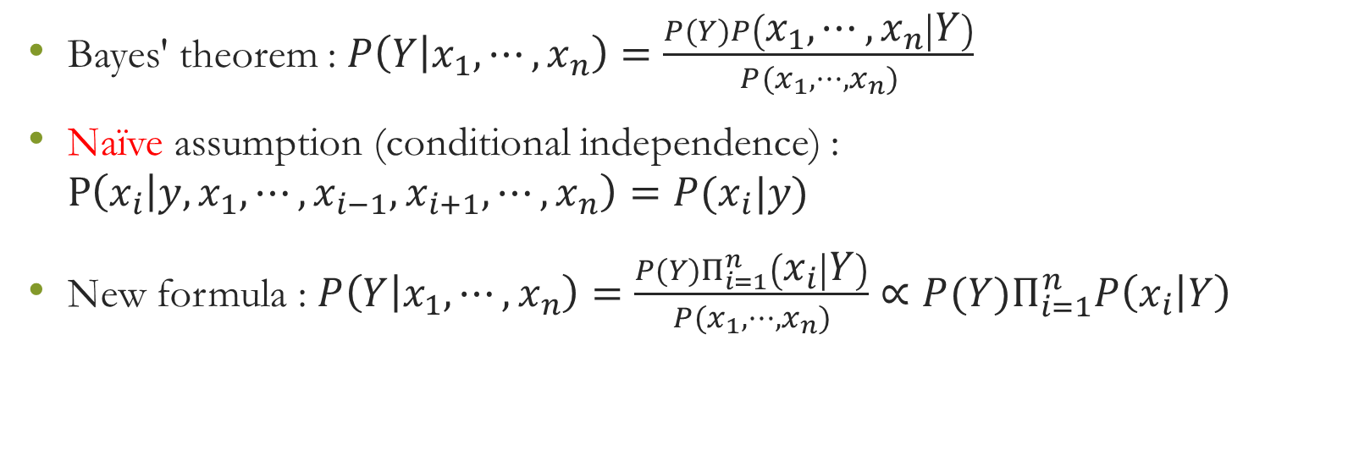
Naive Bayes classifier
Bayes' theorem : $P\left(Y | x_{1},⋯,x_{n}\right)=\frac{P(Y)P\left(x_{1},⋯,x_{n} | Y\right)}{P(x_{1},⋯,x_{n})}$
Naïve assumption (conditional independence) : $P\left(x_{i} | y,x_{1},⋯,x_{i−1},x_{i+1},⋯,x_{n}\right)=P(x_{i}|y)$
New formula : $P\left(Y | x_{1},⋯,x_{n}\right)=\frac{P(Y)Π_{i=1}^{n}\left(x_{i} | Y\right)}{P(x_{1},⋯,x_{n})}∝{P(Y)Π}_{i=1}^{n}P\left(x_{i} | Y\right)$

Slide 13
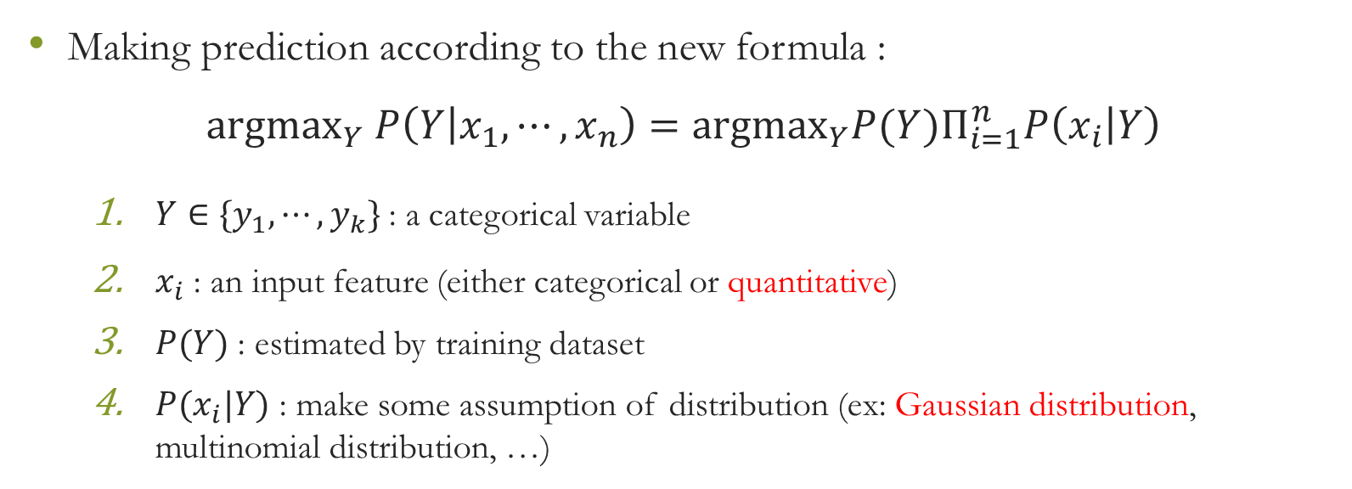
Naive Bayes classifier
Making prediction according to the new formula :
$${argmax}_{Y} P\left(Y | x_{1},⋯,x_{n}\right)={argmax}_{Y}{P(Y)Π}_{i=1}^{n}P\left(x_{i} | Y\right)$$
$Y∈\{y_{1},⋯,y_{k}\}$ : a categorical variable
$x_{i}$ : an input feature (either categorical or quantitative)
$P(Y)$ : estimated by training dataset
$P(x_{i}|Y)$ : make some assumption of distribution (ex: Gaussian distribution, multinomial distribution, …)

Slide 14
K-fold cross validation
3 roles of dataset
Training set : for train model
Validation set : for hyperparameters tuning
Testing set : for model performance evaluation

Slide 15

K-fold cross validation
Hyperparameters is a parameter whose value is used to control the learning process
Find hyperparameter settings that have best average performance of each split.

