Slide 1
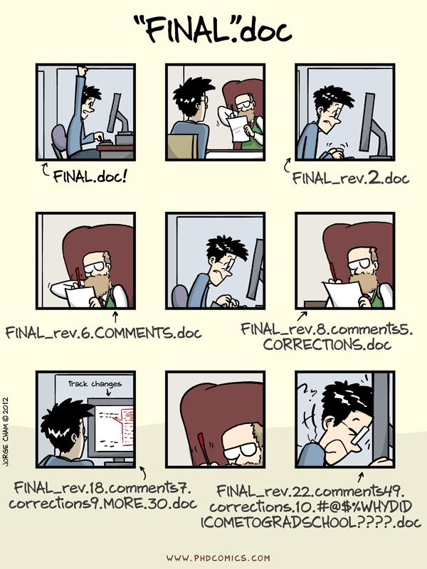
Version CONTROL
www.phdcomics.com/comics/archive.php?comicid=1531

Slide 2
What is VERSION CONTROL?
Version control is a system for recording changes to a file or set of files that change over time which allows a specific version of these files to be recalled later.
Can be used to manager software source code, documents, web sites, or even digital lab notes.
Often embedded behind the scenes in other applications for example Google Docs and Wikipedia both use a version control system.
Extremely useful for organizing software written by multiple developers.

Slide 3
Benefits OF VERSION CONTROL
Provides access to the entire history of a project:
Backup in case of an crash or data loss.
Ability to roll back mistakes.
Try out new ideas without breaking working code.
Recall of older versions of the project.
See what has changed and when.
Allows multiple people to work on a single project at the same time without interfering with each others work.
Work done independently can be integrated into a single version.

Slide 4
Some TERMINNOLOGY
A repository stores the database of changes.
You do your editing on a working copy.
When you are happy with your changes you commit then to the repository.
A repository can therefore be though of as a chain of commits. In time it might split into two branches.
These can be merged back into a single branch.
Branch A
Split
C3
C1
C2
Branch B
C5
C4
Merge

Slide 5
Centralized vs. Distributed
Version control systems come in two flavors:
Centralized version control – A single repository exists. Work is done on working copies on developer’s machines.
Distributed version control – Multiple repositories exist, each developers has their own repository and working copy where they work. Typically a single “master” repository is designated as containing the project’s official source code.
The most common version control systems are git (distributed), mercurial (distributed) and SVN (centralized)
The trend in open source software is a move to distributed version control systems, although many projects (and companies and organizations) still use centralized version control systems.

Slide 6
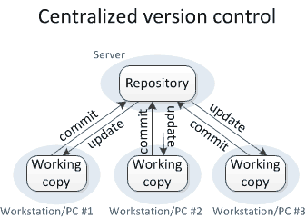
CENTRALIZED VERSION CONTROL
A single repository provides a “central” location for the database of changes.
Each developers has a working copy and commits to the central repository.
Pros:
A single up to date version is always available.
Simple to understand.
Cons:
Single point of failure.
Commits require a connection to the repository.
Branching and merging must be done with permission from the repository – slow and complicated.
https://homes.cs.washington.edu/~mernst/advice/version-control.html

Slide 7
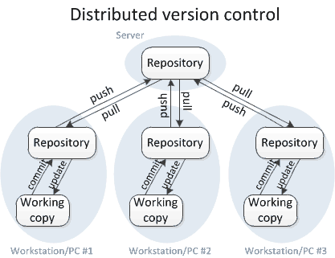
Distributed Version Control
Each developer has a full copy of the repository AND a working copy.
A single “master” repository is agreed upon, developers “push” and “pull” from their local repository to this remote repository.
Pros:
Multiple points of failure – everyone has a full copy.
Commits are made to the local repository.
Branches can be made locally, and merged locally. Lightweight.
Fast – everything is local, commits, branches, merged, etc.
Cons:
Complicated for beginners.
May be unclear when the most up to date version of the project can be found.
https://homes.cs.washington.edu/~mernst/advice/version-control.html

Slide 8
VERSION CONTROL In OPEN SOURCE
Nearly all open source software projects have a version control system, most can be accessed online.
Many projects use a service to host their source code, some example are GitHub, Bitbucket, Google Code, and SourceForge.
You can access these repository to explore the code in an open source project, discover bugs, and even contribute back to the project!

Slide 9
Learning VERSION CONTROL
Resources for learning git:
TryGit – Practice in the browser!
https://try.github.io
ProGit – Book with practical git and some theory.
http://git-scm.com/book/
GitHub guides – instructions on using git with GitHub
https://guides.github.com/
Resources for learning Hg:
Hg Init - Tutorial
http://hginit.com/
Mercurial Documentation – From the source.
http://mercurial.selenic.com/guide

