Slide 1
Neural Networks 2022-2023
LAB 7

Slide 2
Agenda
CNN
Building a CNN model using TensorFlow
How to save and load model weights
Dog-Cat Classification using CNN
Project
Resources

Slide 3
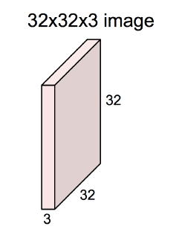
Review: CNN
CNN is a class of deep, feed-forward artificial neural networks, most commonly applied to analyzing visual imagery.
CNNs, like neural networks, are made up of neurons with learnable weights and biases. Each neuron receives several inputs, takes a weighted sum over them, pass it through an activation function and responds with an output
So what the difference between the neural network and the CNN ?
- Unlike neural networks, where the input is a vector, here the input is a multi-channeled image (3 channeled in this case).

Slide 4
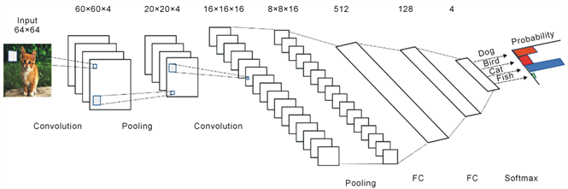
CNN
A CNN consists of an input and an output layer, as well as multiple hidden layers. The hidden layers of a CNN typically consist of convolutional layers, pooling layers, fully connected layers and normalization layer

Slide 5
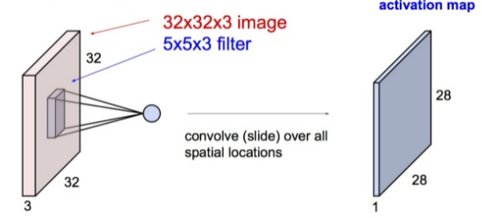
CNN
Convolution layer
what happens when we convolve the complete image with the filter ?

Slide 6
CNN
In Convolution layer , kernel weights are not fixed, they are learnable

Slide 7
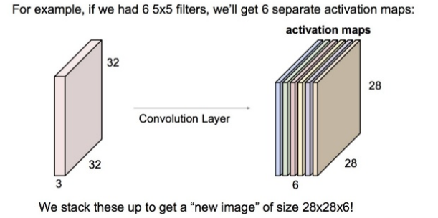
CNN
The convolution layer is the main building block of a convolutional neural network.
The convolution layer comprises of a set of independent filters (6 in the example shown). Each filter is independently convolved with the image and we end up with 6 feature maps of shape 28*28*1.

Slide 8
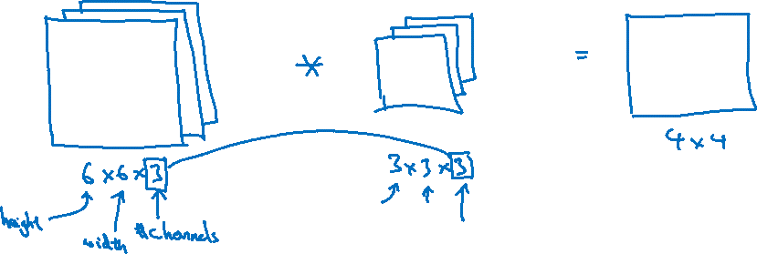
Convolutions on RGB images

Slide 9


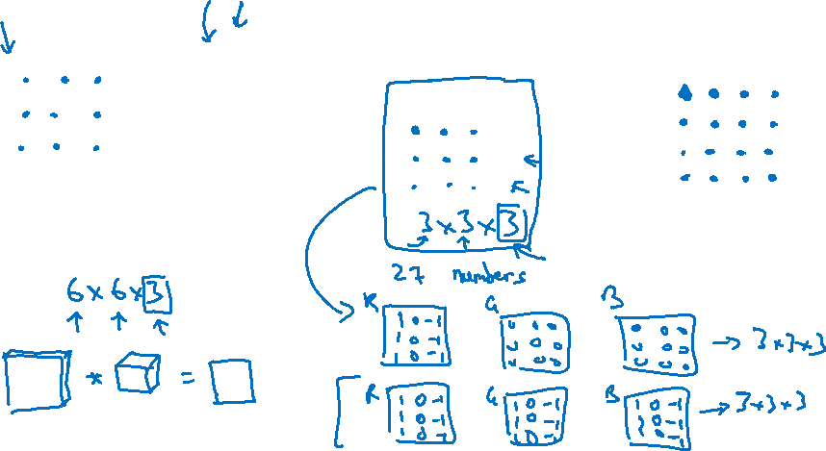
Convolutions on RGB images
$$∗$$
$$=$$
4 x 4

Slide 10
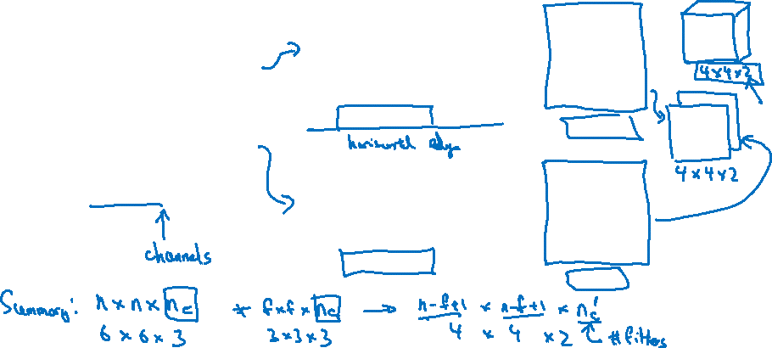




Multiple Filters
$$∗$$
$$=$$
3 x 3 x 3
4 x 4
6 x 6 x 3
$$∗$$
$$=$$
3 x 3 x 3
4 x 4

Slide 11
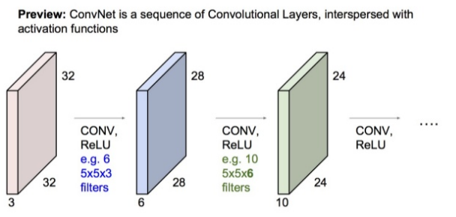
CNN
All these filters are initialized randomly and become our parameters which will be learned by the network subsequently.

Slide 12
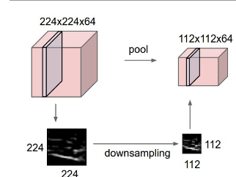
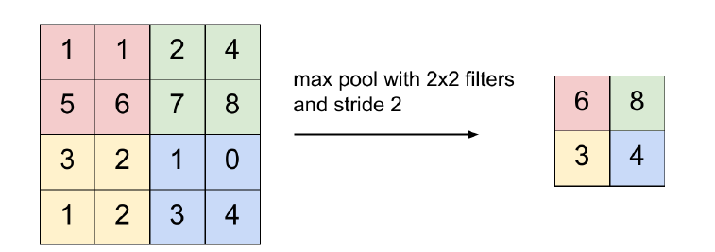
CNN
A pooling layer is another building block of a CNN.
Its function is to progressively reduce the spatial size of the representation to reduce the amount of parameters and computation in the network. Pooling layer operates on each feature map independently.

Slide 13
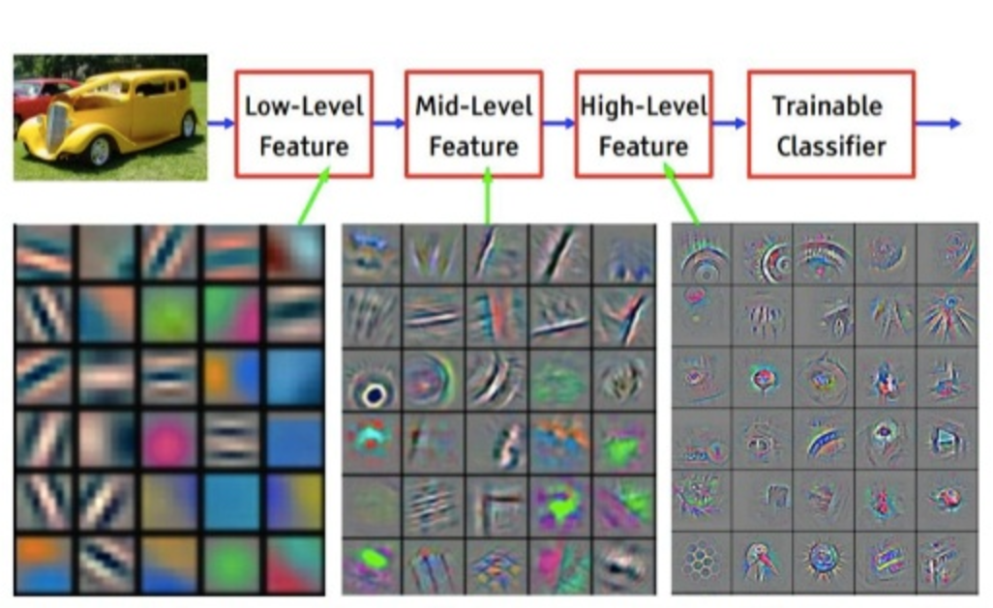
CNN
feature visualization of CNN model trained on ImageNet

Slide 14
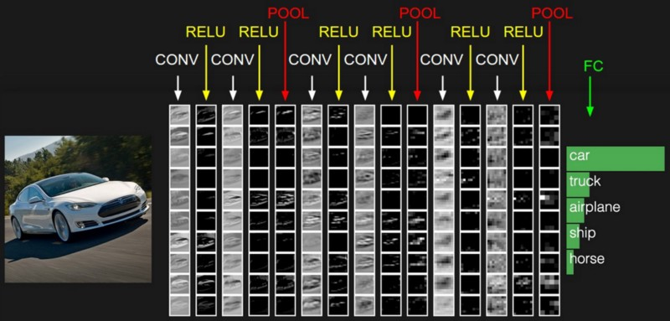
CNN
RELU is just a non-linearity which is applied similar to neural networks.
The FC is the fully connected layer of neurons at the end of CNN. Neurons in a fully connected layer have full connections to all activations in the previous layer, as seen in regular Neural Networks and work in a similar way.

Slide 15
CNN
Let’s Implement a CNN Model using TensorFlow to solve famous problem on Kaggle, which is dog-cat Classification!
We'll write an algorithm to classify whether images contain either a dog or a cat. This is easy for humans, dogs, and cats. Your computer will find it a bit more difficult.
The training archive contains 25,000 images of dogs and cats. Train your algorithm on these files and predict the labels for test1 (1 = dog, 0 = cat).

Slide 16
Google Colab
Google Colab provides free access to GPUs that can be used in deep learning projects.
You can quickly get started by creating an empty notebook, uploading an existing notebook, or importing a notebook from any public GitHub repository.
Your Colab notebooks are automatically saved in a special folder in your Google Drive
Hundreds of packages come pre-installed, and you can install additional packages using pip.
Sessions will shut down after (30-90) minutes of inactivity.

Slide 17
Kaggle Notebooks
Kaggle provides free access to NVIDIA GPUs. These GPUs are useful for training deep learning models, though they do not accelerate most other workflows (i.e. libraries like pandas and scikit-learn do not benefit from access to GPUs).
These can be used through Kaggle Notebooks that are very similar to Colab notebooks
Each user is given ~30-40 hours/week.
Each notebook editing session has 9 hour of available execution time before it is disrupted, and 20 minutes of idle time (meaning that 20 minutes of inactivity will cause the kernel to be shutdown).

Slide 18
Deep Learning Project: Sports Image Classification
In today’s world of internet, a massive amount of data is getting generated every day and content-based classification of images is becoming an essential aspect for efficient retrieval of images and have attracted application in several fields and one of such field is sports. Building a model that is able to classify different sports activities into different categories could be useful for automated sports analysis tasks.
You are provided a dataset that contains 6 sports classes: Basketball, Football , Rowing, Swimming, Tennis and Yoga. This dataset is divided into training and testing sets. You are provided with the labels for the training set in the image names while the test set is unlabeled to be used for the Kaggle competition. (Take note that some images are PNG and some are JPG and the images are of different sizes)

Slide 19
Deep Learning Competition
Competition link (You must use this link to be able to join the competition): https://www.kaggle.com/t/f3e7c2ff1eff448c94b0f7753ddff60d
Competition Rules:
One account per team participant : You cannot sign up to Kaggle from multiple accounts and therefore you can submit only from one account.
The team name on Kaggle should be the same Team ID as the one given to you [here].
No private sharing outside teams : Any form of cheating or illegal behavior will lead to being disqualified and losing the project grades.
Keras.applications or any similar API is NOT ALLOWED
Submission Limits
You may submit a maximum of 5 entries per day.
You may select up to 2 final submissions for judging.
Competition Timeline
Start Date: 2/12/2022
End Date: The earlier practical exam date from all departments.

Slide 20
Deep Learning Competition
You must register and submit your results on Kaggle website.
You will be given a small test sample on the practical exam day, so each team needs to save the weights of the network used during training and create a script that loads the weights, generates a csv file containing the predicted labels for the test samples. Note that on the practical exam day, the test script needs to run on your laptop or if you want to use Colab/Kaggle for the test, make sure to have a very good internet connection as it is not guaranteed that it would be available in the lab.
If you trained the models using a notebook, you must deliver the notebook with the output cell saved displaying the training logs. If you trained the model using IDE (i.e Pycharm). You must deliver screenshots of the training process
The evaluation of the project will be on the following items:-
Building multiple appropriate models (at least two) and understanding each part of it (CNN, Inception, …)
Applying the appropriate data preparation steps
The achieved accuracy on Kaggle
Deliver a detailed report of all trials and your conclusion from these trials

Slide 21
Resources
TensorFlow: https://www.tensorflow.org/guide/low_level_intro
TensorBoard:https://www.tensorflow.org/guide/summaries_and_tensorboard
TFLearn: http://tflearn.org
OpenCV: https://opencv-python-tutroals.readthedocs.io/en/latest/py_tutorials/py_tutorials.html
Good explanation for CNN : https://medium.com/technologymadeeasy/the-best-explanation-of-convolutional-neural-networks-on-the-internet-fbb8b1ad5df8
Kaggle dog-cat classification problem : https://www.kaggle.com/c/dogs-vs-cats

Slide 22
Thank you

