Slide 1














Data Science Competition 2.0
Car Price Prediction

Slide 2



TEAM MEMBERS
خش هتجيبك
Youssef Shabaan
Abdelrahman Ibrahim
Gamal Osama

Slide 3
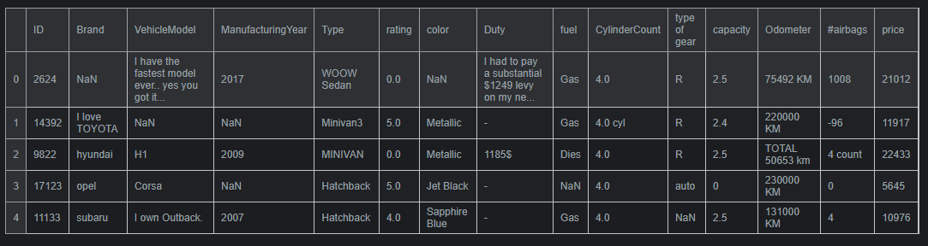
DATA HEAD

Slide 4
DATA UNDERSTANDING
ID - Identifier
Brand- The brand of the car
VehicleModel- The specific name of the car model
ManufacturingYear- The year the car was manufactured
Type- The category or classification of the car
Rating- A numerical or categorical rating indicating the car's quality
Color- The exterior color of the car.
Duty- The tax associated with the car
Fuel- The type of fuel the car use
CylinderCount- The number of cylinders in the car's engine
Type of Gear- the type of the car which automatic or manual
Capacity- The Engine Volume
Odometer- The total distance the car has traveled
Airbags- The number of airbags in the car
Price- The cost of the car

Slide 5
Data Cleaning

Slide 6
Basic Columns
Brand
VehicleModel
Type
Odometer
Airbags
These columns were cleaned up with a few simple steps
Changing all text to lowercase
Removing strange characters like $, ~, and @
Getting rid of extra words like "I like" and "is the best", etc
Pulling out just the numbers from the column

Slide 7
Advanced Columns
ManfactruingYear
extract_4digits_year(text) : This function extracts a 4-digit year from the input text. It uses a regular expression “\d{4}” to find the first occurrence of four digits.
extract_years_ago(text): This function converts text in the format "X years old" to an actual year. It uses a regular expression “^(\d+)years old$” to match text in the format "X years old". If matched, it subtracts the number of years from the current year (2024) to get the manufacturing year.
Then we subtract 1000 or 100 from dates like (3024, 2998) so that, they could be acceptable

Slide 8
Advanced Columns
Duty
Cleaned data by removing non-digit characters
Replaced negative values with the Absolute
Standardized currency to USD:
Identified values containing "pound"
Applied conversion rate: 1 GBP ≈ 1.3 USD

Slide 9
Advanced Columns
Fuel
First we tried to narrow the values by making “Gas” the same as “Natural Gas” which was a wrong assumption, In the west ”Gas” usually refers to liquid gas (Gasoline), so we merged it with Diesel which gave better results
We noticed that cars which has 0 cylinders, are electric cars, we used that to fill some NAN values in the Fuel column

Slide 10
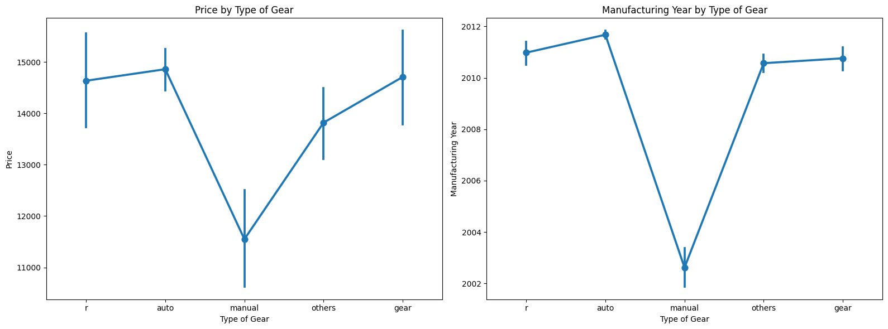
Advanced Columns
Type of Gear
We noticed that All gears mentioned are close to each other in the price and manufacturing year, so we decided to narrow them to auto and manual

Slide 11
Visualization
(understanding the data)

Slide 12
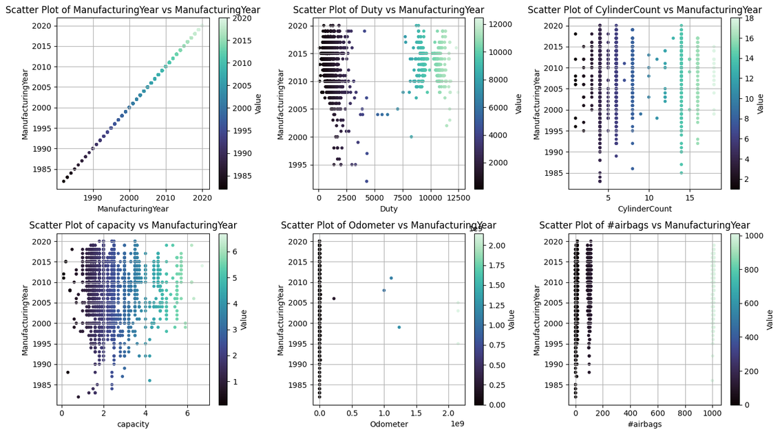
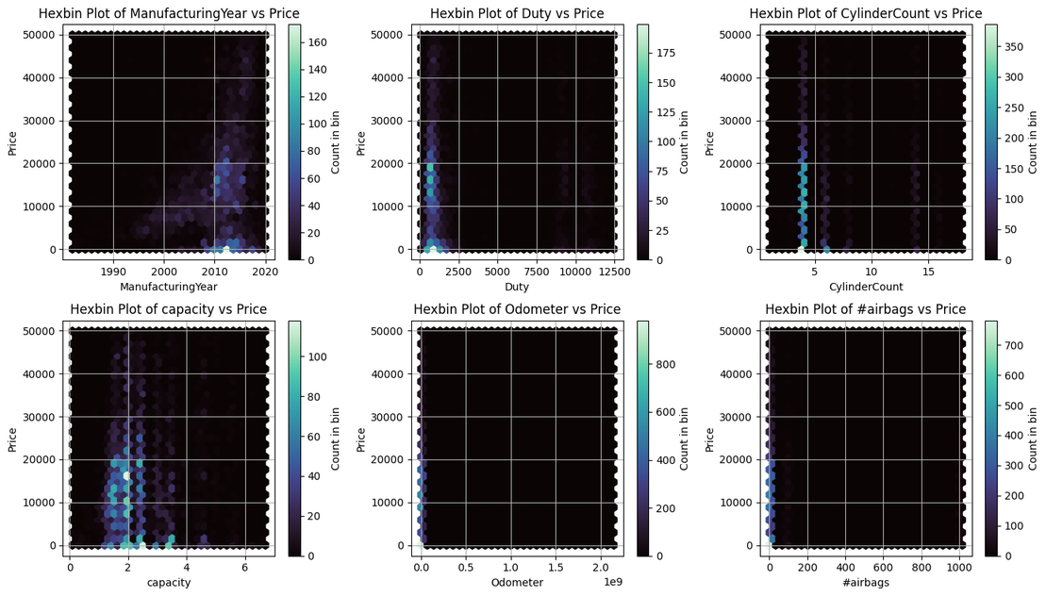
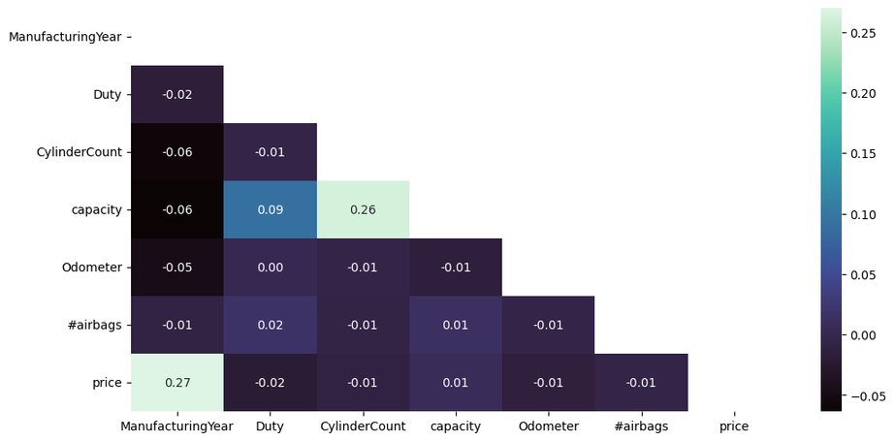

Slide 13
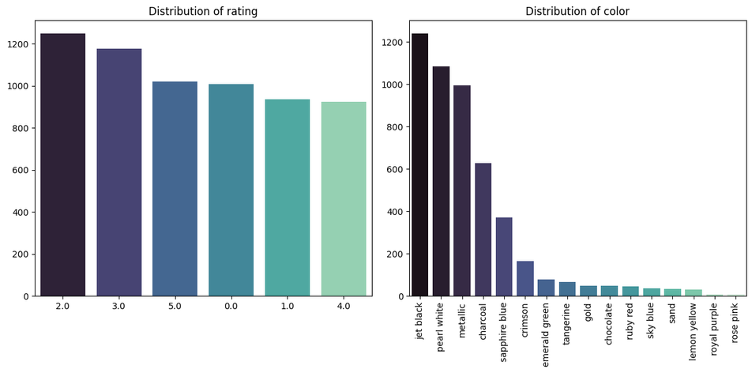
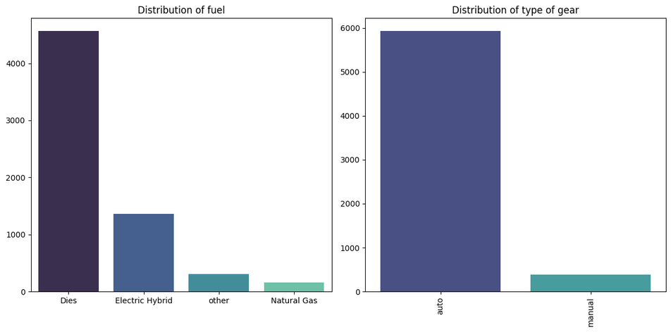
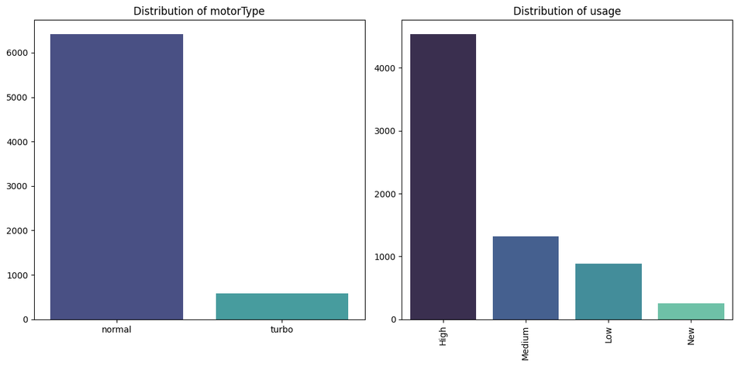

Slide 14
Feature Engineering

Slide 15
New Features
Motor Type
This Feature was extracted from the Capacity column, which had values with “Turbo” and others without
Usage
We got this one from the Odometer column, the odometer column itself shows the total distance traveled by the car, From that, we made the Usage column indicate the usage of the car as (New, Low, Medium, High)

Slide 16
Preprocessing

Slide 17
Detecting Skewness
We tried to find columns with significant skewness to keep them in mind for potential transformation or normalization
ManufacturingYear with skewness -1.33
Duty with skewness 2.55
CylinderCount with skewness 2.17
capacity with skewness 1.50
Odometer with skewness 38.32
#airbags with skewness 5.10

Slide 18
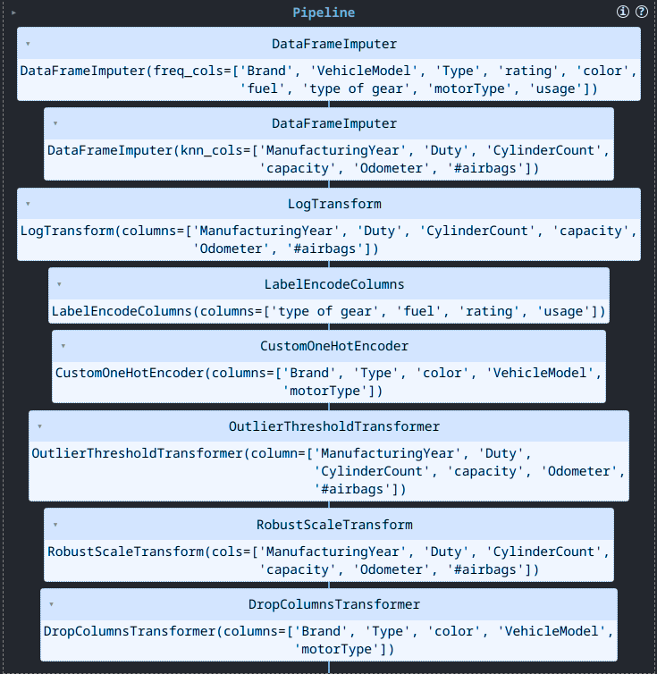
Pipline

Slide 19
Pipline
DataFrameImputer
Imputes Categorical columns with the mode
Imputes Numerical columns with KNN
LogTransform
As said earlier, this is used to handle skewness
LabelEncodeColumns
Converts categories in (type of gear, fuel, rating, usage) columns to numerical values

Slide 20
Pipline
CustomOneHotEncoder
One hot encode (Brand, Type, color, VehicleModel, motorType) columns to 0s and 1s
OutlierThresholdTransformer
Sets outliers to the upper and lower bounds
RobustScaleTransform
DropColumnsTransformer
Scales numerical columns
Drops one hot encoded columns

Slide 21
Modeling

Slide 22

Pipline optimization
Finding
the best model
3. Evaluate the models and choose the best one
2. Training Different models

Slide 23
HyperParameter
Tuning

Slide 24
Best Parameters
n_estimators
750
min_samples_split
4
min_samples_leaf
1
max_features
None
max_depth
None

Slide 25
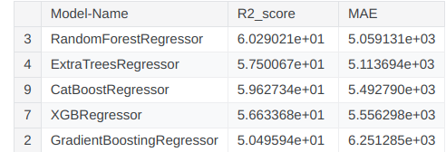
Final Result
CrossValidation
ExtraTreesRegressor
5348

Slide 26
Thank you very much!

