Slide 1


Slide 2
Artificial Intelligence is reshaping the job market. This presentation explores AI's influence on employment, using data-driven insights and advanced analytical tools.

Slide 3


Meet Our Team
رواد مصر الرقمية
Instructor
Dr/ Aml Mahmoud
Member
Member
Member
Eman Saber
Sara Hamdy
Manar Mohamed
Member
Member
Member
Zahraa Ahmed
Hadeer Hasan
Gamal Mohamed

Slide 4

Agenda
رواد مصر الرقمية
Introduction & Goals
Utilize Python, SQL, Excel, and Tableau
Data Source & ETL Process
Exploratory Data Analysis
Insights on AI's impact on job roles and skills
Visualization and Reporting in Excel and Tableau

Slide 5
Introduction & Goals
رواد مصر الرقمية
1
Project Objective
2
Tools Utilized
Analyze AI's impact on the job market through comprehensive data analysis.
Python for data manipulation, SQL for database queries, Excel for data analysis, Tableau for visualization.
3
Expected Outcome
Gain actionable insights into AI's influence on job roles.

Slide 6




Utilize Python, SQL, Excel, and Tableau
رواد مصر الرقمية
Python
SQL
Data cleaning, preprocessing, and advanced statistical analysis using libraries like pandas and sklearn.
Efficient data retrieval and manipulation from relational databases storing job market information.
Excel
Tableau
Spreadsheet analysis, pivot tables, and basic visualizations for quick data insights.
Creation of interactive dashboards and compelling data visualizations for stakeholder presentations.

Slide 7

Data Source & ETL Process
رواد مصر الرقمية
1
Extract
2
Transform
Pulled data from various sources, including a dataset from Kaggle titled "AI Impact on Jobs" (https://www.kaggle.com/code/unclepablo/ai-impact-on-jobs).
Cleaned and enriched the data, handling missing values, standardizing formats, and applying business logic to derive new metrics.
3
Load
Loaded the processed data into Tableau, ensuring it was ready for visualization and insight generation.

Slide 8

رواد مصر الرقمية
Data Cleaning Process
Using Python

Slide 9

Data Cleaning
رواد مصر الرقمية
Data Volume: Thousands of records representing flights over a specified period.
Common Issues Detected:
● Missing Data
● Errors
● Duplicates
Data Type Mismatches: Certain columns may have incorrect data types (e.g., AI Impact stored as text).

Slide 10
Overview of the Data
رواد مصر الرقمية
<class 'pandas.core.frame.DataFrame'> RangeIndex: 4706 entries, 0 to 4705
Data columns (total 6 columns):
# Column Non-Null Count Dtype
df.info()
--- ------ -------------- -----
0 Job titiles 4706 non-null object
AI Impact 4706 non-null float64
Tasks 4706 non-null int64
AI models 4706 non-null int64
AI_Workload_Ratio 4706 non-null float64
Domain 4706 non-null object
There are 4700 rows and 6 column in this dataset
dtypes: float64(2), int64(2), object(2) memory usage: 220.7+ KB

Slide 11
Handling Infinite Values in AI Workload Ratio
رواد مصر الرقمية
##dealing with infinte values
df['AI_Workload_Ratio'].replace(float('inf'), np.nan, inplace=True)
median = df['AI_Workload_Ratio'].median()
df['AI_Workload_Ratio'].fillna(median, inplace=True)
##checking infinite values after cleaning
inf_values1 = (df['AI_Workload_Ratio'] == float('inf')).sum()
inf_values1
inf_values = (df['AI_Workload_Ratio'] == float('inf')).sum()
inf_values
7
0

Slide 12
Identifying Duplicate Rows
رواد مصر الرقمية
0 False
False
False
False
False
…
4701 False 4702 False 4703 False 4704 False 4705 False
print(df.duplicated())
Length: 4706, dtype: bool

Slide 13

رواد مصر الرقمية
Data visualization
Using Python

Slide 14
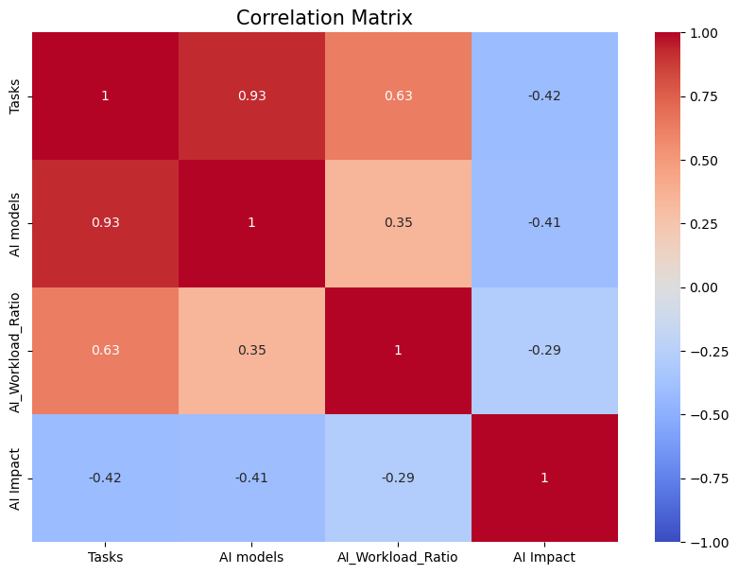
Correlation Analysis
رواد مصر الرقمية
##correlation
correlation_matrix = df[['Tasks', 'AI models', 'AI_Workload_Ratio','AI Impact']].corr()
plt.figure(figsize=(10, 7))
sns.heatmap(correlation_matrix, annot=True, cmap='coolwarm', vmin=-1, vmax=1)
plt.title('Correlation Matrix', fontsize=15)
plt.show()
Visualized the correlation between key variables using a heatmap to identify strong and weak relationships.

Slide 15
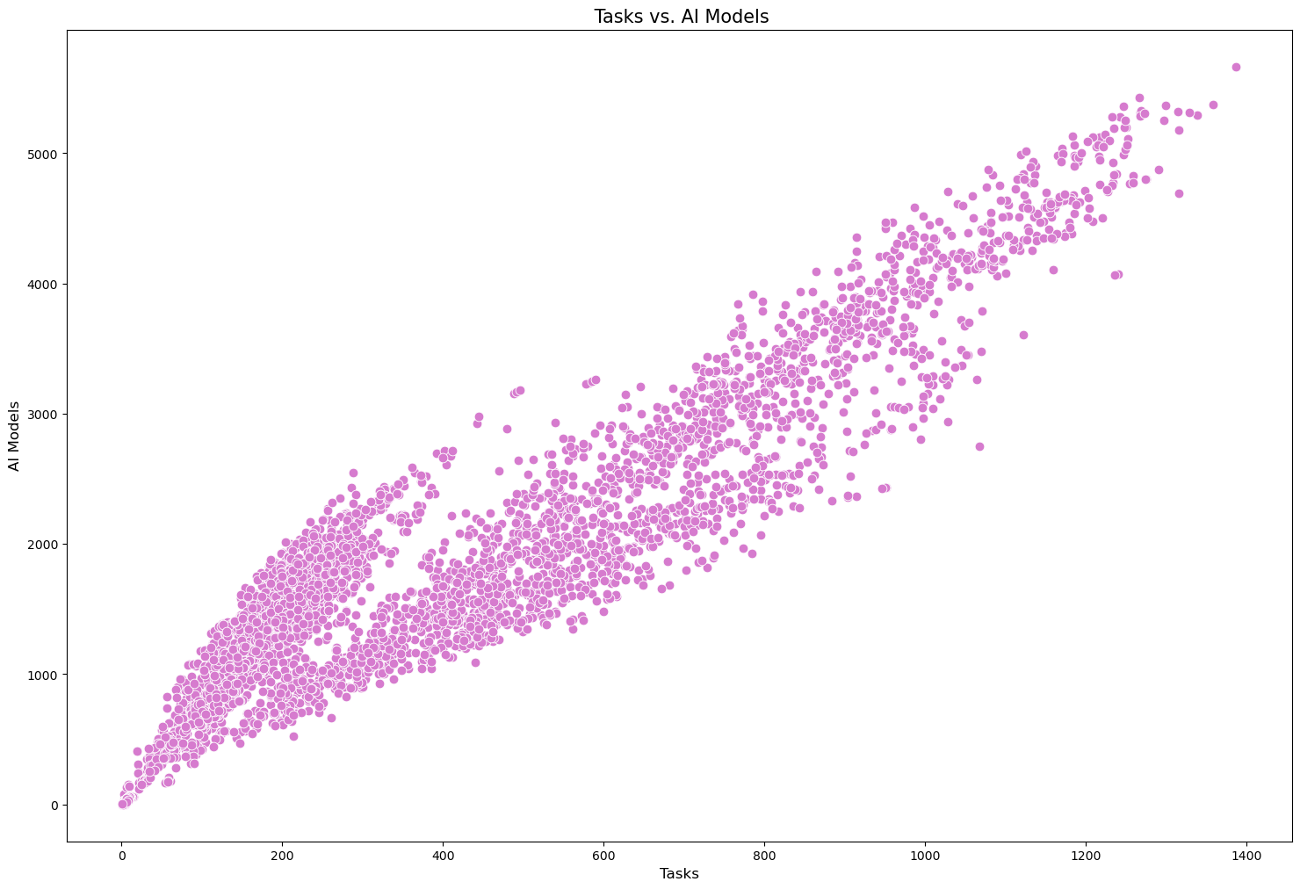
Tasks VS. AI Models
رواد مصر الرقمية
plt.figure(figsize=(18, 12))
sns.scatterplot(data=df, x='Tasks', y='AI models', s=60, marker="o", color="#D67BCE")
plt.title(' Tasks vs. AI Models', fontsize=15)
plt.xlabel('Tasks', fontsize=12)
plt.ylabel('AI Models', fontsize=12)
plt.show()
Plotted a scatter plot to examine the relationship between the number of tasks and AI models.

Slide 16
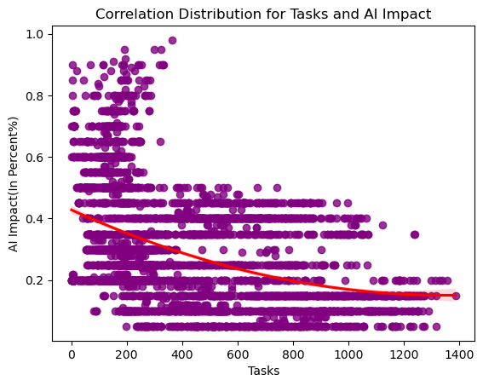
Tasks VS. AI Impact
رواد مصر الرقمية
sns.regplot(data=df, x='Tasks', y='AI Impact',color='purple', order=2,line_kws={"color": "red"})
plt.title('Correlation Distribution for Tasks and AI Impact')
plt.xlabel('Tasks')
plt.ylabel('AI Impact(In Percent%)')
plt.show()
Created a regression plot to analyze the relationship and trend between tasks and AI impact with a polynomial fit.

Slide 17
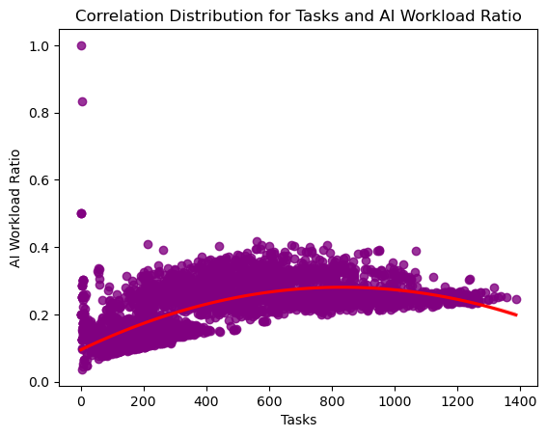
Tasks VS. AI Workload Ratio
رواد مصر الرقمية
sns.regplot(data=df, x='Tasks', y='AI_Workload_Ratio',color='purple',order = 2,line_kws={"color": "red"})
plt.title('Correlation Distribution for Tasks and AI Workload Ratio')
plt.xlabel('Tasks')
plt.ylabel('AI Workload Ratio')
plt.show()
Plotted a regression curve to explore the relationship between tasks and AI workload ratio with a second-order polynomial fit.

Slide 18
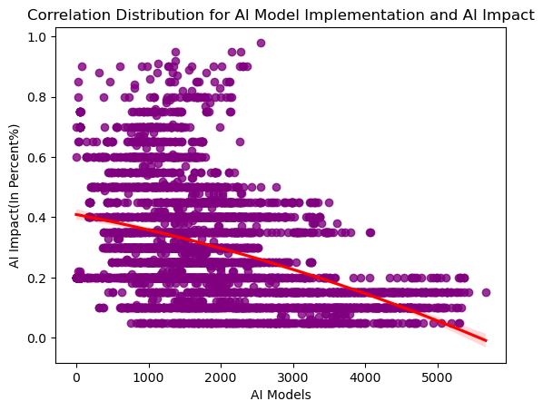
AI Models VS. AI Impact
رواد مصر الرقمية
sns.regplot(data=df, x='AI models', y='AI Impact', color='purple',order=2,line_kws={"color": "red"})
plt.title('Correlation Distribution for AI Model Implementation and AI Impact')
plt.xlabel('AI Models')
plt.ylabel('AI Impact(In Percent%)')
plt.show()
Analyzed the relationship between AI model implementation and AI impact using a second-order polynomial regression plot

Slide 19
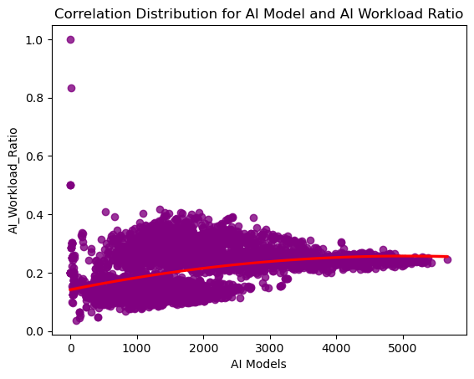
AI Models VS. AI Workload Ratio
رواد مصر الرقمية
sns.regplot(data=df, x='AI models', y='AI_Workload_Ratio',color='purple', order=2,line_kws={"color": "red"})
plt.title('Correlation Distribution for AI Model and AI Workload Ratio')
plt.xlabel('AI Models')
plt.ylabel('AI_Workload_Ratio')
plt.show()
Explored the correlation between AI models and AI workload ratio using a second-order polynomial regression plot.

Slide 20
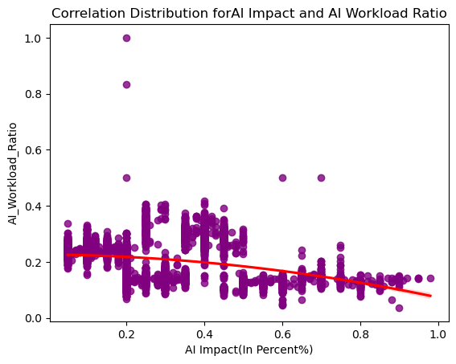
AI Impact VS. AI Workload Ratio
رواد مصر الرقمية
sns.regplot(data=df, x='AI Impact', y='AI_Workload_Ratio', order=2,color='purple',line_kws={"color": "red"})
plt.title('Correlation Distribution forAI Impact and AI Workload Ratio')
plt.xlabel('AI Impact(In Percent%)')
plt.ylabel('AI_Workload_Ratio')
plt.show()
Examined the relationship between AI impact and AI workload ratio using a second-order polynomial regression plot.

Slide 21
رواد مصر الرقمية
Data Cleaning Process
Using SQL

Slide 22
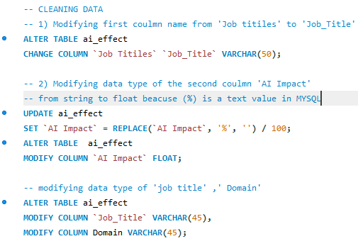
Data Cleaning and Transformation
رواد مصر الرقمية
1. Renamed the column 'Job Titiles’ to ‘Job_Title’ for better readability and consistency.
2. Converted the ‘AI Impact’ column from string to float by removing the percentage sign and dividing by 100, ensuring accurate numerical analysis.
3. Adjusted the data types of ‘Job_Title’ and ‘Domain’ columns to VARCHAR(45) for consistent string handling.

Slide 23
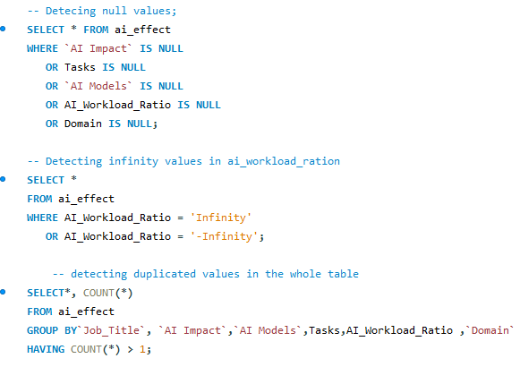
Data Cleaning and Transformation
رواد مصر الرقمية
1. Identified null values in critical columns such as ‘AI Impact’, ‘Tasks’, 'AI Models’, ‘AI_Workload_Ratio’, and ‘Domain’ to ensure data completeness.
2. Checked for any ‘Infinity’ or ‘-Infinity’ values in the ‘AI_Workload_Ratio’ column to validate numerical data integrity.
3. Detected duplicate entries based on key columns to maintain data integrity and avoid redundancy.

Slide 24
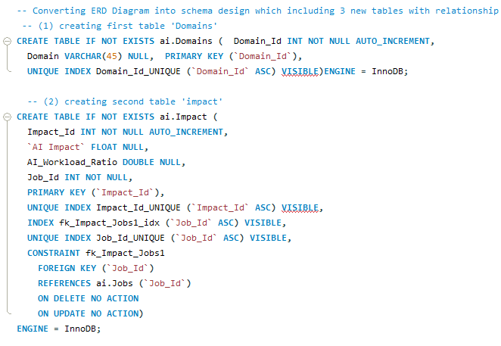
Creating and Structuring New Tables with Relationships
رواد مصر الرقمية
Converted the ERD into a schema by creating the Domains and Impact tables. The Domains table holds job categories, while the Impact table stores data on AI Impact and AI_Workload_Ratio, linked to the Jobs table via a foreign key. Unique indexes and constraints ensure data integrity and enforce relationships between tables.

Slide 25
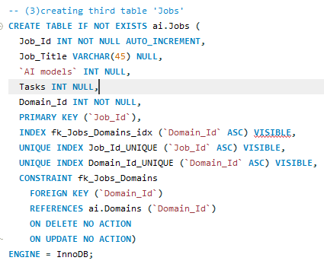
Creating the Jobs Table and Establishing Relationships
رواد مصر الرقمية
The Jobs table was created to store job-related data, including Job_Title, AI models, and Tasks. It is linked to the Domains table via a foreign key relationship on Domain_Id, ensuring that each job is categorized within a specific domain. Unique indexes and constraints were applied to maintain data integrity and ensure the correct relationships between tables

Slide 26
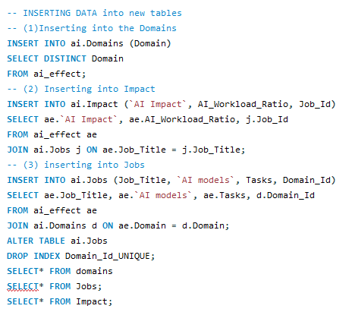
Populating the New Tables with Transformed Data
رواد مصر الرقمية
1. Inserted distinct domains into the ‘Domains’ table.
2. Populated the ‘Jobs’ table with job titles, AI models, tasks, and domain IDs.
3. Inserted AI impact and workload ratio into the ‘Impact’ table by linking with ‘Jobs’.

Slide 27
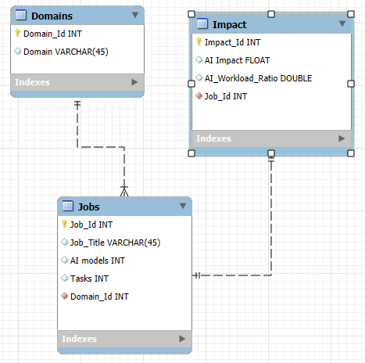
Entity-Relationship Diagram (ERD) Design
رواد مصر الرقمية

Slide 28

رواد مصر الرقمية
Dashboards & Insights
Using Excel and Tableau

Slide 29
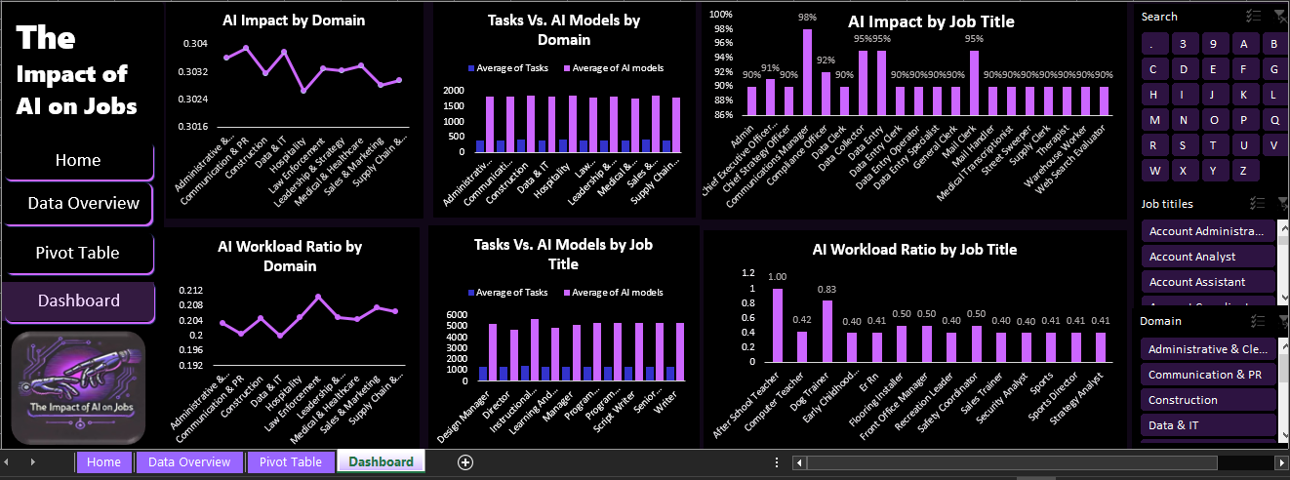
Excel Dashboard
رواد مصر الرقمية

Slide 30
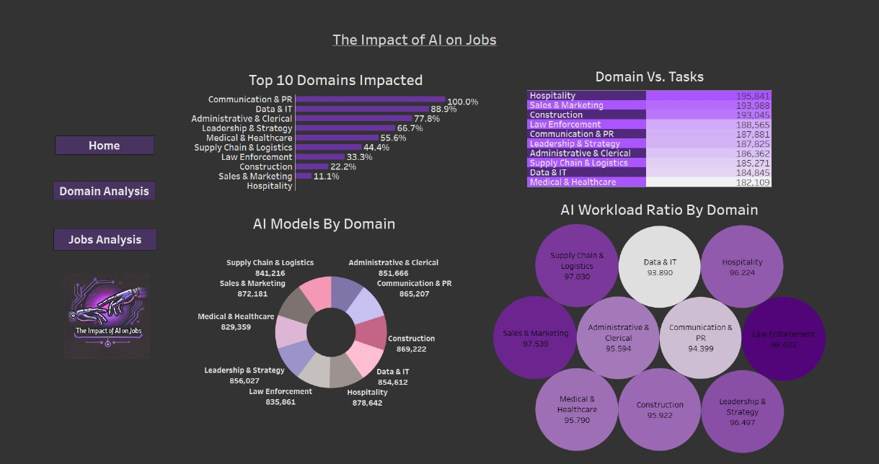
Tableau Dashboard
رواد مصر الرقمية

Slide 31
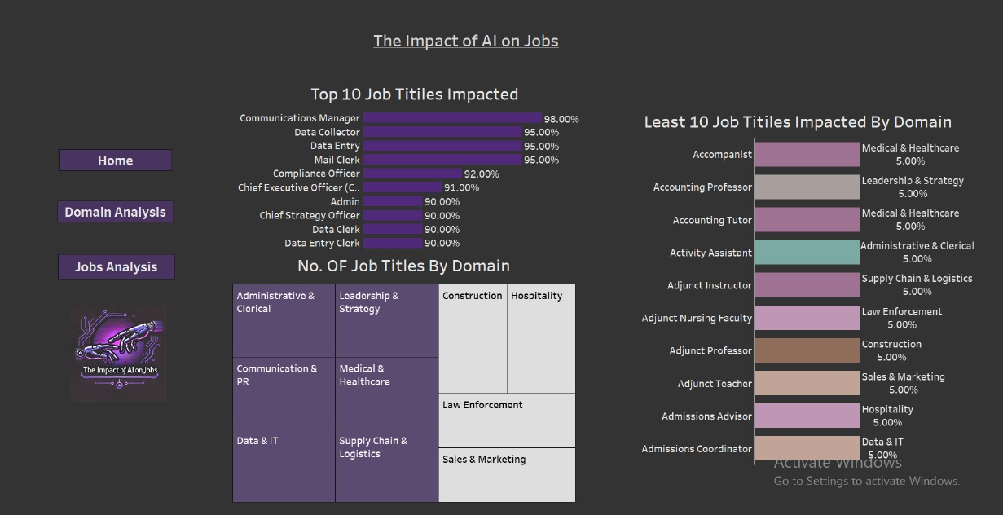
Tableau Dashboard
رواد مصر الرقمية

Slide 32
AI Impact by Domain
رواد مصر الرقمية
Chart Type: Line Chart
Insight:
- This chart shows that AI impacts all domains at similar levels, with Administrative & Communication and Data & IT experiencing the highest influence. The variation in AI impact across domains is minimal, indicating a consistent trend of AI integration.

Slide 33
AI Workload Ratio by Domain
رواد مصر الرقمية
Chart Type: Line Chart
Insight:
- This chart shows that AI workload varies slightly across domains, with Leadership & Healthcare and Medical & Healthcare experiencing the highest ratios, while Construction and Hospitality see the lowest.

Slide 34
Tasks Vs. AI Models by Domain
رواد مصر الرقمية
Chart Type: Bar Chart
Insight:
-The chart presents the average number of tasks and AI models across different domains.
-The Hospitality sector shows the highest average with 416.7 tasks and 1,869 AI models, indicating a significant reliance on AI.
-The Sales & Marketing sector also exhibits a high average of 412.7 tasks and 1,855 AI models.
-Overall, the average across all domains is 401.3 tasks and 1,820 AI models, highlighting consistent AI integration in various fields.

Slide 35
Tasks Vs. AI Models by Job Title
رواد مصر الرقمية
Chart Type: Bar Chart
Insight:
-The chart shows the average number of tasks and AI models for different job titles.
-Instructional Designer has the highest values, with 1,387 tasks and 5,666 AI models.
-On average, jobs involve 1,324 tasks and 5,233 AI models.
-AI is playing a significant role in roles related to design, writing, and management.

Slide 36
AI Impact by Job Title
رواد مصر الرقمية
Chart Type: Bar Chart
Insight:
- The chart highlights the “AI impact on various job titles”, with roles like Data Clerk (98%) and Medical Transcriptionist (95%) showing the highest risk of AI automation.
- Clerical and data entry positions are particularly vulnerable to AI replacement.
- Most job roles shown have a high AI impact, generally around “90%”, signaling a significant shift in workforce demand for these roles.

Slide 37
AI Workload Ratio by Job Title
رواد مصر الرقمية
Chart Type: Bar Chart
Insight:
- The chart shows the **AI Workload Ratio** across various job titles.
- Roles like “After School Teacher” (100%) and “Dog Trainer” (83%) have high AI workload ratios, indicating more tasks may be handled by AI.
- Jobs such as “Computer Teacher” (42%) and “Security Analyst” (40%) have lower ratios, suggesting less AI impact.
-On average, the AI workload ratio is around “50%”, reflecting a moderate influence of AI across these roles.

Slide 38

Summary
رواد مصر الرقمية
AI is affecting various job sectors, especially those that rely on computer-based tasks. While some roles may be replaced, AI also creates opportunities by automating routine tasks, allowing workers to focus on more meaningful responsibilities. This shift can help companies adapt and create new job opportunities aligned with emerging technologies.

Slide 39

Thank You for Listening! Your feedback and questions are welcome. Let’s discuss further!
رواد مصر الرقمية

