Slide 1
14. 6. Subword Embedding
Background
Internal structures and formation
Same root, different suffixes
Dog
Dogs
Dogcatcher
Possible to extend
Boy / Boyfriend
Girl / Girlfriend
Not unique to English
French and Spanish, a lot of verbs can have more than 40 different forms

Slide 2
14. 6. Subword Embedding
14. 6. 1. fastText
In word2vec model, it uses different vectors to represent words with different forms
Dog and Dogs are represented by two different vectors
Didn’t consider the direct relationship between these two vectors
fastText, subword embedding, introduce morphological information in the skip-gram in word2vec
Example) where, n = 3
Add the special characters “<“ and “>” generating “<where>”
Extract the n-grams, “<wh”, “whe”, “her”, “ere”, “re>”
Record the union of all its subwords
Central word vector can be expressed as sum of its subword vectors
Compared to skip-gram model, it needs more parameters because the size of dictionary is larger
Also, it needs more computation complexity to get summation of all subword vectors
But fastText can obtain vector for more uncommon words, even if it’s not in the dictionary

Slide 3
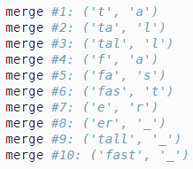
14. 6. Subword Embedding
14. 6. 2. Byte Pair Encoding
In fastText, it uses specified length of subword, thus dictionary size cannot be predefined
Byte pair encoding, allowing for variable-length subwords in a fixed-size dictionary
Overall process (training dataset to discover common symbols within a word)
Starting from symbols of length 1
Iteratively merges the most frequent pair of consecutive symbols to produce new longer symbols
In the end, we can use such symbols as subwords to segment words

Slide 4


14. 7. Finding Synonyms and Analogies
Background
Trained word2vec embedding model on a small dataset and searched for synonyms using cosine similarity
In practice, word vectors pretrained on a large-scale corpus can often be applied to downstream nlp tasks
Finding Synonyms
Search for synonyms by cosine similarity
Finding Analogies
Man (A) : Women (B) = Son (C) : Daughter (D)
Vec(C) + Vec(B) – Vec(A)

Slide 5
14. 8. BERT
14. 8. 1. From Context-Independent to Context-Sensitive
In fact, word2vec like embedding models are all context-independent
Given complex semantics in natural language, context-independent representations have obvious limitations
A crane is flying
A crane driver came
Above two cranes have totally different meanings
Same word may be assigned different representations depending on contexts
TagLM (LM augmented sequence tagger), CoVe (Context Vectors), ELMo (Embeddings from LM)
ELMo is taking entire sequence as the input, and assigns a representation to each word from input
Can be added to a downstream task’s existing supervised model as additional features
Concat ELMo representation and the original representation (e.g. GloVe)

Slide 6
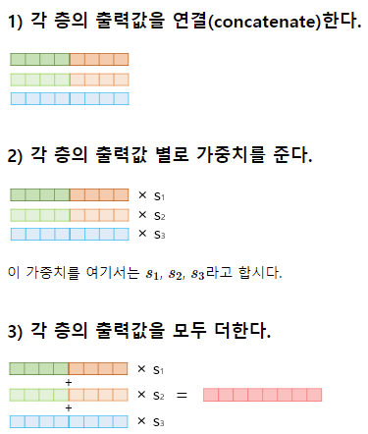
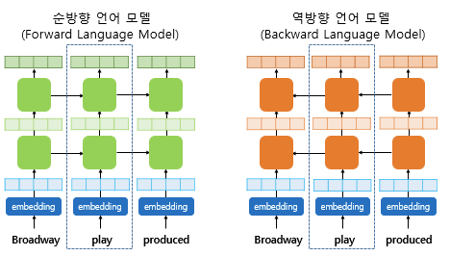
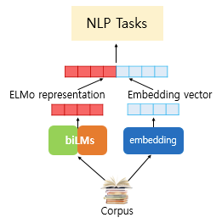
14. 8. BERT
14. 8. 1. From Context-Independent to Context-Sensitive
Concat ELMo representation and the original representation (e.g. GloVe)
https://wikidocs.net/33930

Slide 7
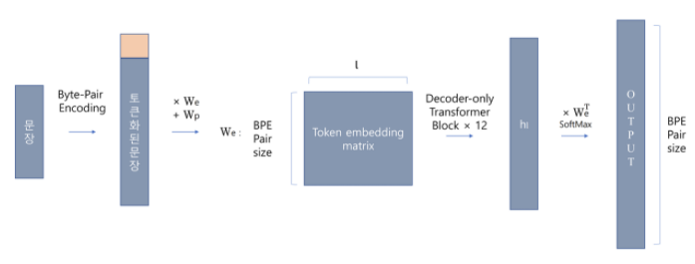
14. 8. BERT
14. 8. 2. From Task-Specific to Task-Agnostic
Although ELMo has significantly improved solutions, each solution still hinges on a task-specific architecture
It is practically non-trivial to craft a specific architecture for every nlp tasks
GPT (Generative Pre-Training) model represents an effort in designing a general task-agnostic model for context-sensitive representations
Built on a Transformer decoder, GPT pretrains a language model that will be used to represent sequences
The output of the LM will be fed int an added linear output layer to predict the label of the task
GPT only looks forward (left-to-right)
I went to the bank to deposit cash
I went to the bank to sit down
https://www.quantumdl.com/entry/12%EC%A3%BC%EC%B0%A81-Improving-Language-Understanding-by-Generative-Pre-Training

Slide 8
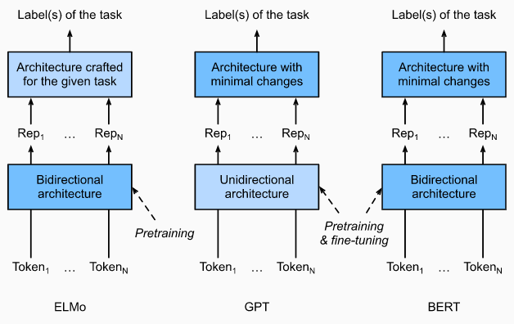
14. 8. BERT
14. 8. 3. BERT: Combining the Best of Both Worlds
ELMo encodes context bidirectionally but uses task-specific architectures
GPT is task-agnostic but encodes context left-to-right
Combining both of methods => BERT
BERT representations will be fed into and added output
All the parameters of the pretrained Transformer encoder are fine-tuned
Improved the state of the art on eleven nlp tasks
Sentiment analysis
Question answering
NER
...

Slide 9
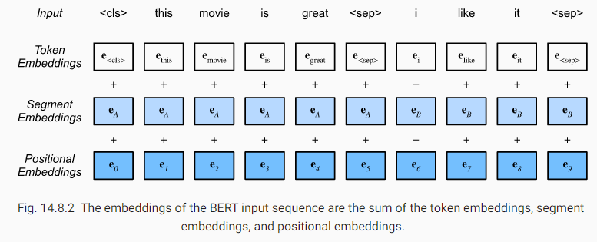
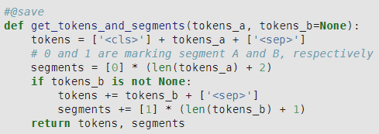
14. 8. BERT
14. 8. 4. Input Representation
Single text as the input (e.g. sentiment analysis), pair of text sequences (e.g. Question Answering)
BERT can handle both type of inputs
<cls>, tokens of text sequences, <sep>
<cls>, tokens of first sequences, <sep>, tokens of second text sequences, <sep>
Sum of the token embeddings, segment embeddings, and positional embeddings

Slide 10
14. 8. BERT
14. 8. 5. Pretraining Tasks – Masked Language Modeling
LM predicts a token using the context on its left
BERT randomly masks tokens and uses tokens from the bidirectional context to predict the masked tokens
In pretraining task, 15% of tokens will be selected at random as the masked tokens for prediction
Replace it with a special <mask> token
<mask> will never appear in fine-tuning
A special <mask> token for 80% of the time (this movie is great becomes this movie is <mask>
A random token for 10% of the time (this movie is great becomes this movie is drink)
The unchanged label token for 10% of the time (this movie is great becomes this movie is great)

Slide 11
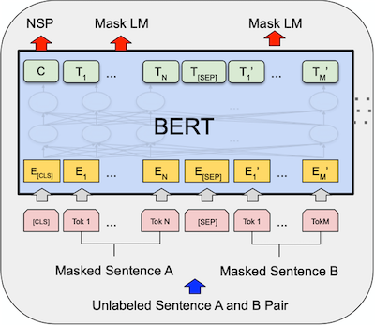
14. 8. BERT
14. 8. 5. Pretraining Tasks – Next Sentence Prediction
Although masked LM is able to encode bidirectional context for representing words
It does not explicitly model the logical relationship between text pairs
To help understand the relationship between two text sequences
BERT considers a binary classification task, next sentence prediction
When generating sentence pairs for pretraining
50% of inputs are labeled true
Second sentence of others are randomly sampled and labeled false
Due to self-attention in the Transformer, <cls> encodes both two sentences

Slide 12
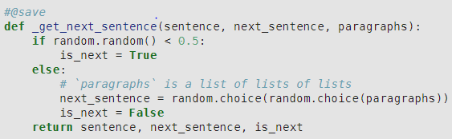
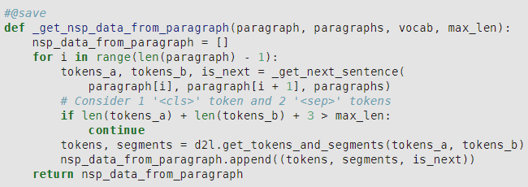
14. 9. Dataset for Pretraining BERT
14. 9. 1. Generating the Next Sentence Prediction Task

Slide 13
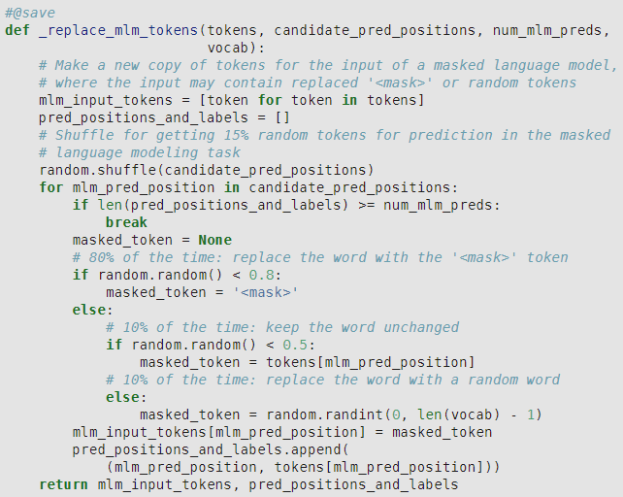
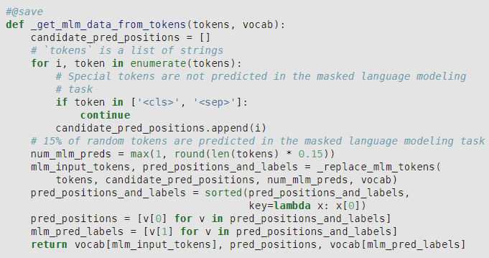
14. 9. Dataset for Pretraining BERT
14. 9. 1. Generating the Masked Language Modeling Task

