Slide 1


Deforestration (Fire Classification)
GAMANA CHIRUMAMILLA
2320040075
INTERNSHIP_175040797468551b2636342

Slide 2

Learning Objectives
Understood how MODIS satellite data helps in tracking and identifying different types of fire events across India.
Learned how to clean and prepare large satellite datasets for further analysis and modeling.
Explored fire data using visualizations to identify trends over time and across different regions.
Applied machine learning algorithms to classify fire types based on important features.
Created interactive maps to visualize and better understand fire patterns geographically.
GOAL
Source :
www.freepik.com/

Slide 3
Tools and Technology used
Tools & Technologies I Used
Python for all coding and analysis tasks
Google Colab to run and test my code online
VS Code for writing and organizing my scripts
Libraries I Worked With
sklearn – used it to apply different machine learning models
pandas and numpy – handled data cleaning and numerical operations
matplotlib and seaborn – created graphs and plots for better understanding of data
folium – helped me map the fire locations interactively
joblib – used to save my trained models for reuse

Slide 4
Methodology
Data Collection Took MODIS fire data for India from 2021 to 2023.
Data Preprocessing Removed missing values, handled outliers, and filtered important features.
EDA (Exploratory Data Analysis) Used graphs and plots to understand how fires are spread over time and places.
Model Selection Tried different ML models and picked the one that gave the best results.
Deployment Used Python to build a simple interface and deployed the final model for real use.

Slide 5
Problem Statement:
In recent years, different types of fires like crop burning, forest fires, and industrial fires have caused serious environmental issues.
Even though satellite data (like MODIS) helps detect fire locations, there’s no proper system to classify the type of fire early.
For example, farmers burning crops, offshore vegetation fires, or static fires in factories — all need different types of responses.

Slide 6
Solution:
I used satellite data to understand and analyze different fire types.
Converted the data into a proper dataset with selected features and target labels.
Performed scaling and applied SMOTE to balance the dataset.
Trained a Random Forest Classifier, which gave me around 95.04% accuracy.
The model worked well without overfitting or underfitting.
I deployed it locally to test the predictions using real values.
GitHub Repo: https://github.com/gamana29/MODIS-Satellite-Data-Fire-Classification

Slide 7
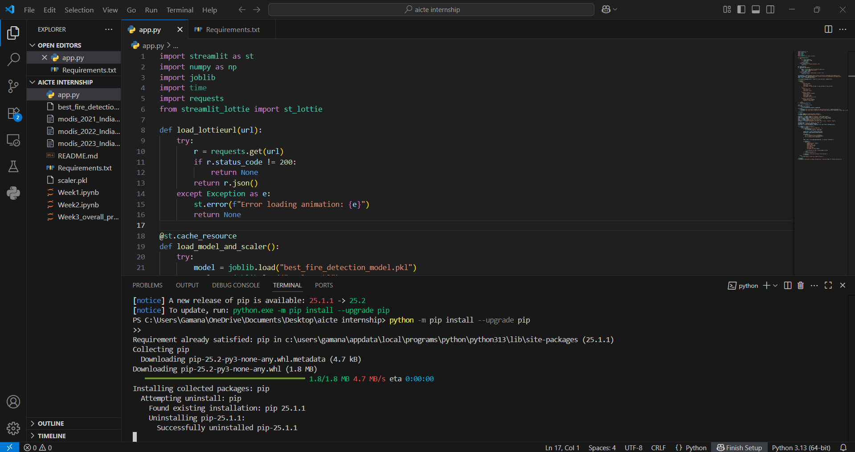
Screenshot of Output:
1) Installed and Updated Libraries

Slide 8
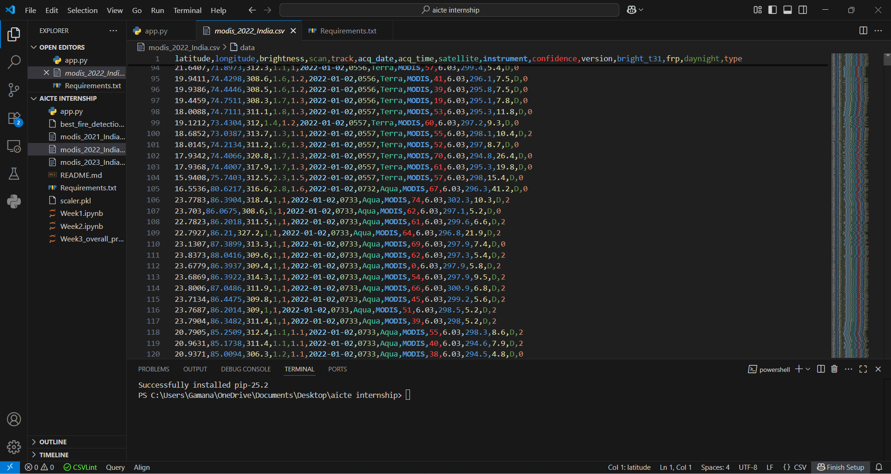
Screenshot of Output:
2) Dataset : MODIS Sensor Satellite Data from 2021 to 2023

Slide 9
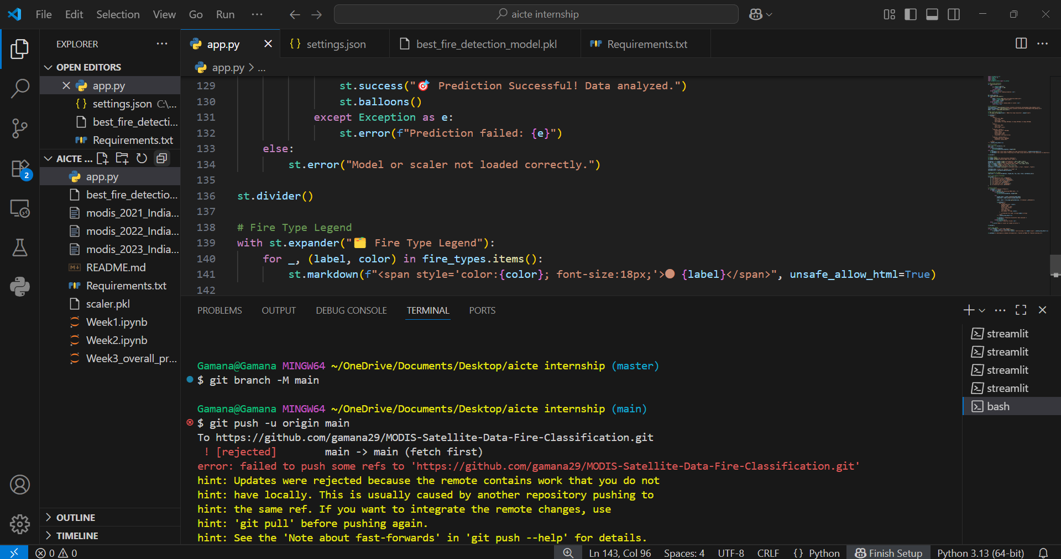
Screenshot of Output:
3)Pushing Files using Git commands

Slide 10
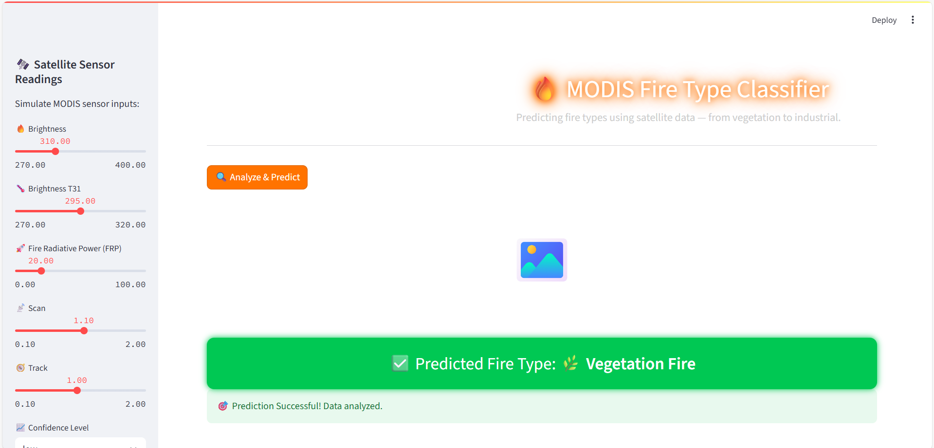
Screenshot of Output:
4)Streamlit app Model

Slide 11
Conclusion:
I collected and cleaned satellite data to classify different fire types.
Used a Random Forest model and achieved around 95.04% accuracy.
Handled data imbalance using SMOTE and applied scaling.
Tested the model locally and it worked quite well in predictions.
Future Scope & Improvements:
Collect and include more recent data from different regions.
Improve the model by trying out advanced algorithms.
Build a simple user interface to make it easy to use.
Add alert system to notify users or authorities.
Aim for better accuracy, especially for rare fire types.

