Slide 1


2
Geiser with
Gambit
Mathieu Perron
Notes:
10/11/2019
1
1

Slide 2

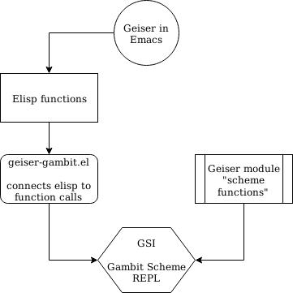
WHAT IS GEISER ? Geiser is an Emacs environment to hack and have fun in Scheme. ( inspired by : Common Lisp’s Slime, Factor’s FUEL, Squeak or Emacs itself)
Notes:
10/11/2019
2
2

Slide 3
What can you do with Geiser?
Form evaluation
Macro expansion
File/module loading and/or compilation
Identify completion
Autodoc: the echo area shows information about the signature of the procedure/macro around point automatically.
Access to documentation (including docstrings when the implementation provides it).
Listings of callers/callees of procedures.
Rudimentary support for debugging (when the REPL provides a debugger) and error navigation.
Support for multiple, simultaneous REPLs.
Remote connection to REPL
Notes:
10/11/2019
3
3

Slide 4
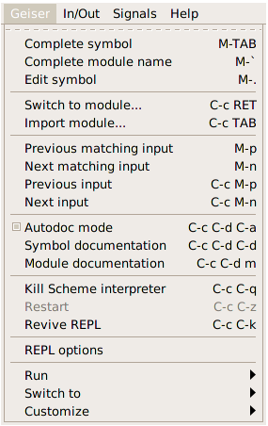
Functionalities helper
Handy until you’ve memorized Geiser commands ( learning device )
Ctrl-h m :: another option
Notes:
10/11/2019
4
4

Slide 5
Notes:
10/11/2019
5
5

Slide 6
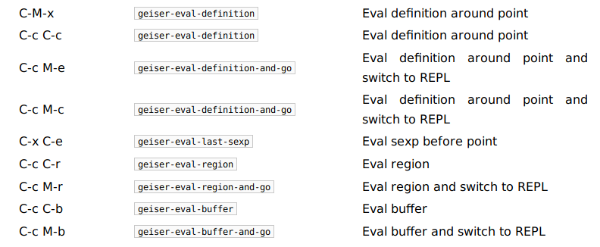
Form evaluation
You can open a scheme file and evaluate every sexpr and the entire file directly from Emacs !
Notes:
10/11/2019
6
6

Slide 7
A lot of nice details
Code indentation in REPL
Company-mode
compatibility
Macro-expansion
Remote REPL connection
Notes:
10/11/2019
7
7

Slide 8

Fully customizable
Indentation in terminal vs indentation using Geiser
Notes:
10/11/2019
8
8

Slide 9
Macro-expand example
Notes:
10/11/2019
9
9

Slide 10
Buffer evalutation
Autodoc
Notes:
10/11/2019
10
10

Slide 11

Remote connect
To connect to a distant REPL
Notes:
10/11/2019
11
11

Slide 12
FIRST OPEN A REPL USING THE GEISER MODULE

Slide 14
Coming soon !
Current thread identification in geiser REPL for multiple connections.
Remote connection request to Geiser from the REPL
You can contribute too ! Suggestions of functionnalities are always welcome too.
Debugging system for multithreadding
Notes:
10/11/2019
14
14

Slide 15
How to configure Geiser with Gambit for full functionalities ?
Configure using –enable-rtlib-debug
Be sure to add gsi to your terminal path
Package-install geiser (from Melpa)
Notes:
10/11/2019
15
15

Slide 16
Missing features:
External documentation
Better debugging system
Modules handling directly from geiser
Compilation
Still very usable.
LETS DO A DEMO!

Slide 17
QUESTIONS?

