Slide 1
Chess
CS386 Final Project
Daniel Garcia
Spring 2012

Slide 2
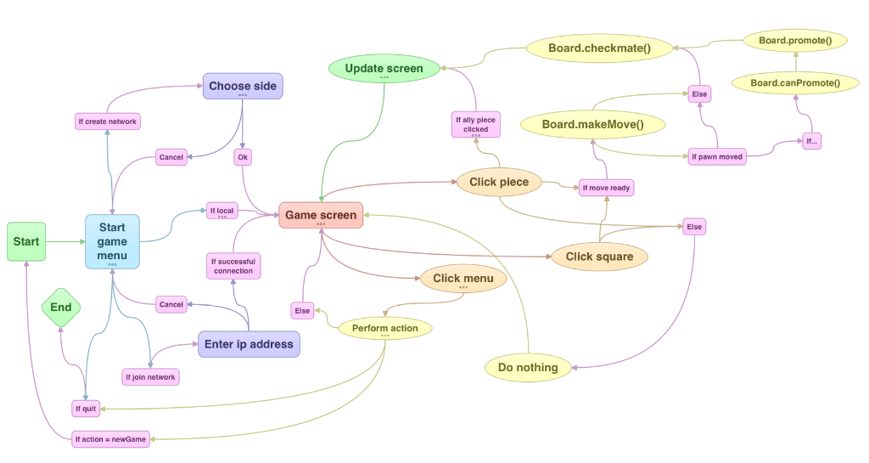
FSM

Slide 3
Pieces
All:
Color, position, iAm (string indicating type)
Move( newpos )
validMoves( ) – just checks square contents to see if it can move, pieces don’t know if they leave their king in check
squaresAttacked( )
King and pawn
Bool hasMoved to figure out castle move and intial 2 square move for pawn.

Slide 4
Squares
Data:
Position, whitePiecesAttacking, blackPiecesAttacking, content, contentColor, neighbors
Methods:
attackedBy[white/black]
Neighbor( direction )
Returns position tuple of adjacent square in given direction, None if square doesn’t exist.

Slide 5
Move Object
Contains two tuples, one for starting position and one for end position.
Inverse() method returns a new move object with the start and end position switched

Slide 6
Board
Data:
Pieces{}: keys are position tuples (e.g (a,1) )
Squares{}: keys are same as pieces.
Moves[]: keep track of all moves made

Slide 7
Board Methods
Reset() – set board to a “new game” state
validPieceMoves() – starts with the piece validMoves() method and then strips out any moves that leave the king in check.
gameState() – returns a different constant depending on the current game state. Four different possibilitites: check, checkmate, stalemate, and in progress. Each case is a private method inside the board class

Slide 8
Board Methods
(bool) canPromote() – checks if a pawn has reached the other end of the board
Promote(newType) – updates the pieces dictionary with the new piece type provided
makeMove( moveObject ) – makes sure a move is valid using other methods and then makes it. Return parameter is a bool.

Slide 9
Board Methods
moveAndUpdate() – handles all data updating when making moves
validMove() – used by makeMove(). Three possible return values: True if move is valid, False if it isn’t, and, if move is valid castle, return a move object with the rook’s start and end position
updateSquares(): called after each move to make sure squares have accurate information

Slide 10
Board Methods
Undo() – reverts last move in the move list
canCastle[left/right](): bool method used to highlight square in the screen
Allies(): returns a list of pieces belonging to the color in turn
enemies(): returns a list of enemies of color in turn

Slide 11
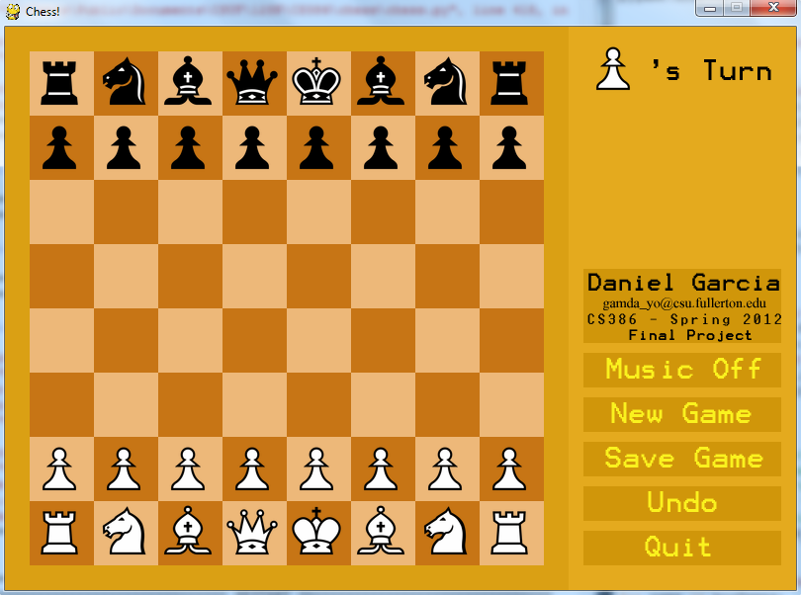
Screen
Two areas: board and info are big rects

Slide 12
Screen
All squares in the board are represented in a dictionary with position tuples as keys and pygame.Rect objects as values.
Chess pieces are blitted to those same rects after the squares.
Buttons are images blitted to rects.

Slide 13
Piece Drag
A special rect “activePiece” is used.
When the user clicks a piece of the current player, append the rect to the mouse position and blit the image of the piece clicked to this rect.

