Slide 1
Project CISP 1020
Maxmilian Boyson, Jonathan Babb, Anthony Tello Bazan, and Stephen Hyberger

Slide 2


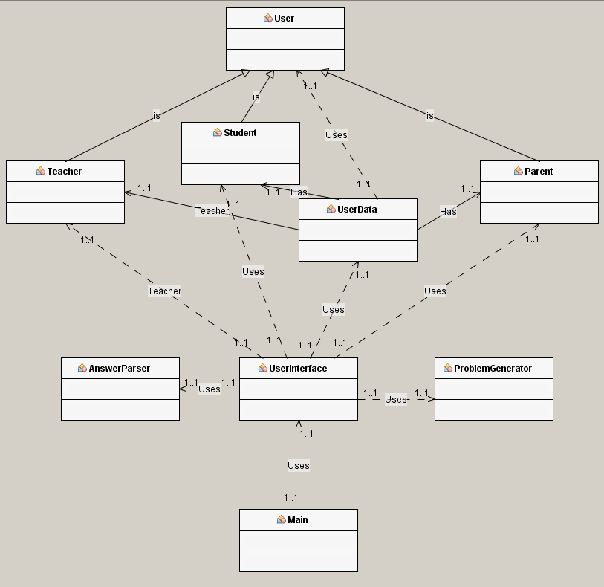



UML Diagram

Slide 3
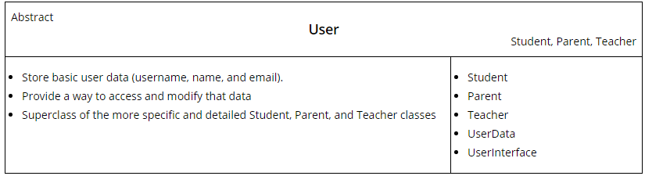
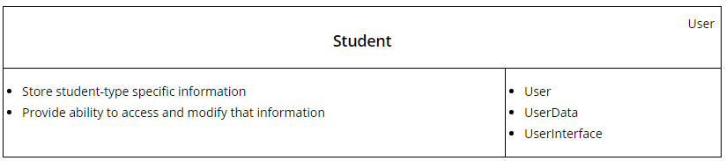
CRC Cards
User
Student

Slide 4
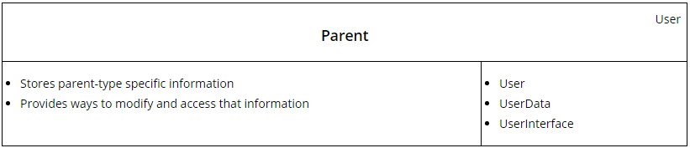
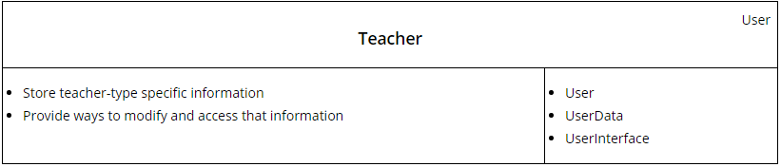
CRC Cards
Parent
Teacher

Slide 5
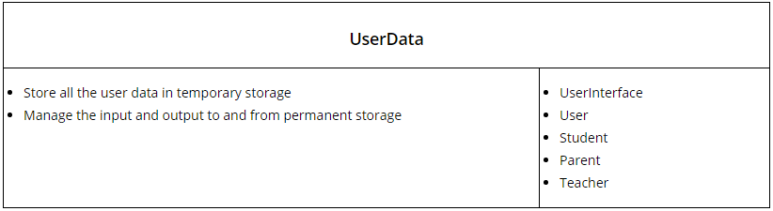
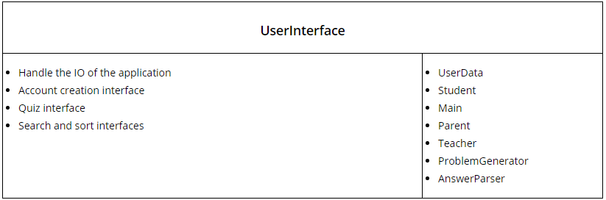
CRC Cards
UserData
UserInterface

Slide 6
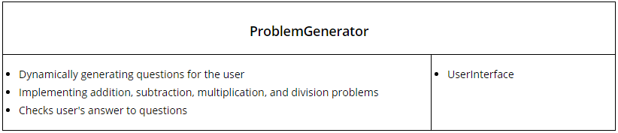
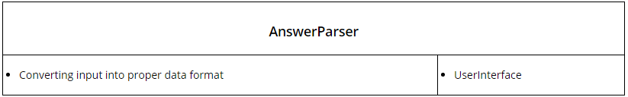
CRC Cards
ProblemGenerator
AnswerParser

Slide 7
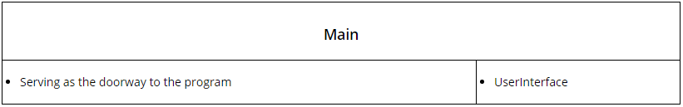
CRC Cards
Main

Slide 8
End

