Slide 1
STUDENTS GRIEVANCE SYSTEM
ST JOSEPH’S COLLEGE OF ENGINEERING
B.TECH IT - 3RD YEAR
TEAM NAME : BASE64
TEAM MEMBERS:
VENKATESH.K
SRENIVASAN.K.S
SANTHOSH.A
SYED NISHAD.N
VIGNESH.K

Slide 2
STUDENTS GRIEVANCE SYSTEM
Student grievance system is a structural system which helps students to report a complaint or a cause of discomfort caused by their fellow classmates or the staffs of their respective subjects.
This comprises of three logins namely
Student Login
Grievance Cell Member’s Login
Admin Login

Slide 3
PROBLEM STATEMENT
Our project for Students Grievance Support System is based on following criterias :
(1) It must be an easy access application, accessible to students, members of Student Grievance Redressal Committees, respective heads.
(2) Students should be able to post complaints under Department Level. Department Level would be subdivided among sub categories such as Admission, Finance, Examination, Lecture Timetable/Learning, Paper Revaluation, etc.
(3) Members of Students Grievance Redressal Committee should be able to sort complains based on keywords.
(4) The Portal should link students with respective Department‘s Students Grievance Redressal Committees

Slide 4
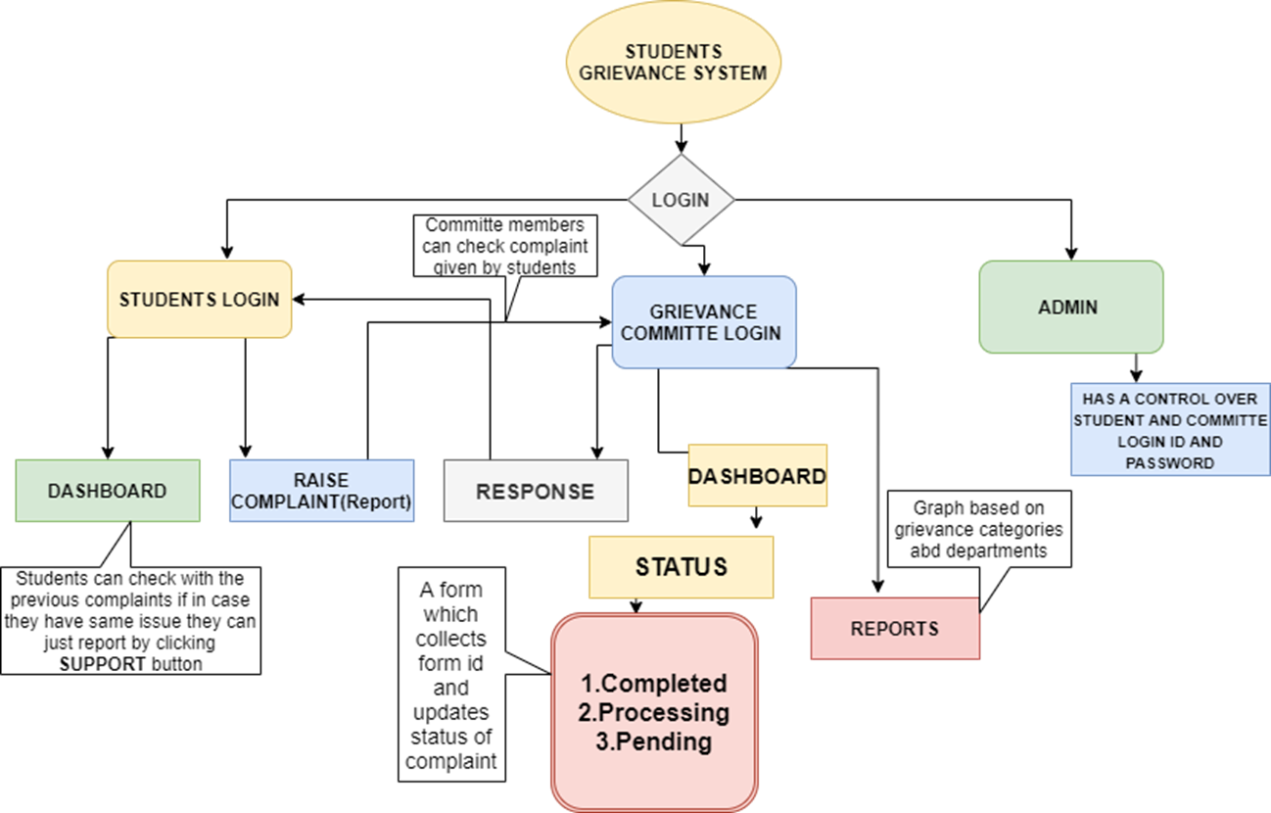

Slide 5
SALIENT FEATURES
Students are able to report if they have the same problem by just liking the report submitted by other students.
Graph representation of reports on all fields of grievances.
Admin can access the feedbacks on webapp.
Change of password requested to admin via forms.
Students can able to track the grievance once the complaint has been registered.
Grievance reported by the student is completely anonymous.

